Slide 1
Indian wind energy: variability and forecasting challenges
Hannah Nissan
Ralf Toumi

Slide 2
Overview
Context: wind energy in India
Opportunities and challenges
Analysis of the wind energy resource using ERA-Interim
Spatial variations in wind energy
Temporal variability in wind energy
Short term wind forecasts
Initial stochastic parameterisation experiments using WRF

Slide 3
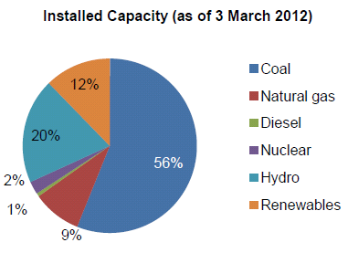
The Indian energy market
Issues
Growth Massive growth in Energy demand and more projected (8-9% p.a.).
Supply falling coal and gas production
Security increasing imports of coal and gas
Policy low investor confidence, inadequate infrastructure, poor grid connectivity
Wind: 8.7% of total/ 67% of renewable
Wind energy
5th largest wind energy producer.
20GW installed wind capacity in 2014, but potential to expand 4 or 5 times this amount
Offshore wind capacity huge (est 350GW)
Policy drivers:
12th five year plan (2012-17): big expansion of renewable power capacity of 30GW, of which 15GW from wind
Desert Power India Plan: 35% installed capacity from renewables by 2050
.
Source: International Energy Agency (2012) Understanding Energy Issues in India;

Slide 4
The Indian energy market
In 2012…
www.bloomberg.com

Slide 5
The Indian energy market
In 2013 a new directive was issued…
Energy is traded with the grid every morning to provide power for the next day
Large wind providers (>10MW) must forecast energy supply to within ±30% every 15 minutes for the following day or face fines

Slide 6
The Indian energy market
The fallout from this was not good…

Slide 7
Demand for wind forecasts
1-2 day: operational energy trading
5-10 day (intra-seasonal): planning maintenance
Decadal (20 year) : investors, government policy development
Notes:
Met Office provide service for wind operators: hourly time resolution, site specific wind forecasts up to 6 days ahead

Slide 8
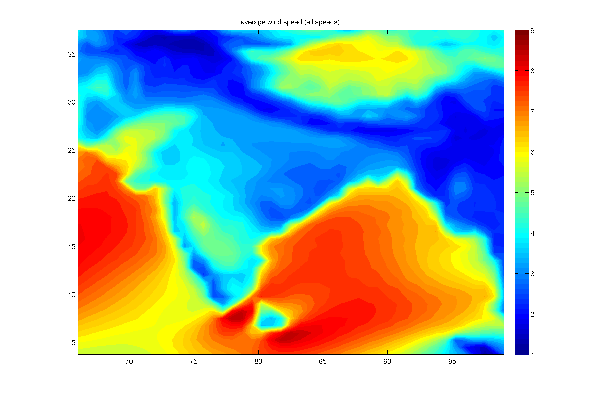
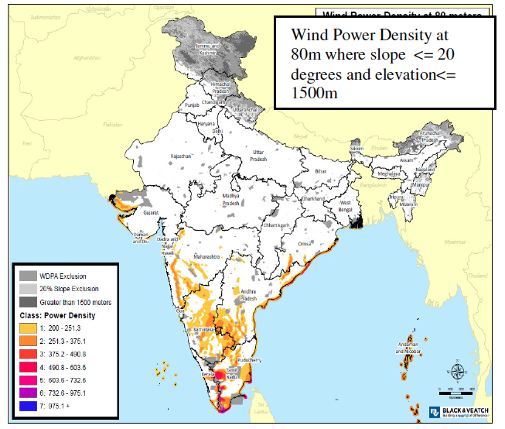
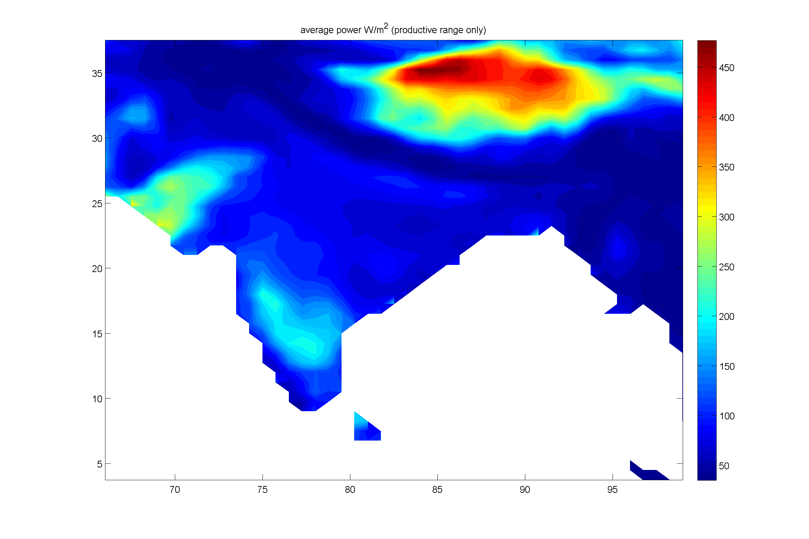
Wind power potential in India
Analysis of ECMWF ERA Interim: 1979-2014 (36 years)
Mean 80m wind speed (m/s)
Offshore potential substantial
Key areas of potential along Western Ghats and in south
ERA-Interim fails to capture strong winds in south
Mean wind power (W/m2)
Phadke et al 2011, LBNL Paper LBNL-5077E

Slide 9
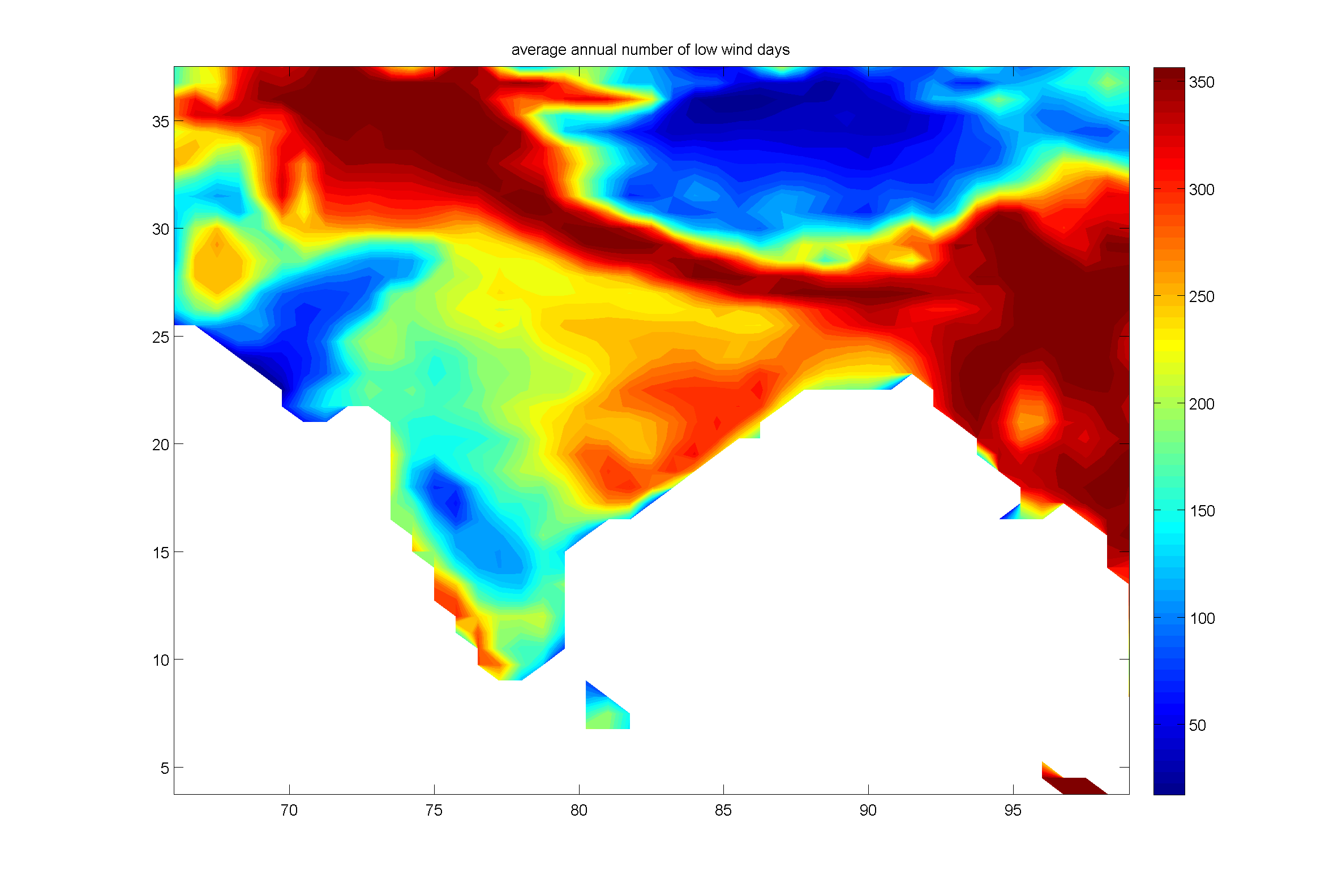
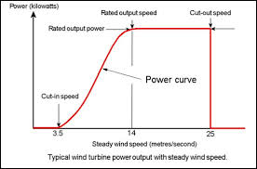
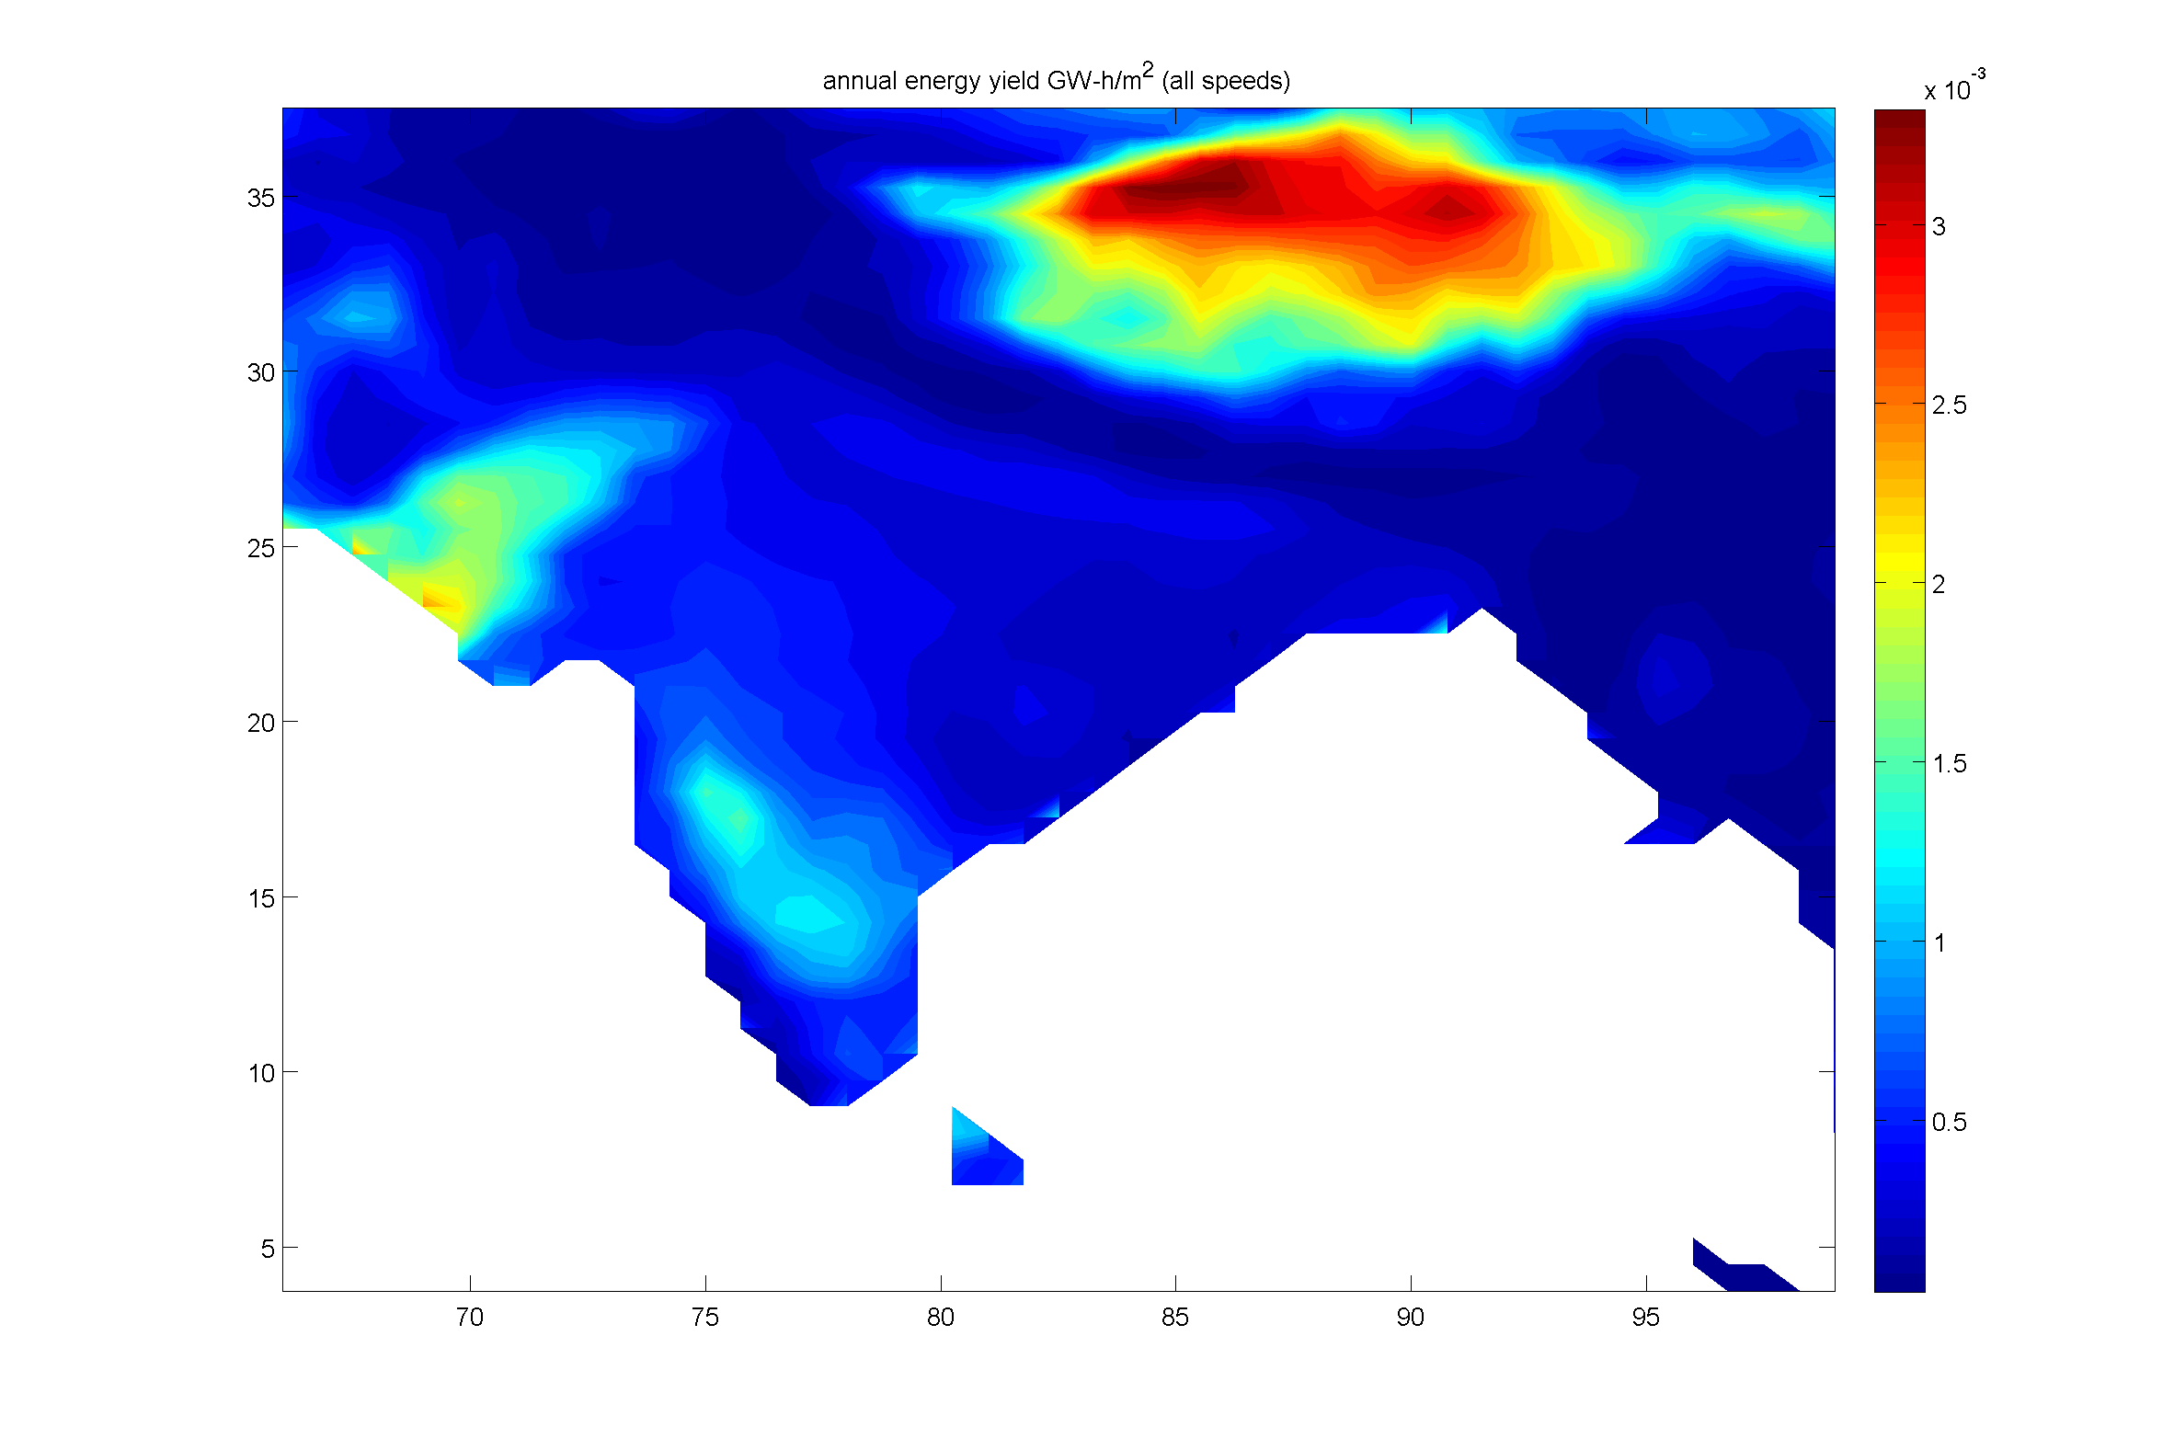
Low wind events
Annual number of low wind days
Annual energy yield (GWh/m²)
(all wind speeds)
Annual energy yield (GWh/m²)
(productive wind speeds only)
Notes:
Low wind event=mean daily wind < cut in speed
Bottom panel: site these events don’t impact long term energy yield, so may not be considered when deciding whether to install wind capacity, but important operationally

Slide 10
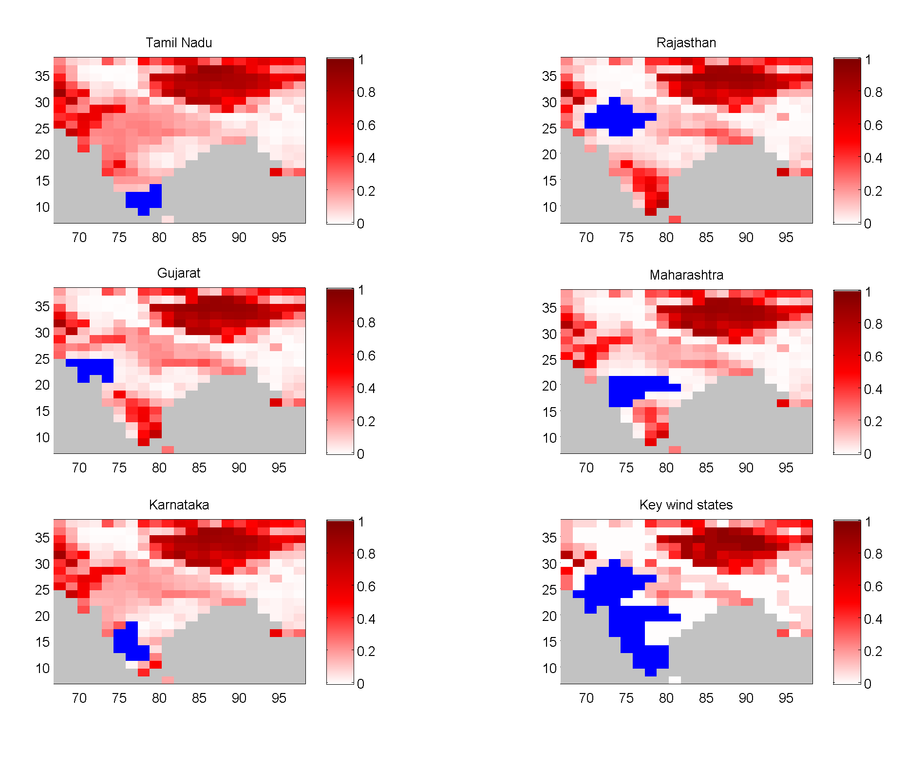
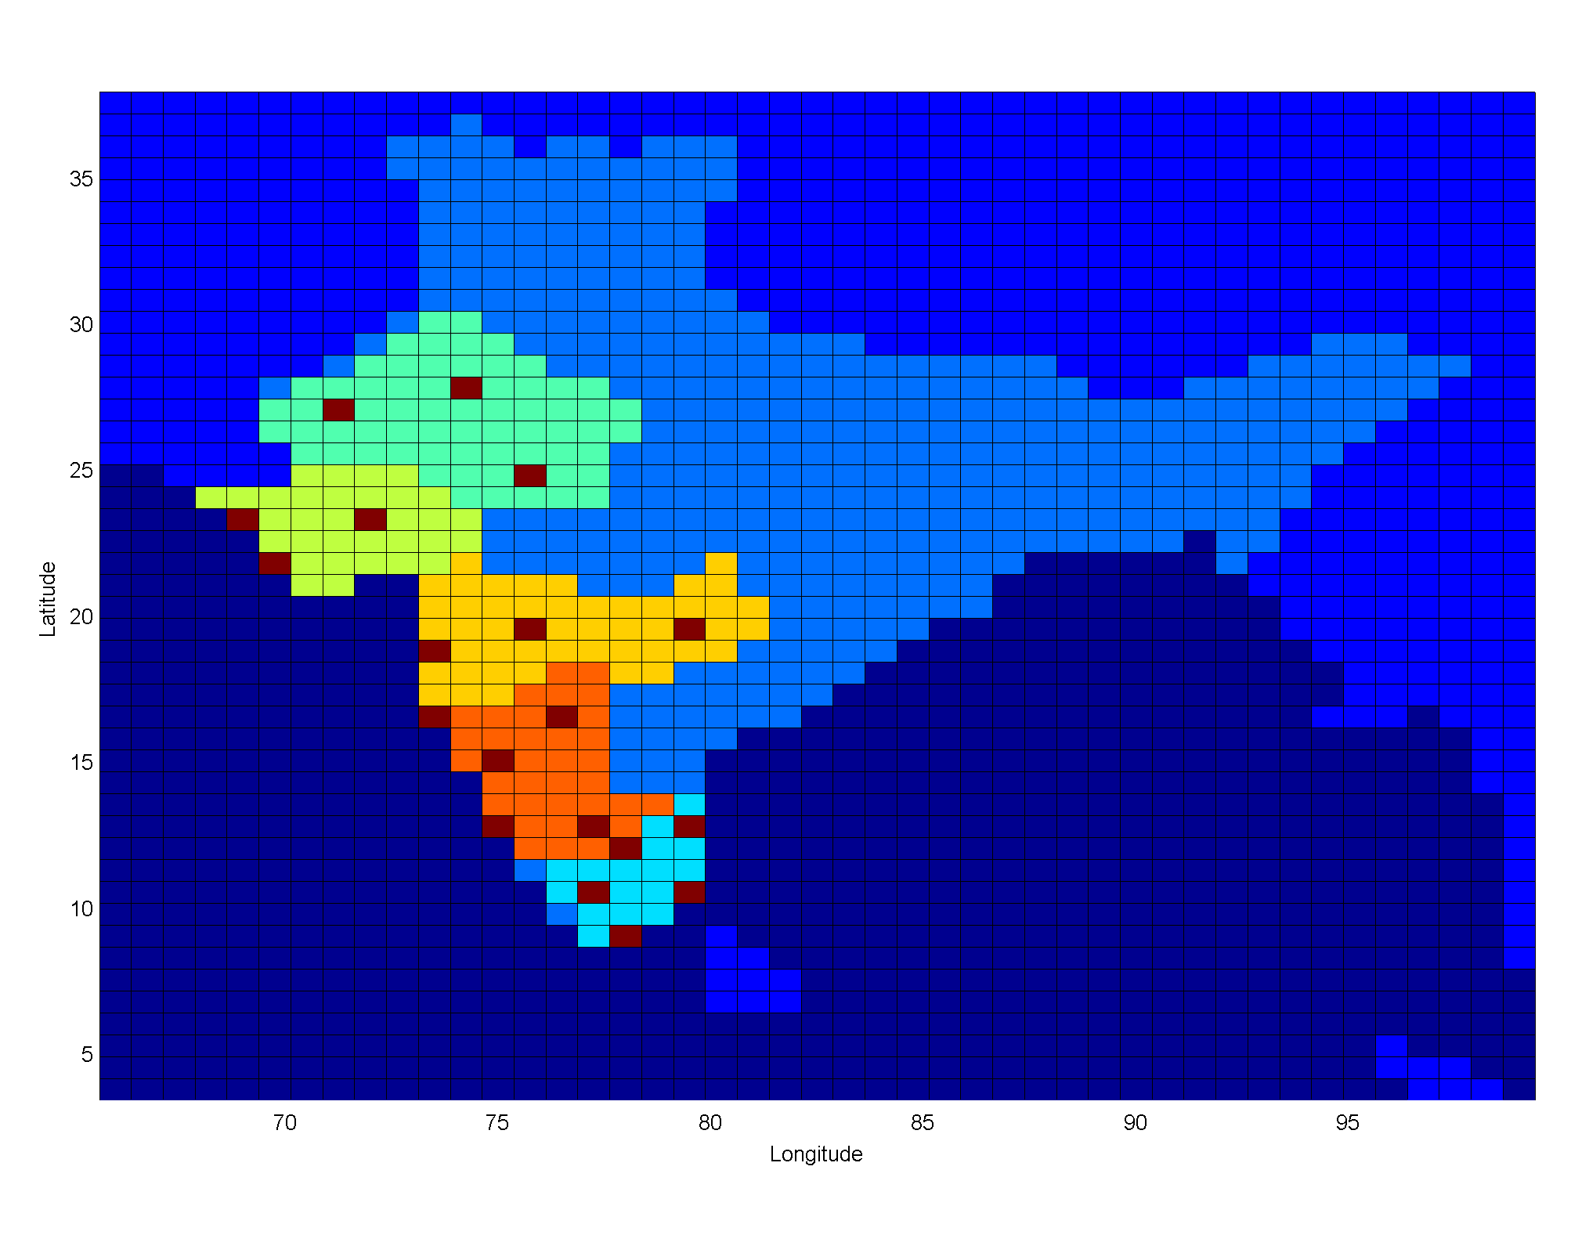
Spatial optimisation of wind portfolios
Can spatial correlations can be exploited for grid wind energy generation/efficiency?
Distributed portfolio across 5 key wind states offsets risk of no production
However, only northeast (Himalaya) or Pakistan are windy when the key wind states are calm (0.5%)
Notes:
Panel plot shows fraction of days which have noon wind speed > cutin speed when the key states have no wind (NB now looking at noon speed not daily mean just for this slide)
Left plot shows selected regions on ERA Interim grid (5 key wind states and some sample sites used for following slides)

Slide 11
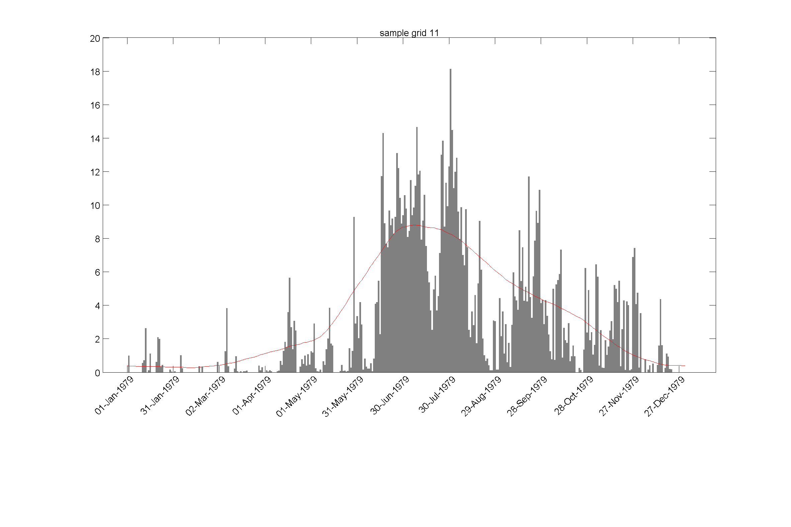
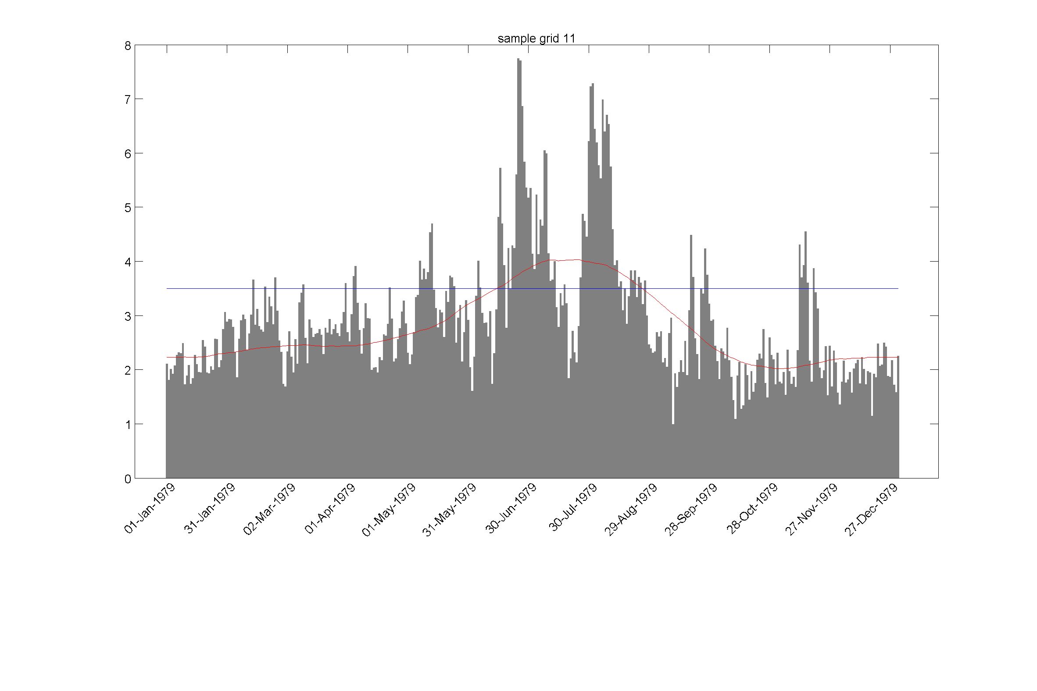
Intra-seasonal monsoon breaks
Precipitation
(mm)
Cut-
in
speed
Wind speed
(m/s)
Notes:
Monsoon rains are brought by zonal winds coming from western Indian Ocean – correlations between precip and zonal wind well studied
For wind energy generation, direction doesn’t matter – does wind speed follow same variability as zonal wind and precip? Are intraseasonal fluctuations important on same timescales as for precip? Are there other patterns of variability in wind speed that we don’t know about?

Slide 12
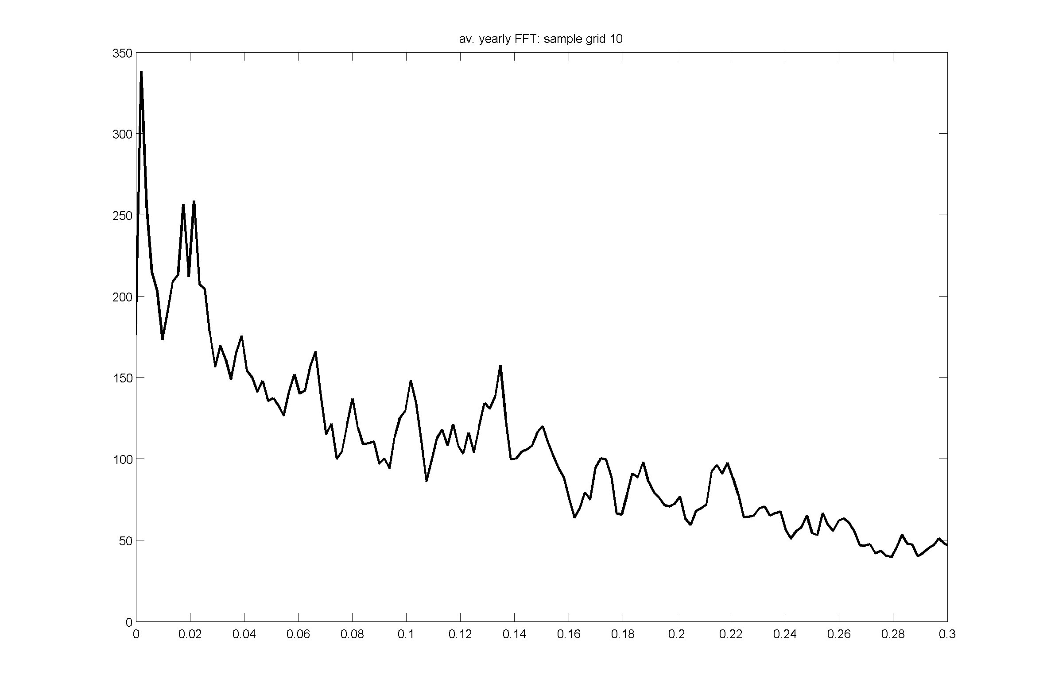
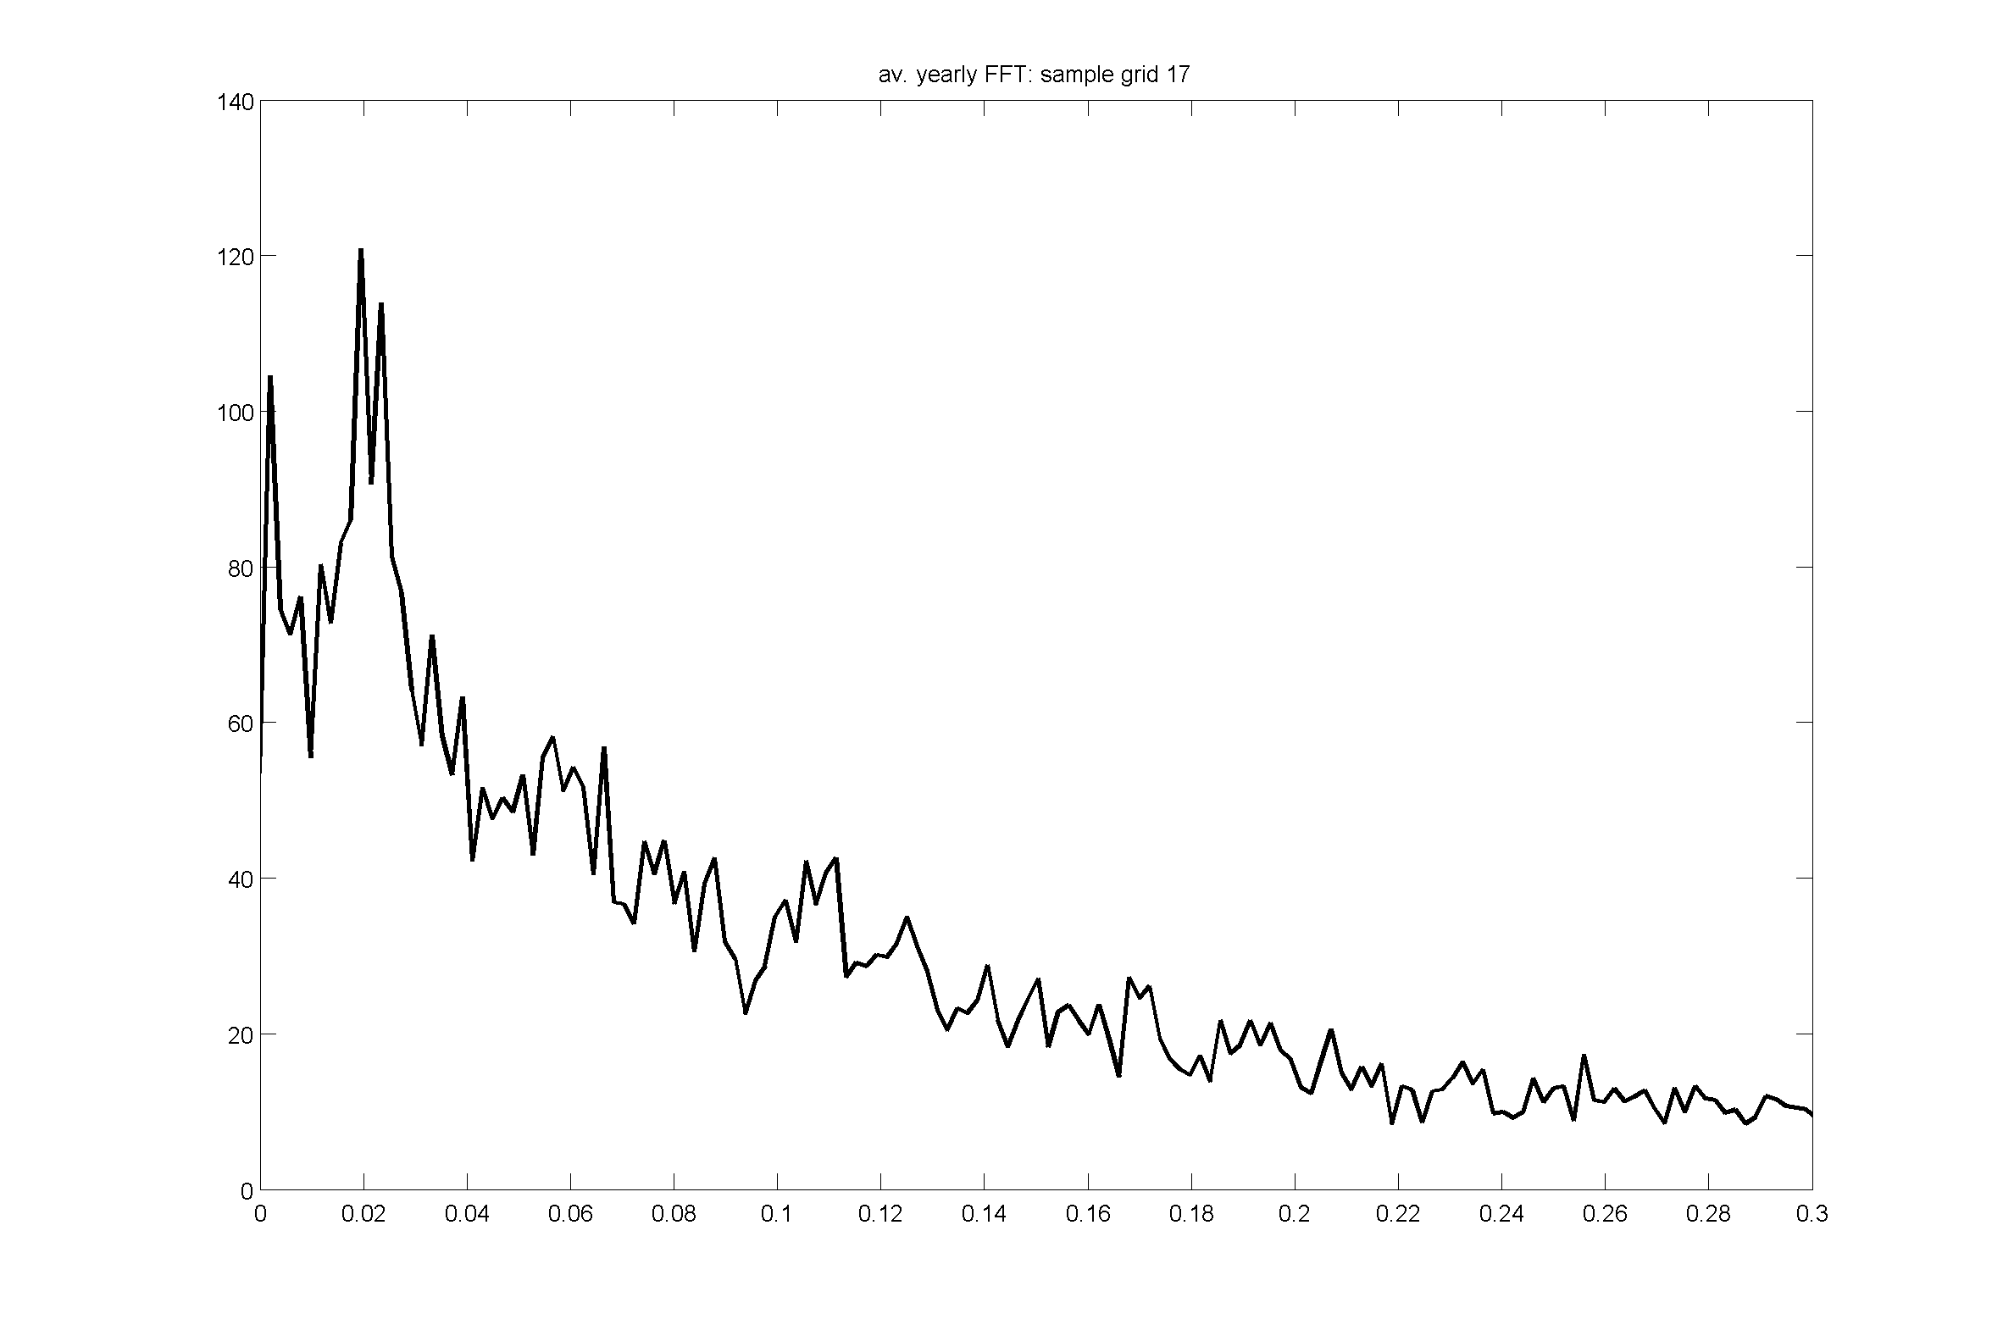
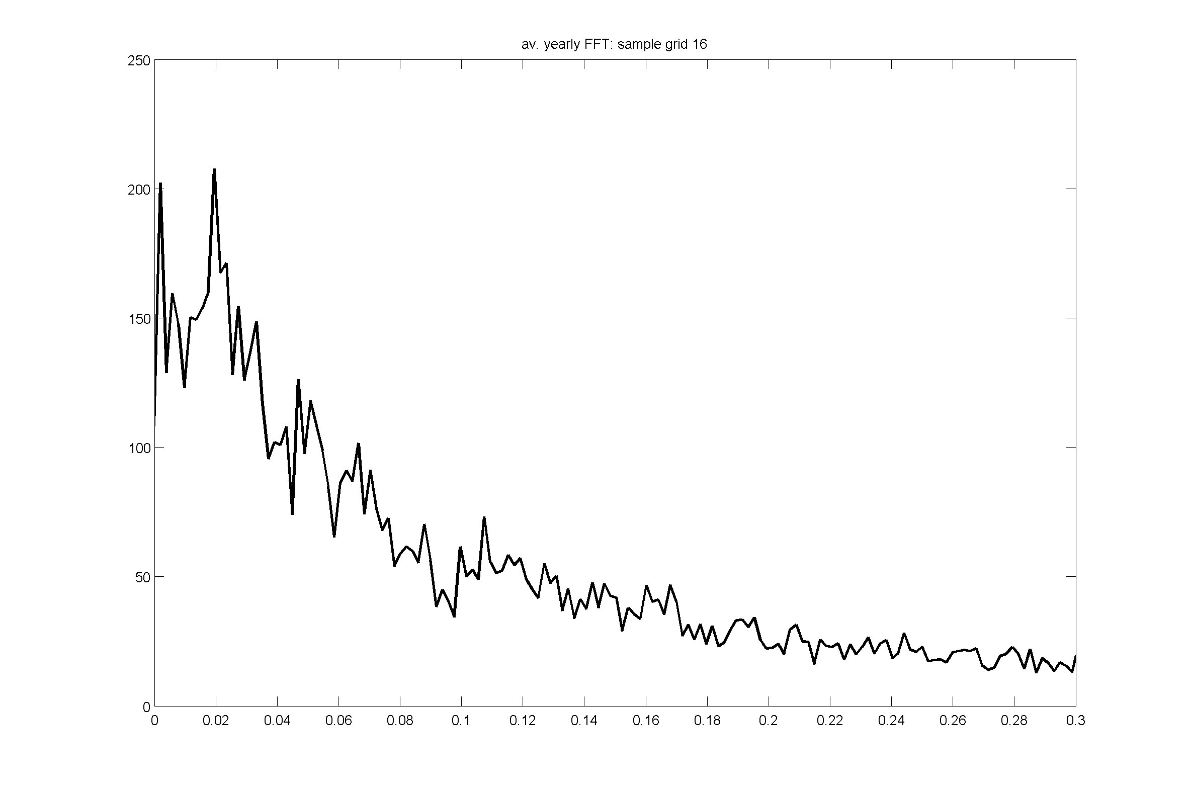
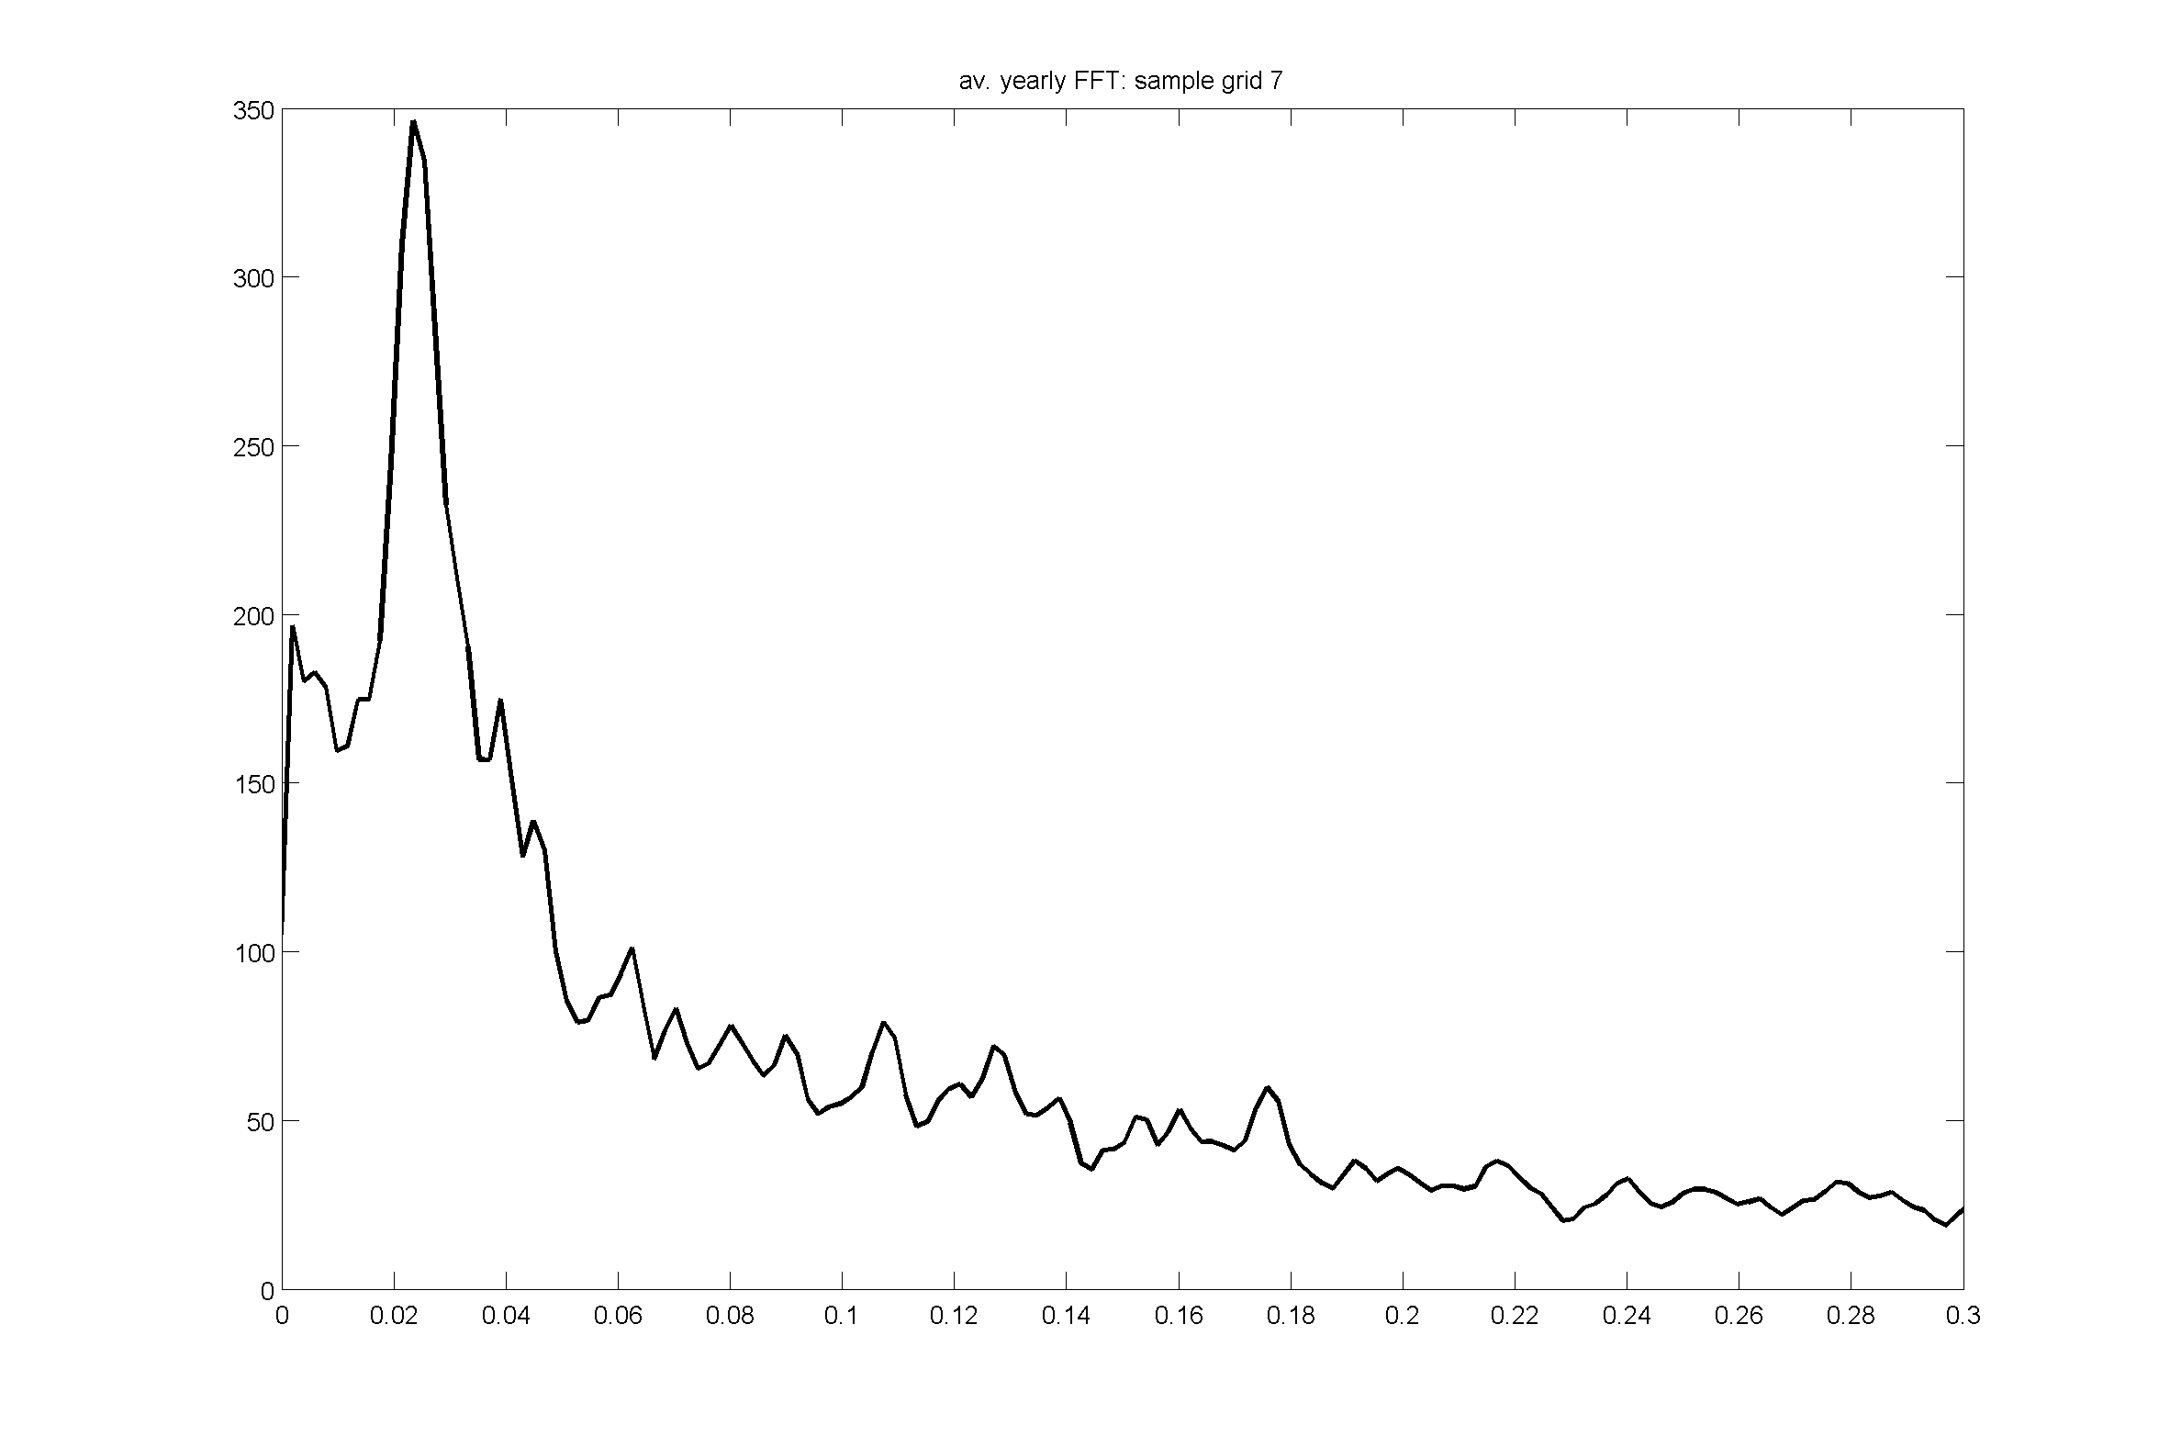
Precipitation cycles
Variance/
(cycles/day)
Variance/
(cycles/day)
Cycles/day
Cycles/day
Notes:
Power spectral densities of four example grids from key wind states
Spectra taken from 1 year daily data centred on summer and averaged across 36 years
See peak at 0.02 cycles/day = 50 days – thought to be associated with MJO

Slide 13
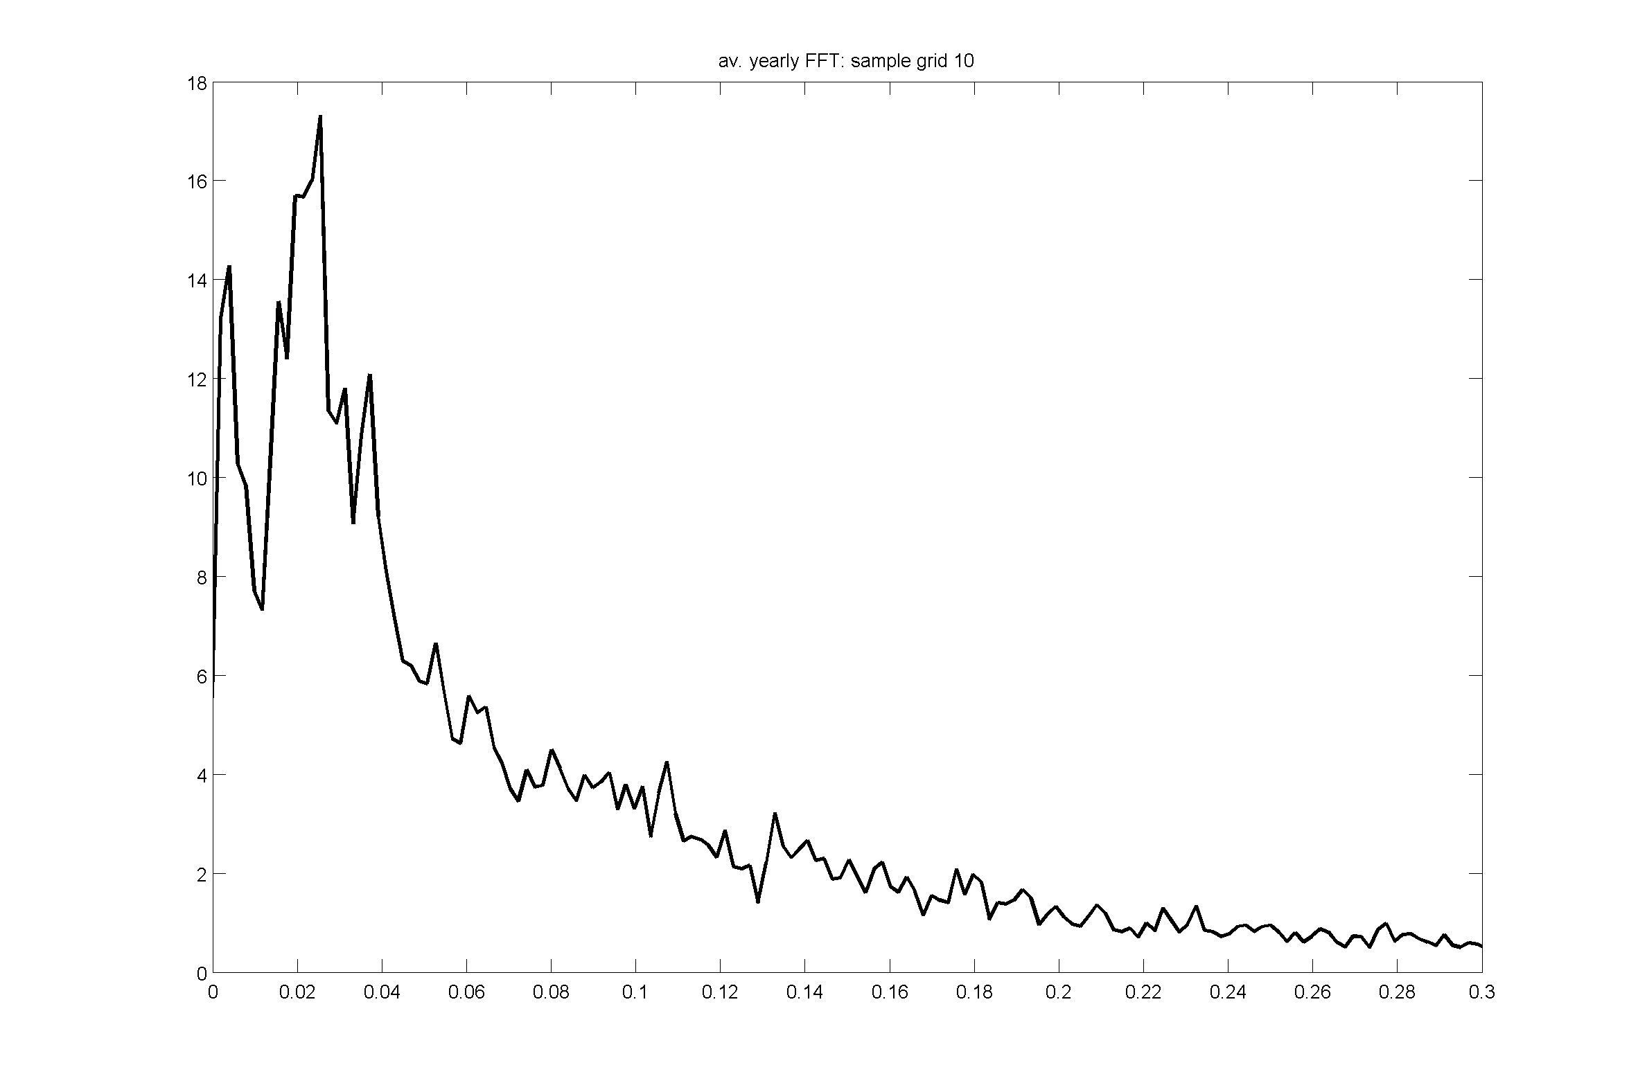
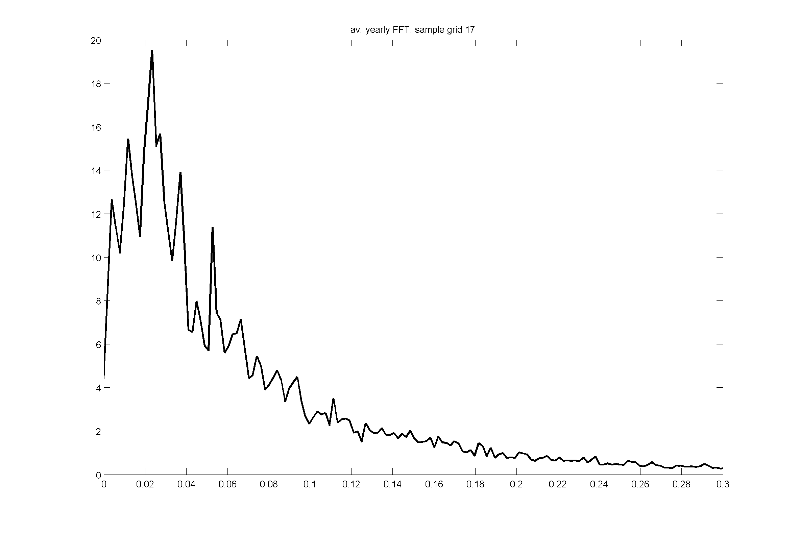
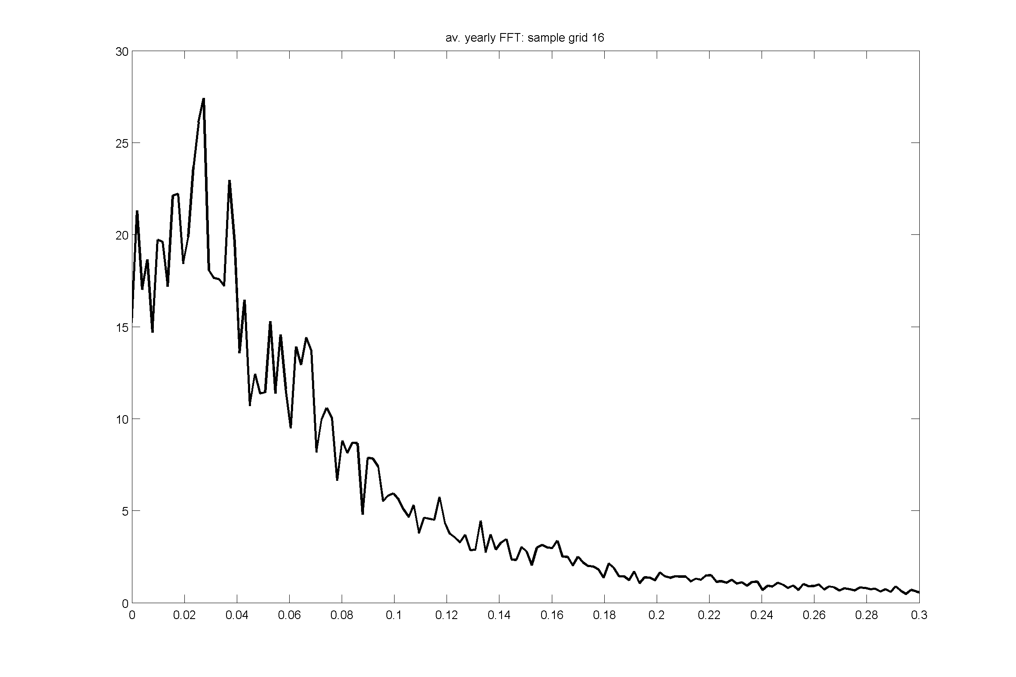
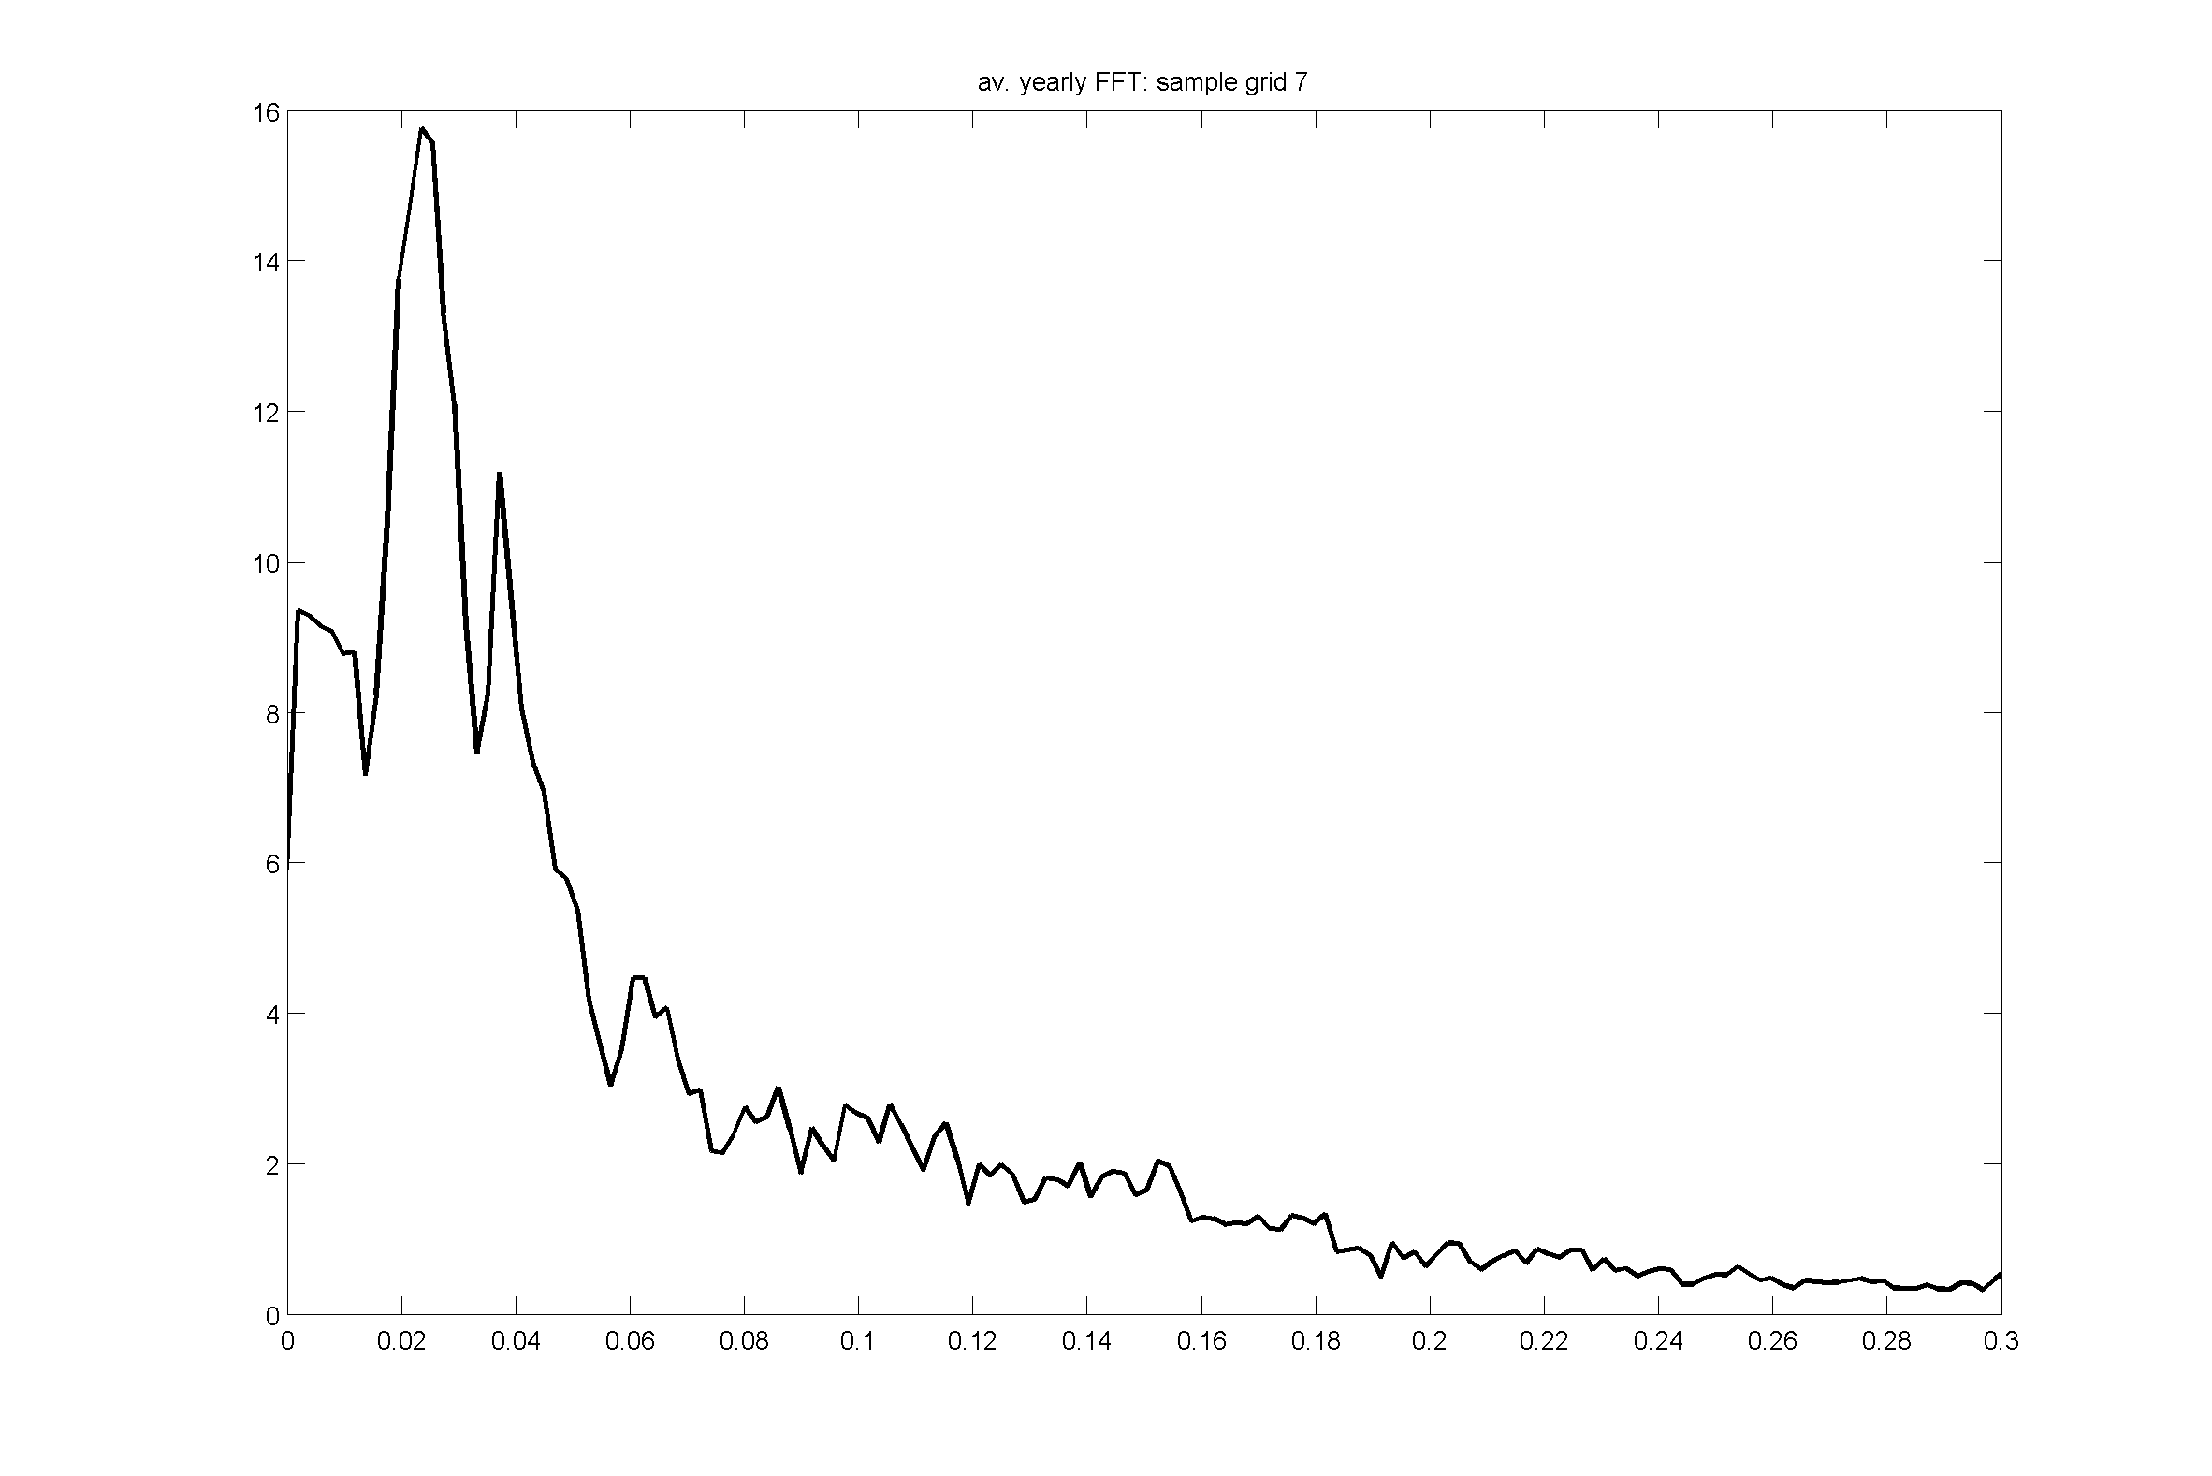
Wind speed cycles
Variance/
(cycles/day)
Variance/
(cycles/day)
Cycles/day
Cycles/day
Notes:
Find that wind speed does follow the same cycle as precip and zonal wind

Slide 14
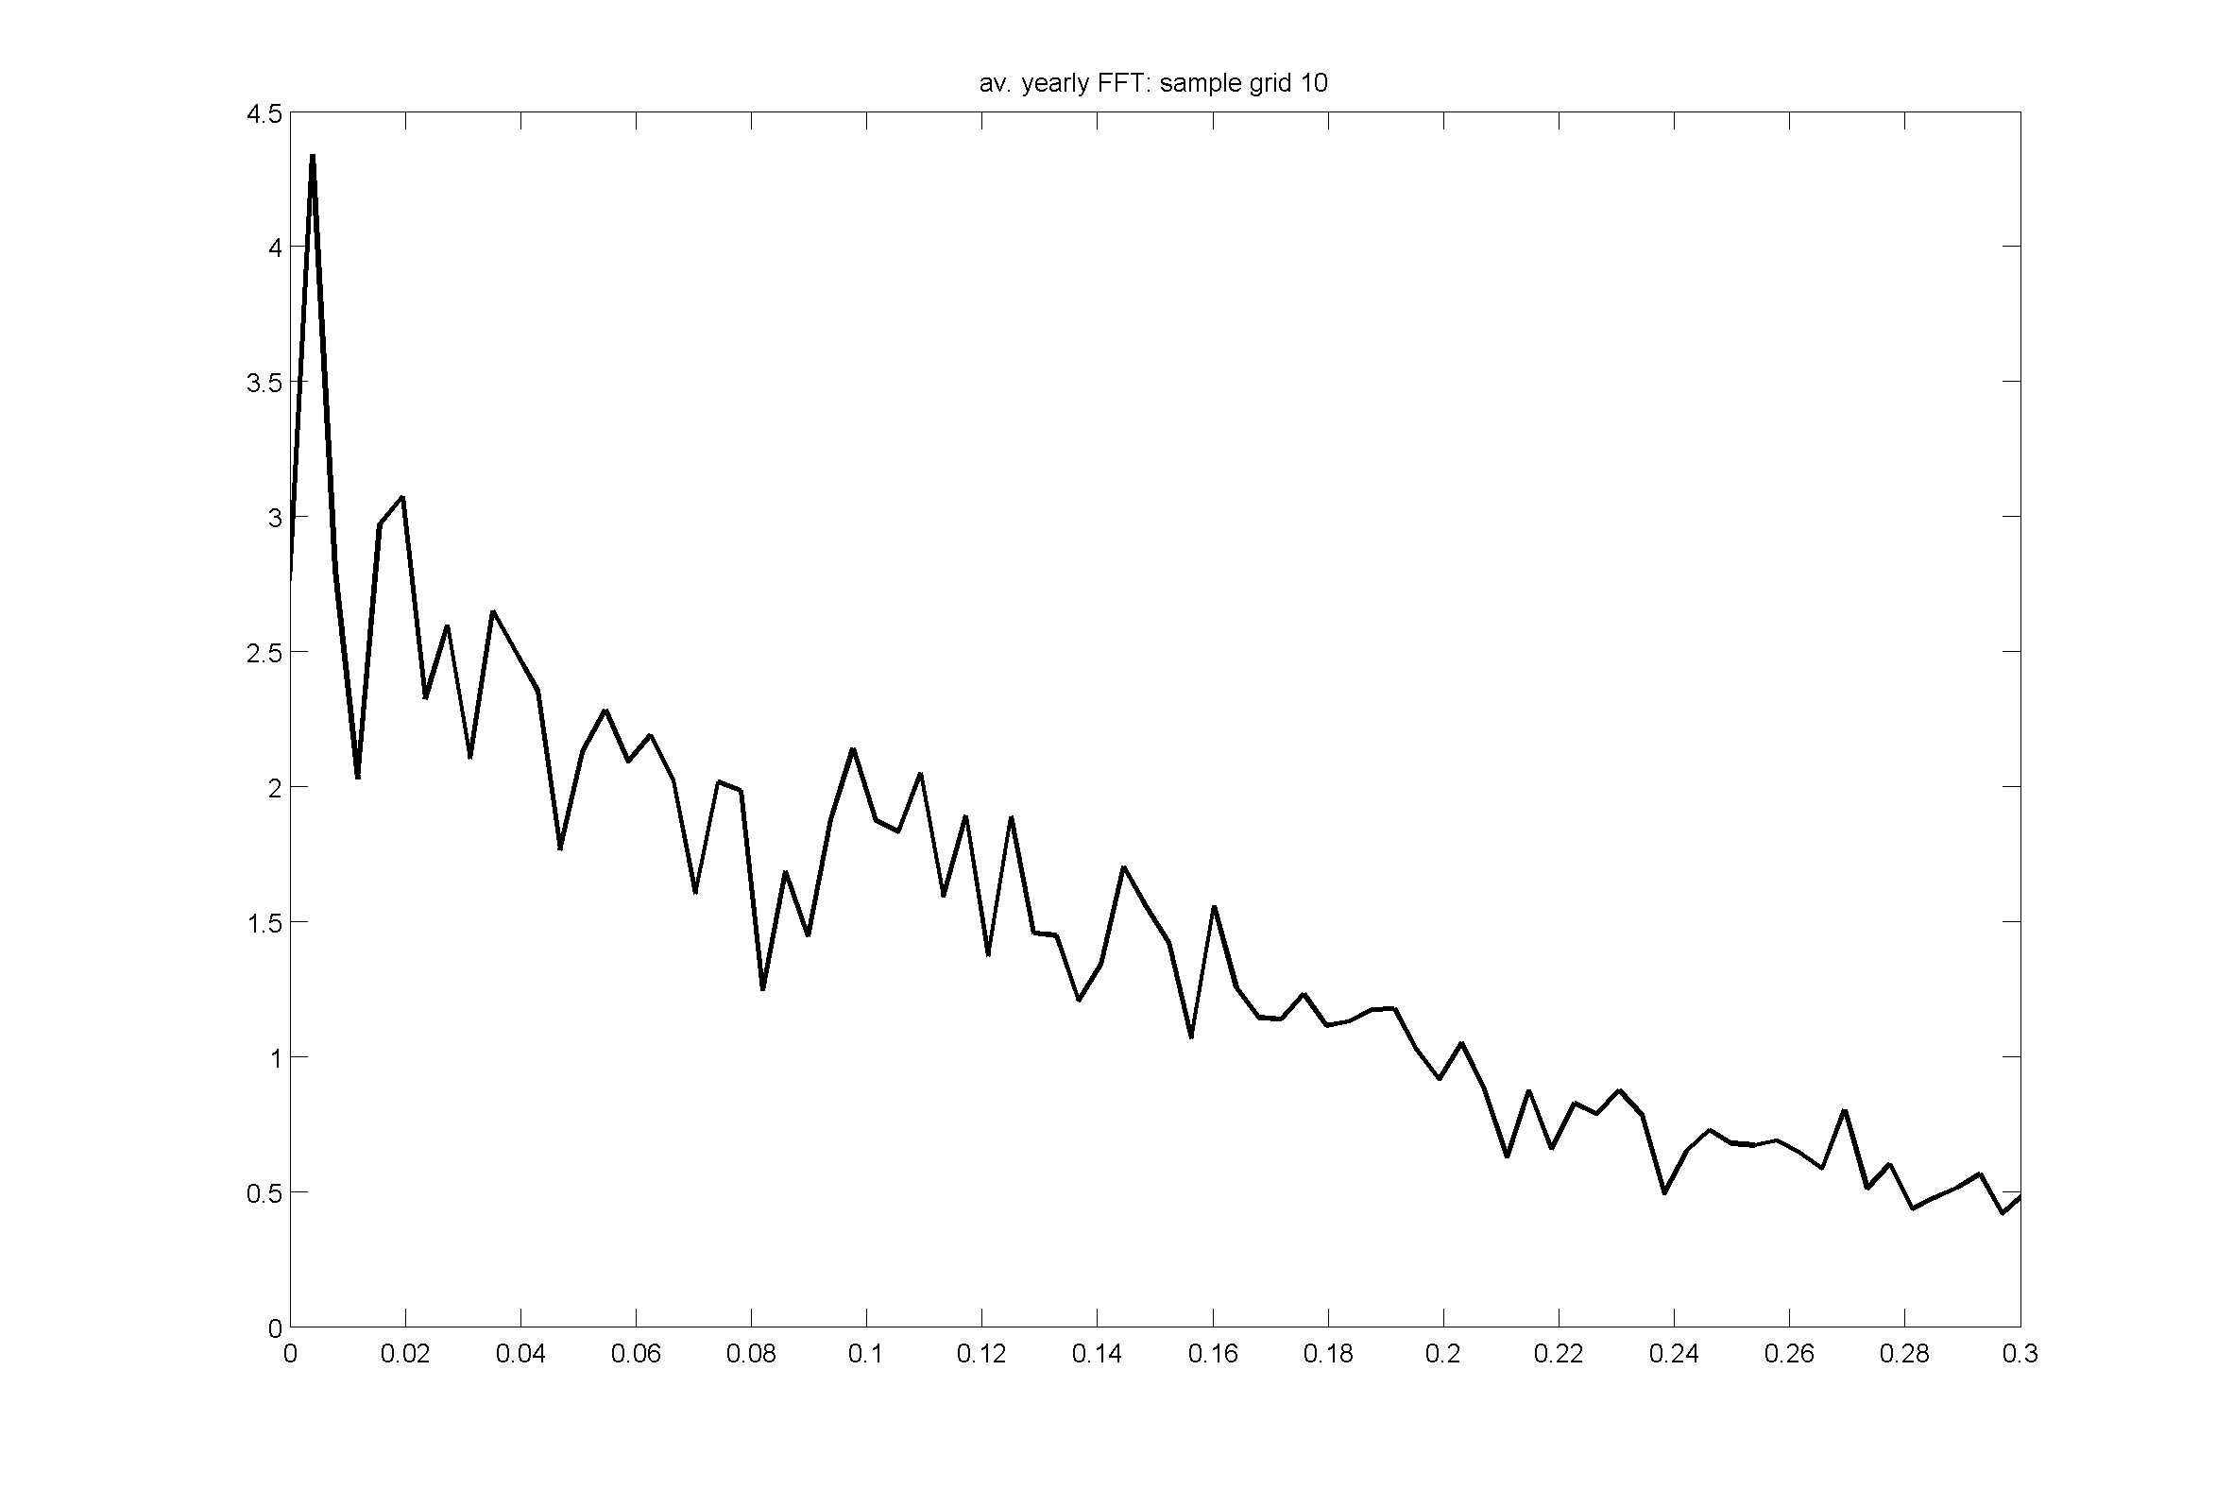
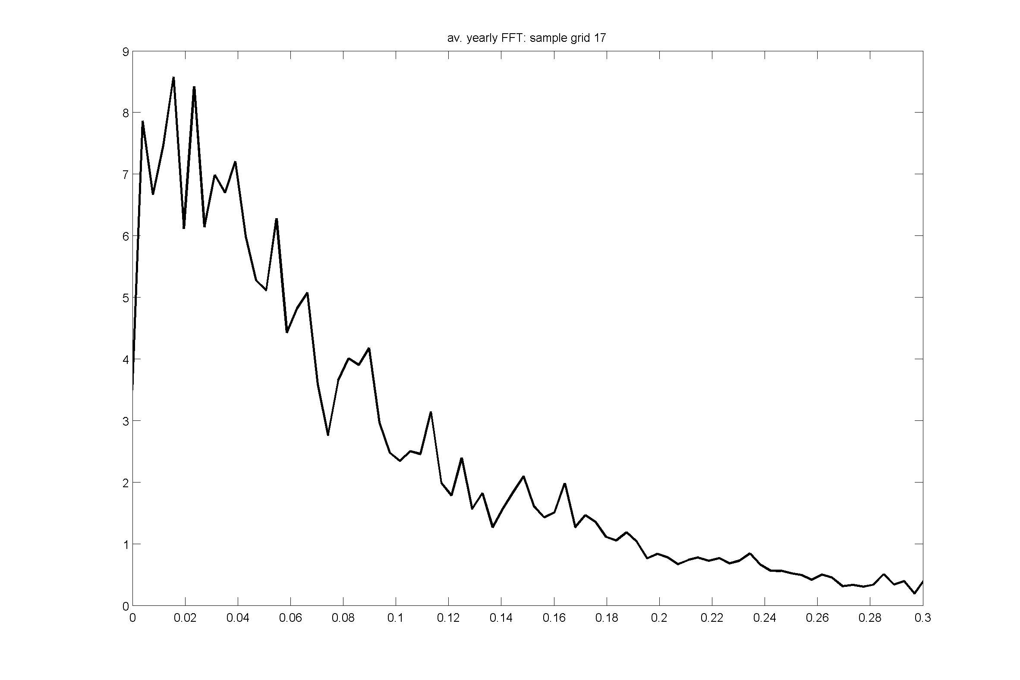
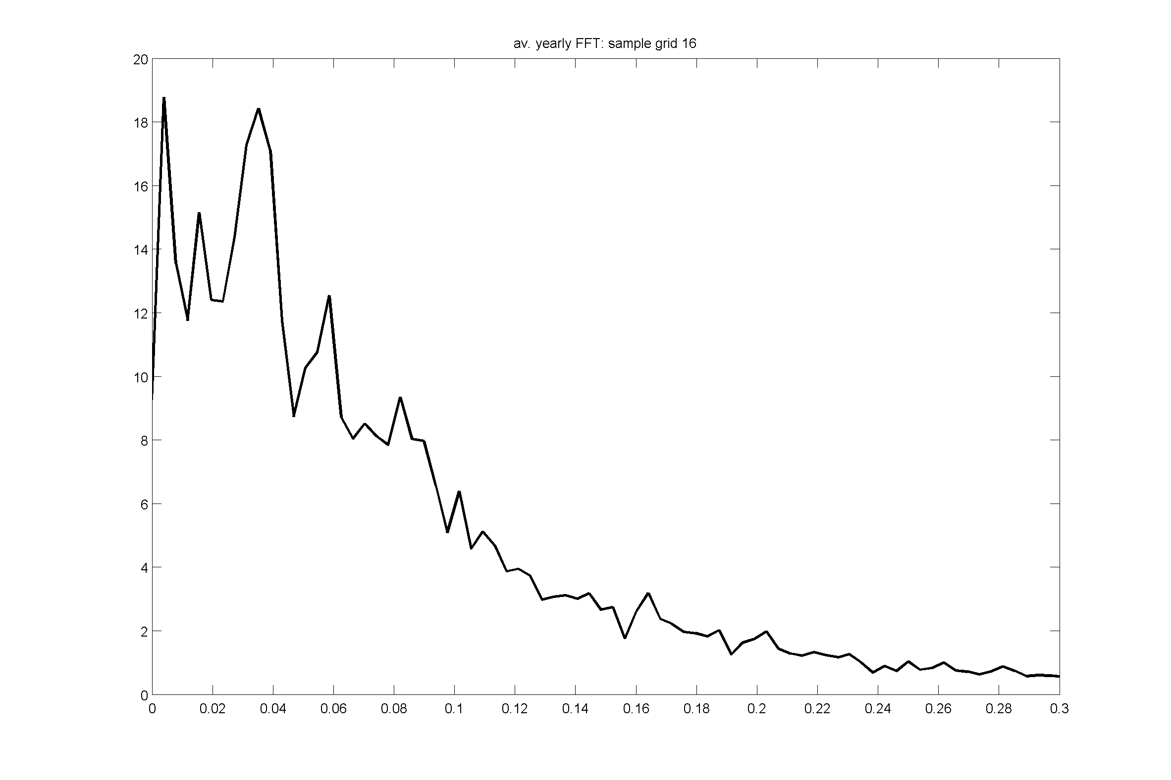
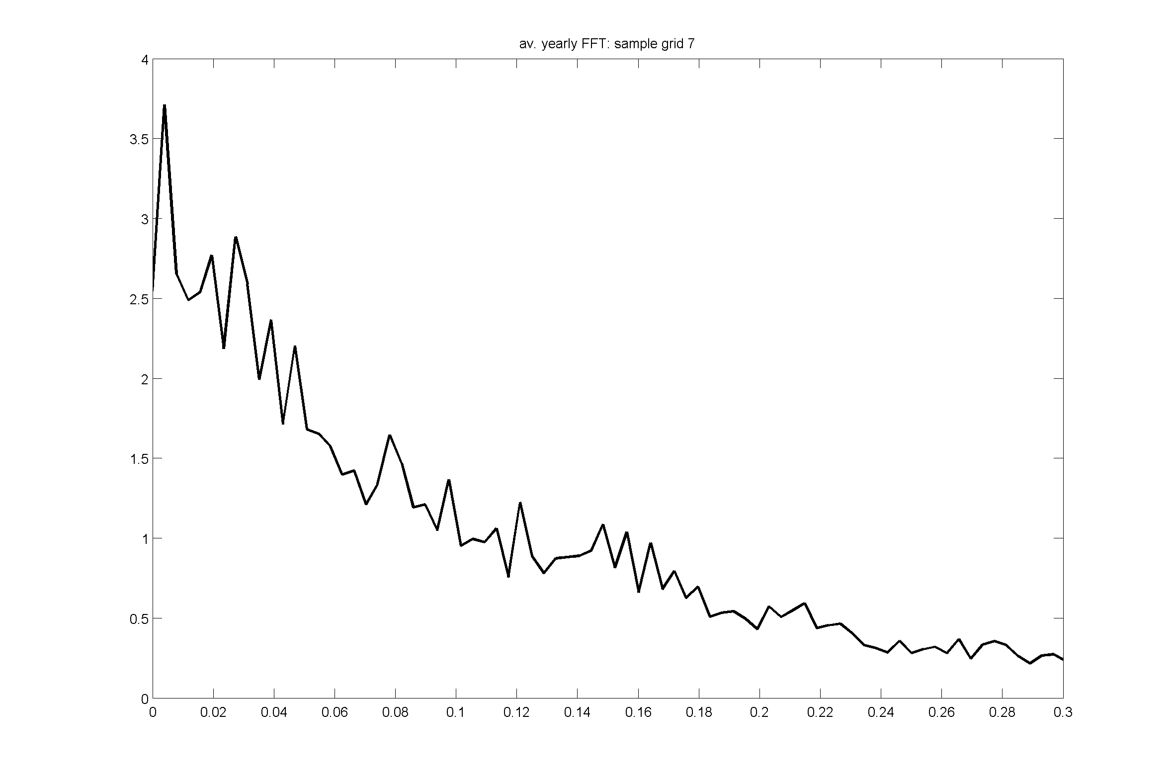
Winter wind speed
Variance/
(cycles/day)
Variance/
(cycles/day)
Cycles/day
Cycles/day
Notes:
Main focus is on summer because of precipitation
Demand for energy is year-round – do we see similar cycles in winter wind speed?
Expected to see this because MJO is year-round
But no – inconsistent signal
Conclude: intraseasonal variability on 50 day cycle important for wind in summer, but not conclusive in winter

Slide 15
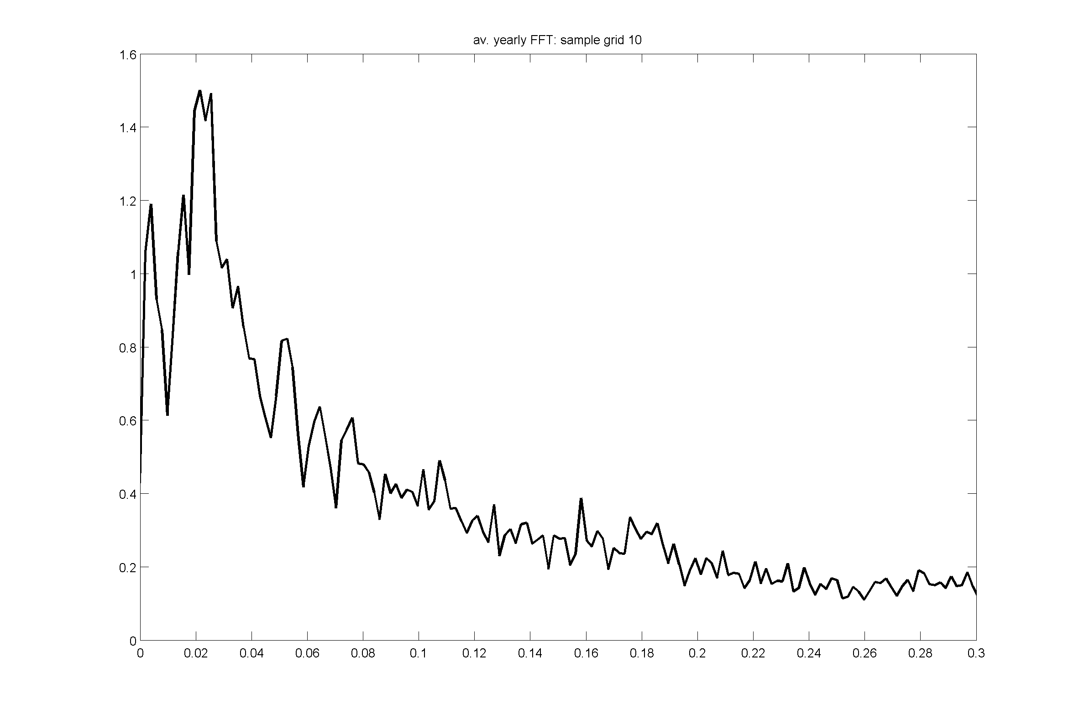
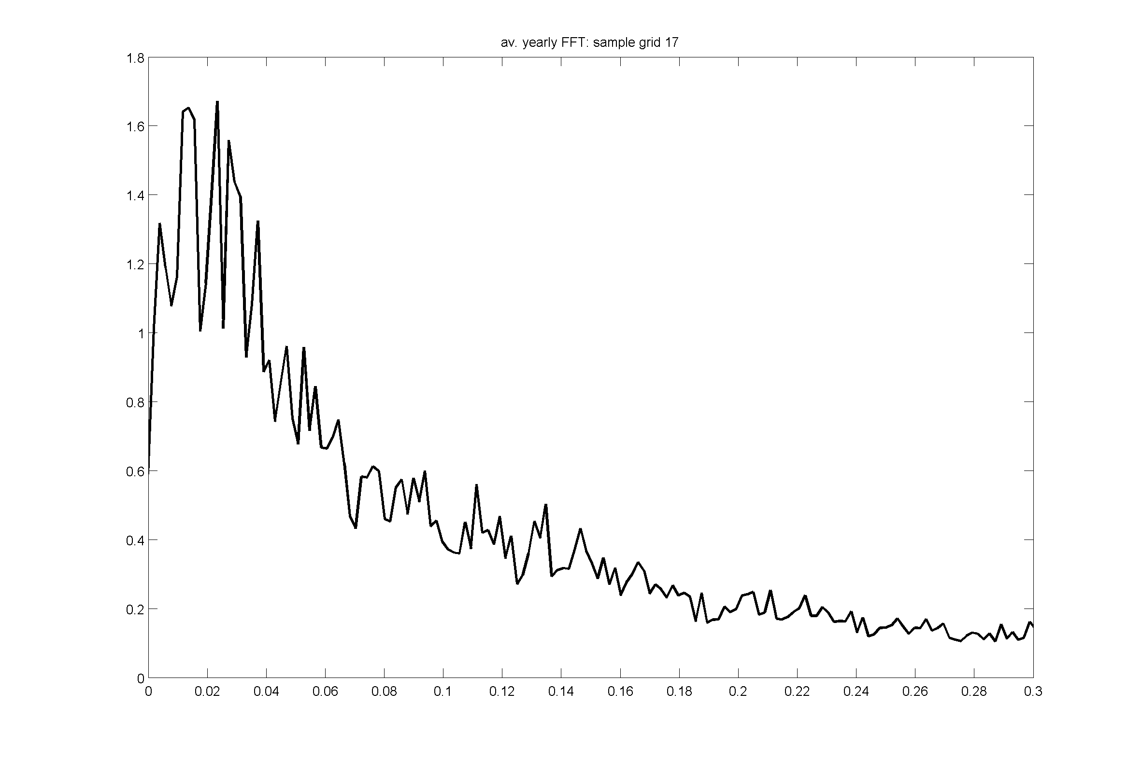
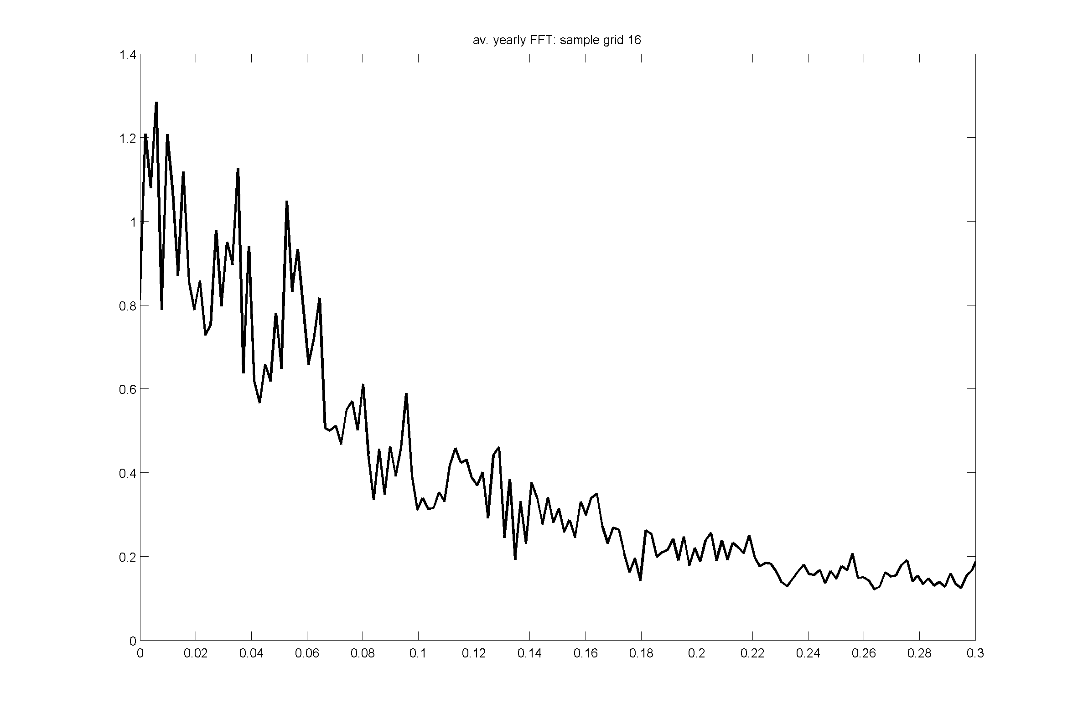
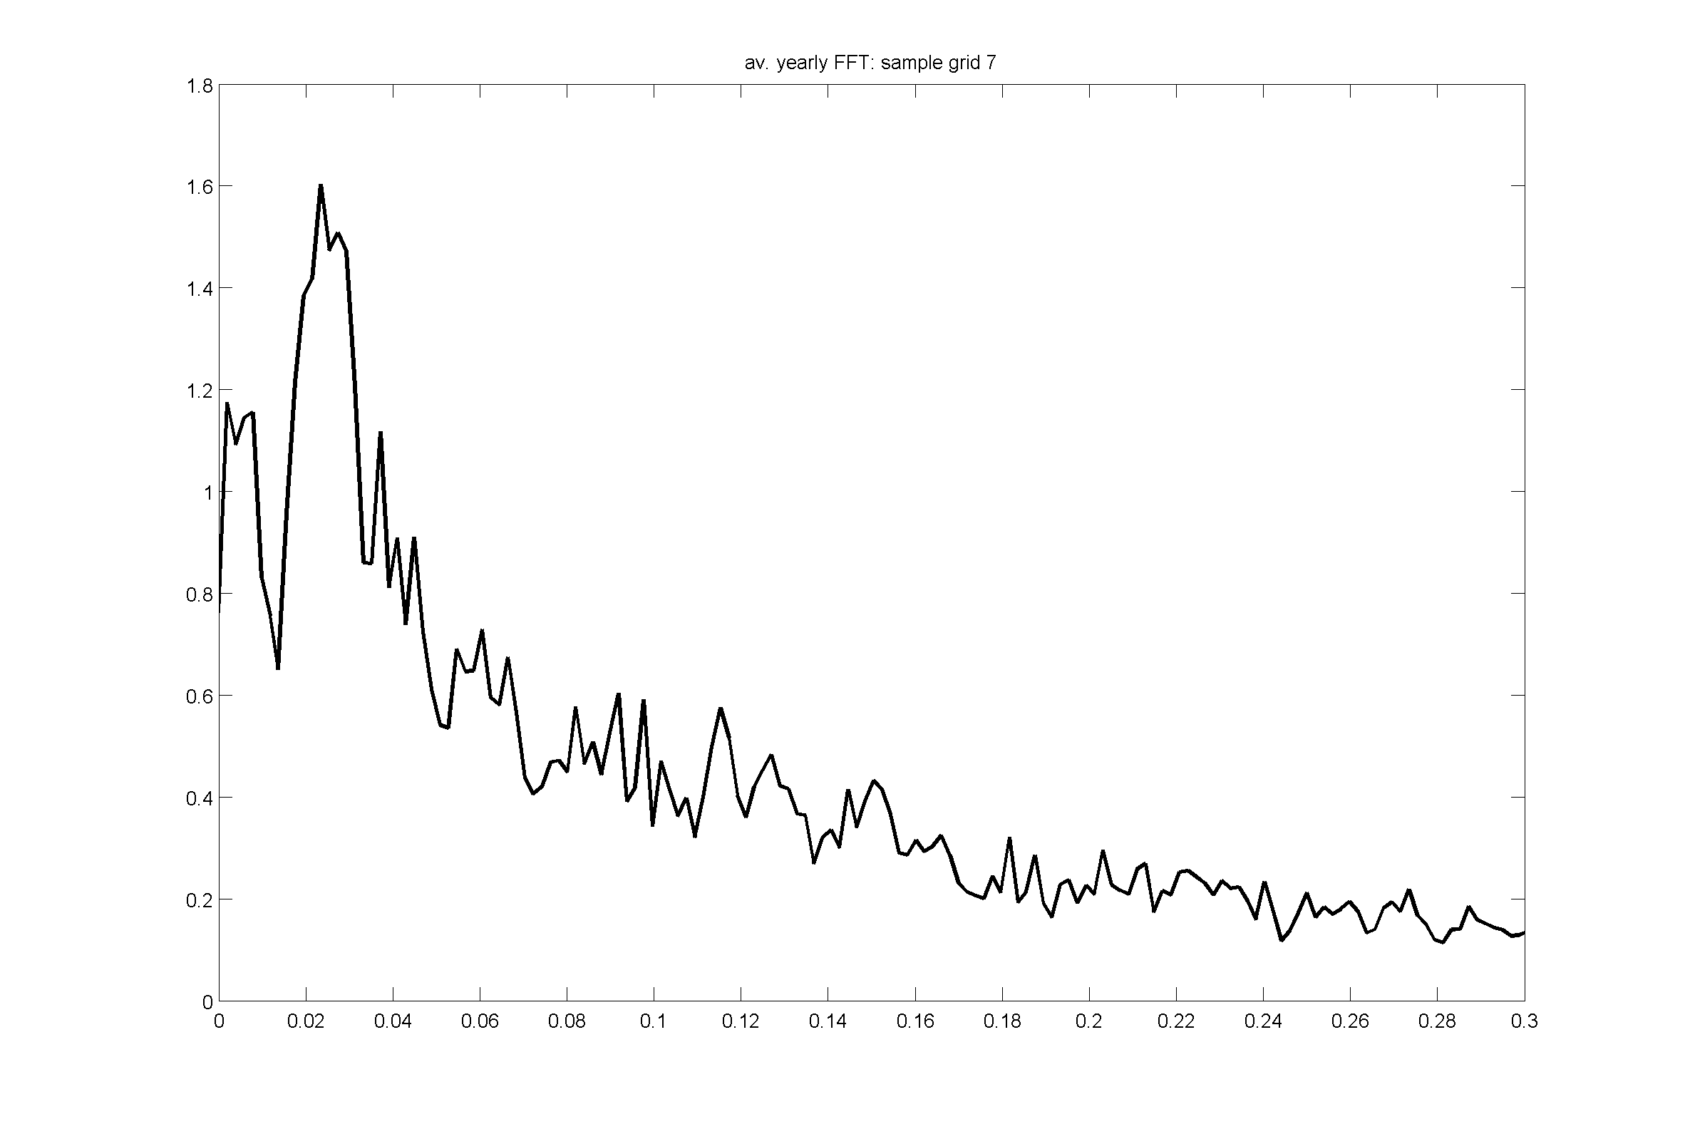
Low wind event cycles
Variance/
(cycles/day)
Variance/
(cycles/day)
Cycles/day
Cycles/day
Notes:
Tailoring question towards wind farm operators, how often do they need to be concerned about no-wind events?
See hints of same 50 day cycle but of course strongly threshold dependent
Turbine threshold is instantaneous but I am applying it to the daily mean

Slide 16
Short term wind forecasts: stochastic parameterisation
Stochastic parameterisation injects extra noise into an ensemble forecast
Used at ECMWF and Met Office
Has shown improvement over multi-physics and initial conditions ensembles
Stochastic Kinetic Energy Backscatter (SKEB, available in WRF and UM):
represents upscale energy transfer that models fail to do
injects fraction of dissipated turbulent energy into large scale winds and temperature
Berner et al (2010), MWR 139

Slide 17
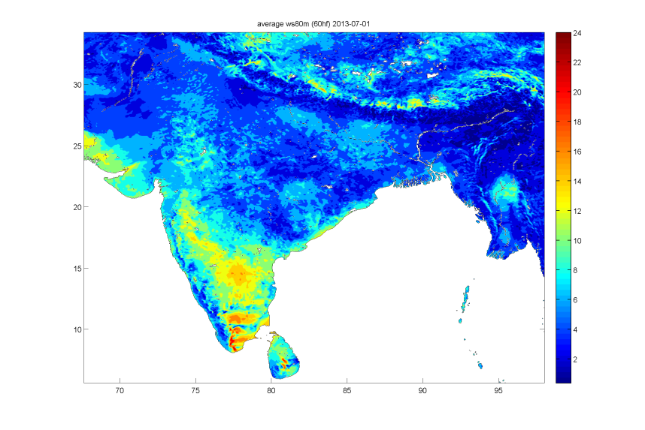
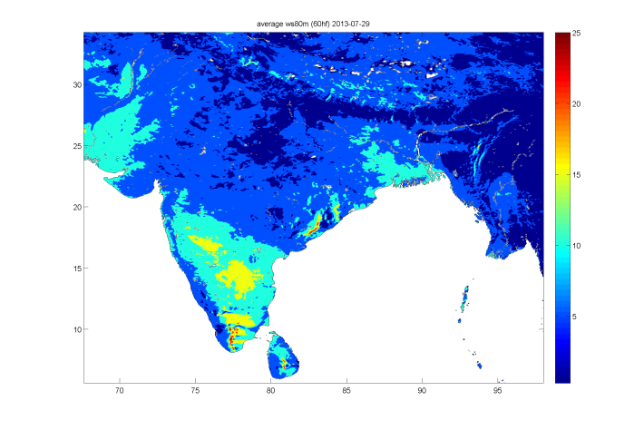
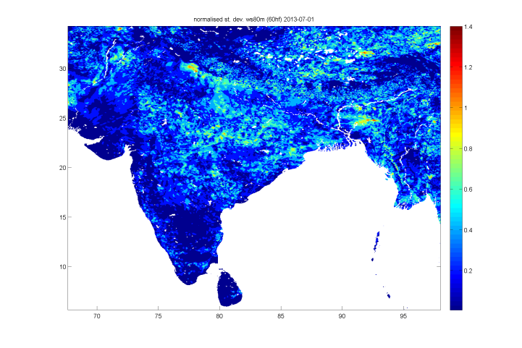
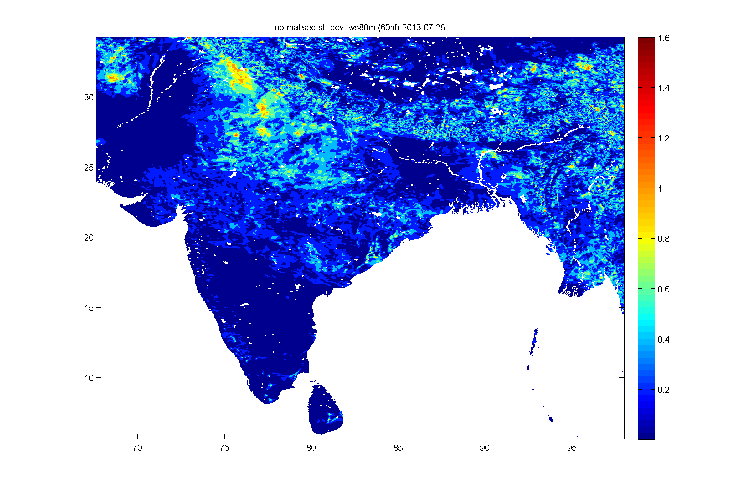
80m wind speed forecast (T+60h)
Experiment setup
WRF forced with GFS analysis
4km resolution
60 h forecast
Hourly output
5 stochastic ensembles
Two dates
2013-07-01
2013-07-29
80m wind speed forecast (t+60h)
normalised σ of wind speed forecast

Slide 18
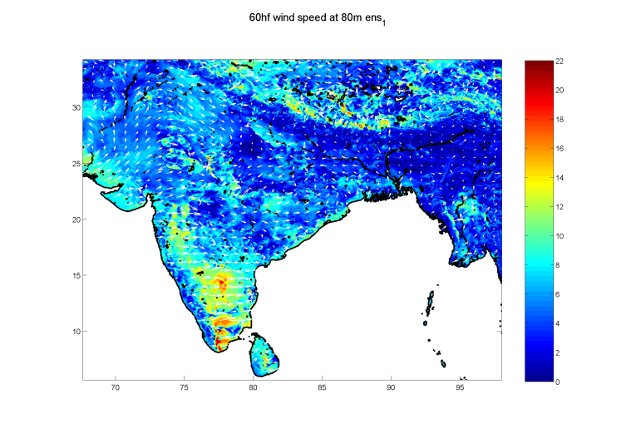
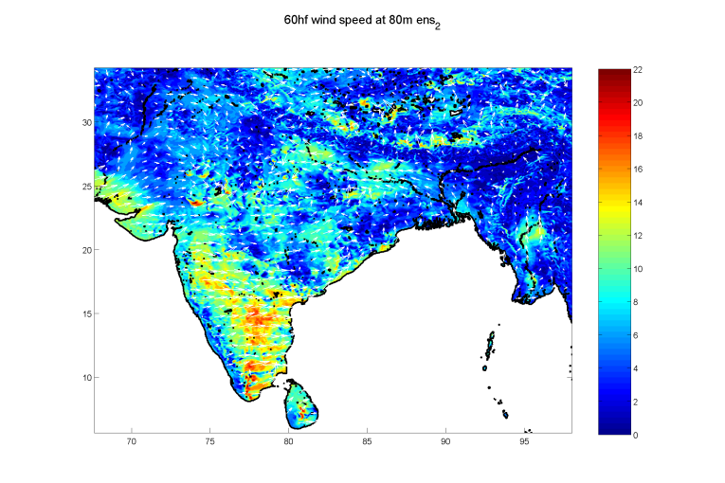
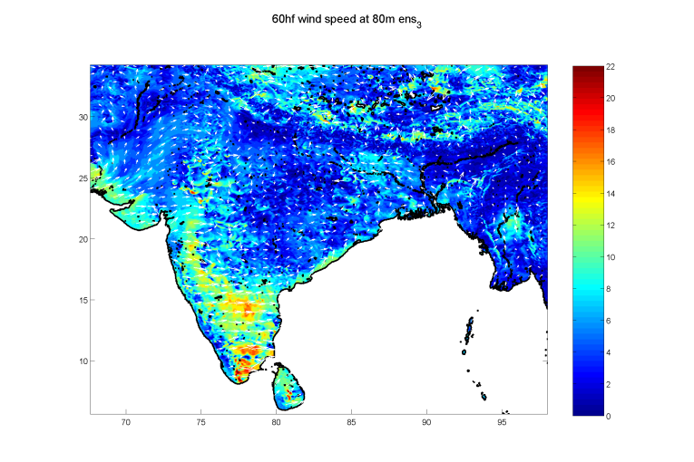
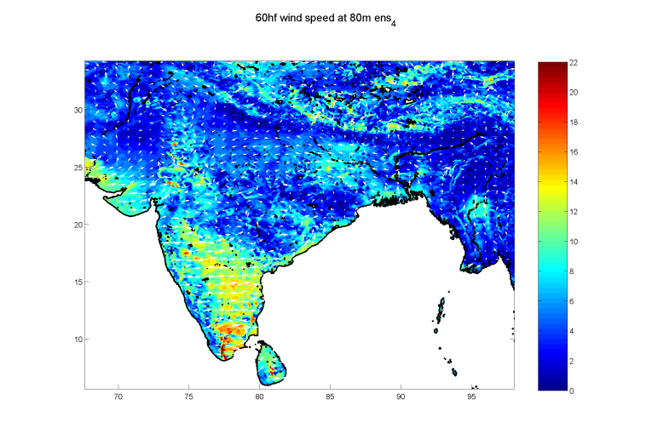
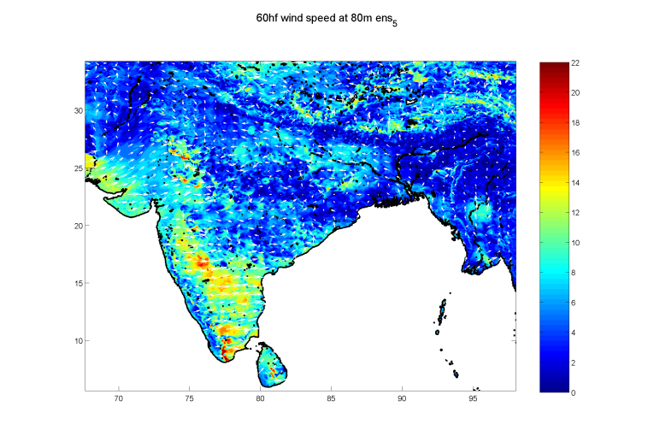
Ensembles: 80m wind speed forecast (2013-07-01 + 60h)
Notes:
Individual ensemble members for one date

Slide 19
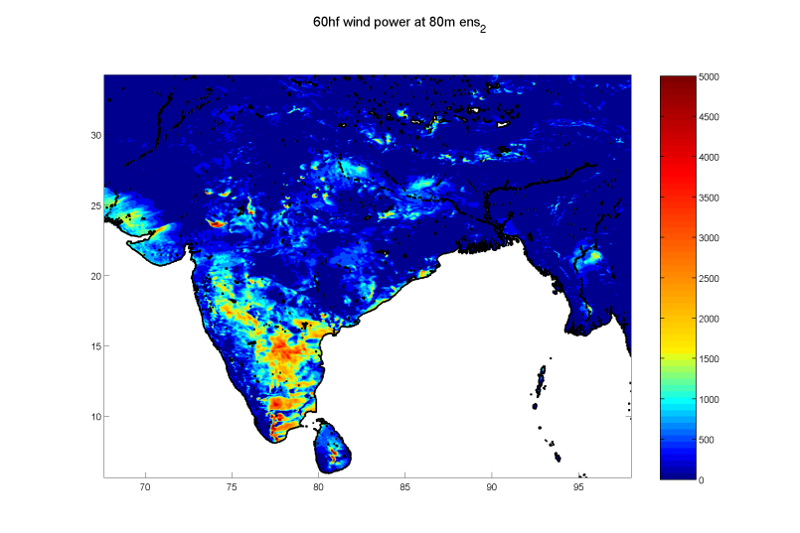
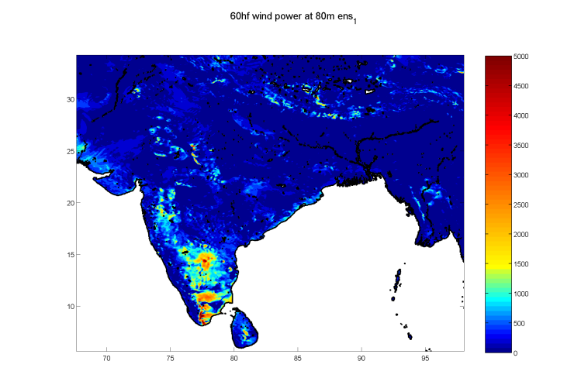
Ensembles: 80m wind power forecast (2013-07-01 + 60h)

Slide 20
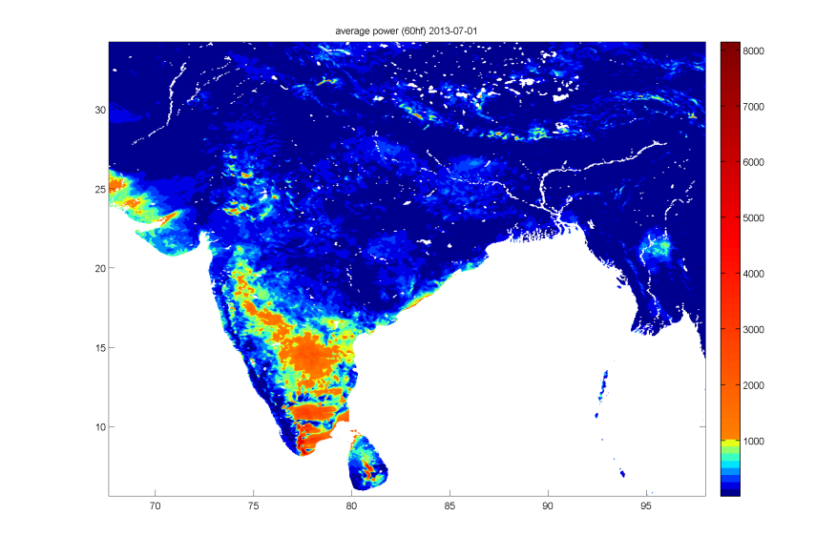
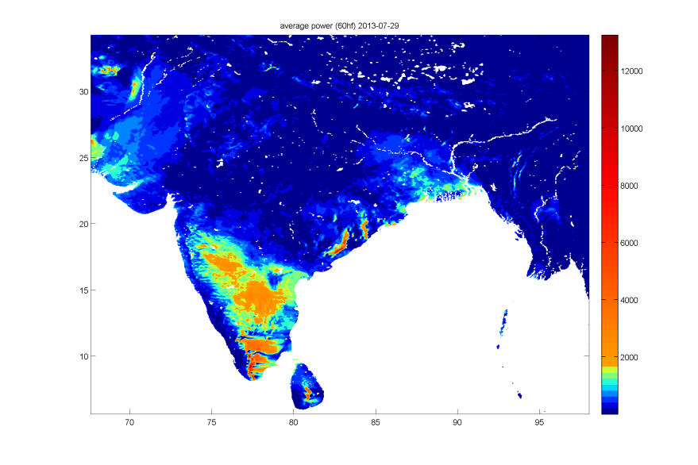
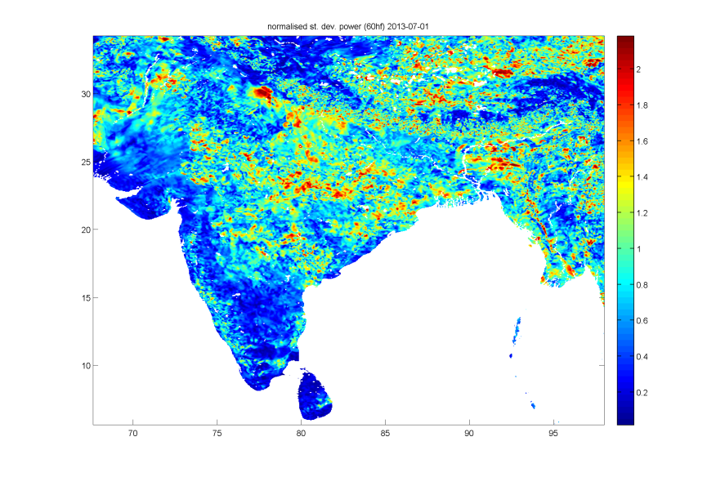
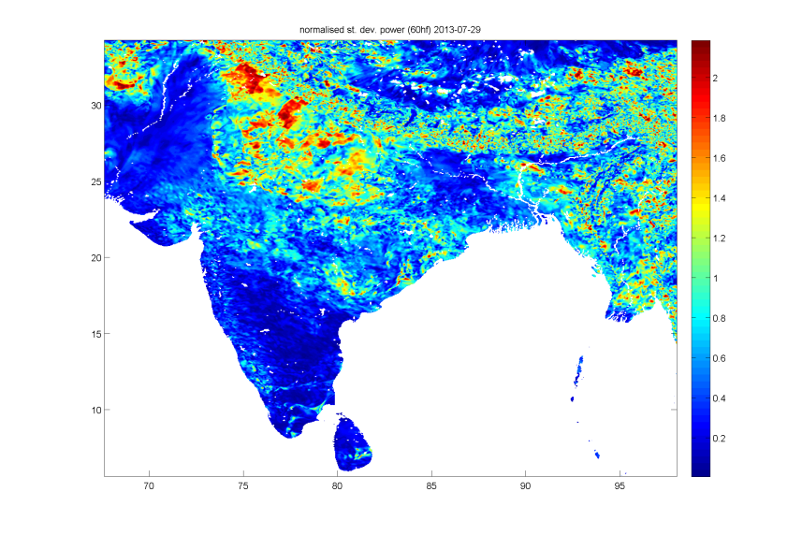
Wind power forecast (T+60h)
2013-07-01
2013-07-29
Power forecast (t+60h)
normalised σ of
power forecast
Notes:
Normalised standard deviation largest in non windy areas, but 20% of several thousand MW/m2 still large
Already close to 30% error limit in windy areas even without accounting for initial conditions or model uncertainty

Slide 21
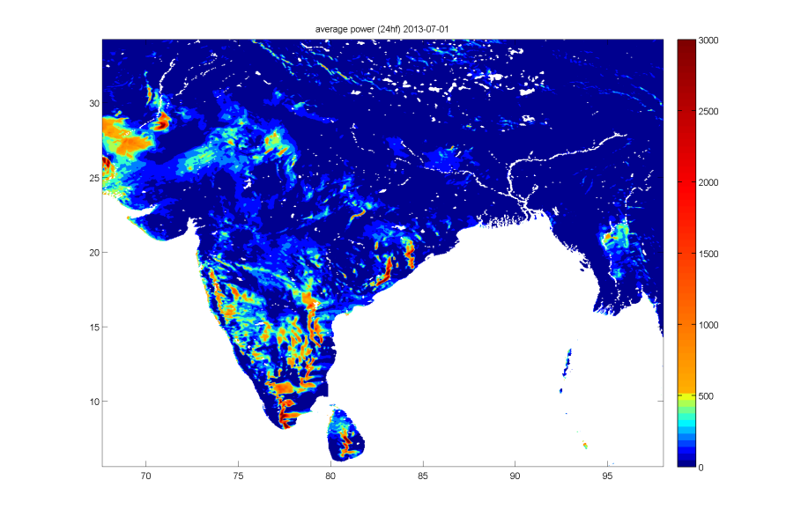
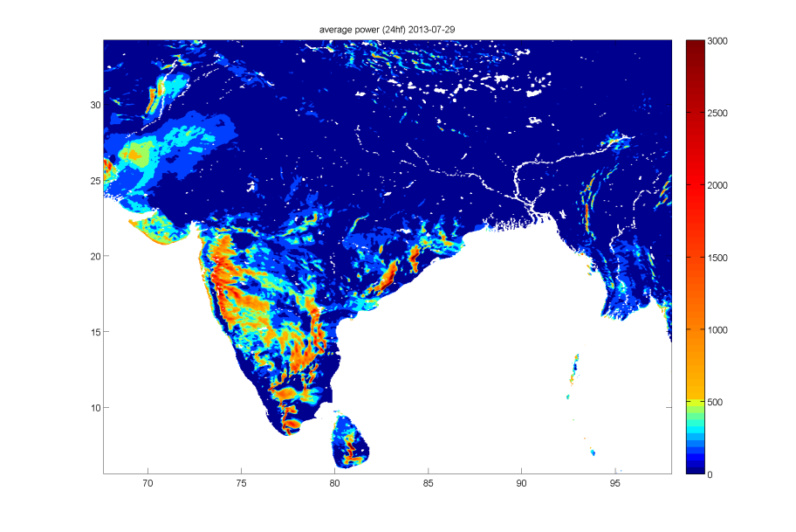
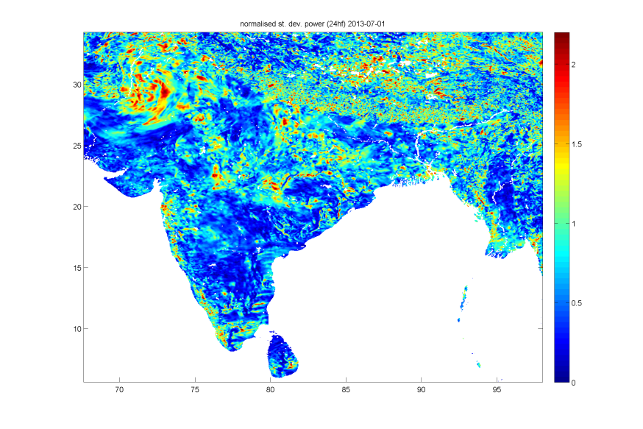
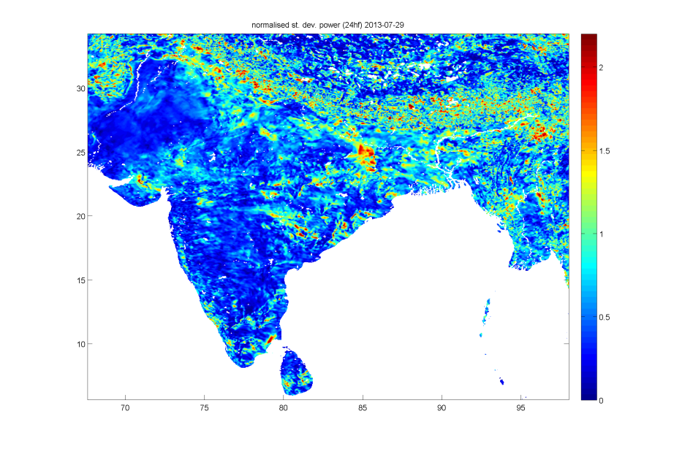
Wind power forecast (T+24h)
Experiment setup
WRF forced with GFS analysis
4km resolution
60 h forecast
Hourly output
5 stochastic ensembles
Two dates
2013-07-01
2013-07-29
Power forecast (t+24h)
normalised σ of
power forecast

Slide 22
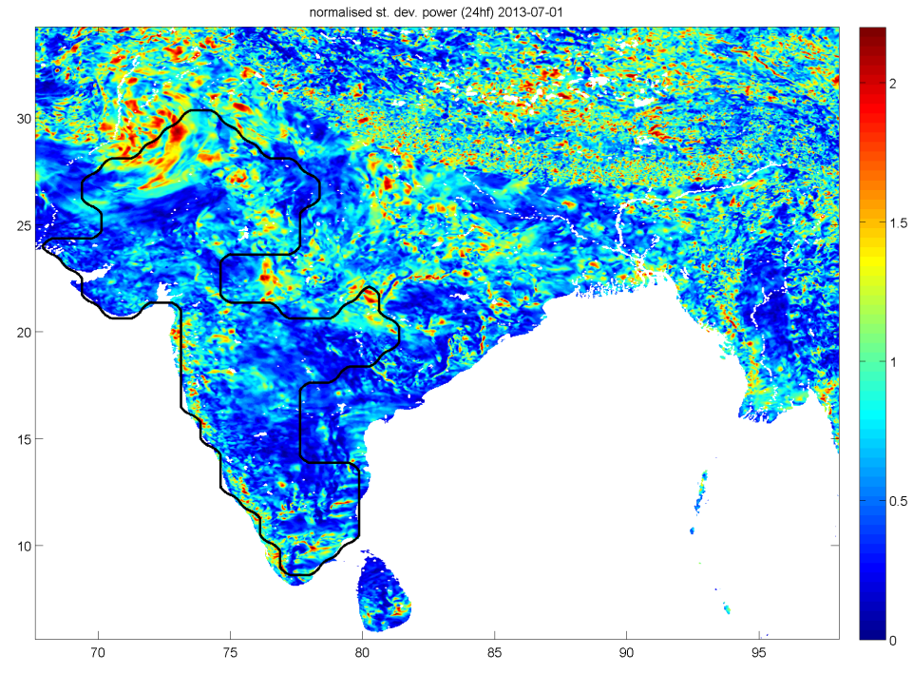
Wind power forecast (T+24h)
2013-07-01
In the five key wind states:
Tamil Nadu, Gujarat, Maharashtra, Karnataka, Rajasthan.
Ensemble spread > 30% in
in 86% (2013-07-01)
76% (2013-07-29)
of the total area
2013-07-29

Slide 23
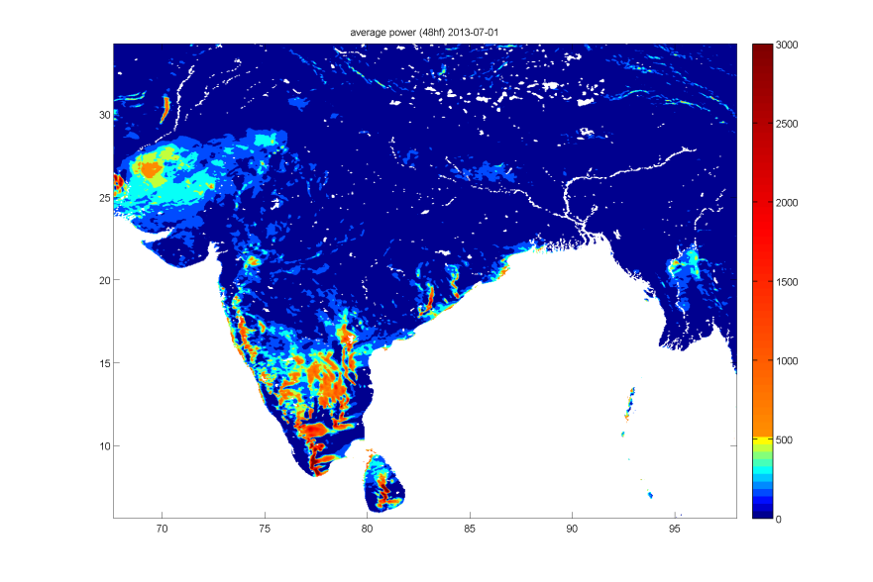
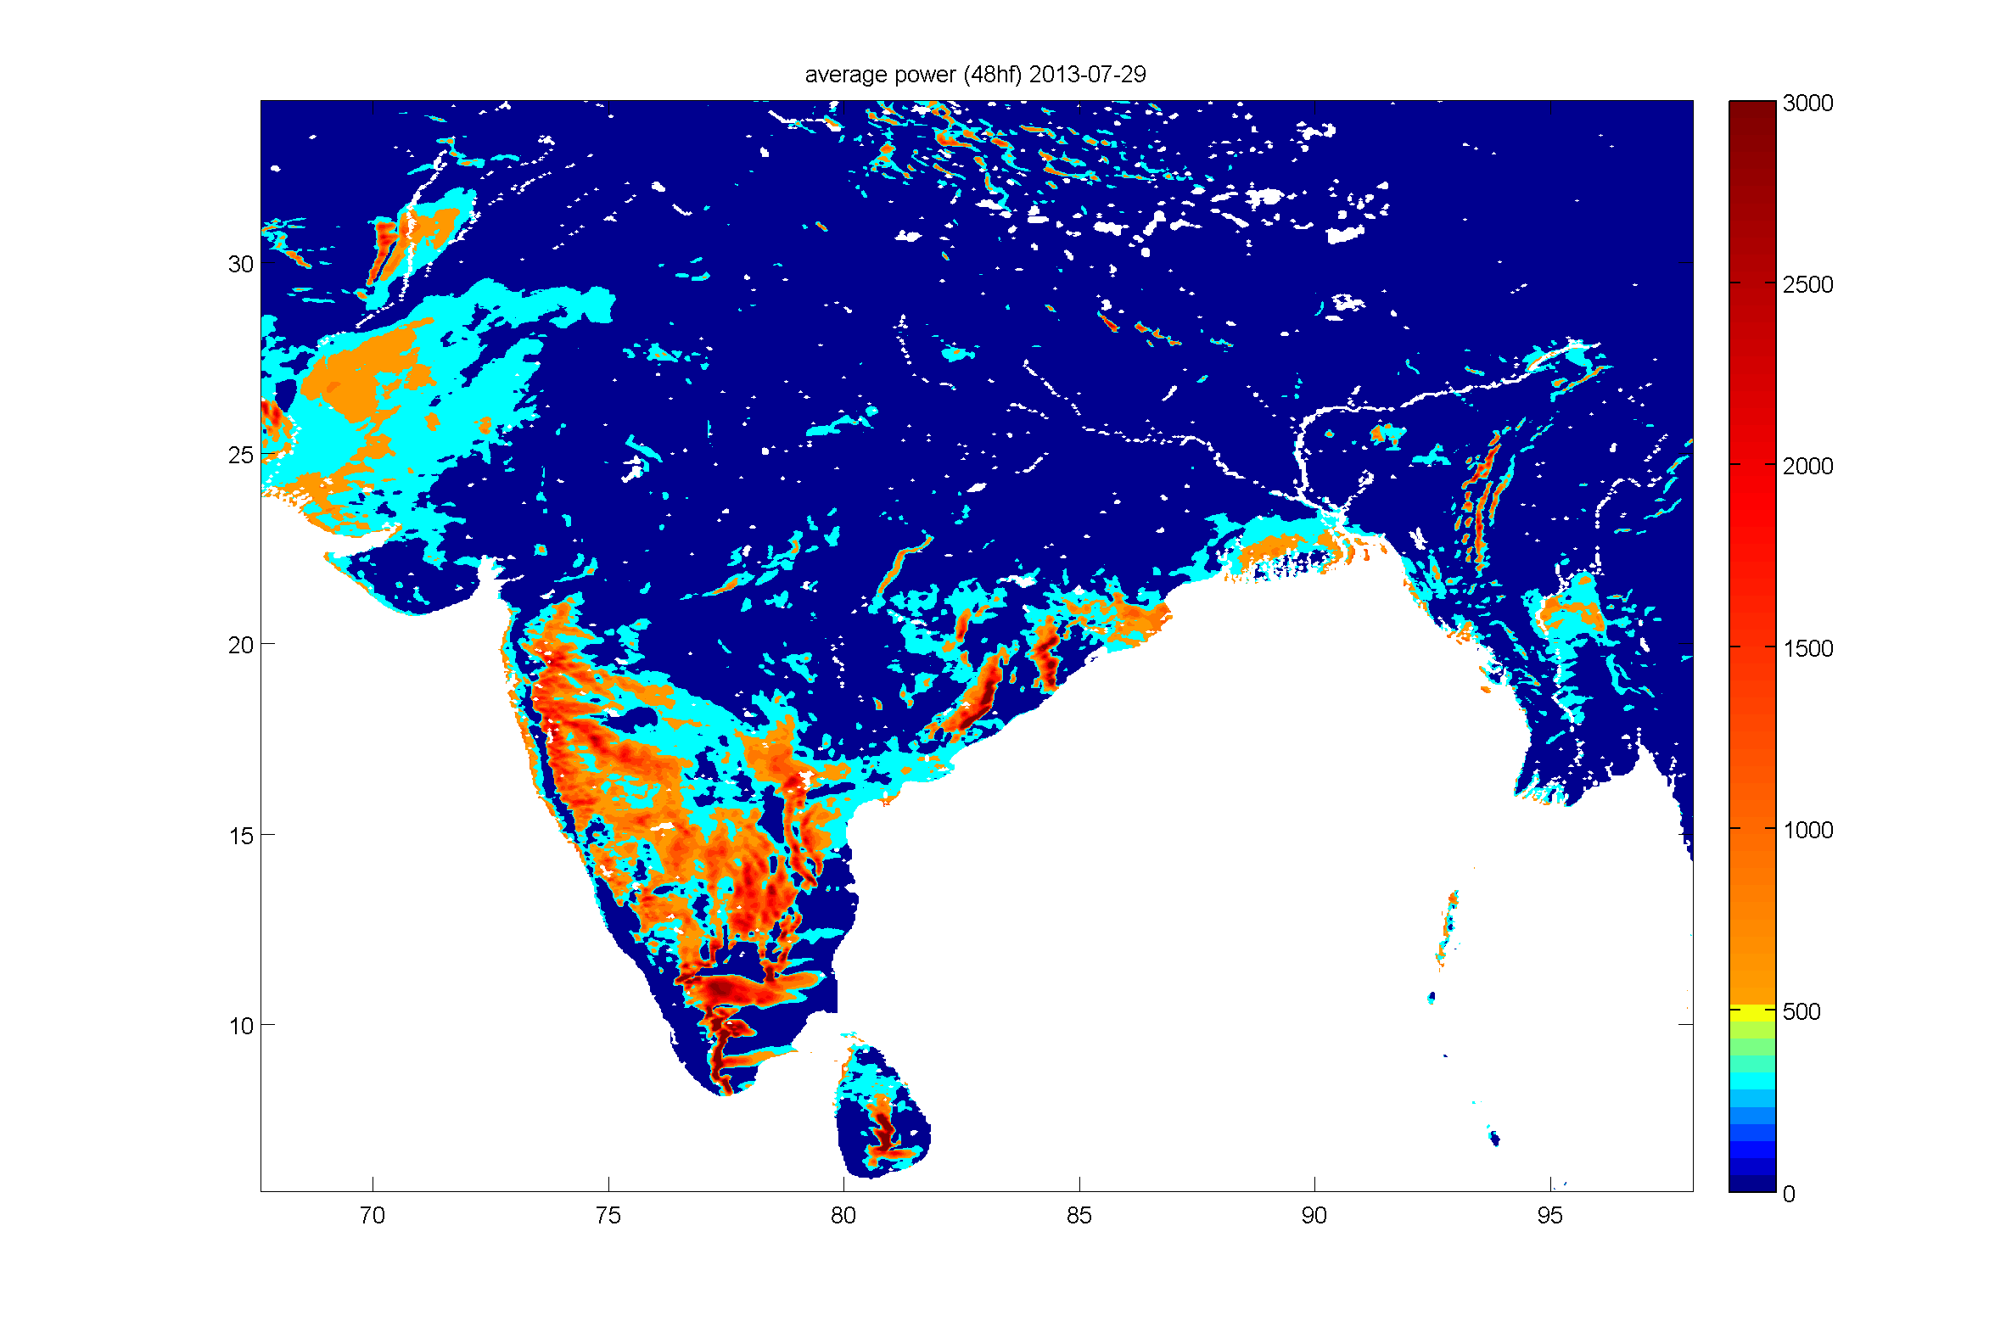
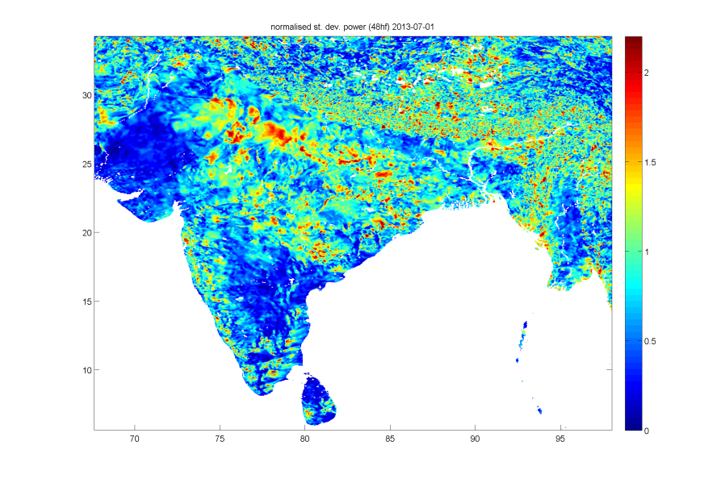
Wind power forecast (T+48h)
2013-07-01
2013-07-29
Power forecast (t+48h)
normalised σ of
power forecast

Slide 24
Wind power forecast (T+48h)
2013-07-01
In the five key wind states:
Tamil Nadu, Gujarat, Maharashtra, Karnataka, Rajasthan.
Ensemble spread > 30% in
in 86% (2013-07-01)
72% (2013-07-29)
of the total area
2013-07-29
Notes:
Pink contours are for normalised standard deviation of 30%

Slide 25
Wind power forecast hourly time series: 2013-07-01
Notes:
Time series of 80m wind power forecast for selected sample grids (shown as X on map)

Slide 26
Wind power forecast time series: 2013-07-29

Slide 27
Summary
Spatial variability
A portfolio of wind farms across all key wind states can offset risk of producing no wind energy.
However, when there is no wind in all the key wind producing states, the only other windy area is the Himalaya
Temporal variability
Wind speed exhibits 50 day intra-seasonal variability (like precipitation and zonal wind)
This signal is not clear during winter
Hourly ensemble spread just from backscatter parameterisation alone may exceed 30% regulator requirement
Is the stochastic approach fit for purpose here ?
Notes:
Next step is to develop a simple parameterisation tool to allow us to infer hourly spread in ensemble wind forecast from a daily forecast to allow wind farm operators to better understand their risks when committing to providing a certain amount of power for the following day

Slide 28
Future work
2015
Tool for risk assessment of low wind energy events across India for planning by government and investors. A novel spatial-temporal stochastic model of wind.
2016
Tool to estimate high time resolution (15-60 minutes) ensemble spread for energy traders. A novel high frequency stochastic model.
Notes:
Next step is to develop a simple parameterisation tool to allow us to infer hourly spread in ensemble wind forecast from a daily forecast to allow wind farm operators to better understand their risks when committing to providing a certain amount of power for the following day

