Slide 1
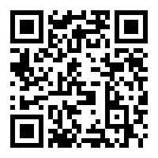
How to Use of QR code for utilization of I.I.T.M. Library Services
Library Information and Publication Division
QR Code (Quick Response Code) Service
Requirements:
Any Smart Phone with Internet Access
QR Code Reader App.

Slide 2
Step 1: Download QR Code Reader Through Application Store

Slide 3
Step 2: Open QR Reader Scan QR Code

Slide 4
Click on: Go to website
Step 3:

Slide 5
Following Screen will be Displayed for New Arrivals: Click on Month

Slide 6
New Arrivals will be Displayed

Slide 7
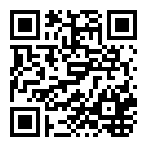
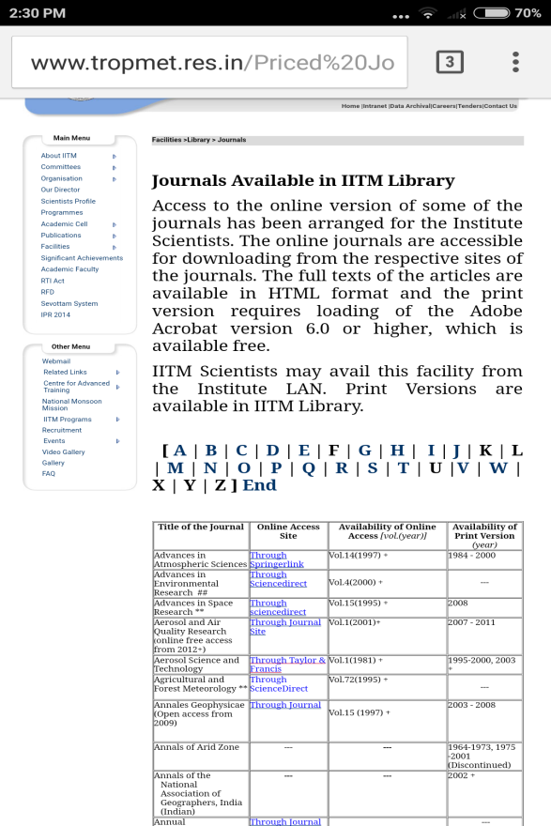
Accessing Priced Journals using QR Code
Steps :
Scan QR Code
Click on : Go to website
Following Screen will be displayed

Slide 8
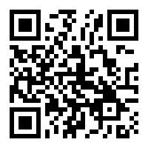
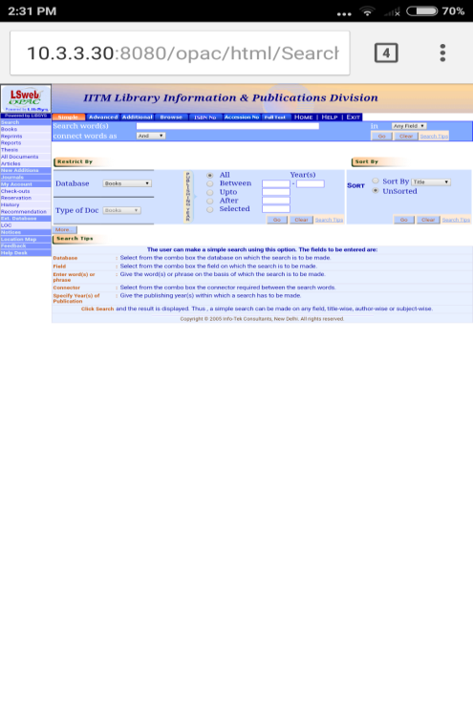
Accessing Web OPAC using QR Code
Steps :
Scan QR Code
Click on: Go to website
Following Screen will be displayed
Search the Publications

Slide 9
For any Query Please Contact :
Mrs. Rohini Ovhal Mr. Girish Moghe LIP Division Phone: +91-20-2590-4439 Email: lip@tropmet.res.in

