Slide 1
Progress of research for the monsoon mission proposal from T N. Krishnamurti
Title: Sensitivity Studies for Indian summer Monsoon Forecast Modeling
Progress of research thus far:
Our project carries three research areas. i) Errors arising from different areas of GFS/CFS
model's physics and dynamics. ii) Studies of the march of the monsoon onset isochrones
across India (from Kerala to New Delhi) during June. iii). Modeling recent extreme rain
events over India. Much progress in area (iii) during the first two years. Here we carry out
a) Physical initialization of near radar resolution rains within a cloud resolving model.
b) Physical initialization carries over its high now-casting skills for initial rains to the
one and two day forecasts. Site specific day one forecasts of heavy rains were possible
for 6 out of seven cases that were examined. c) A next part of this study examines
buoyancy streams within atmospheric moist rivers in these episodes of heavy rains.

Slide 2
We suggest a hypothesis that moist rivers with strong boundary layer moisture transports along
the moist river convey an army of buoyant elements that eventually reach regions of
orographic ascent where the buoyancy is stretched along the vertical and heavy flooding rains
are seen. This appears to be one important possibility for extreme rains. This has been
tested in several of the cases examined.
d) Our post processing algorithm for the cloud resolving model forecasts includes a
detailed buoyancy budget. Here we keep track of terms that generate buoyancy and those
that destroy buoyancy. These show that both internal( in cloud processes) and also of the
cloud environment carry generation terms during extreme events , a strong convergence of
flux of buoyancy confines the buoyant streams within the moist river making it very important
for extreme rain events. Dr. Soma Sen Roy of IMD (currently Pune) is visiting us in the
month of March for three month duration. She is expected to carry out a transfer of this
entire software for testing and operations at IMD New Delhi.

Slide 3
The work is continuing on the topic of the march of the isochrones. Dr. Vinay Kumar of FSU and
Dr. Ashis Kumar Mitra of NCMRWF are working on factors that show large sensitivity for the
meridional march of the isochrones. This work extends previous work of the PI and will be
completed by the end of year three of this project.
The tagging of errors that arise within GFS, from different areas of model physics and dynamics
is continuing under the leadership of Dr. Rajagopal of NCMRWF.
This is a joint project that includes FSU, NCMRWF and IISc (Dr. Arindam Chakraborty). This work
carries statistical elements from 100ds of model runs that have been completed. Next step is the
design of a stochastic GFS model, based on the above statistics.
Planned activities for the remaining period to meet the remaining objectives
During the second and third year of monsoon mission, we are planning to employ this updated
version of our model to produce forecasts using our multipliers for different monsoon years. The reduction of systematic errors of model and resulting improvement in the forecast skill will be also studied in full detail.

Slide 4
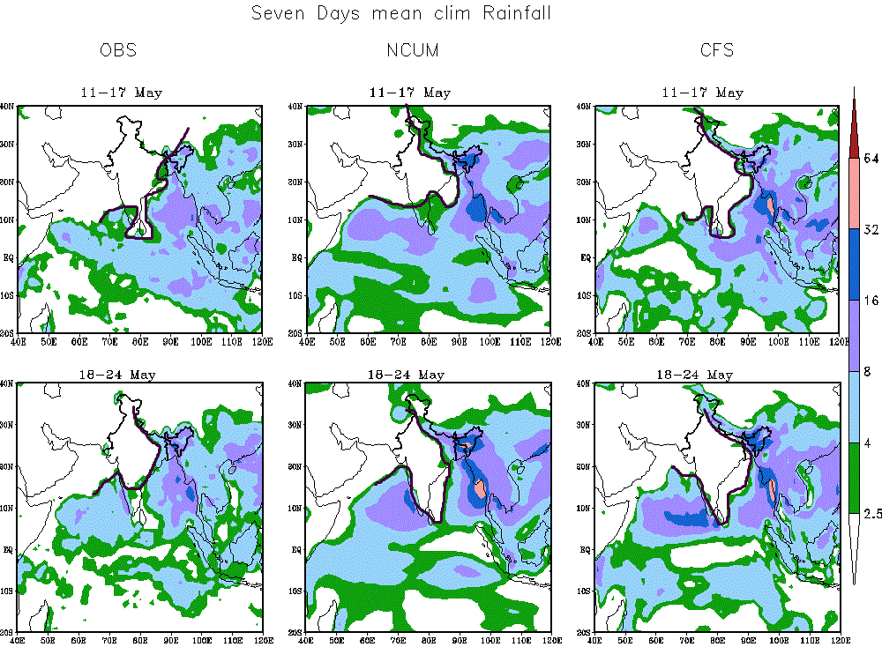
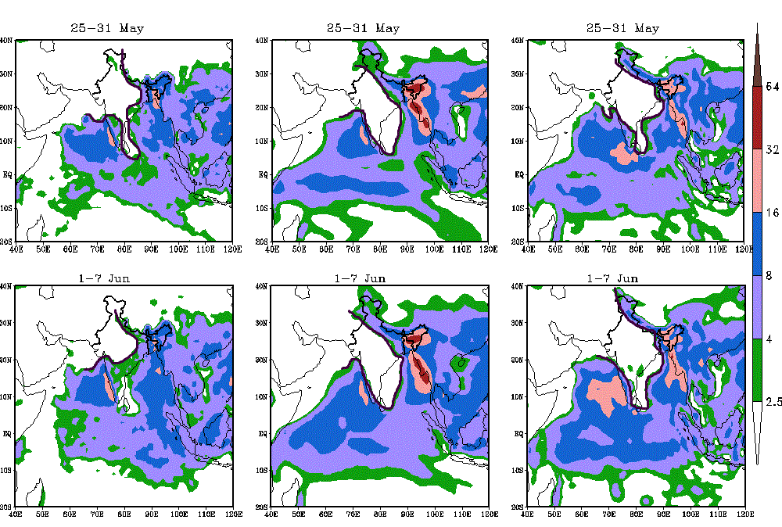
OBS
UKMO-GS4
CFSV2
7-days mean climatological rainfall (mm/day)
Calendar day
based climatology of isochrone motion
11-17 May
18-24 May
25-31 May
1-7 June
Movement of Isochrones of Rainfall In Coupled Model During Onset/Progress of Monsoon
Each year simulation starts at 9th May

Slide 5
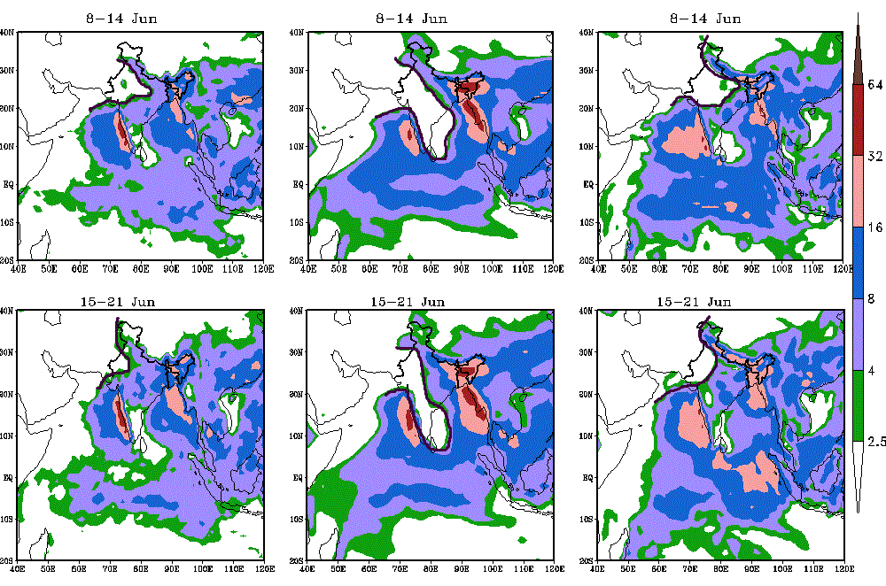
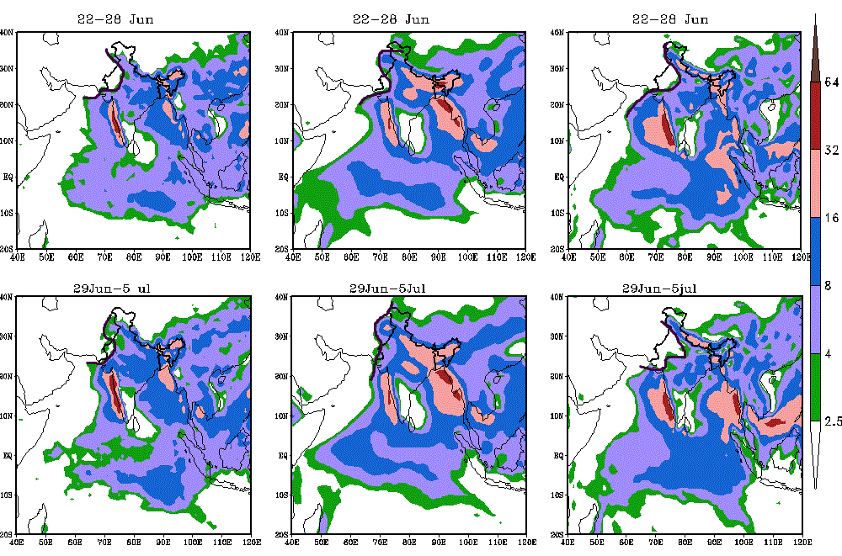
OBS
UKMO-GS4
CFSV2
7-days mean climatological rainfall (mm/day)
Calendar day
based climatology of isochrone motion
8-14 June
15-21 June
22-28 June
29 June-5 July
Movement of Isochrones of Rainfall In Coupled Model During Onset/Progress of Monsoon

Slide 6
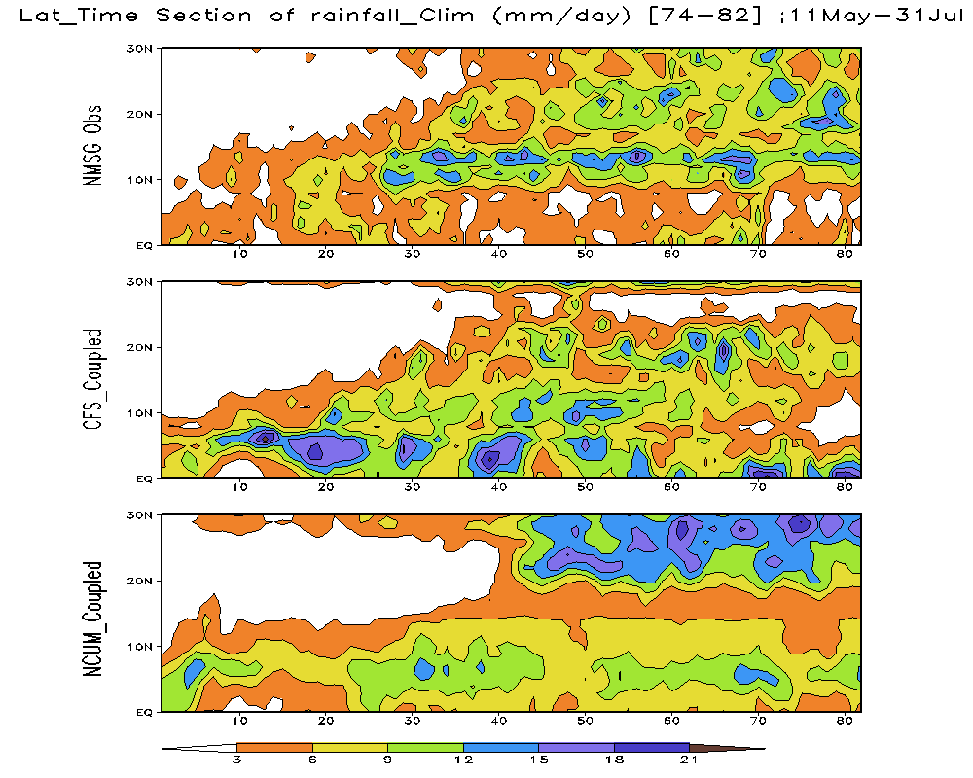
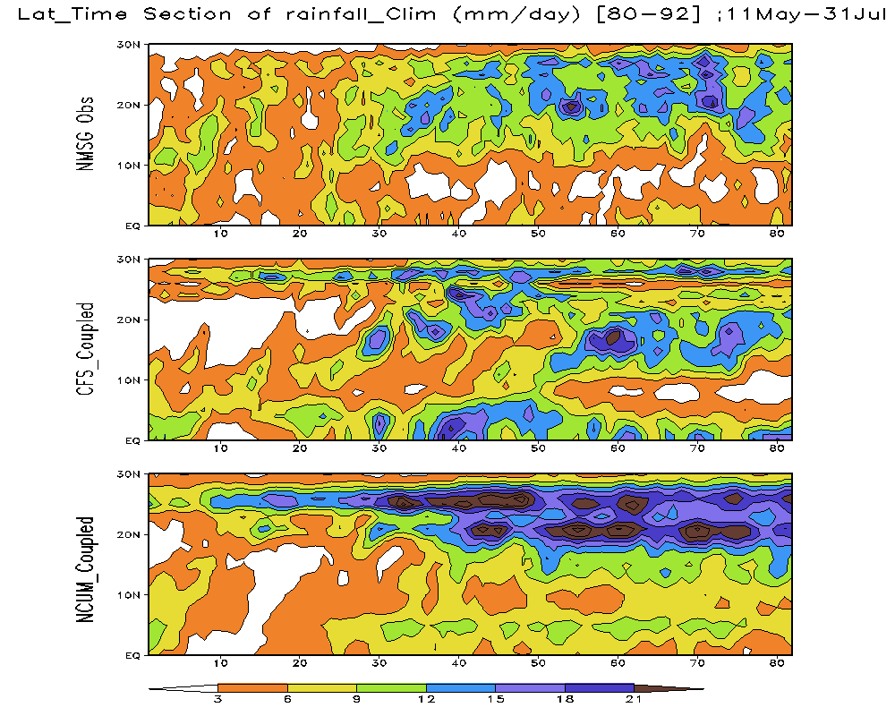
Latitude-Time section (Zonally averaged) of
Climatological Rainfall (mm/day): 11May-31July
Central Indian Region Bay of Bengal Region
OBS
OBS
CFSV2
CFSV2
UKMO-GS4
UKMO-GS4

Slide 7

March of Buoyancy Elements during Extreme Monsoon Rainfall T.N. KRISHNAMURTI Collaborators Drs Vinay Kumar, A. Simon, A. Thomas, A Bharadwaj & S. Das FLORIDA STATE UNIVERSITY, USA

Slide 8
GOALS OF THE STUDY
This presentation includes high resolution rain rate initialization, for cloud resolving models. This study addresses population and amplitudes of buoyancy elements for extreme rain cases of the Indian summer monsoon and their buoyancy budgets. The finding here relates to moist rivers with large convergence of flux of moisture that generates a rich stream of buoyancy which are impacted by the local orography resulting in very heavy rains.

Slide 9
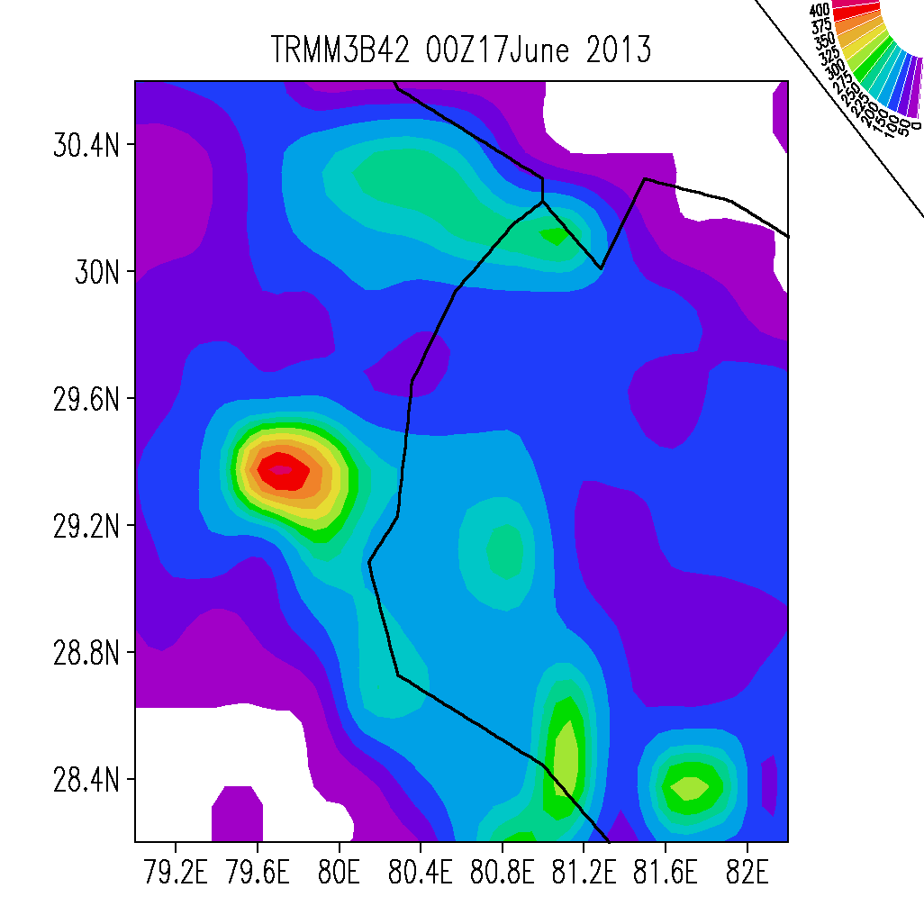
mm/day

Slide 10
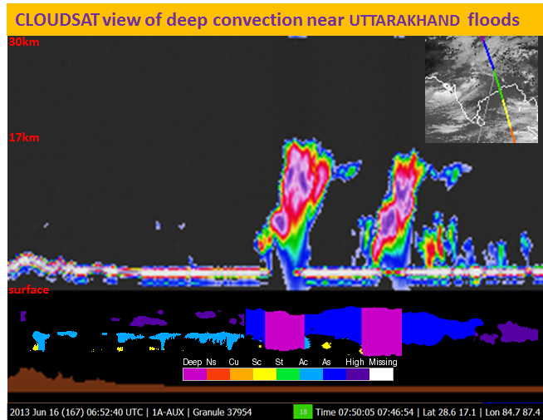

Slide 11
What is Physical Initialization?
Physical initialization for the regional mesoscale model WRF/ARW follows the same principles as in our global model Krishnamurti et al (1991, 1994). This carries four components:
A reverse cumulus parameterization algorithm
A reverse similarity algorithm
A matching of model and satellite based OLR.
All contained within a Newtonian Relaxation.
The reverse cumulus parameterization algorithm follows the method proposed by Treadon (1996).
References:
1. KRISHNAMURTI, T. N., XUE, J., BEDI, H. S., INGLES, K. and OOSTERHOF, D. (1991), Physical initialization for numerical weather prediction over the tropics. Tellus A, 43: 53–81.
2. Krishnamurti, T. N., H. S. Bedi, G. D. Rohaly, D. K. Oosterhof, R. C. Torres, E. Williford, and N. Surgi, 1994: Physical Initialization. ECMWF Workshop, Modelling, validation and assimilation of clouds, 31 October- 4 November 1994, ECMWF, Shinfield Park, Reading, U.K.
3. Treadon, R. E., 1996: Physical initialization in the NMC global data assimilation system. Meteor. Atmos. Phys., 60, 57–86.

Slide 12
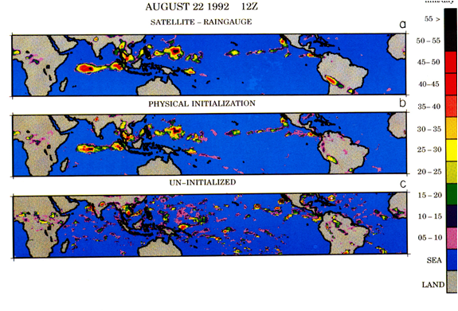
How Global Physical Initialization Performs
Nowcasting
Correlation
0.93
High Skill
0.31
Low Skill
Figure: (a) Observed (based on SSM/I OLR and rain gauge) 24-hr rainfall estimate (mm., day-1) between 1200 UTC 21st August and 1200 UTC 22nd August 1992, compared with (b)Physically initialized precipitation (using FSU GSM at T255 resolution) and (c)Control run (un-initialized run).
IN GLOBAL PHYSICAL INITIALIZATION WE USE TRMM RAIN ESTIMATES AND GFS GLOBAL ANALYSIS.

Slide 13
Physical Initialization for Cloud Resolving Models
Matching model rain rates at any horizontal grid point to satellite-based estimates of rain rates (interpolated to that time step) calls for a change of the model's vertical profile of moisture by a factor of (1+ε), where ε is defined by the relation:
Model total column rain rate:
where is the vertical velocity, q is the specific humidity and is the surface pressure.
is not changed in order to avoid excitation of gravity waves and mass motion imbalances. Moisture is more of a passive variable and its vertical profile is changed during physical initialization.
Note that the relation is a measure of the rate of condensation, if super saturation is not permitted.
This is approximated above by (and also note that the saturation value).
The model rain rate is being forced towards the satellite-based value with the modification of the moisture by the parameter 1+ε. However, that does not guarantee that the model will accept that value since all other model variables must come into equilibrium with that change of moisture and the rain rate. This necessitates the other steps of physical initialization.
EXPLICIT CLOUDS AND NO CUMULUS PARAMETRIZATION

Slide 14
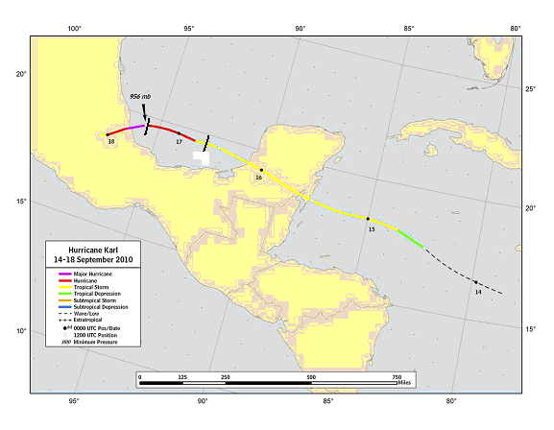
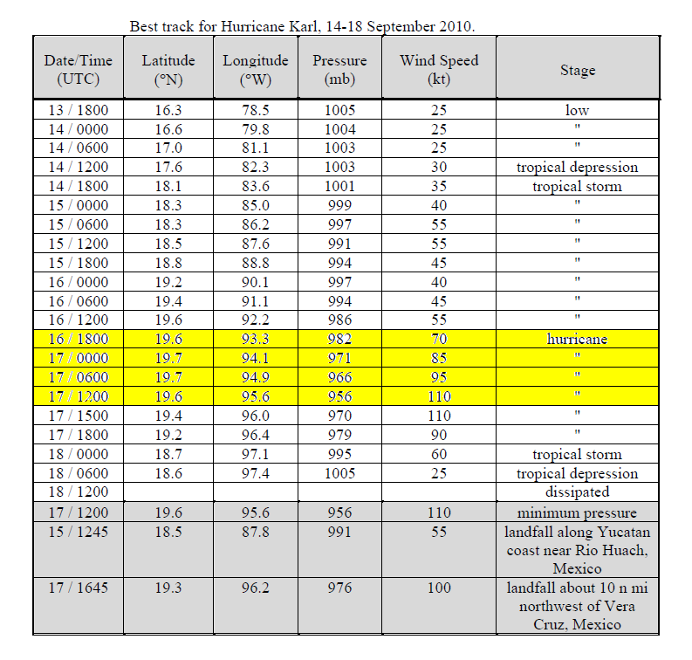
Track and Intensity of Hurricane KARL 14th-18th Sep 2010d
The observed track of HURRICANE KARL during September 14 to 18 2010 is shown here.
The red portion of the track, as the hurricane makes a landfall over Mexico is of interest here. Physical initialization at radar resolution was carried out starting on august 16th at 12 UTC and continued for a 24 hour period, thereafter a free forecast was continued.

Slide 15
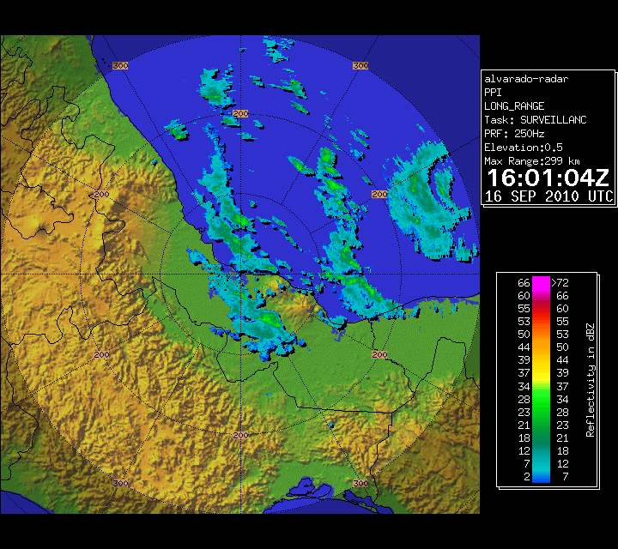
Alvarado radar loop as received from Mexico. This is the radar reflectivity animation covering the period September 16 , 2010 16Z to September 17, 2010 17Z. This is Hurricane KARL that made landfall in Mexico.

Slide 16
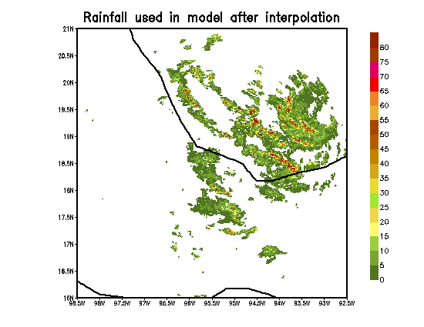
Alvarado radar data converted to rainfall (mm/hour) at model resolution of 1.33 km. Animation of rainfall during the landfall of Hurricane KARL.
RAINFALL USED IN MODEL AFTER INTERPOLATION AT 1.33^{O} LAT/LON GRID

Slide 17
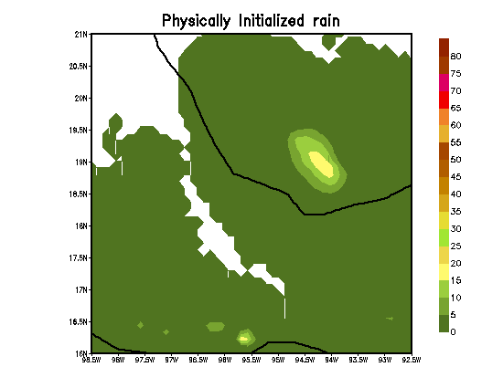
ANIMATION OF PHYSICALLY INITIALIZED RAIN
The animation shows the spin up of rains for Hurricane KARL during physical initialization. Frames were interpolated from the radar reflectivity movie provided by the Mexican weather service. Those radar reflectivities were carefully interpolated to a 1.33 km grid and frames were taken for every 5 minutes in time to convert the radar reflectivity to rain rates using a z = r relationship that was carefully calibrated and validated against rain gauges over Mexico. This animation shows that the WRF/ARW model catches up to the radar rains very closely by around 16 hours after the start of the physical initialization.

Slide 18
Spin-up of correlations between physically initialized rain and rain based on the Alvarado radar, during 22 hours
This illustration shows the spin up of model rain towards the radar based rainfall estimates. The ordinate shows the correlation among these two rainfall (this is within a 100km square centered at the storms center). The correlation starts out with a value of 0.1 and spins up to a value close to 0.8 by around 16 hours (abscissa) of physical initialization.

Slide 19
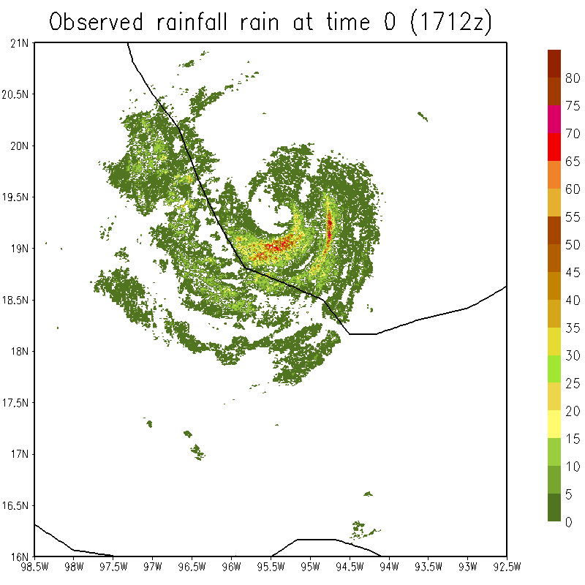
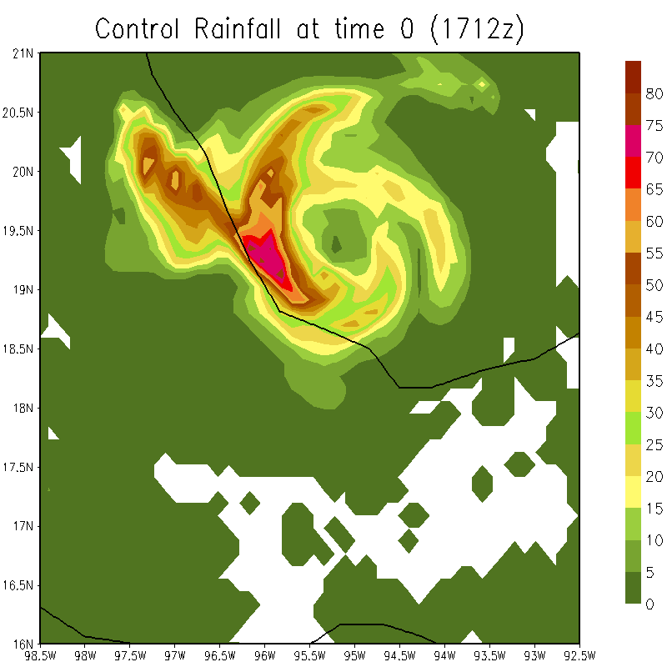
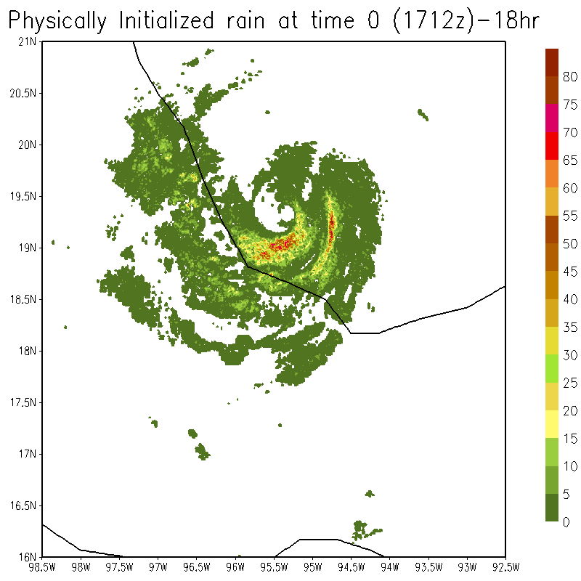
RMSE =10.4mm/hour
Corr. = 0.32
FIELDS AT THE END OF PHYISCAL INTIALIZATION t=0
OBSERVED RAIN BASED ON ALVARADO RADAR
CONTROL
ETS SCORE
RMSE =5.24mm/hour
Corr. = 0.74
PHYSICALLY INITIALIZED RAIN
Heavy rains

Slide 20
Observed
Physical Initialized Exp.
Control Exp.
Location
20.89N, 95.05W
Location
19.4N, 95.5W
Forecast
Forecast
THESE SHOW COMPARISONS OF THE TIME HISTORY OF OBSERVED, PHYSICALLY INITIALIZED AND FORECAST RAINS (mm/hour) AT SPECIFIC LOCATIONS
Location
18.79N, 95.8W
Extreme rainfall of the order of 60mm/hour predicted from radar resolution physical initialization
Forecast

Slide 21
Physical Initialization for Uttarakhand rains

Slide 22
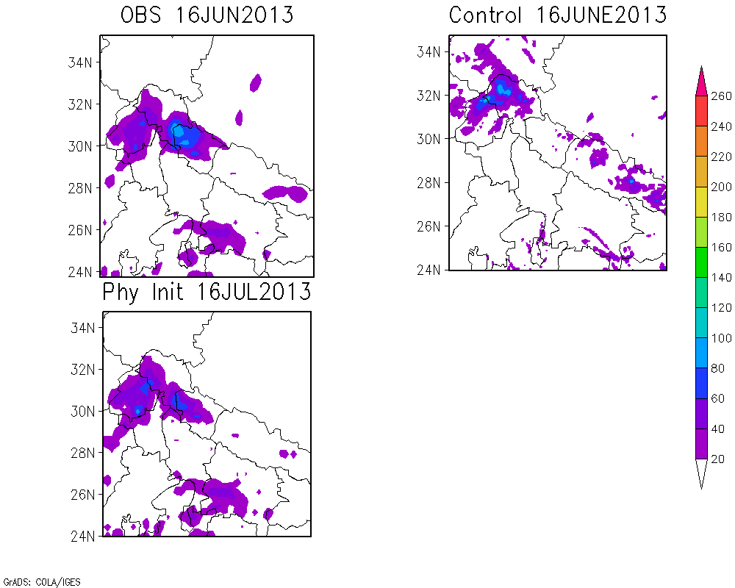
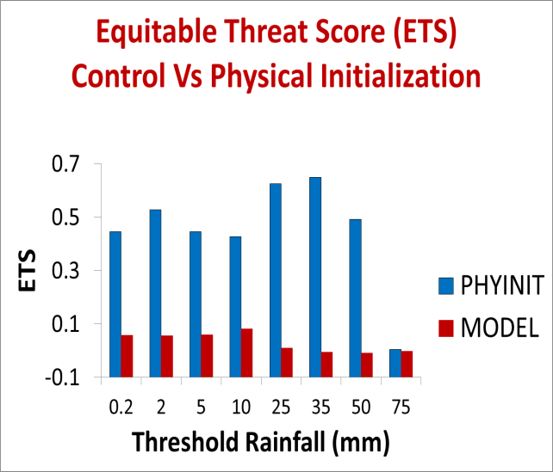
CC = 0.06
RMSE =17.82
mm/day
CC = 0.77
RMSE =9.24
Day 0

Slide 23
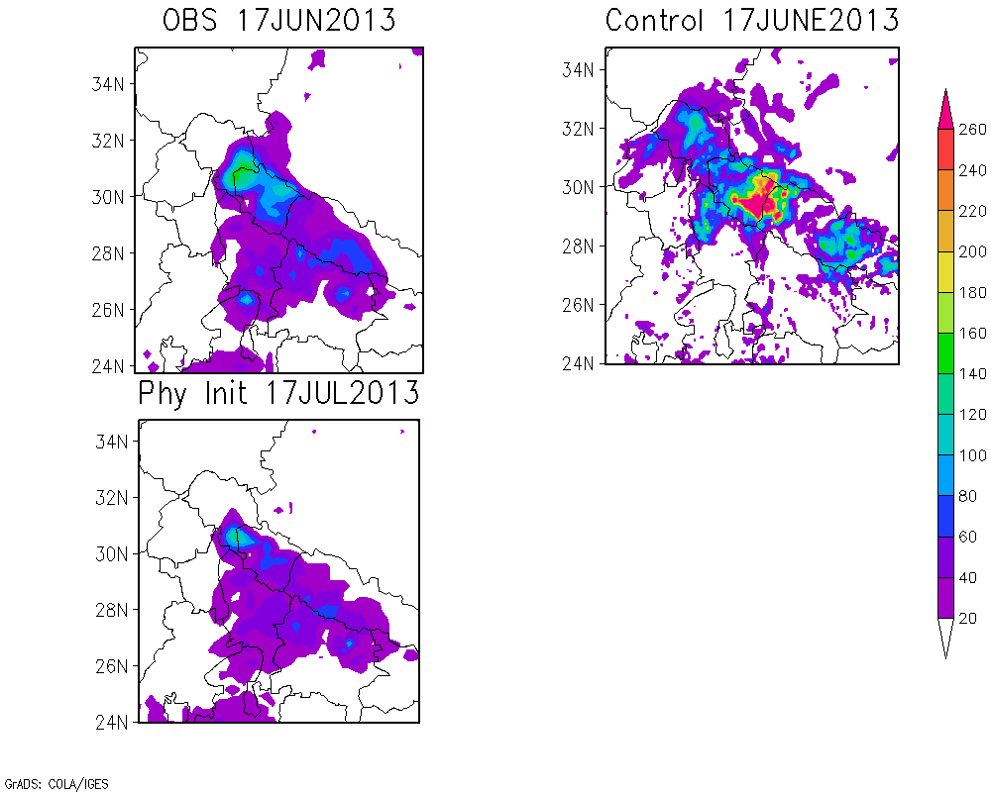
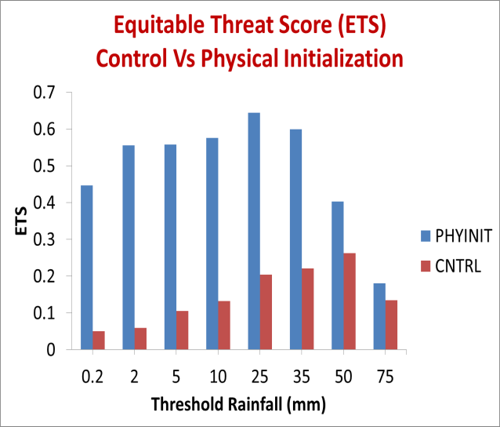
mm/day
CC = 0.25
RMSE = 40.66
Day 1
CC = 0.79
RMSE = 10.13

Slide 24
Buoyancy is defined by the relation
where g is the acceleration of gravity,
virtual temperature of the cloud environment ,
virtual temperature inside a cloud ,
liquid water mixing ratio in the cloud (usually > 0.1 g/kg)
Virtual Temperature

Slide 25
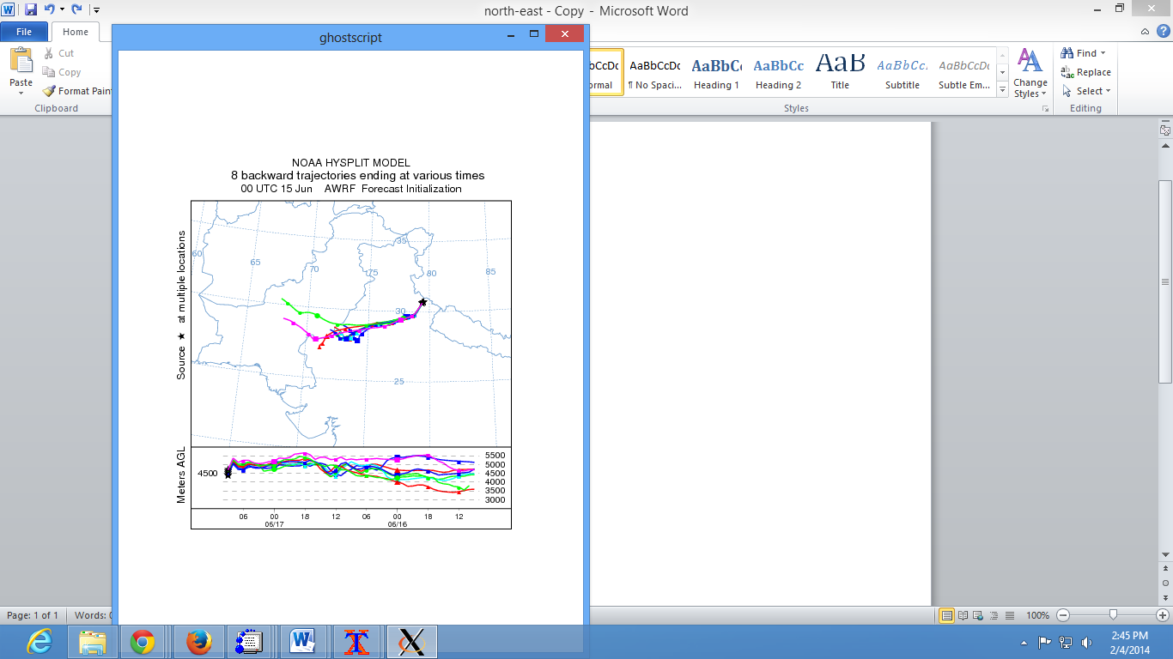
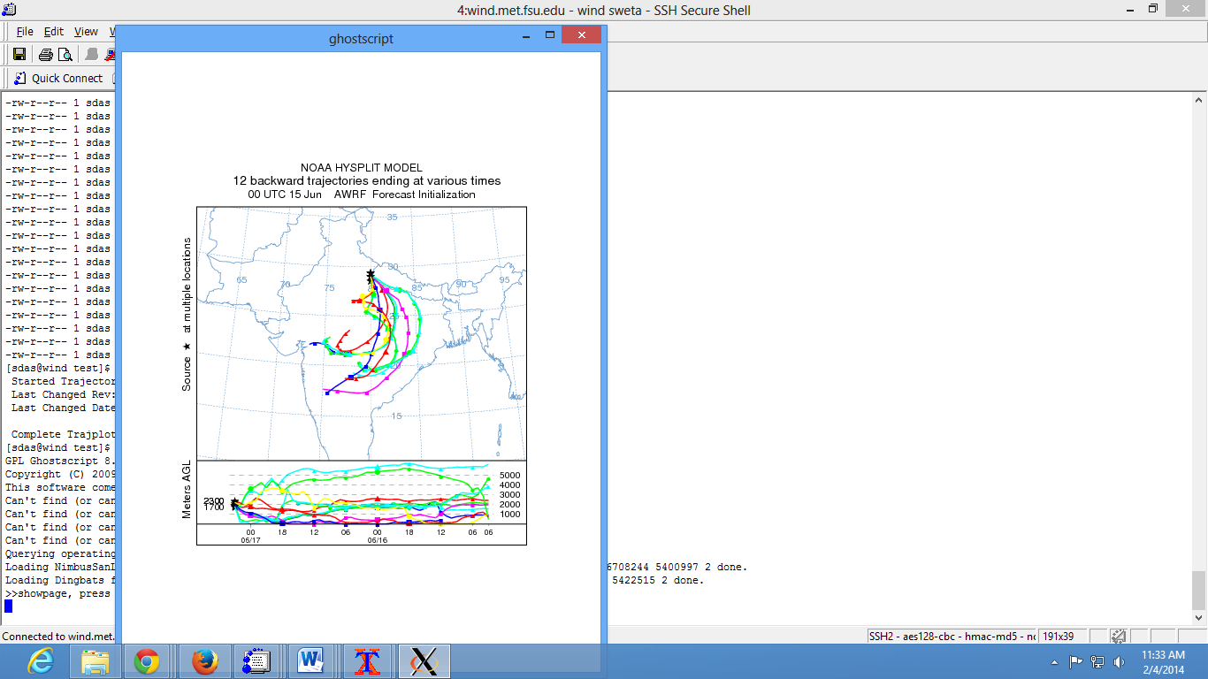
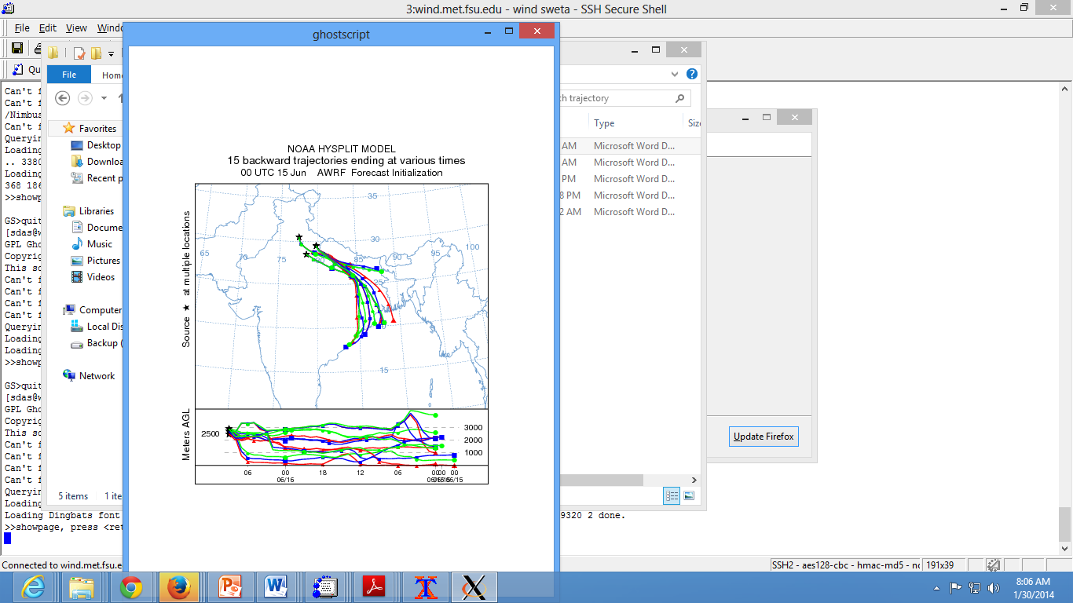

Slide 26
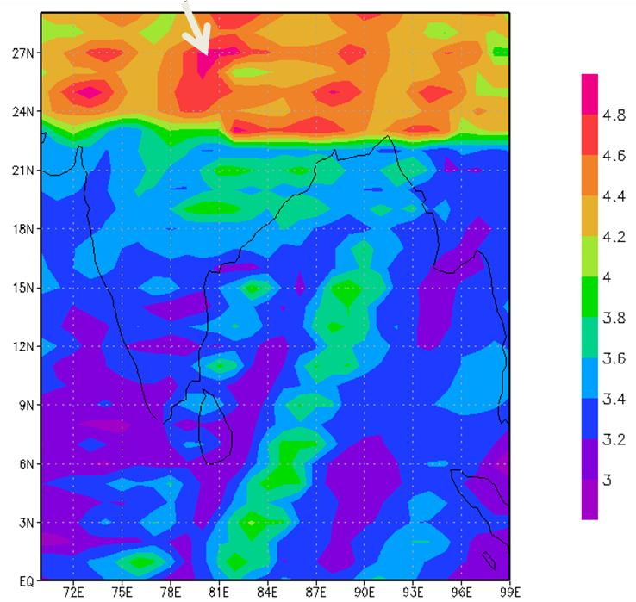
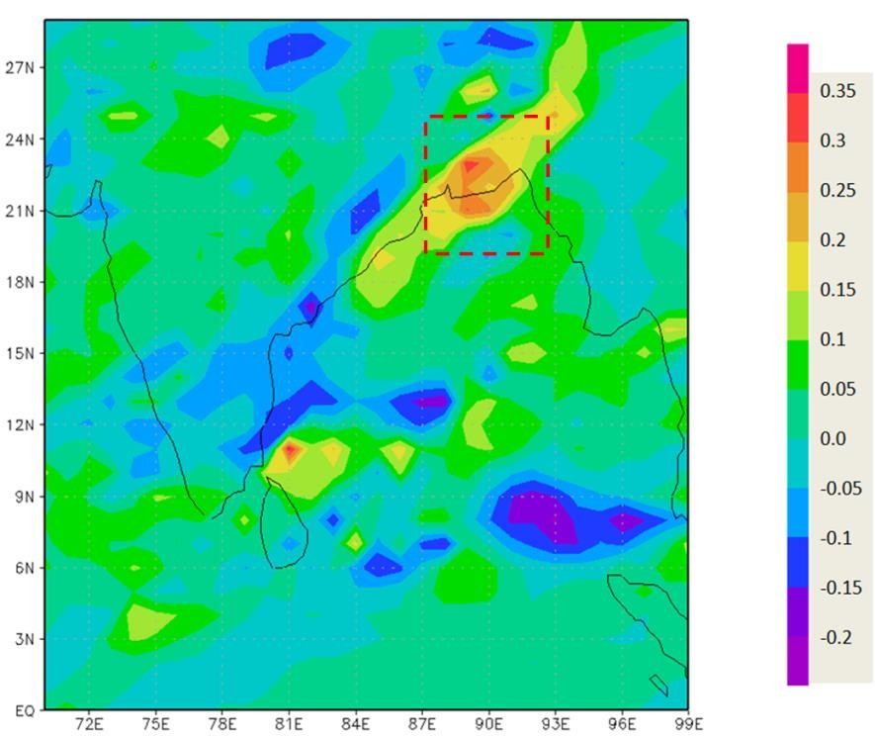
ADAPTIVE OBSERVATIONS
Region of large standard deviations for hour 48 of forecasts. (b) The back correlations.
Results are drawn from adaptive observation strategy computations.

Slide 27
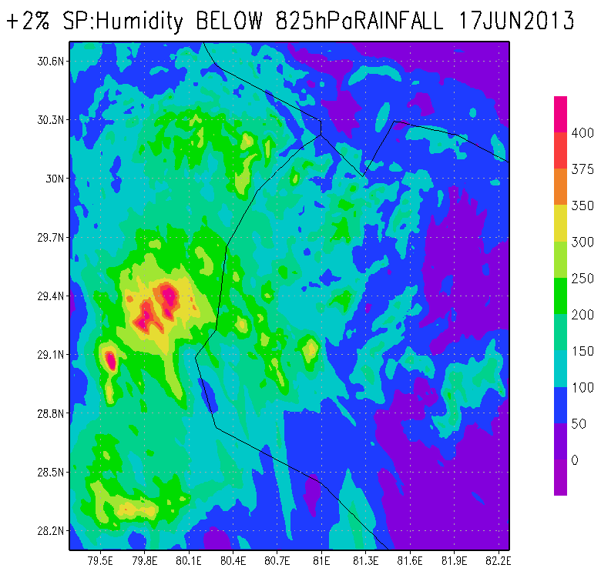
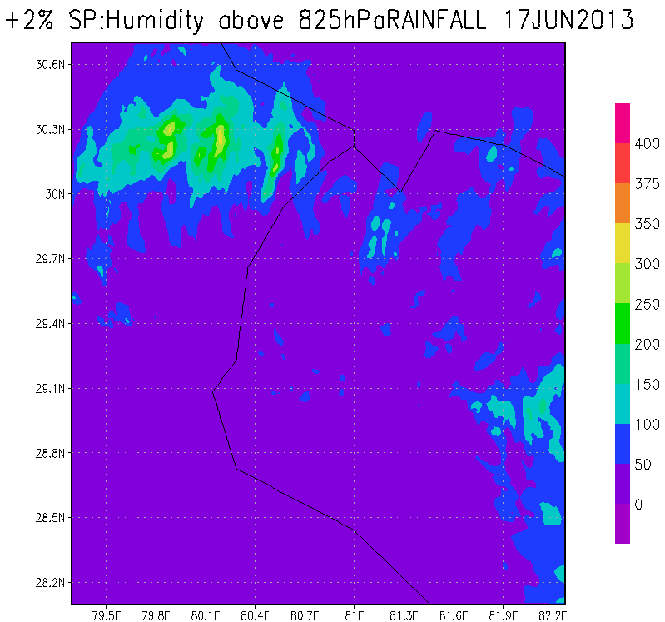
RAINFALL
Plus 2 Percent in PBL
Minus 2 Percent in PBL

Slide 28
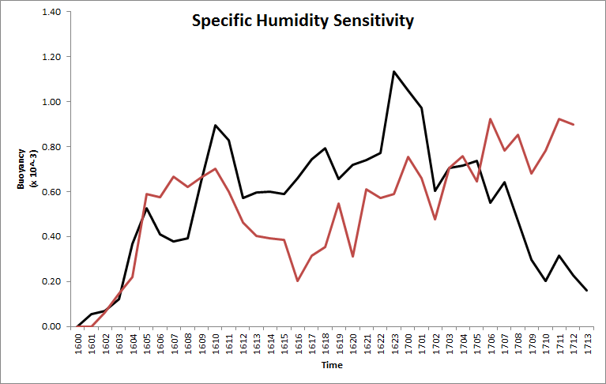
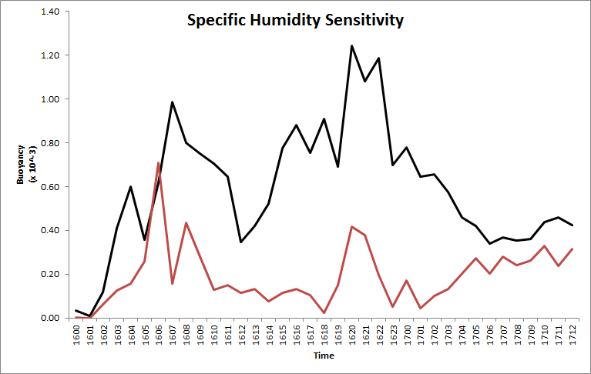
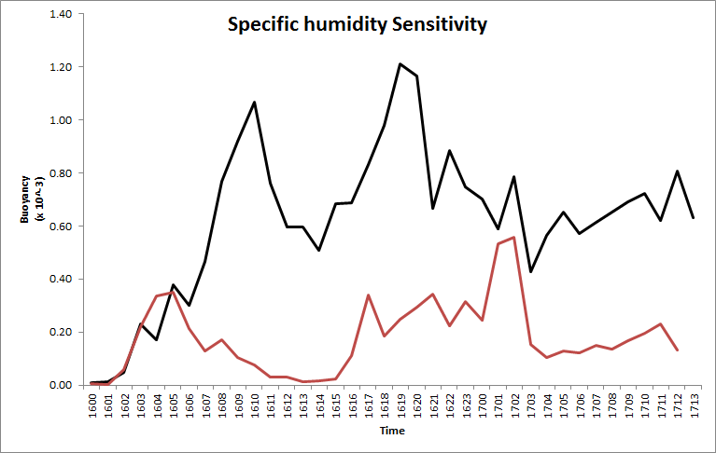
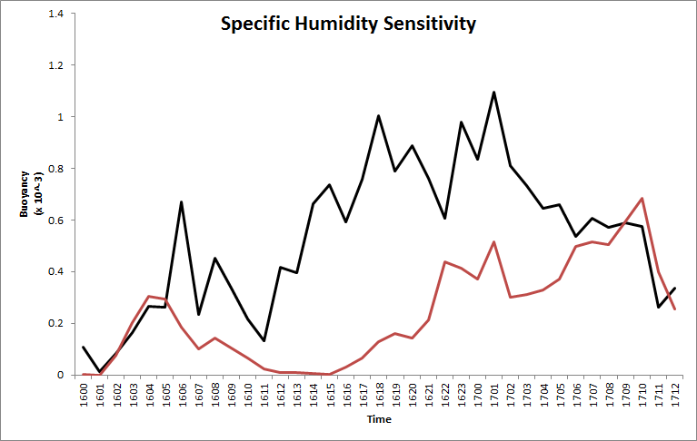
(1%)
(2%)
Area occupied
by Buoyancy
Population of Buoyancy
Black solid line – Moisture enhanced by 1%,2%, 3% and 4% below 825hPa
Red solid line – Moisture enhanced by 1%,2%, 3% and 4% % above 825hPa
(3%)
(4%)

Slide 29
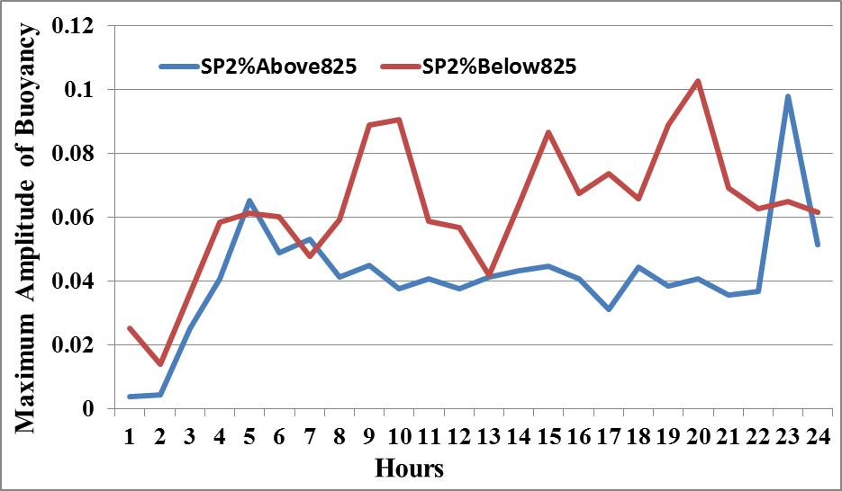
Maximum Amplitude of Buoyancy (m sec⁻²)
(00Z16-00Z17 June 2013)

Slide 30
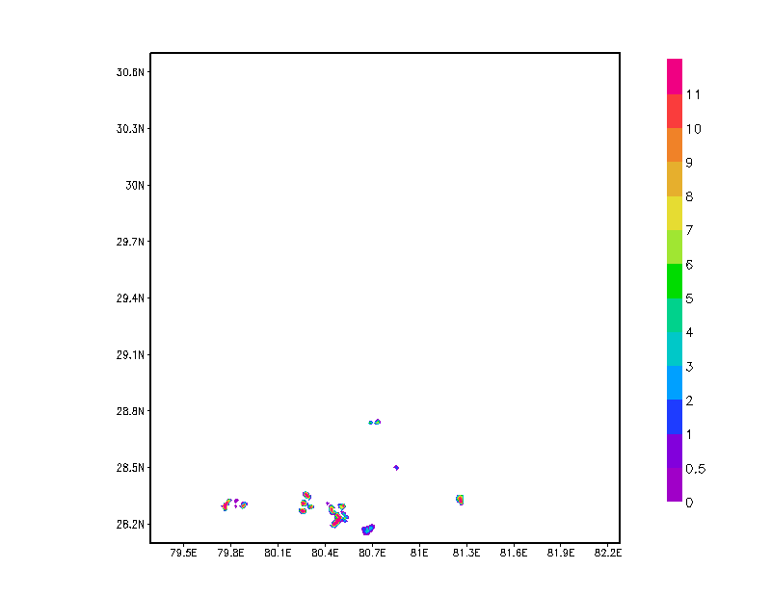
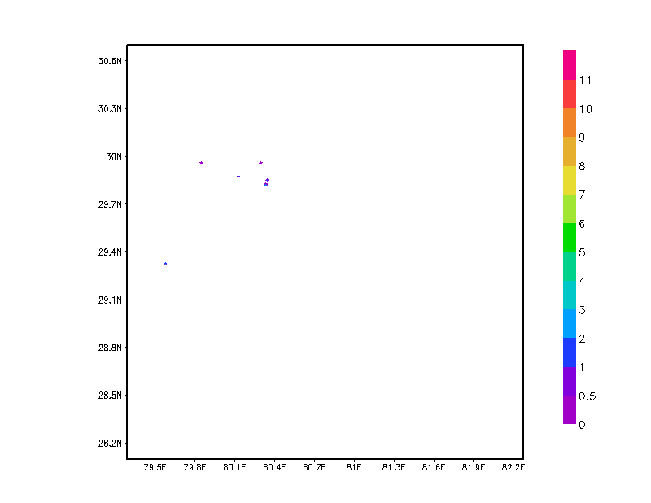
Buoyancy
Experiment: SP2%below825
Buoyancy
Experiment: SP2%above825
Buoyancy (*10⁻³) Unit: m sec⁻²

Slide 31
RATE OF CHANGE OF BUOYANCY
Term on the right hand side denote:
1. Horizontal Convergence of Flux of Buoyancy
2. Vertical Convergence of Flux of Buoyancy
3. Local change of virtual temperature of cloud
4. Horizontal Advection of virtual temperature
5. Vertical Advection of virtual temperature
6. Change of virtual temperature of parcel of air in the environment
7. Change in Buoyancy from accumulation or depletion of parcels liquid water mixing ratio

Slide 32
Noting that
is obtained from the WRF’s use of the first law which is
The thermal equation can be written as:
$\frac{∂θ}{∂t} = −\overset{⃑}{V} . ∇θ −w\frac{∂θ}{∂z} − \frac{1}{ρ}\frac{∂}{∂z}\overline{ρw′θ′} +D_{θ}+\frac{L_{v}}{C_{P}}\left(c−e_{c}−e_{r}\right)+\frac{L_{f}}{C_{p}}\left(f−m\right) +\frac{L_{s}}{C_{p}}\left(d−s\right)+Q_{R}$
The moisture equation is expressed by :
$\frac{∂q_{v}}{∂t} = −\overset{⃑}{V} . ∇q_{v} –\overline{W } \frac{∂\overline{q}}{∂z} −\frac{1}{ρ} \frac{∂}{∂z}ρ\overline{w^{′q_{v}′}} +\overline{Dq_{v}} –\left(c−e_{c}−e_{r}\right) –\left(d−s\right)$

Slide 33
Enhancing moisture by 2% below 825mb over the target area
Enhancing moisture by 2% above 825mb over the target area
The leading terms of the local buoyancy production at 750mb include
the horizontal convergence of flux of bouncy
the vertical convergence of flux of buoyancy,
the vertical advection of the cloud virtual temperature and
the change of virtual temperature of the parcels of air in the cloud environment.
These terms were computed for the 2% enhance of the boundary layer moisture (over the control experiment) Below and Above 825mb over the target area of the respective initial states. Units of buoyancy production m/sec³.
(a)
(b)
(c)
(d)

Slide 34
A HURRICANE APPLICATION

Slide 35
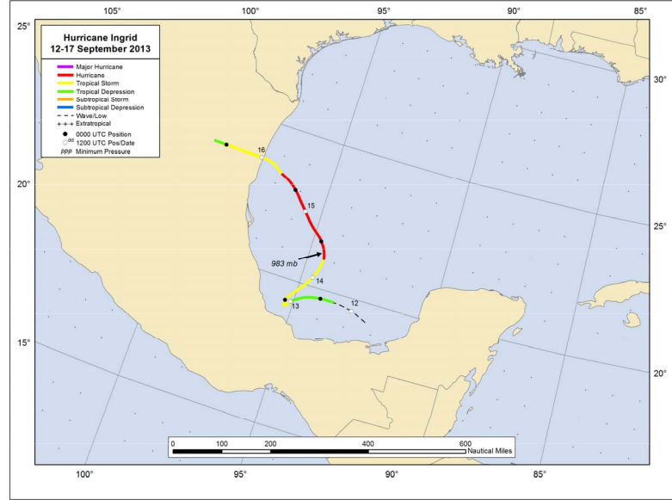
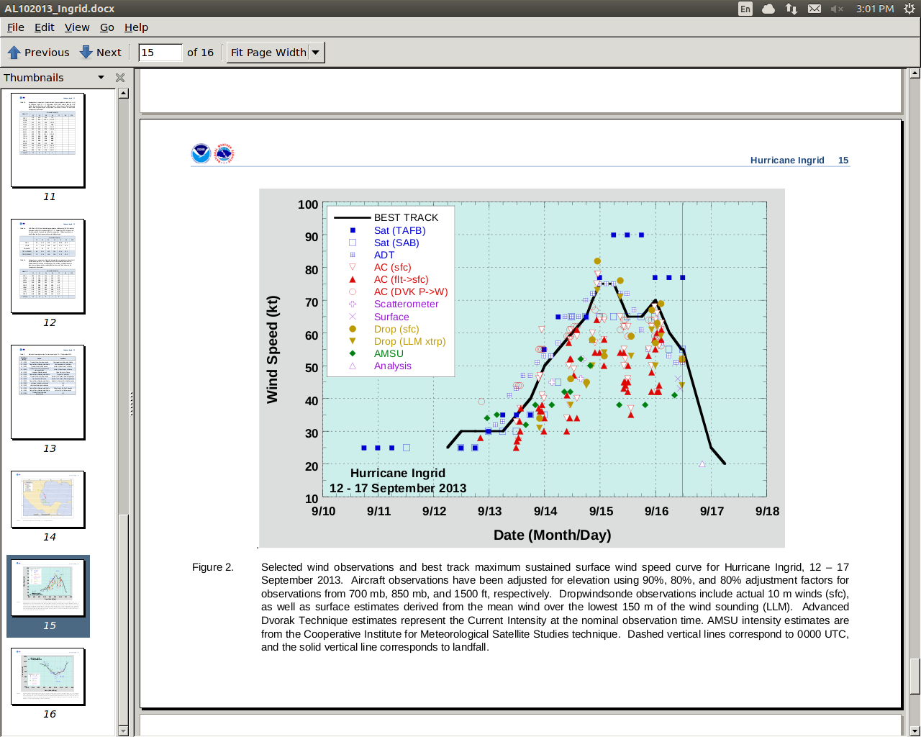
Hurricane Ingrid (2013)
TRACK
WIND SPEED
Image courtesy of the National Hurricane Center

Slide 36
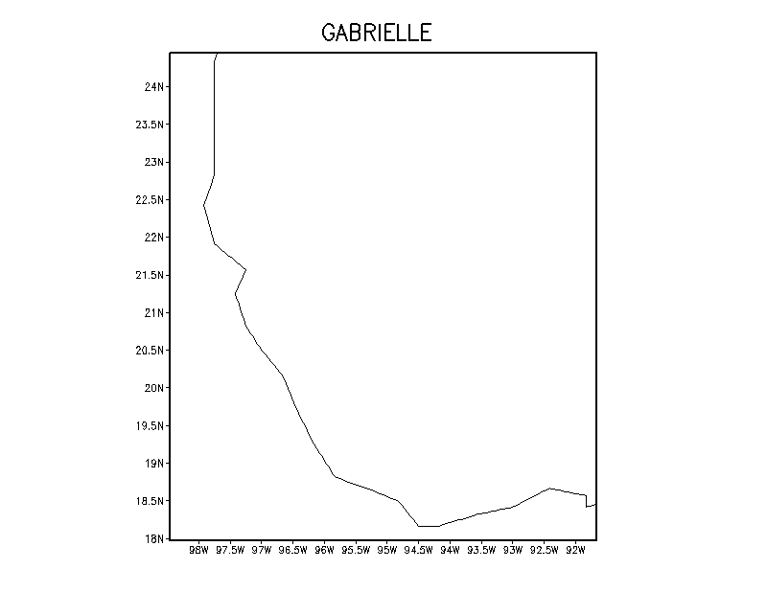
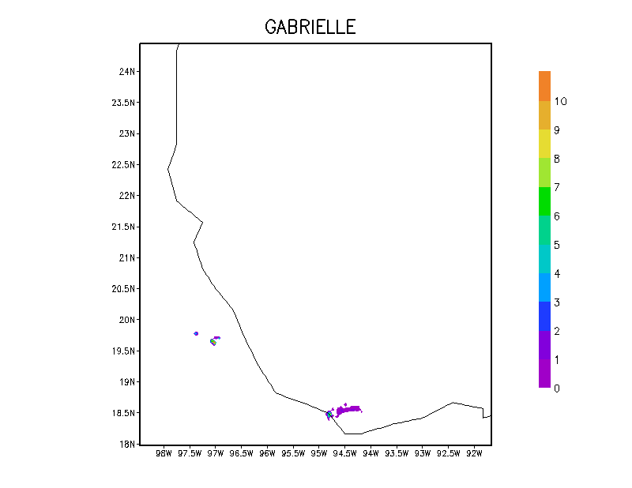
INGRID
Watch this region
Animation: Buoyancy (m sec⁻²)
for Ingrid Hurricane
15:00Z to 17:00Z Sept 2013
(Integrated, 950-500hPa)
INGRID
Watch this region
Ingrid Control
Click once in the middle of picture to show animation
Ingrid Physical Init

Slide 37
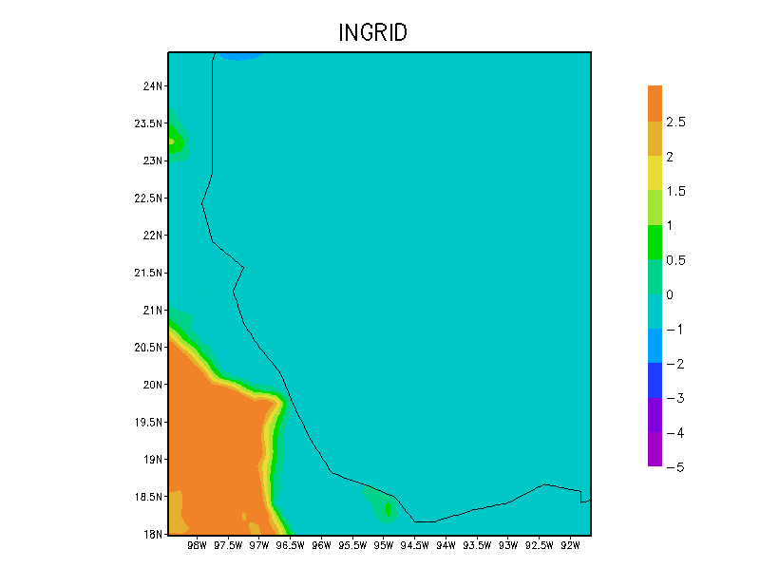
Delta Q of Ingrid = Specific Humidity of Phy. init. - Specific Humidity of Control
Watch this region
Color scale g/kgm, moisture integrated between surface and 700 hPa

Slide 38
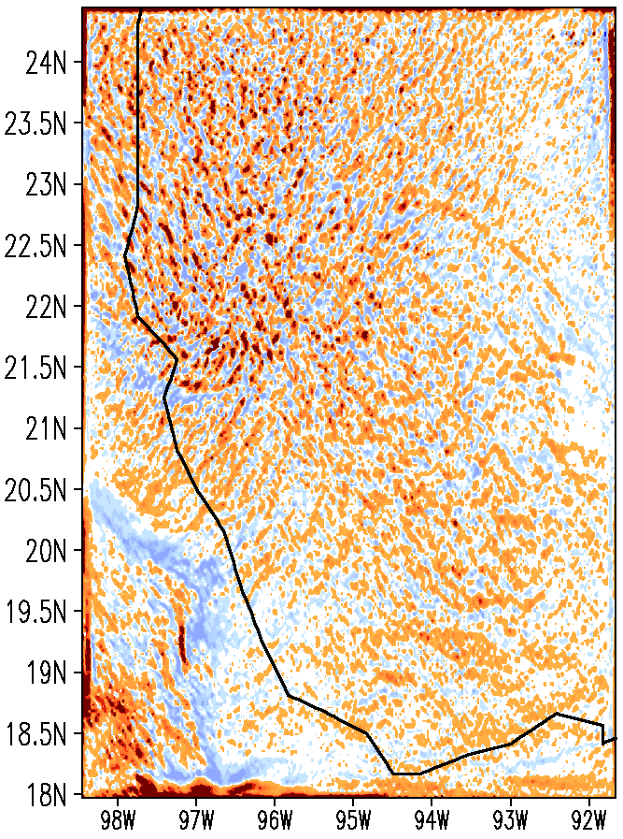
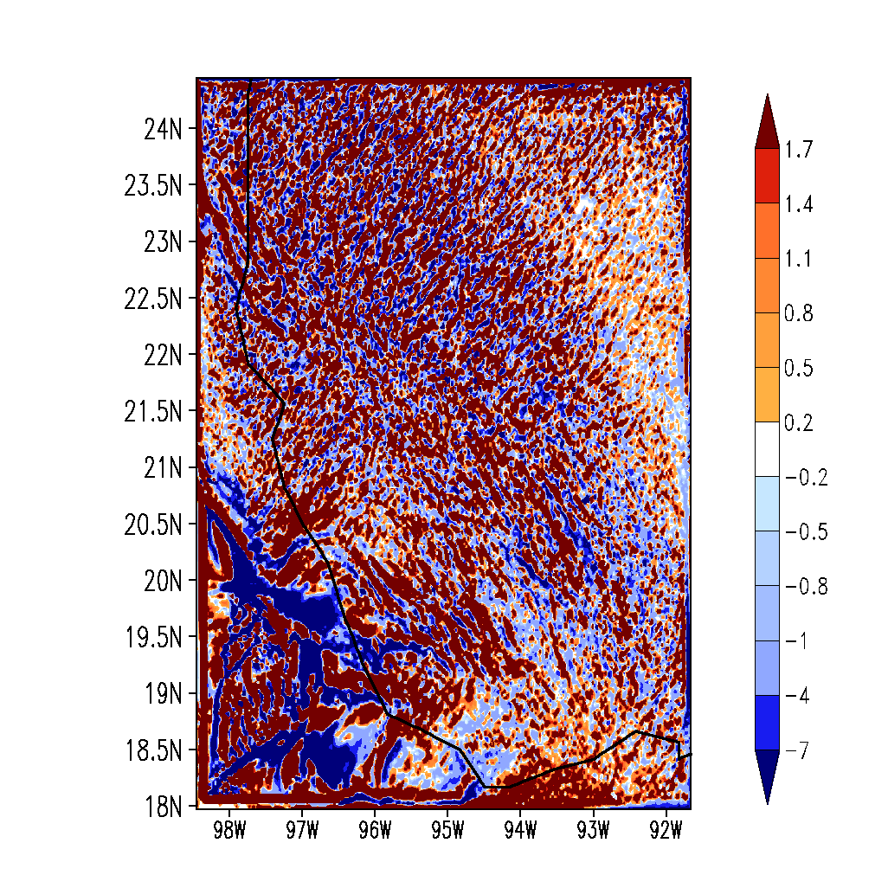
HORIZONTAL CONVERGENCE OF FLUX OF BUOYANCY (*1E5)
averaged for 15:00Z to 17:00Z Sept 2013 at 832mb : Unit: m sec⁻³
Experiment
Ingrid _Control
Ingrid_Physical Init

Slide 39
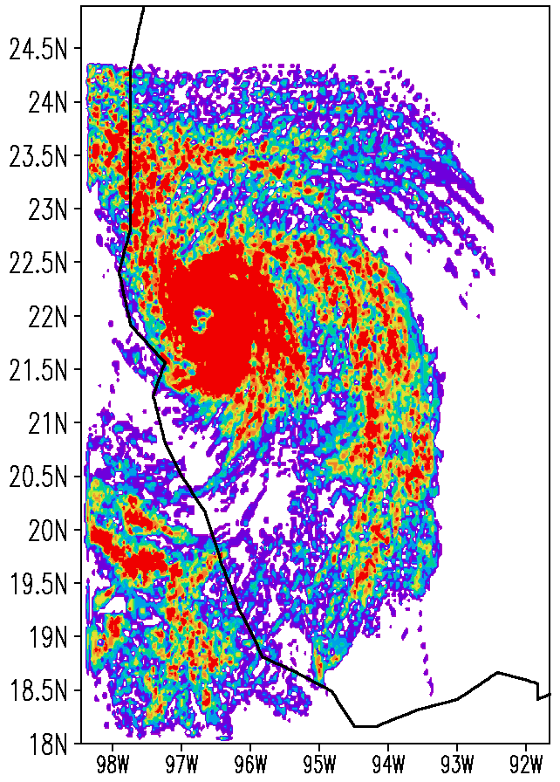
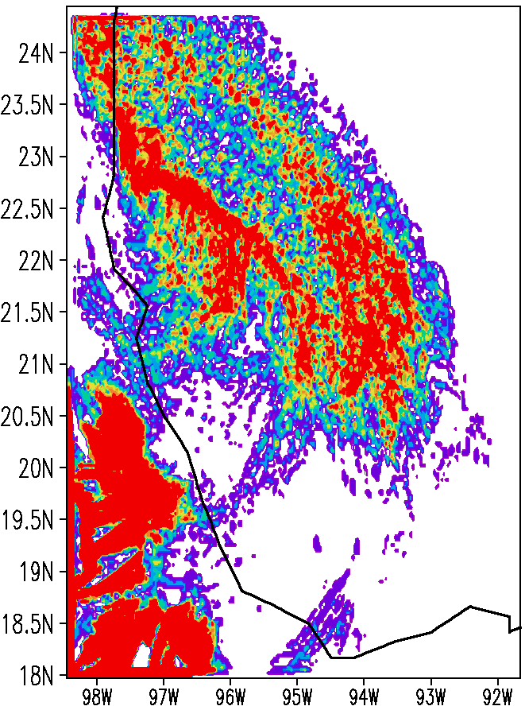
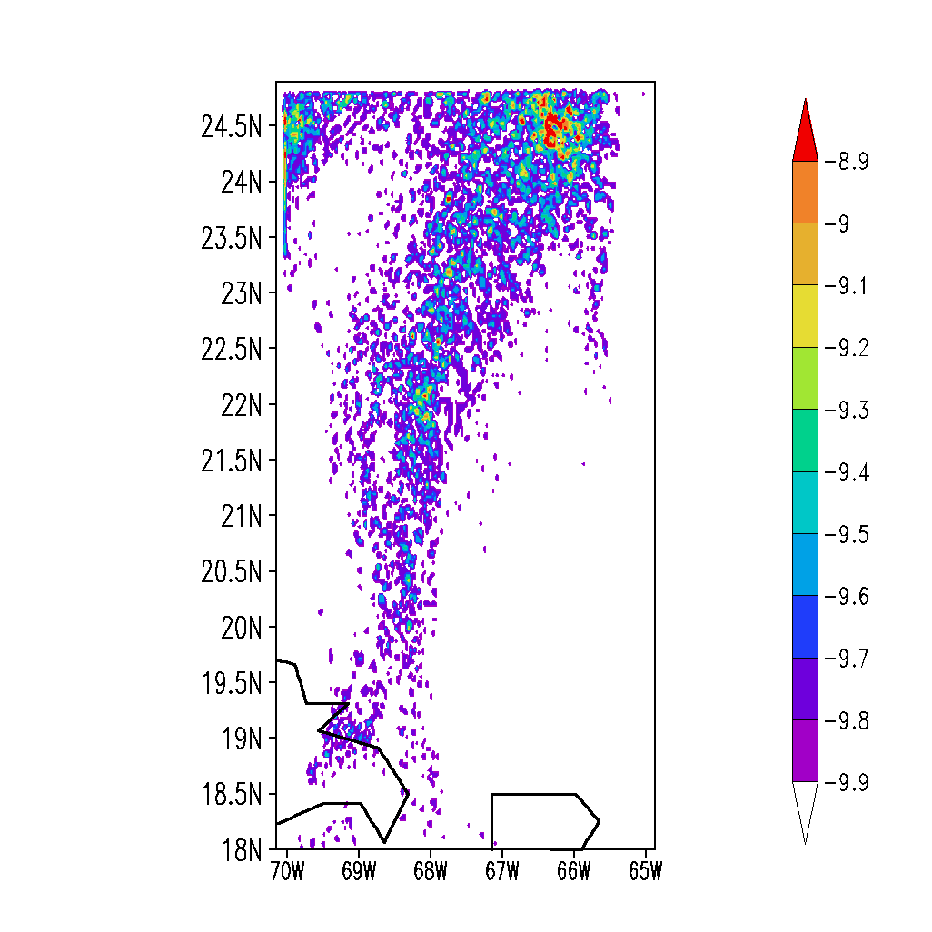
Vertical advection of cloud’s virtual temperature (*1E8)
averaged for 15:00Z to 17:00Z Sept 2013 at 832mb ; Unit: m sec⁻³
Experiment
Ingrid_Control
Ingrid_Physical Init

Slide 41
Some more Extreme Events……………….
NASA Modern Era Retrospective Analysis for Research and Applications [MERRA]
The MERRA uses the
Goddard Earth Observing System Model, version 5 (GEOS-5) atmospheric circulation model
Catchment land surface model
Three-dimensional variational data assimilation (3DVAR) analysis algorithm.
Incremental analysis updates (IAU) procedure- analysis correction is applied to the forecast model states gradually to improve the spin- down problem with precipitation.
MERRA incorporates observations from:
NASA Earth Observing Systems (EOS) satellites, particularly those from EOS/Aqua.
The MERRA is updated in real time, spanning the period from 1979 to the present.
The three-dimensional 3-hourly atmospheric diagnostics on 42 pressure levels are available at a 1.25 resolution is used for the present work..
Rienecker et al. (2011)

Slide 42
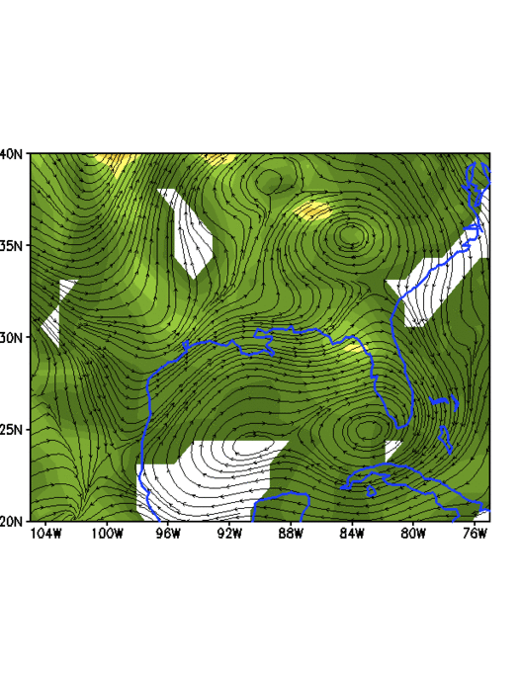
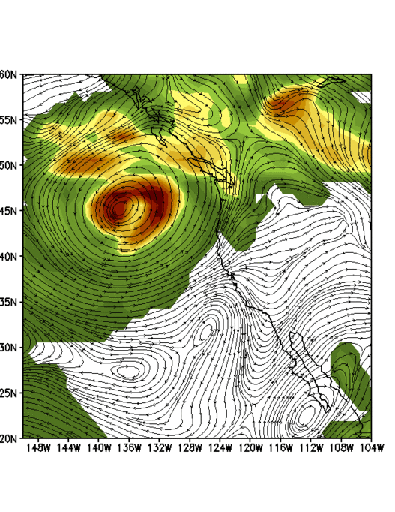
Vertically Integrated Buoyancy and Moist Transport Vectors
CALGARY ALBERTA CANADA, 2013
June 19
EVANSVILLE USA, 2006
Sep 12-13

Slide 43
ONGOING WORK ON MONSOON MISSION:
This work on the buoyancy driven extreme rain event forecasts will be continued by Dr. Deepa Raveendranpillai of FSU and by Dr. Soma Sen Roy of IMD New Delhi. Dr. Sen Roy will be visiting FSU during March to June of 2015, she will we working towards preparations for implementing the codes at IMD.
The research on tagging errors of GFS/CFS arising from different components of model physics is currently being done jointly among FSU, IISC (Bangalore) and NCMRWF (New Delhi) at this AMS meeting Dr. Sarvesh Kumar Dubey of FSU has a poster on this topic.
The research on the march of the monsoon onset isochrones during the first month of the summer monsoon over India is continuing at FSU. Dr Vinay Kumar presented a talk at NCMRWF on this topic in December 2014. Dr Samir Pokhrel of IITM will emphasize our work on the sensitivity of the march of isochrones to various model parameters.

Slide 44
CONCLUSIONS
Importance of moisture measurements for assimilating features such as atmospheric rivers and also land surface soil temperatures.
Rain rate initialization using high resolution modeling for extreme events. Physical initialization seems to consistently show high rain rate initialization skills (for pattern correlations skills are generally greater than 90 percent).
An ensemble of forecasts should be used to identify possibilities for extended duration growth of amplitudes and geographical distributions of Buoyancy and CAPE over a prospective heavy rain areas. This ensemble should explore the impacts of perturbations of the warm land surface regions and of moist rivers (originating from neighboring oceans) on heavy rainfall events.

Slide 45
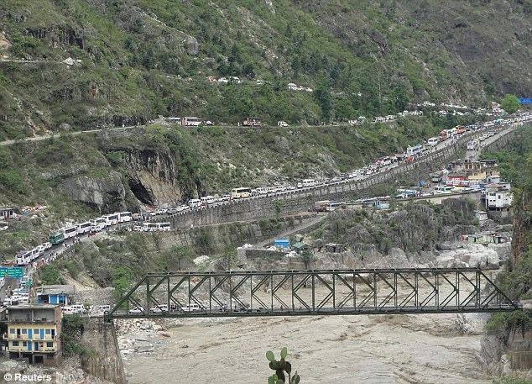
THANKS..

