Slide 1
. Latest techniques utilized improving convective processes in
climate model CFSv2
P. Mukhopadhyay
Dr. Phani Muralikrishna, Abhik Santra, Dr. Bidyut Goswami, Malay Ganai, Dr. Medha Deshpande, Mata Mahakur,
Dr. Marat, Dr. Jimmy Dudhia, Dr. Moorthy, Dr.. Han, Prof. BNG

Slide 2
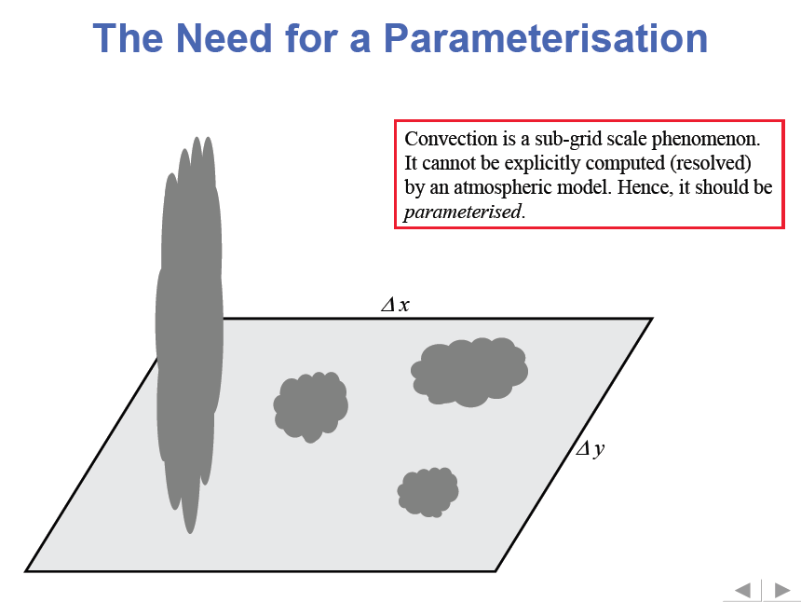
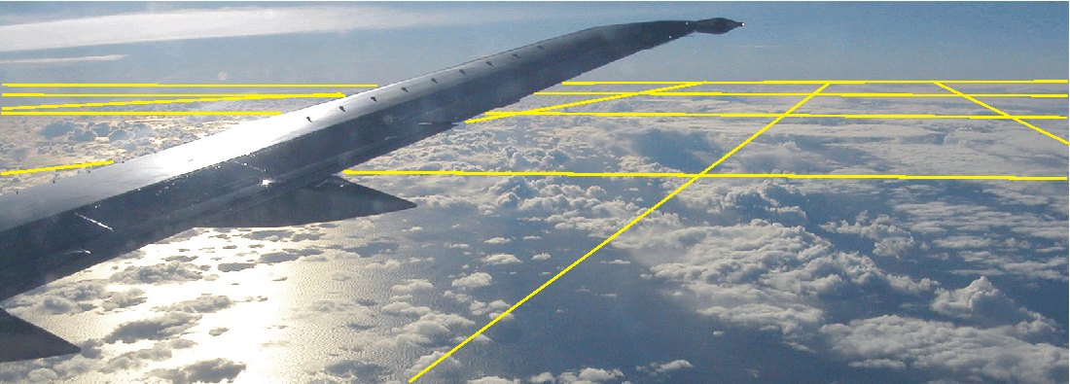

Slide 3
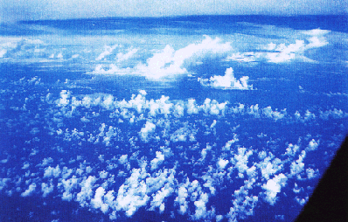
Clouds in GCMs - What are the problems ?
Many of the observed clouds and especially the processes within them are of subgrid-scale size (both horizontally and vertically)
GCM Grid cell 40-400km

Slide 4
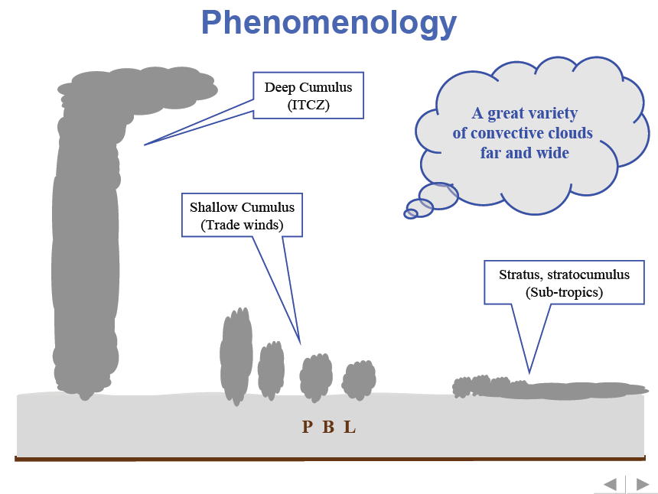
Latitude

Slide 5
A recent Review (Sept 2014) obtained on our analyses of CFSv2 T382 climate run
“My main point is that without modifying/optimizing the model physics for very high resolution, simply increasing the model resolution and generating long simulation is scientifically incorrect and useless.
Hence, before conducting various analysis with long term simulation data, it is very important to verify the physical robustness of the model physics and the biases observed in the simulation of BSISOs are not due to error coming from inappropriate use of model physics.”

Slide 6
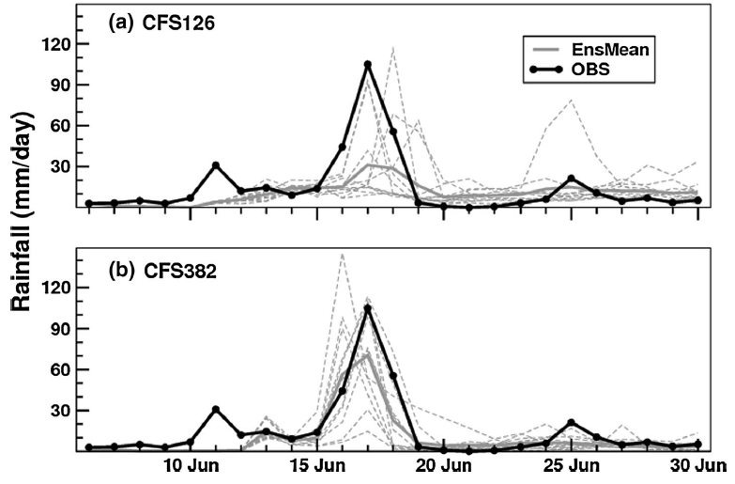
Extended range prediction of Uttarakhand rainfall event by a CFS126 and b CFS382 from 05 June initial condition. The region where rainfall values are averaged is 78°–80°E; 29°–31°N. Individual ensemble members are shown as dashed lines
Joseph et al., Clim. Dyn., Aug, 2014

Slide 7
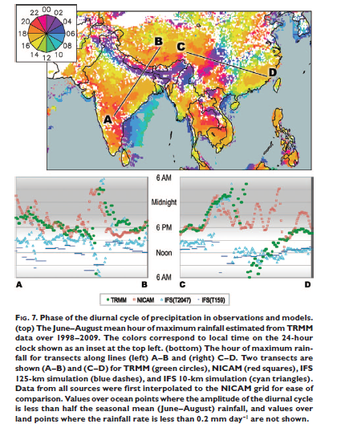
REVOLUTIONIZING CLIMATE MODELING with PROJECT ATHENA:A Multi-Institutional, International Collaboration
by Kinter et al. BAMS, 2013

Slide 8
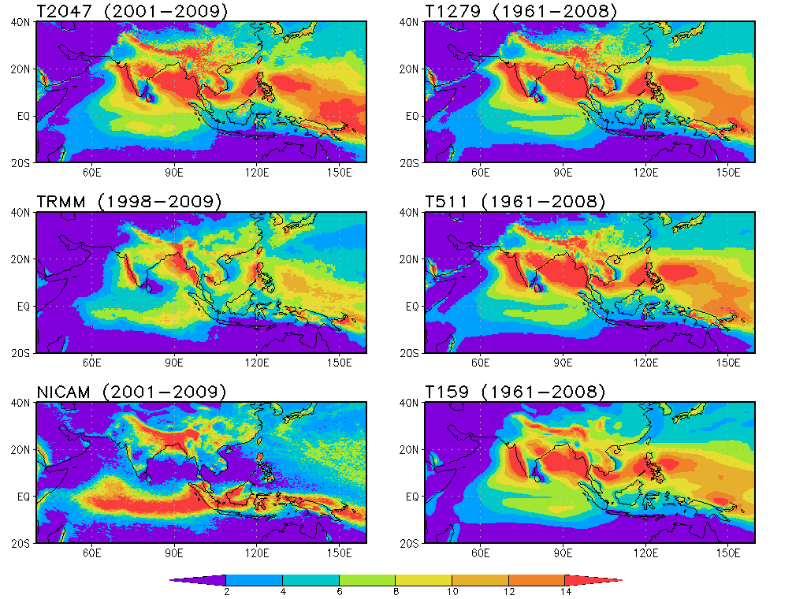
Climatology of JJA Precipitation
IFS T2047
10 km
IFS T1279
15 km
TRMM
25km
IFS T511
39km
NICAM
7 km
IFS T159
125 km
Slide Courtesy: Emilia Jin, COLA
Notes:
Clim prcp jja high

Slide 9
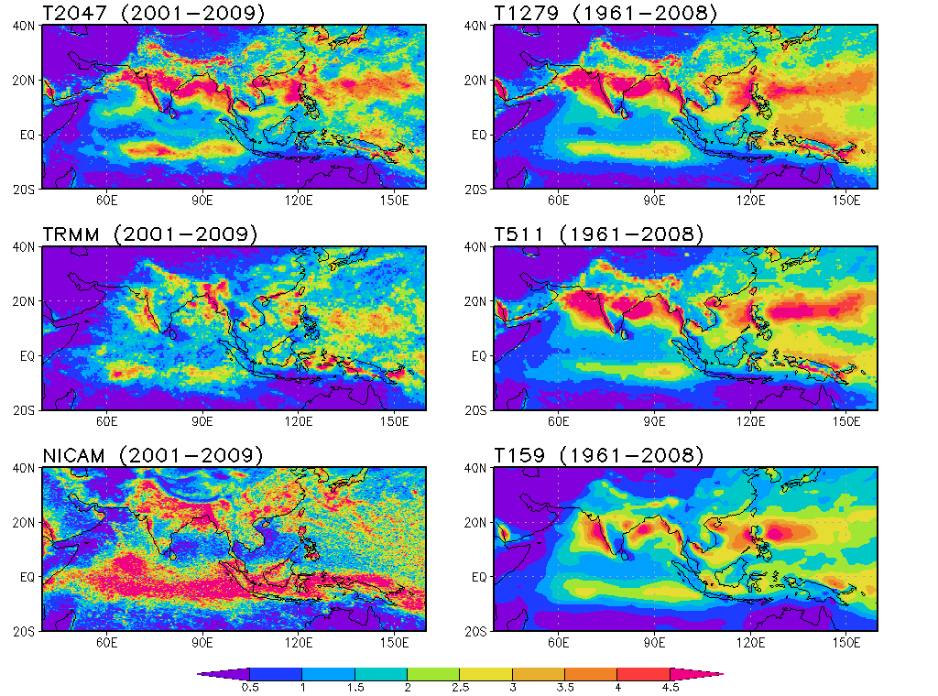
Standard Deviation of JJA Precipitation Anomalies
IFS T2047
10 km
IFS T1279
15 km
TRMM
25km
IFS T511
39km
NICAM
7 km
IFS T159
125 km
Slide Courtesy: Emilia Jin, COLA
Notes:
Rms.prcp.jja.high.0109

Slide 10
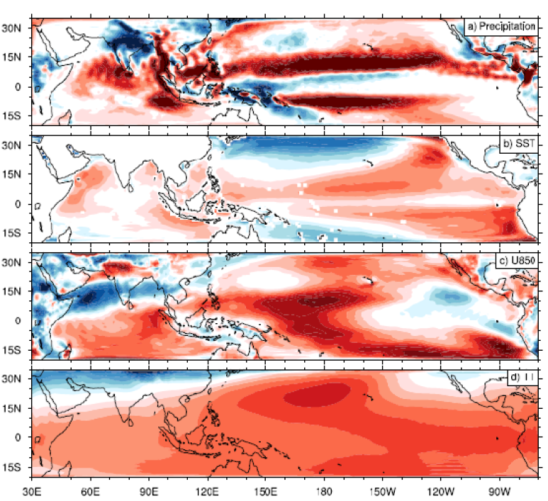

CFST382 Free Run
Seasonal mean bias in (a) precipitation (mm day‐1), (b) SST (°C), (c) zonal wind at 850 hPa (m s‐1) and (d) tropospheric temperature (TT, K) relative to TRMM, TMI observation and CFSR.

Slide 11
JJAS clim of phase (mm/hr)
JJAS clim of absolute amplitude (mm/hr)

Slide 12
TRMM-Rain (mm/hr) (black line) and INSAT-OLR (W/m²) (Red line)
CI

Slide 13
JJAS climatology (1999-2008) of diurnal cycles of area-averaged cloud liquid water (Kg/m²) (Red line) and cloud ice (black line)
a) CI

Slide 14
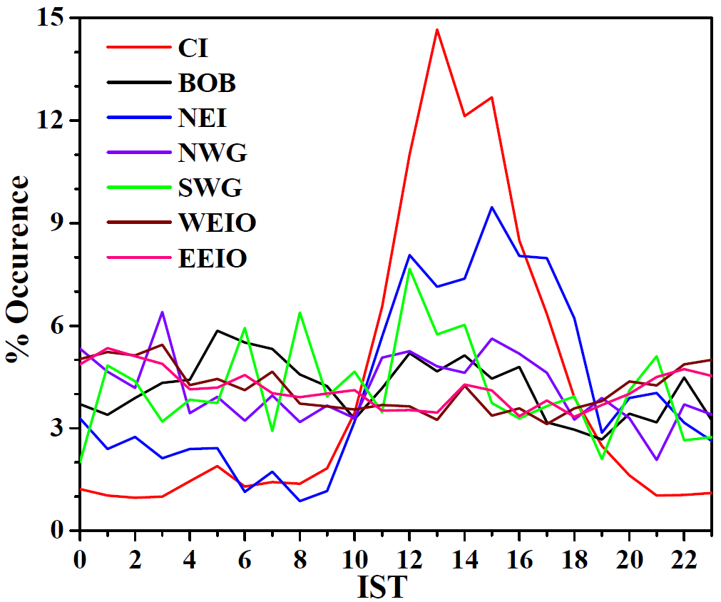
Diurnal variation of population of TRMM VIRS congestus for different regions over Indian monsoon region

Slide 15
ISCCP estimated low cloud (%) (black line) and high cloud (%) (Red line)
a) CI

Slide 16
Model
Analysis..
CFSv2-T382
CFSv2-T126
OLR is higher in model
Model precipitates earlier than observation
Cloud water and low cloud peaks later than observation
Cloud ice and high cloud show weak diurnal cycle compared to observation

Slide 17
OMEGA (PaS⁻¹)::CFST382 (RED line), CFST126 (BLACK line), MERRA ( BLUE line) over CI

Slide 18
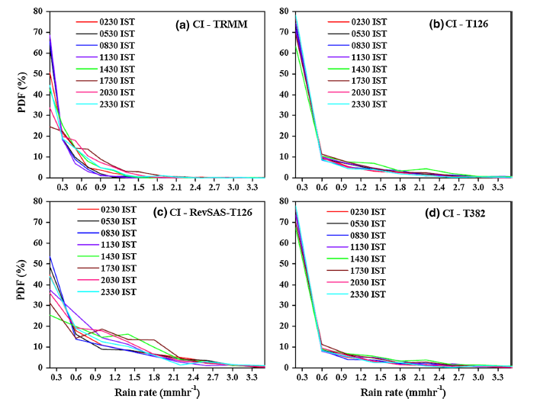
Percentage of PDF of rainfall rate over CI from a TRMM, CFSv2 with b old SAS at T126 resolution, c revised SAS at T126 resolution and d old SAS at T382 resolution corresponding to the eight octets,0230 IST through 2330 IST at 3-hourly intervals

Slide 19
Scatter plot: OLR vs Rainfall
Observation shows deepening of convection in the afternoon hours.
Model simulated convection is shallower for all the times.
OLR (Wm⁻²)
230 Wm⁻²
Rain rate (mmhr⁻¹)

Slide 20
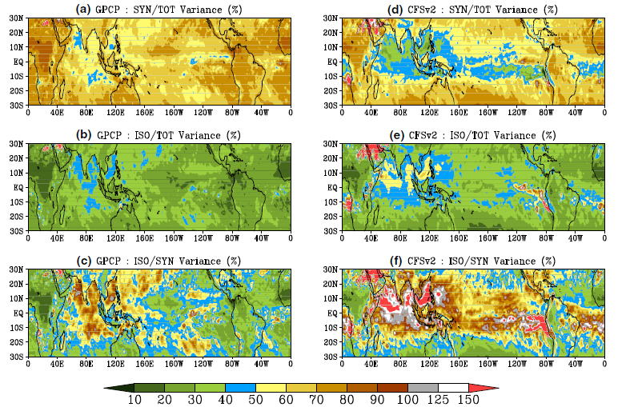
Goswami et al. 2014
a Ratio of synoptic scale (2–10 day bandpassed) variance to total variance in GPCP; b ratio of ISO scale (10–90 day bandpassed) variance to total variance in GPCP; c ratio of ISO scale variance to synoptic scale variance in GPCP; d ratio of synoptic scale variance to total variance inCFSv2. e Ratio of ISO scale variance to total variance in CFSv2; f ratio of ISO scale variance to synoptic scale variance in CFSv2 (the values are given in percentage)

Slide 21
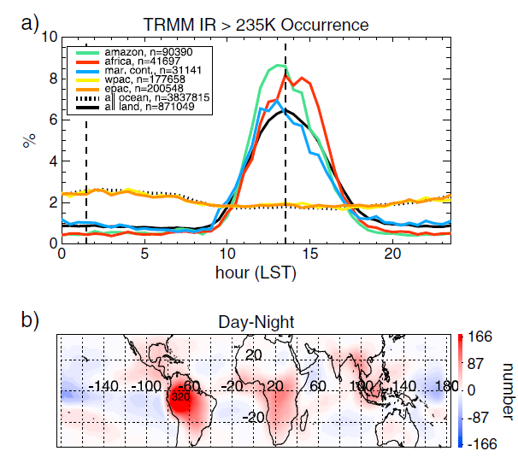
CFST382 (RED line), CFST126 (BLACK line), TRMM & MERRA (Dotted BLUE line)
OLR (INSAT) from Mahakur et al.
Diurnal variation of population of TRMM VIRS congestus for different regions. The black dashed lines indicate the times of CloudSat overpass.
Wall et al., 2013
Malay et al.

Slide 22
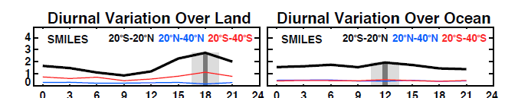
Cloud Ice
Jiang et al. 2015

Slide 23
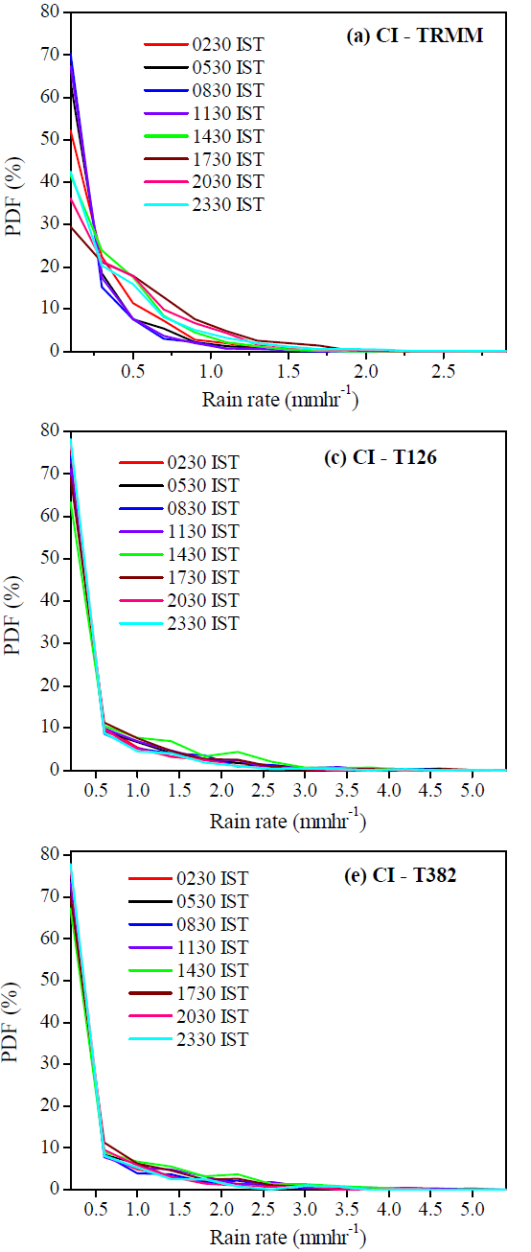
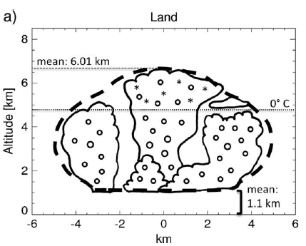
CFSV2 T126 Diurnal Rainfall PDF
We hypothesize that the diurnal cycle of convection and hydrometeors need to be parameterized properly for improving diurnal precip
Wall et al. 2013

Slide 24
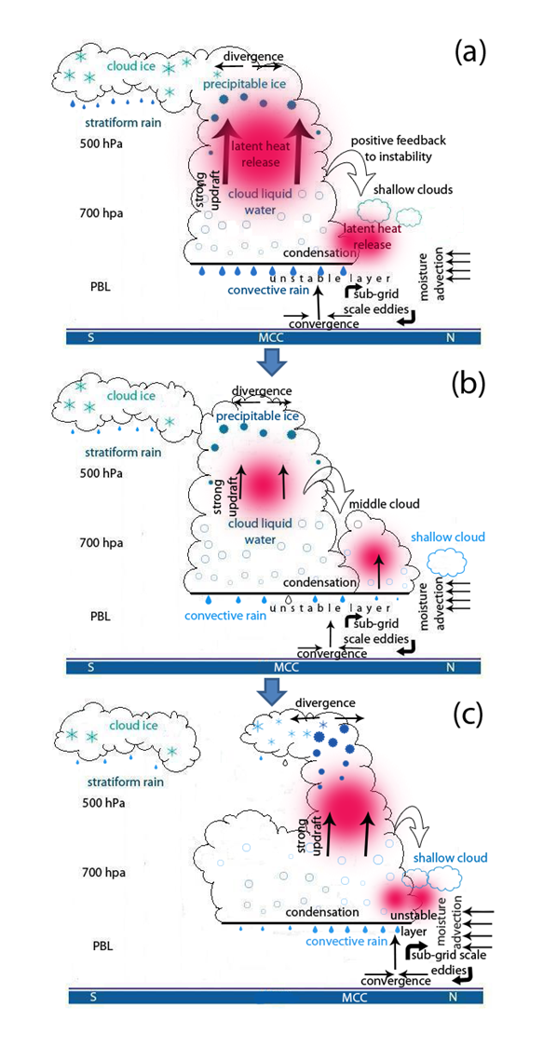
Hypothesis based on observation for northward propagation BSISO (Abhik et al, 2013)
Our results are supplemented by few recent studies e. g.
Preconditioning Deep Convection with Cumulus Congestus by Hohenegger and Steven, 2013
A climatology of tropical congestus using CloudSat by Wall et al. 2013

Slide 25
CloudSat IWC/LWC Retrieval
ICE
ICE
ICE
CloudSat measurements are sensitive to multiple particle types:
➔ cloud ice (~small particle), snow, graupel
➔ cloud liquid (~small particle), rain
SNOW
MIXED
GRAUPEL
LIQUID
LIQUID
LIQUID
RAIN
Note that: The Micro Wave Limb Sounder (MLS) provides IWC estimates described as small ice particles at levels in the upper-troposphere
Slide Courtesy: Frank Li, JPL

Slide 26
Hypothesis
To simulate better stratiform clouds a spectrum of cumulus clouds is necessary.
Model tuning via coupled convective and stratiform clouds
0830
1130
1730

Slide 27
State of the art:
Separation into stratiform and convective clouds, detraining water from convective clouds is source for stratiform clouds => radiative effects
If convective clouds change so do stratiform.
Latent heat
water

Slide 28
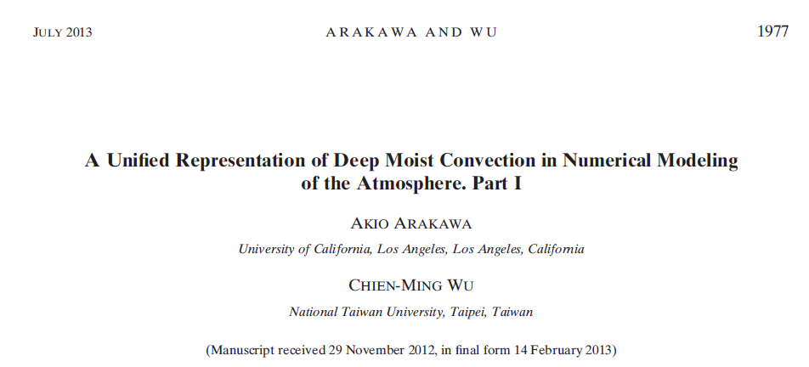
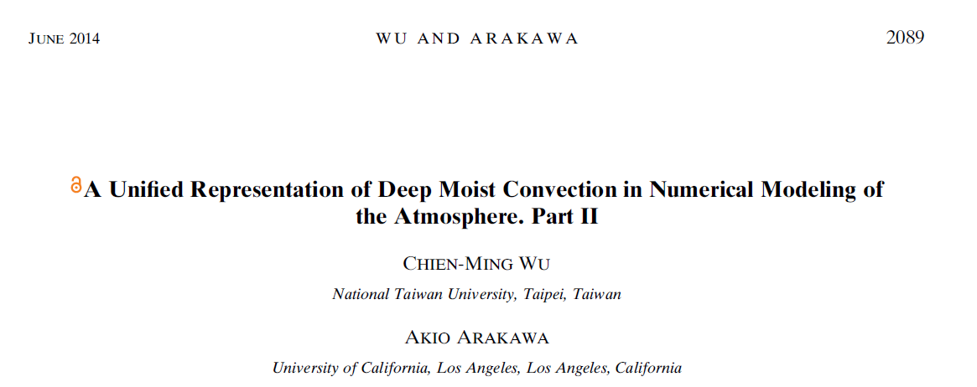

Slide 29
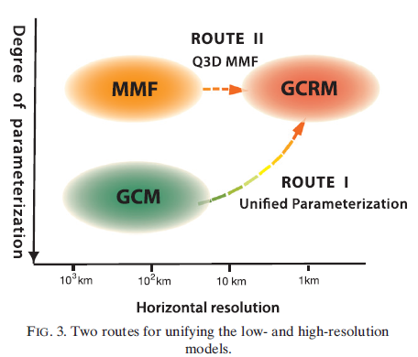
Arakawa and Wu, 2013

Slide 30
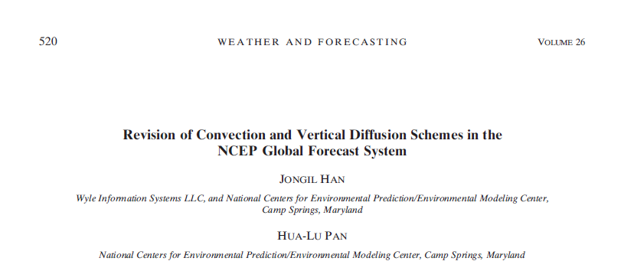
Han and Pan 2011
For deep convection, the scheme is revised to make cumulus convection stronger and deeper to deplete more instability in the atmospheric column and result in the suppression of the excessive grid-scale precipitation.

Slide 31

Large eddy simulation (LES) studies by Siebesma and Cuijpers (1995) indicate that the fractional entrainment and detrainment rates for the SC are one order of magnitude larger than the values used in most existing deep convection schemes. The LES study by Siebesma et al. (2003) indicates that a typical value for the fractional entrainment rate is ε ~ 2.0 X 10⁻³m⁻¹ near the cloud base, which agrees with other LES studies (Siebesma and Cuijpers 1995; Grant and Brown 1999) and observations
(Raga et al. 1990), and that the entrainment rate behaves as

Slide 32
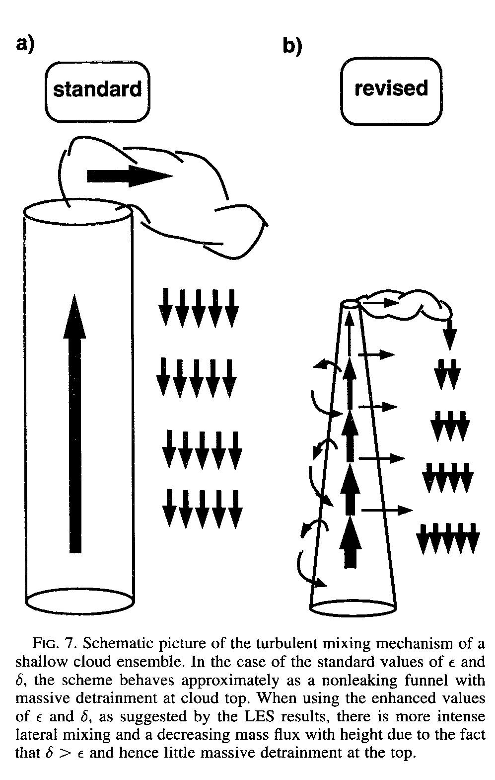
JAS, 1996

Slide 33
The mass flux decreases with height above the cloud base while it increases with height below the cloud base, which is consistent with the aforementioned LES studies.
The liquid water in the updraft layer is allowed to be detrained from every layer into the convective rain and grid-scale cloud water with conversion parameters of 0.002 m⁻¹ and 5.0 x 10⁻⁴ m⁻¹, respectively.
The feedback of cumulus convection into the largescale environment is accomplished via the compensating subsidence in the environment and the entrainment and detrainment processes between the cloud and the environment.
Han and Pan 2011

Slide 34
“The CFS run was initialized at 0000 UTC 16 December 2002 and ran for 45 days. The CFS forecasts during the preceding 15 days (a spinup period) have been discarded from the analysis, and forecast results during the remaining 1-month period are presented. An evaluation using a longer CFS run would be desirable, but will be left for a future study.”
Han and Pan 2011, WAF

Slide 35
Revised SAS Experiment Results
Ganai et al. Clim. Dyn. 2014

Slide 36
Rainfall 15 years daily data

Slide 39
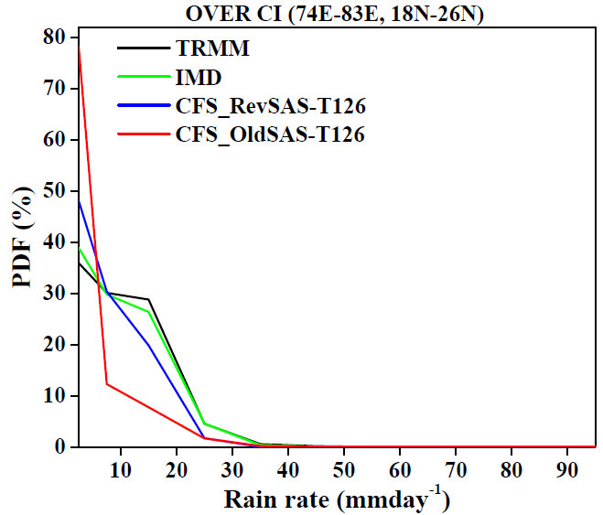
Rainfall PDF for 15 years daily data

Slide 40
(a)
(b)
Fig 6

Slide 41
850 hPa wind (m/s)
LLJ has strengthened, however still weaker over some locations
Notes:
Cross equatorial LLJ has strengthened, however still weaker over some locations

Slide 42
200 hPa
wind (m/s)
TEJ has strengthened, however still weaker over some locations

Slide 43
Fig 8

Slide 44
Fig 9

Slide 46
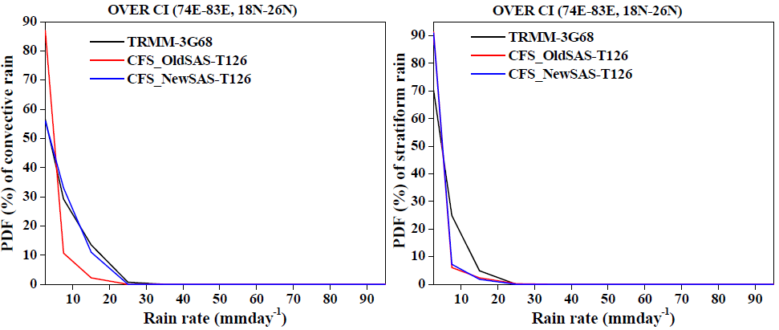
Convective and Stratiform Rainfall PDF

Slide 47
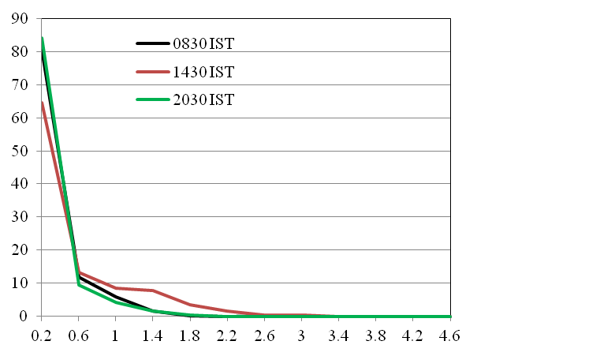
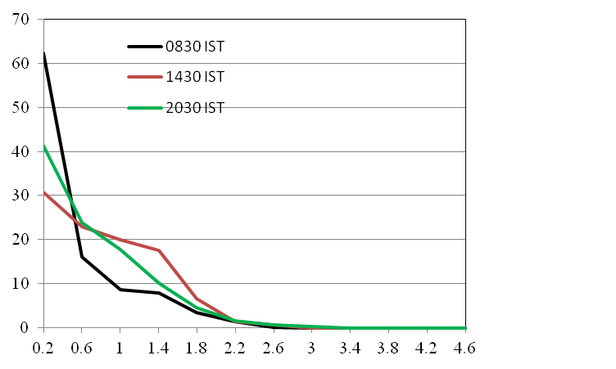
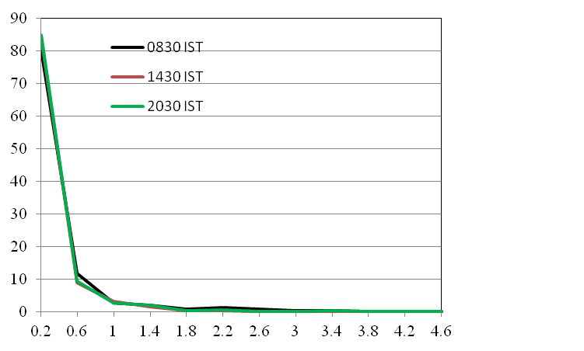
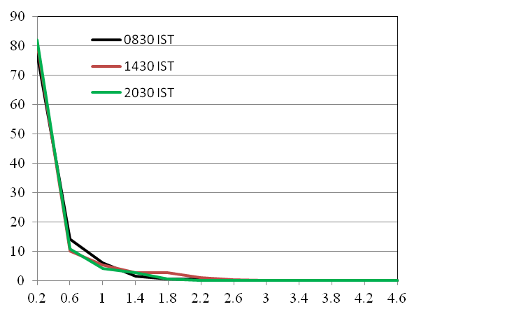
Convective-rain-OldSAS
Convective-rain-NewSAS
Stratiform-rain-OldSAS
Stratiform-rain-NewSAS

Slide 48
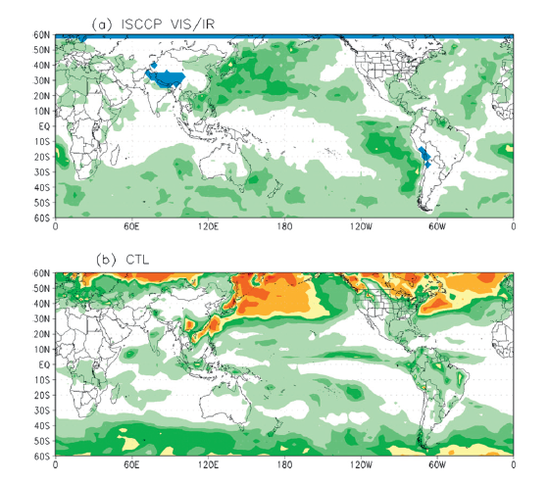

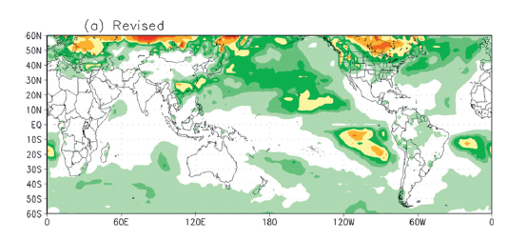
Monthly mean low cloud cover (%) for January 2003 from (a) the International
Satellite Cloud Climatology Project (ISCCP; Rossow and Schiffer 1991) VIS/IR satellite observations (regions with no data available are shown in blue) and (b) a control simulation using the old convection scheme.
(c)
Han and Pan (2011)

Slide 51
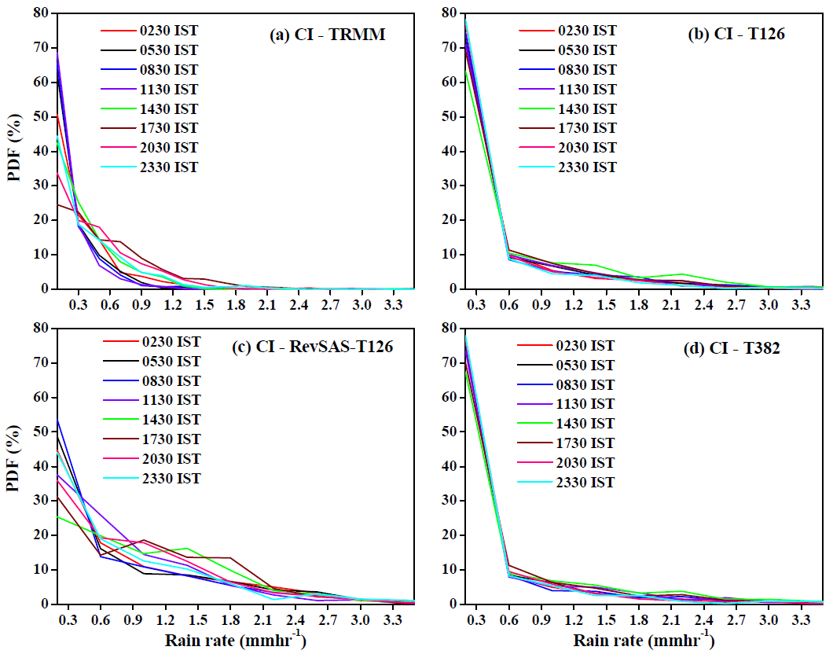
Notes:
Separate out lighter and moderate category rainfall at different times, however overestimates the moderate and heavier category

Slide 52
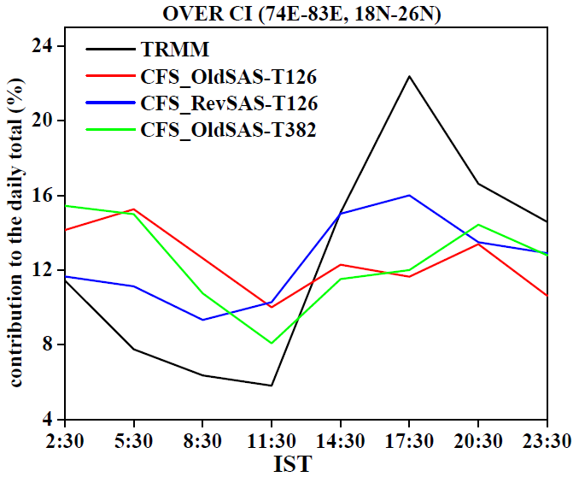

Slide 54
Arakawa and Wu, 2013

Slide 55
Grabowski 1999, Randall and Khairoutdinov 2001
Multi-scale Modeling Framework
The black squares represent an array of GCM
grid boxes, and the red lines represent embedded twodimensional CSRMs. The CSRM domains do not extend to the edges of the GCM grid boxes. The lateral boundary conditions on the CSRMs are periodic. At the black dots, the GCM and the domain average of the CSRM
An evolved version of the original superparameterization concept depicted in Fig at left. Two CSRMs are embedded in each GCM grid box. They are oriented at right angles to each other. They have periodic boundary conditions, as before. At the point where the two high-resolution grids overlap, the CSRM is three-dimensional.
Elsewhere, it is two-dimensional.

Slide 56
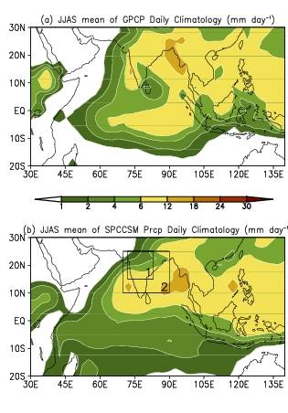
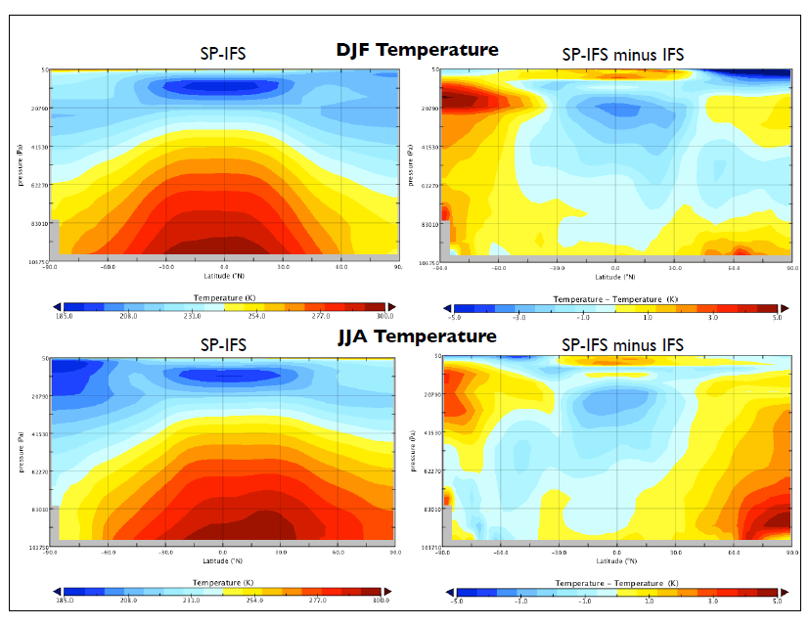
SP-CCSM is already developed and analysed (Stan et al. 2010, Demott et al. 2011)
Goswami et al. 2013
Slide courtesy: Dr. Marat

Slide 57
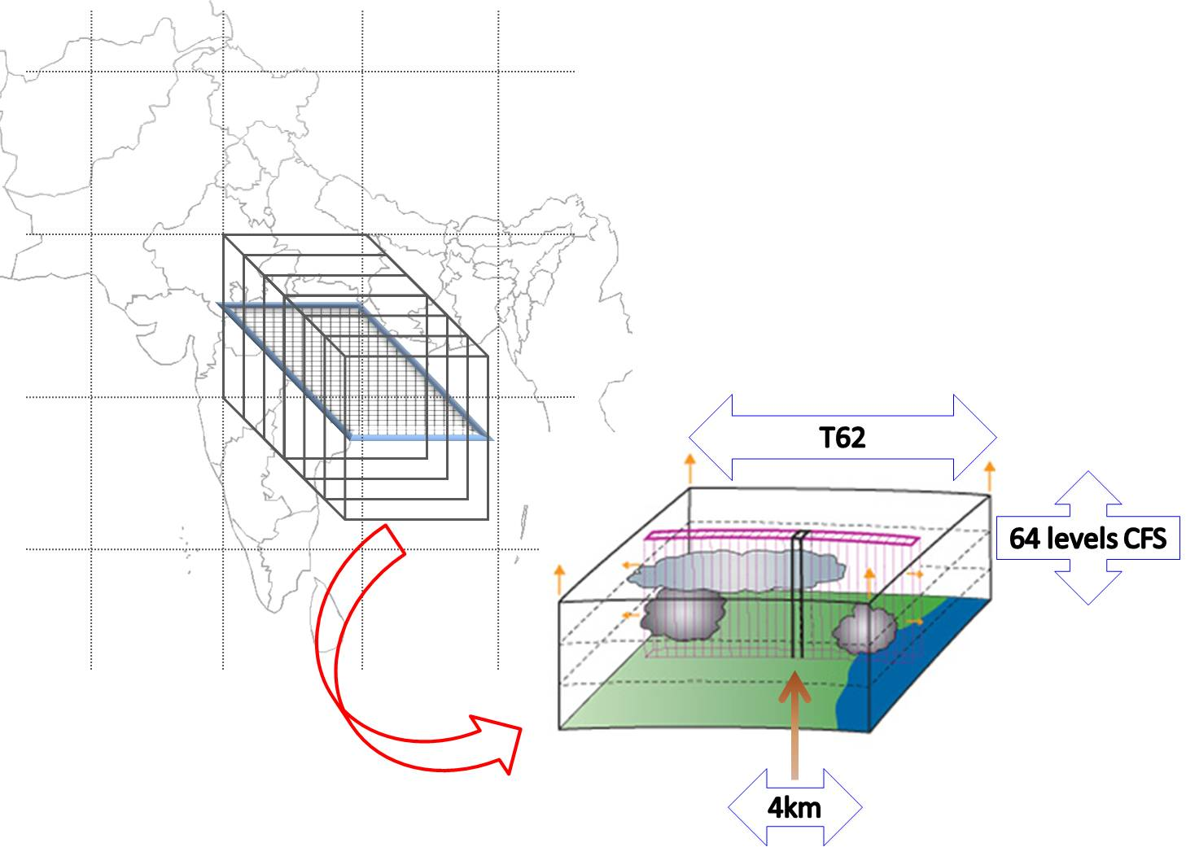
Superparameterized Climate Forecast System (SP-CFS) Model
Convective tendencies are explicitly simulated with a Cloud Resolving Model running in each GCM grid column which replaces the traditional cumulus parameterization of the GCM.
32 CRMs (SAM) in each GCM (CFS-V2.0) grid
60 levels of CRM collocated with first 60 levels of GCM
Accepted with revision (J. of Clim)

Slide 58
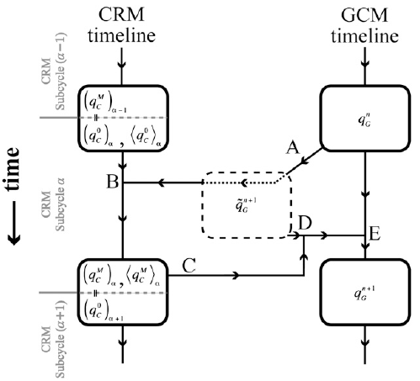
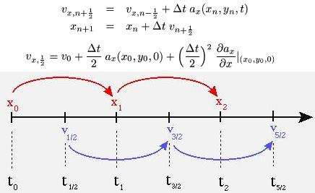
The Concept of Superparameterization
Requirement for CFS for Leap-Frog
BENEDICT AND RANDALL, JAS 2009

Slide 59
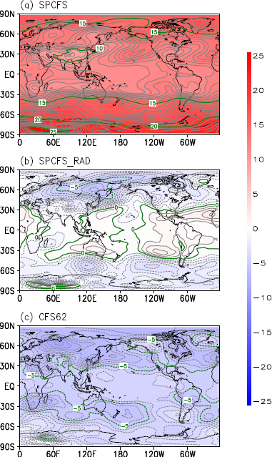
Results without and with Radiation coupling: The radiation senses all the variety of cloud hydrometeor

Slide 60
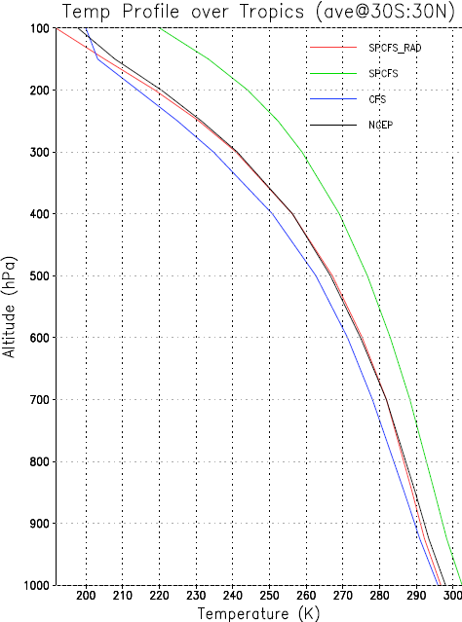
SPCFS
SPCFS_RAD
NCEP
CFS

Slide 61
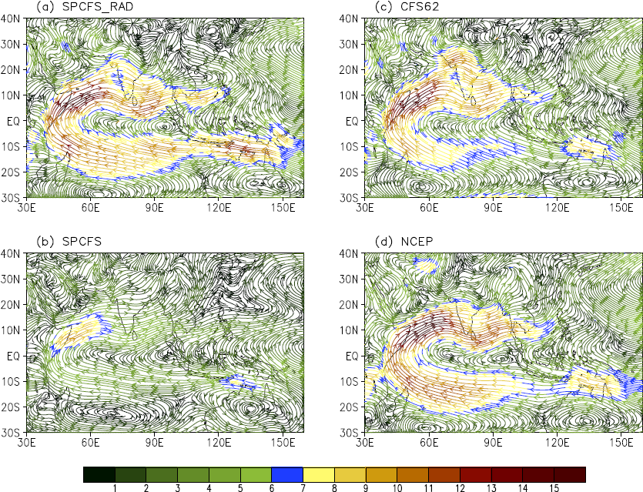

Slide 62
Noticeable Improvement of tropospheric temperature bias in SP-CFS

Slide 63
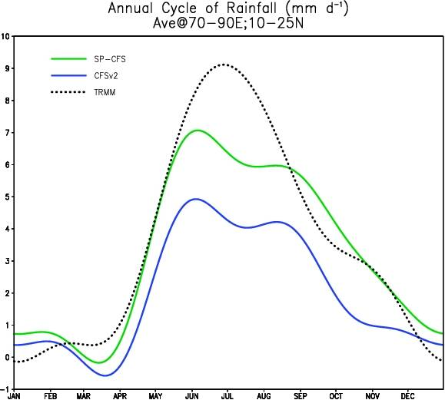
Annual Cycle of Rainfall. (mm/day)

Slide 64
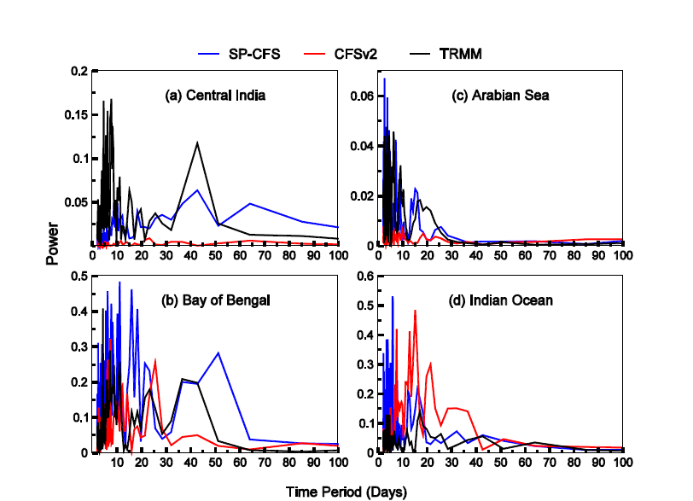
Power spectra of the JJAS rainfall anomalies averaged over (a) Central India [73ºE-82ºE; 15ºN-25ºN], (b) Bay of Bengal [88ºE-95ºE; 13ºN-20ºN], (c) Arabian Sea [70ºE-75ºE; 10ºN-15ºN] and (d) Equatorial Indian Ocean [89ºE-96ºE; 6ºS-1ºS]

Slide 65
Ratio of Synoptic to ISO variance.

Slide 66
MJO simulation: Wheeler-Kiladis Diagram

Slide 67
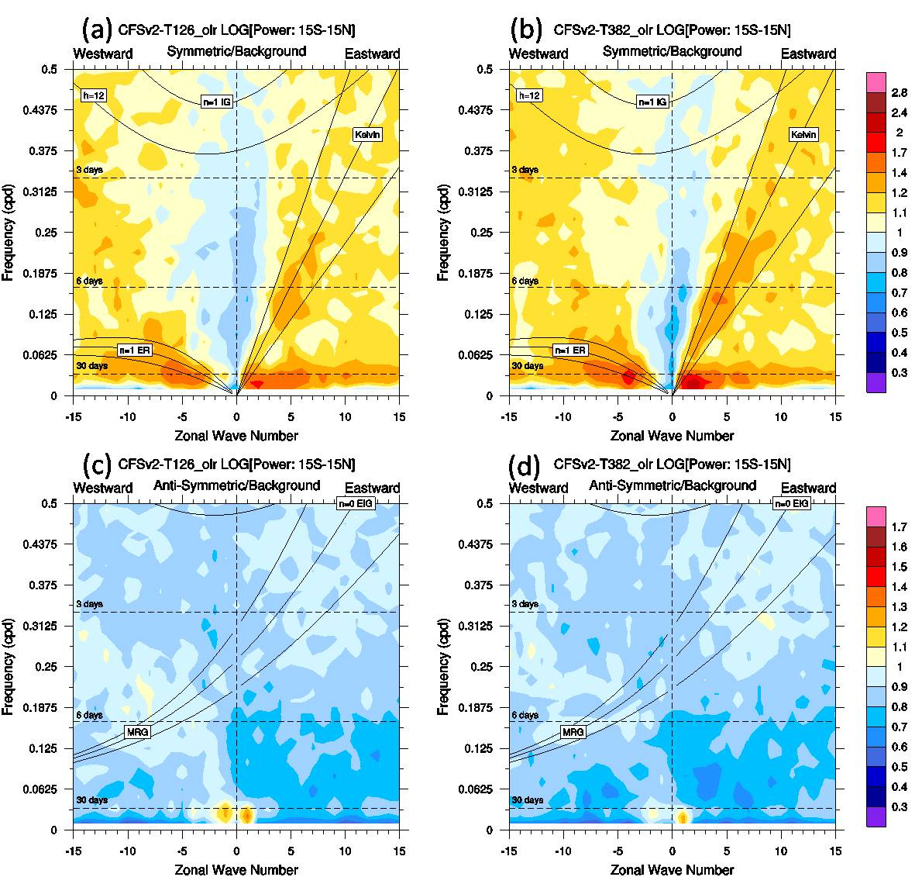

Slide 68
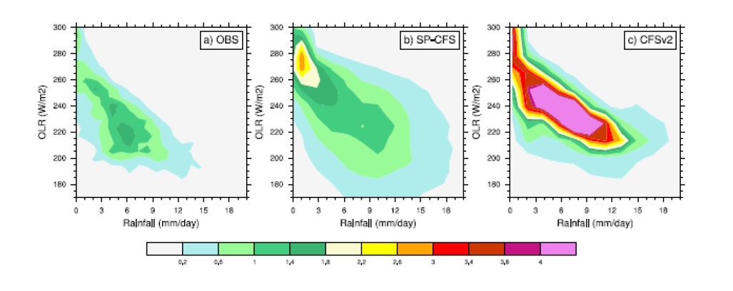
Probability density function (PDF) computed for each grid point over the entire tropics (30ºS to 30ºN) for climatological rainfall (mm day⁻¹) and OLR (Wm⁻²) for the boreal summer (JJAS) for (a) Observation (TRMM rainfall and NOAA OLR), (b) SP-CFS and (c) CFSv2.

Slide 69
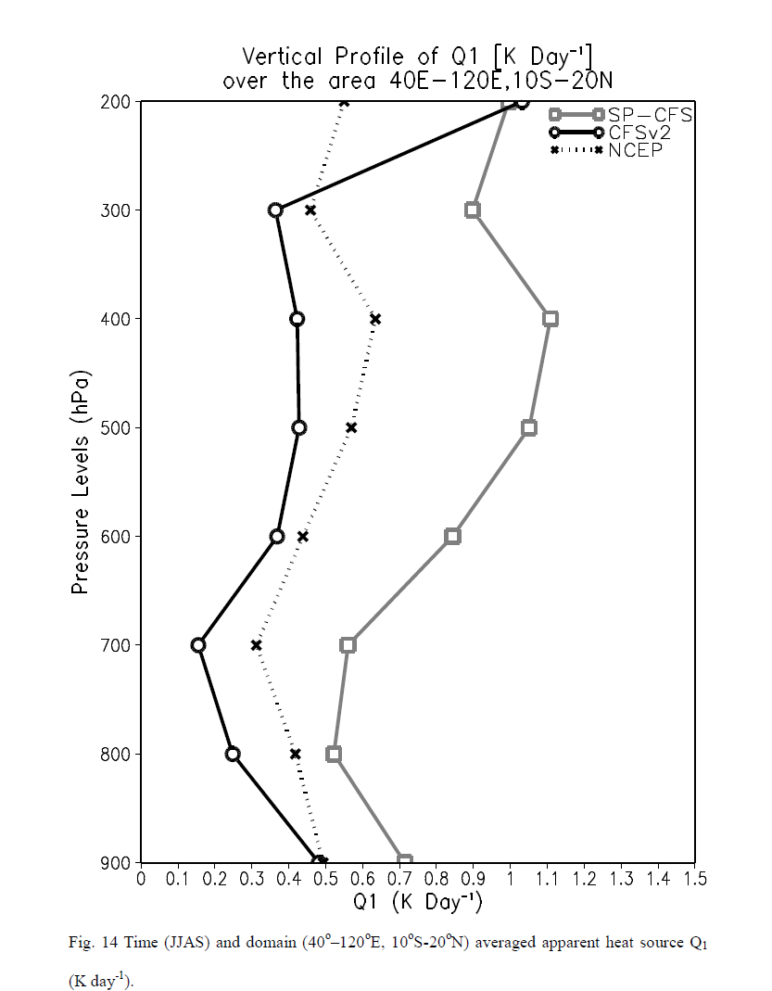

Slide 70
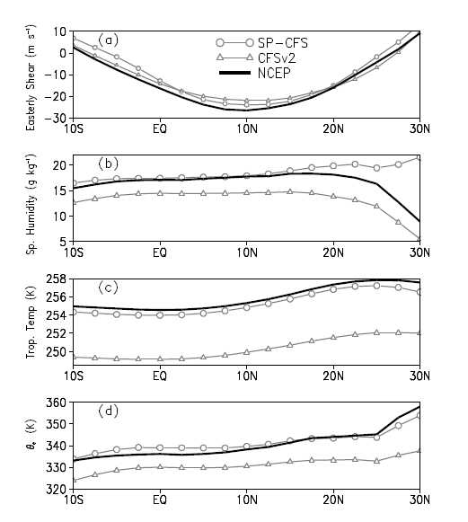

Slide 71
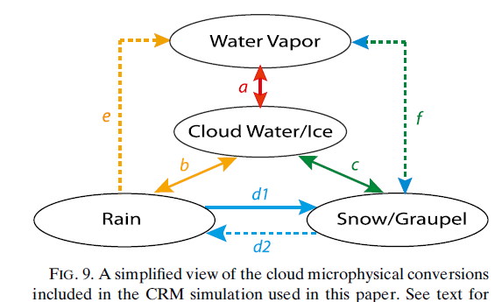
Arakawa and Wu, 2014

Slide 72
Summary
Revised SAS (enhanced deep convection) help improve some of the systematic biases from diurnal pdf, daily and seasonal rain.
It also improves the convective cycle and high cloud diurnal variation
Sub-grid scale convection (such as RevSAS) alone is not able to resolve biases such as cooler troposphere.
Superparameterization coupled with radiation is able to improve the biases such as cold tropospheric temperature, moist instability.

Slide 73
Thank you

