Slide 1
Atmospheric Observational systems
Y. V. Rama Rao

Slide 2
outline
New Initiatives
Improvement in Forecast and warning
Quality and sustenance of observations
Future Plan & Targets

Slide 3
Quality and sustenance of observations
INSAT-3D earth station project completed. All images and products received through INSAT-3D satellite are disseminated on IMD website. Validation of OLR, SST, AMV, Fog and vertical profiles of temperature completed and validation of other parameters is in progress.
Establish a state-of the-art climate data centre with advanced climate data management system with observation Quality Control as per WMO standard.
Commissioning of DWRs at Goa, Paradip, Karaikal , Mumbai, Bhuj and Srinagar. High Wind Speed Recording System (HWSR) systems 16 are installed along east coast, Goa and Gujarat coast. Online inventory management of the instruments at IMD Surface Observatories (including Airports) started. This also includes their functional status and reporting, etc.
“Integrated Himalayan Meteorology Programme for Western & Central Himalaya” covering four states: Jammu & Kashmir, Himachal Pradesh, Uttarakhand, and Sub Himalayan West Bengal with Commissioning of 9 Doppler Weather Radars (DWRs) , 15 Micro Rain Radars (MRRs), 09 GPS based UA Systems along with GPS radiosonde, 230, AWS, ARG & Snow Gauges, 12 Compact Severe Weather Detection Radar Systems to develop appropriate system of 24×7 monitoring and early warning for extreme weather.

Slide 4
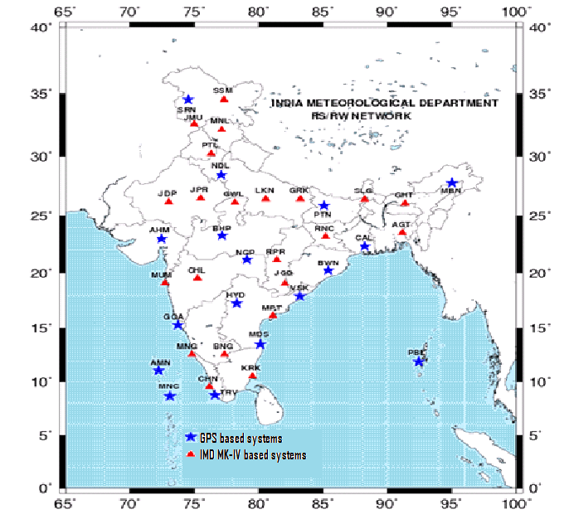
Upper air Observation
IMD has 39 operational Radiosonde radiowind stations in their upper air network- 17 Nos upgraded to GPS based systems.
Achievements by up-gradation
GPS based radiosondes
Random large fluctuations have reduced significantly.
Difference (O-B) between observations (O) and first guess (B) have reduced at all levels.
Maximum height reported has increased significantly.
NWP models have accepted all the data received from 17 GPS based stations being within the tolerance limits of the first guess.
Almost nil data rejection rate.

Slide 5
Radars
Out of Total 24 radars – 8 are in final stages of installation/induction
East coast is fully covered with 7 Cyclone detection Doppler radars; Radars at Karaikal, Gopalpur and Paradip are under installation
All radars are centrally connected to data servers at Delhi for data conversion to NetCDF, BUFR and distribution to user community ( NCMRWF, IITM, INCOIS, IAF, and IMD use at NWP, Synergy etc)
IMD-NWP Division using Radar data to run models: ARPS, WRF and nowcasting tools like WDSSII
Nowcasting unit solely issues Radar based nowcasting in near-realtime
Synergy systems have the capability to display radar products
GIS based systems overlays the radar products on Google Maps
Central server generates composites
The entire data flow is automatically updated for online monitoring at DDGM(UI) website

Slide 6
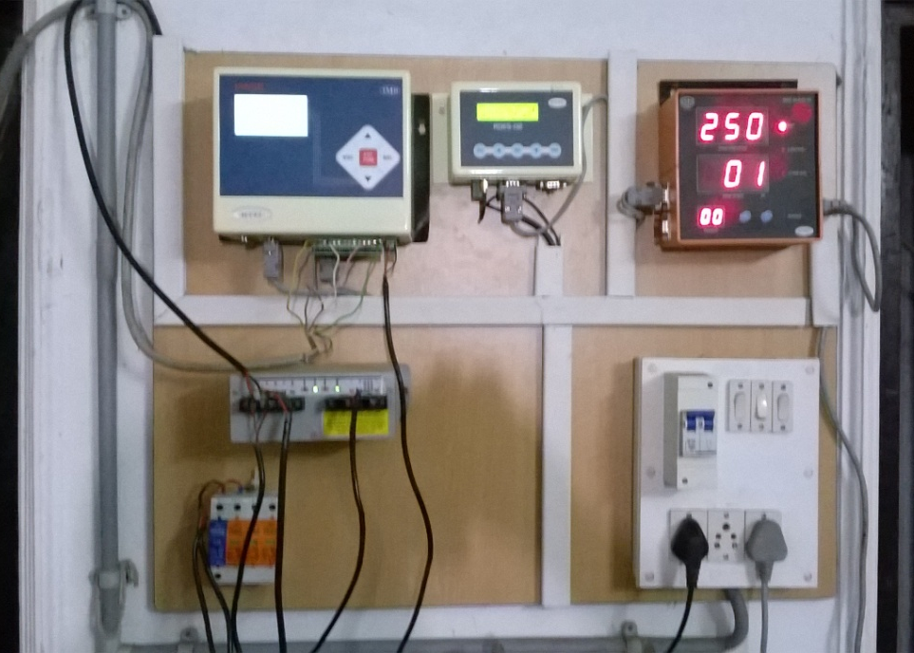
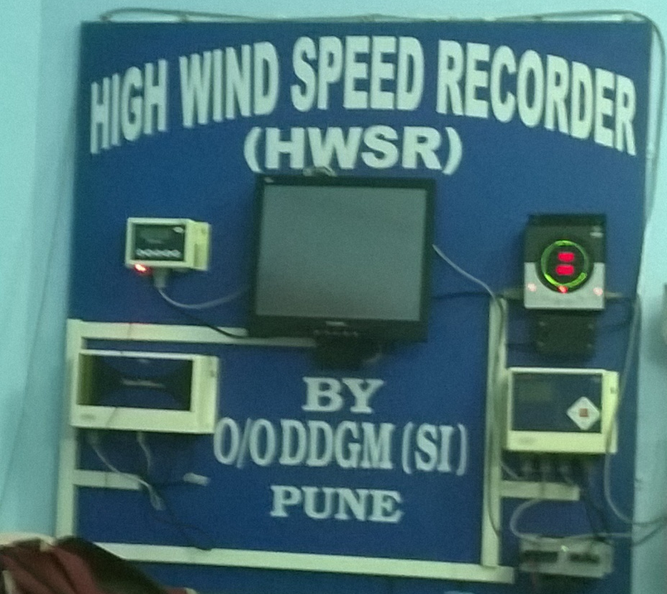
High Wind Speed Recording System (HWSR)
Naliya
Bhuj
Haldia
Total 16 HWSR systems are installed
New Installations planned during 2014-15 :
Up gradation planned during 2014-15 :
New Installations planned during 2015-16 :
Mumbai, Porbandar, Paradip and Chandbali
Bhuj, Naliya
Nellore, Dwarka
Dwarka
Sagar Island
Digha
Veraval
Balasore
Puri
Gopalpur
Kalingapatnam
Panjim
Visakhapatnam
Kakinada
Machilipatnam
Nellore
Chennai
Karaikal

Slide 7
Satellite Meteorology
INSAT-3D Earth Station project completed. All images and products received through INSAT-3D satellite disseminated on IMD website.
Results analyzed and report prepared for the joint CAL/VAL campaign held during December, 2013 at Jaisalmer, Rajasthan to characterize the site for INSAT-3D by ISRO , NPL, IITM and IMD .
Images and products provided for special requirements e.g. Amarnath Yatra, Vaishno Devi etc.
Validation of OLR, SST, AMV, Fog and vertical profiles of temperature done and validation of other parameters is in progress.
178 CWDS installed in Tamilnadu region and further installation is in progress.
NOAA/Metop data is being sent to RARS group of WMO and in turn RARS data of other global stations is being received.

Slide 8
Polar Meteorology
Established Surface Meteorological Observatory (Met parameters and Solar radiation) and High Wind Speed Recorder at Bharti during summer expedition in 2014.
Supply order issued for the procurement of Upper Air Ozone sounding System using Global Navigation Satellite system for Antarctica. LC will be opened during September, 2014.
Indent issued for AWS full set with one set of spares for Bharati. Tender enquiry will be refloated for UV-Surface ozone analyzer for Bharati station.

Slide 9
Installation of Weather Observatory
at Bharati, Antarctica during 33rd ISEA

Slide 10
Surface Instruments Management System
Online inventory management of the instruments at IMD Surface Observatories (including Airports) started.
This also includes their functional status and reporting, etc.

Slide 11
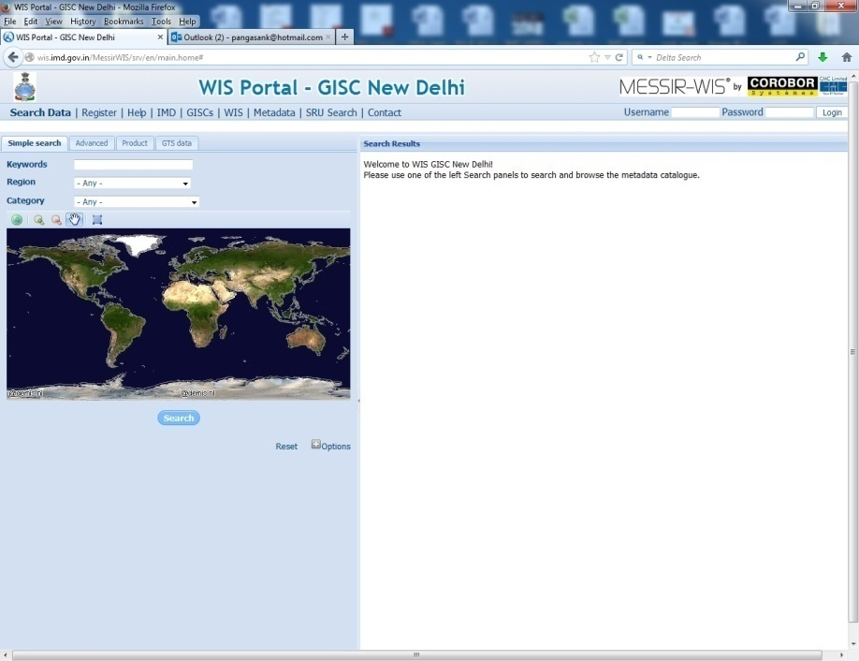
Global Data Dissemination Centre
Other achievements in Telecom
Launch website
www.indiaweather.gov.in
www.rsmcnewdelhi.imd.gov.in
Upgradation of Internet
Internet bandwidth to 100 Mbps during cyclone ‘Hudhud’ resulted in failure free service
NKN connectivity
Video conferencing System
WMO WIS (WMO Information System) programme, Global Information System Centre (GISC) installed at IMD Pune.
GISC implementation has upgraded IMD status from Regional to Global data dissemination centre.
Future Plan
Centralized GIS Based Content managed Website
Upgradation of IMD LAN at HQ
Expansion of NKN.
Upgradation of National VPN links
Replacement of Old AMSS

Slide 12
Improvement in Forecast and warning

Slide 13
Observations
Communication
Analyses & Forecasting
Dissemination
Surface Observations
Manned (559) + AWS (725) +ARG (1046)
Data-flow at Three Hourly Intervals on 24x7 Mode
Delhi
National Weather Forecasting Centre
Upper-Air Observations
(62 PB stations + 39 RS/RW)
State Level
Met. Centres
Airport Met. Offices
Pune
Weather Central
Regional Telecom Hub (RTH)
Aircraft Reports
IMD, Delhi
LAFS NWP forecasts
Ship Reports
Data Flow
Ocean Buoys data
(Deployed by Dept. of Ocean Development)
Central / State Govt/ Media/ Public
Data ported to NCMRWF for medium range weather forecasts
Satellite Observations
Sat. Met Division, IMD
(Deployed by Department of Space)
Regional Centres – 6
Global Data

Slide 14
IMD Service Standards
SN | Our Services and Transactions | How we measure our performance in this area | Service Standard
1 | Weather Forecasts and Warnings | Timely release of 3 day Weather Forecast and Warnings | 6 Hours
2 | Agro-meteorological advisories and Forecast at district level | Issue of Agro-meteorological advisories and Forecast at district Level (625) | 5 Days
3 | Meteorological support for Civil Aviation purpose | Meteorological support for Civil Aviation purpose | 60 Minutes
4 | Rainfall monitoring | Rainfall Monitoring (District/subdivision wise) | 1 Day
5 | City Forecast | 5 day Forecast From 18 to 317 locations | 6 hourly
6 | Tourism Forecast | 5 day Forecast From 0 to 87 Locations | 6 hourly
7 | Nowcast | 3 hourly warnings from 0 to 127 Locations | 3 Hourly

Slide 15
Increased city Forecast to 310 cites
Increased Tourist city Forecast from 87 to 107 destinations.
Validity of local forecast increased from 5 to 7 days.
Introduced 7 days meteorological subdivision-wise weather forecast & warnings in All India Weekly Weather Report and weekly monsoon press release during monsoon 2014

Slide 16
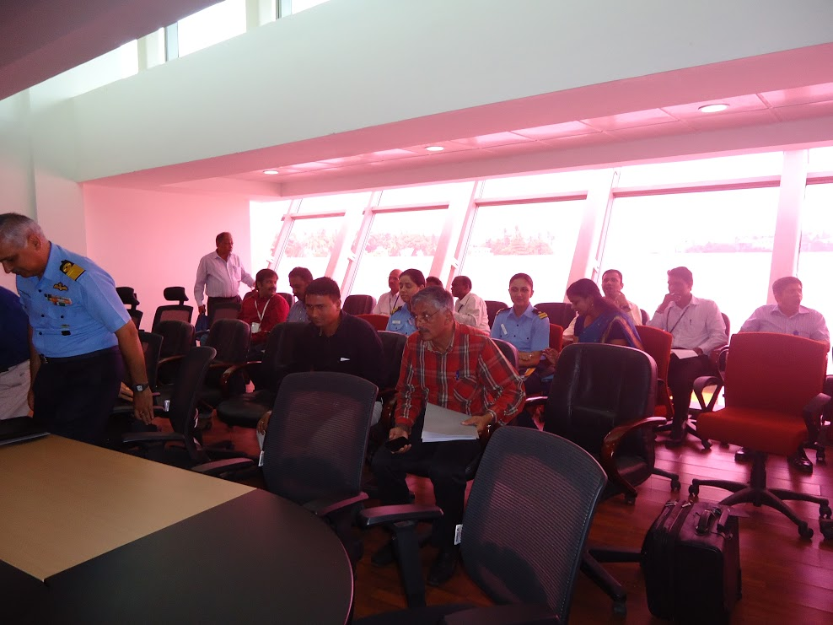
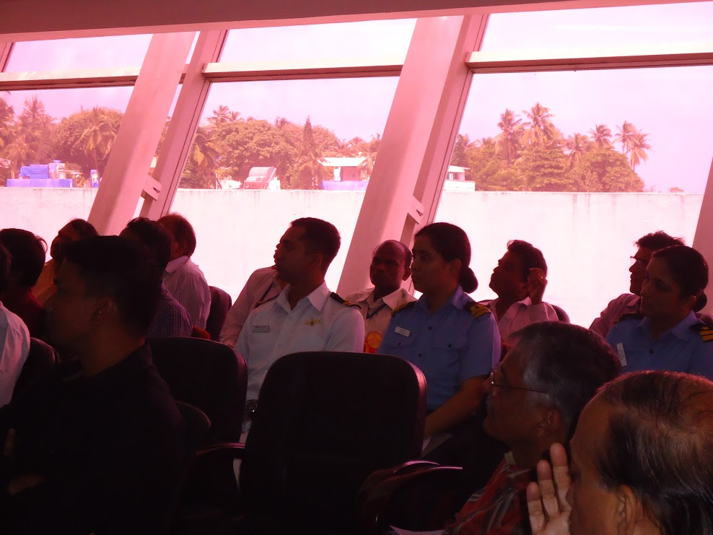
Workshop on “Meteorological Support to Helicopter operation”
Workshop organized for Helicopter Pilots/operators at Juhu Airport Mumbai on 12th September 2014, attended by over 40 Helicopter pilots and Helicopter operators.
Features in OLBS for low level flight, impact of adverse weather on helicopter operation, safety related issues, and requirements of additional meteorological support for operation were deliberated in the workshop.

Slide 17
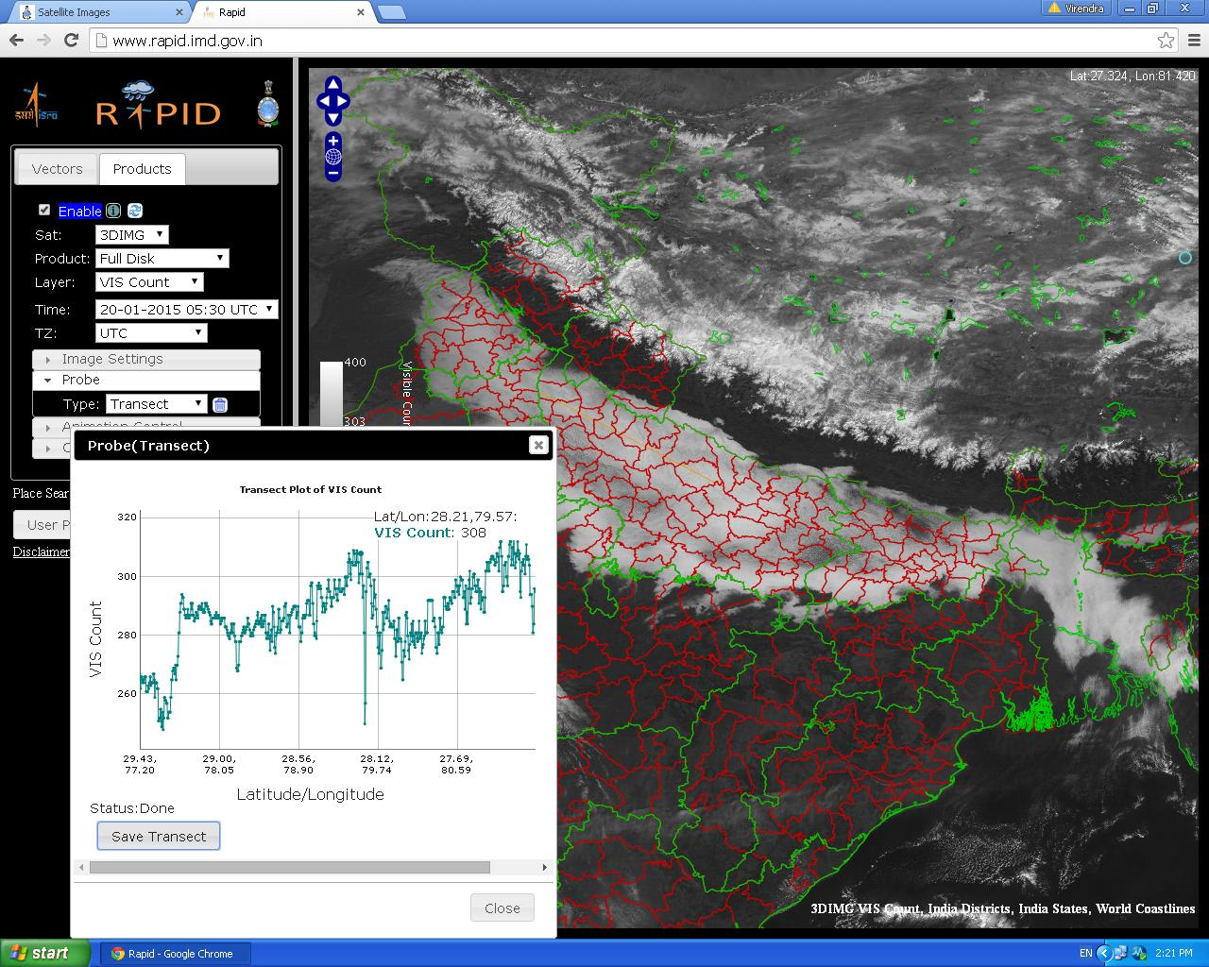
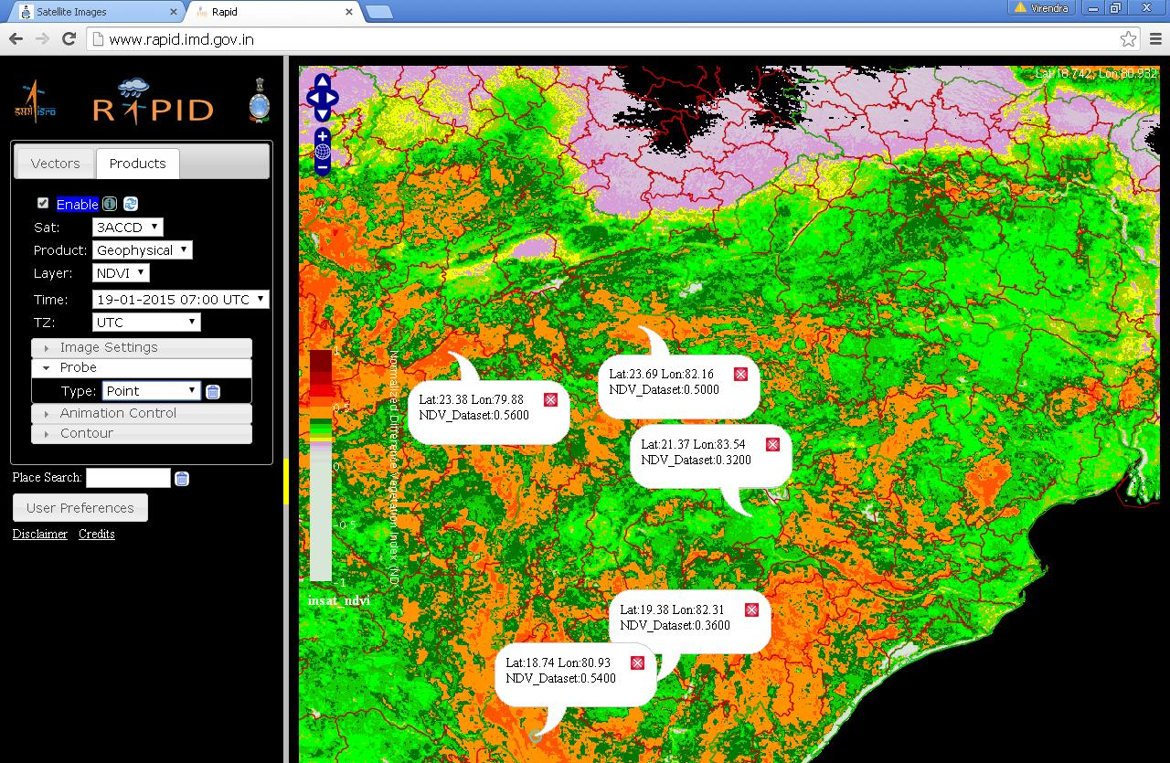
Web-based analysis tool: RAPID – INSAT 3D
RAPID: Real time Analysis of Products & Information Dissemination
This introduces Next Generation Weather Data Access & Advanced Visualization Application
Application ranges from severe weather monitoring to to agricultural production.
We can detect Fog over railway track and highways & a pilot can see the position of clouds, fog and visibility of the entire route in real time

Slide 18
User specific NWP products
S. No. | User Name | Type of Forecasts
1 | Agro-met Services | MME based five days quantitative forecasts of rainfall, max and min temperature, cloud cover, surface humidity and winds at District Level
2 | Cyclone Services | HWRF, Statistical based MME Cyclone track and intensity prediction, genesis forecast
3 | Aviation services | WRF model based weather map of temp and wind for low flying aircrafts, meteograms
4 | Hydrological services | MME/WRF based gridded location specific rainfall forecasts
5 | Public Weather Services | Five days City forecast
6 | Day to day forecast | Weather forecast Graphics Products
Additional satellite Data:
MEGHA-TROPIQUES satellite SAPHIR Radiance (6 channel - WRF)
INSAT 3D Sounder Radiance (5 Channels) Imager Radiance (1 Channel - WRF)
INSAT-3D AMV (WV,MR,IR) in WRF & GFS
DWR data assimilation in WRF model

Slide 19
Cyclone Forecasting
Radius is targeted to be reduced by about 30 (20%), 50 (20%), 80 (23%), 115 (26%) and 170 km (32%) for 24, 48, 72, 96 and 120 hours forecasts respectively
Cyclone Data portal will be developed with accessibility of all types of data, product and information for each cyclone. Concept paper is under preparation.
Development of Decision support system is in progress
Coastal inundation modeling will be made operational
Concept paper has been prepared for implement of Common Alert Protocol (CAP)
IMD and INCOIS bulletins will complement each other for fishermen warning, coastal bulletin, port warning, sea area bulletin thus improving quality and outreach.

Slide 20
Cyclone warning : Appreciations
Cyclone Hudhud stands in 9 position
in Top Searched New Events in 2014
Source : TOI: 17 Dec 2014
Advances in cyclone forecasting and warning is appreciated On the occasion of Prawasi Bhartiya Diwas (7-9 Jan 2015)
Prawasi Bhartiya Diwas(7-9 Jan 2015)
Advances in cyclone forecasting and warning is appreciated by Prime Minister in India Science Congress
Text of PM Shri Narendra Modi’s address
“I must congratulate …. their accurate prediction of Cyclone Hudhud saved thousands of lives ……...”

Slide 21
ISO Certification
ISO 9001:2008 Certification for five offices (MC Hyderabad, RS/RW and RADAR New Delhi, AMO Palam & Met Observatory Safdarjung)was extended for 3 years (2014-17)
Recertification audit for the period 2014-17 & surveillance audit for the year 2015-16 is completed.
The ISO 9001:2008 certification is awarded for one year (2015-16).
Consultant visited 4 offices ( CAMD, Delhi, AMO Mumbai, Chennai and Kolkata) for ISO process. Certification is in current year)
Committee submitted Consolidated RFP for
Weather Forecasting Services (NWFC, RSMC, NWP)
National Information System Services
National Satellite Meteorology Centre
National centre for Seismology
IMD Pune and RMCs for issue tender locally.
The surface instruments division of the IMD acquired ISO 9001:2008 certification for the process of manufacturing, testing, calibration and supply of meteorological Instruments.

Slide 22
Hydro-meteorological Services
Automatic preparation of Rainfall graphs depicting daily, cumulative and departures of rainfall from their long period average on operational basis for All India and Four regions namely,
District wise rainfall statistics for last five years period 2009-13 uploaded on website for 641 districts.
Design storm studies of 14 projects completed.
NW India,
Central India,
Peninsula India and
East & North East India
Quantitative Precipitation Forecast (QPFs ) were issued for the flood prone river sub-basins of Ganga, Brahmaputra, Mahanadi, Godavari, Krishna, Narmada, Tapi etc.

Slide 23
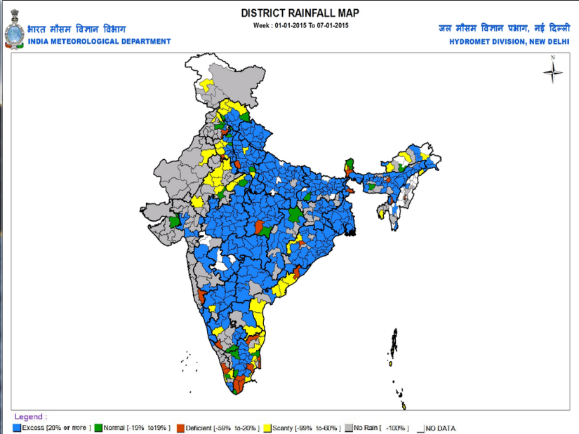
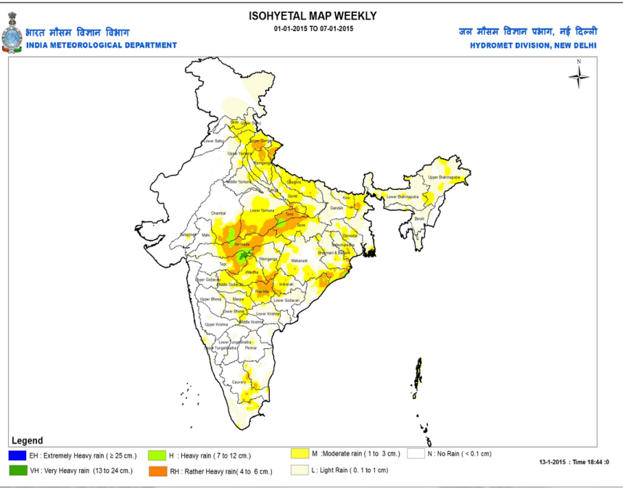
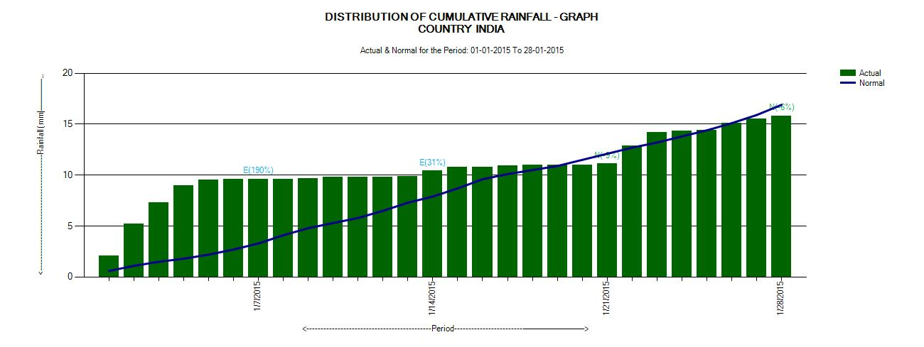
CRIS (Customised Rainfall Information System)
OPERATIONAL ON 15TH JANUARY, 2015 PROVIDES REAL-TIME RAINFALL INFORMATION BY MEANS OF GIS BASED RAINFALL PRODUCTS FOR ANY PLACE IN INDIA.
THE DISTRICT-WISE RAINFALL STATISTICS IS HELPFUL TO FARMERS FOR THEIR AGRICULTURAL ACTIVITIES.
RIVER BASIN-WISE STATISTICS IS USEFUL FOR FLOOD FORECASTING AND WATER MANAGEMENT PURPOSES
Daily, weakly and monthly rainfall statistics help various stake holders for estimating drought and flood conditions
RAINFALL GRAPHS

Slide 24
River Basin wise Rainfall Products for Flood Forecasting
RAINFALL PRODUCTS OF WRF AND MME
PROPOSED EXTENDED RANGE MODEL
RAINFALL FORECAST

Slide 25
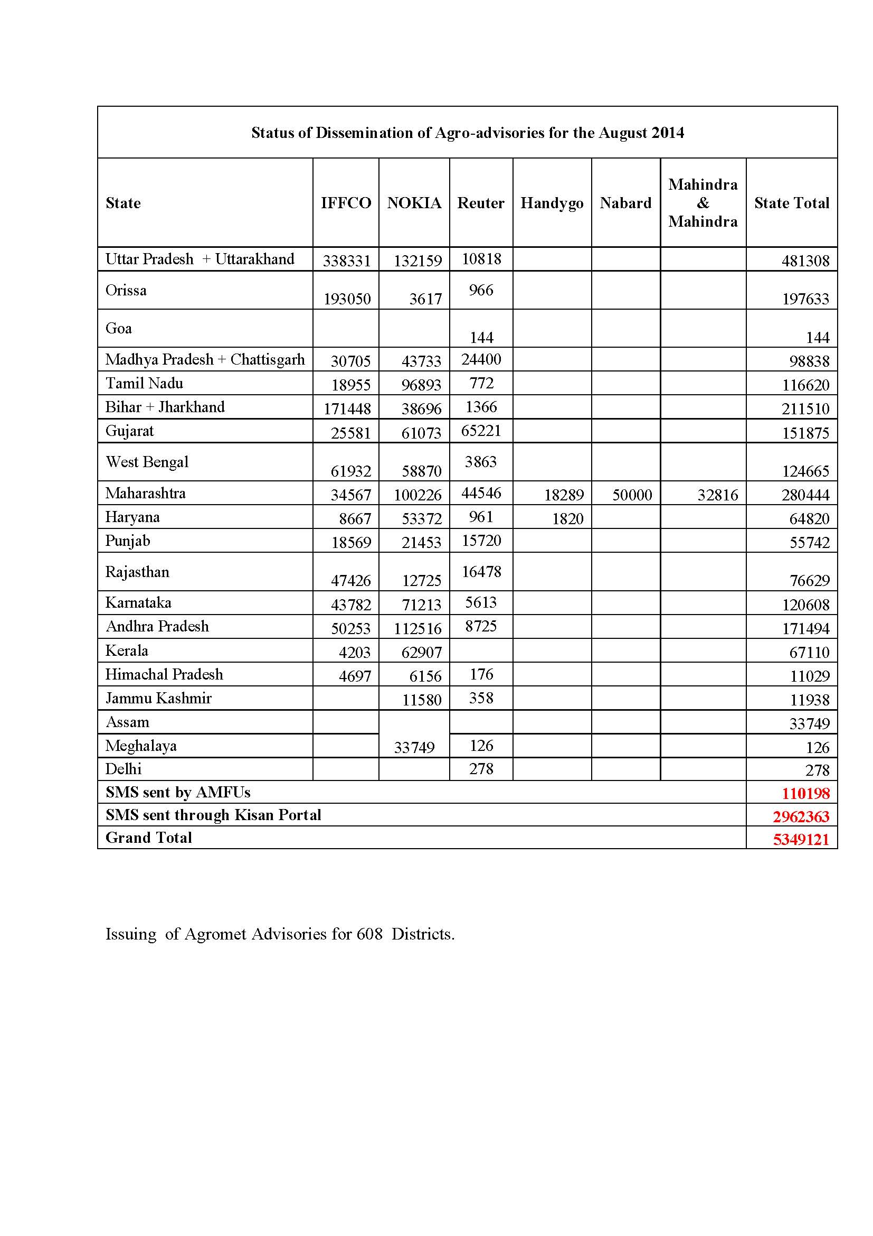
Gramin Krishi Mausam Sewa: Preparation and Dissemination of Agromet Advisory
Target is to issue 615 district wise bulletins
District level AAS bulletins are issued to 608 districts
Agromet advisories through SMS and IVR technology are being disseminated to 8.1million farmers in the country including other modes of dissemination like TV, Radio and Print media.
Target is to disseminate agromet advisories to 10 millions farmers by March 2015.
5349121

Slide 26
GKMS: Action Plan for agromet advisory
Establishment of 50 District Agromet Units jointly by ICAR and IMD
Real time data collection of Agromet data by modernization of existing agromet observatories including basic and derived Agromet Parameters, crop information and remote sensing data with the linkage with the National Data Centre of IMD located at Pune.
Three Working Groups along with the Coordination & Monitoring Team for implementation of Satmet information on agromet products.

Slide 27
New Initiatives

Slide 28
Integrated Himalayan Meteorology Programme
Administrative order issued on 6th August, 2014 for the project “Integrated Himalayan Meteorology Programme for Western & Central Himalaya” covering four states namely Jammu & Kashmir, Himachal Pradesh, Uttarakhand, and Sub Himalayan West Bengal.
RFP documents of all equipments under preparation
Letters written to Chief Secretaries of concerned states to identify & allot the land to IMD
Concerned MCs and RMCs in process to identify the land and tie up the matter with state authorities.
To develop appropriate system of 24×7 monitoring and early warning for extreme weather

Slide 29
Integrated Himalayan Meteorology Programme
Commissioning of 9 Doppler Weather Radars (DWRs)
Commissioning 15 Micro Rain Radars (MRRs)
Commissioning of 09 GPS based UA Systems along with GPS radiosonde
Commissioning of 230Surface Observing equipment consisting of Automatic Weather Stations, Automatic Rain Gauges & Snow Gauges
Commissioning of 12 Compact Severe Weather Detection Radar Systems
Commissioning of 9 Heliport Automated Weather Observation Systems (HAWOS)
Establishment of 15 Surface Field Observatories.
Establishment of Mountain Meteorological Research Cell
Commissioning of 3 Radiation Equipments.
Procurement of mobile observing systems.
Procurement of On-line UPS, Generators, Test Equipment, etc.

Slide 30
Development of High Impact Severe Weather Warning System
Administrative order issued on 4th June 2014.
Brainstorming meeting on I-WRF was held on 8-9 August 2014. Minutes are circulated. Research proposals for funding through GIA are being invited.
Experiments with WRF on the new HPC machine at IITM-Pune to be started.
RFP committee meetings held for AWS, Radars, UAV and upper air instruments. The RFPs are being finalized.
Locations for Mesonet Observation Test bed (Supersite) around NCR-Delhi and Eastern India (for Nor’westers) are being finalized by RMC-Delhi and RMC-Kolkata.

Slide 31
Development of High Impact Severe Weather Warning System
Equipment | Number
AWS | 200
Mobile Mesonets | 10
Mobile GPS Upper Air System | 2
50 cm Boundary Layer Tower | 1
Cloud Radar | 1
Precipitation Radar Mobile | 1
Raman Lidar | 1
Wind Profiler / Doppler wind Lidar | 2
UAV | 6
Disdrometer | 6
Polarized Lidar | 1
Microwave Radiometer | 4
Phased Array SODAR | 1
Dual Polarized Mobile Radar | 2
Recruitment of project scientists and technical staff are in process.
Working space for project scientists and visualization laboratory are being created through CPWD.
As two quarters of the financial year already over, the amount of Rs. 21.0 crores earmarked for 2014-15 may not be utilized. Revised amount of Rs. 1.0 crore projected for the remaining part of the financial year 2014-15.

Slide 32
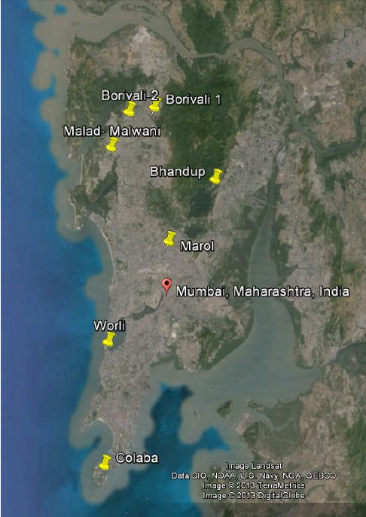
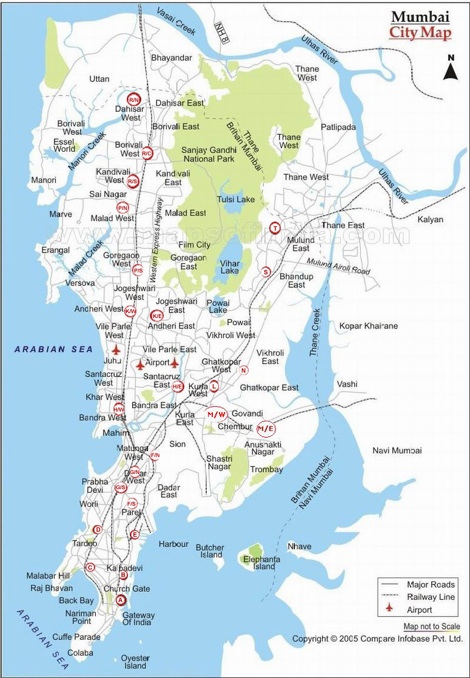
Metropolitan Air Quality and Weather Services
Automatic Air Quality and Weather stations to be installed in Mumbai with the components of 10 AQMS, 30 AWS and 12 Public displays in Mumbai.
The BMC Commissioner agreed in principal for the Mumbai Metropolitan project
Site selection completed jointly by RMC Mumbai, IITM Pune and BMC.
Megacity Forecasting project: SAFAR – Mumbai: Sites for AQMS and AWS

Slide 33
Modelling of Changing Water Cycle and Climate
Hydro-meteorological Information system to be developed using the data as follows:
Procurement of application software/hardware for hydro-meteorological information system and hydrological models.
Meteorological data processing as per model requirement.
Observational data from CWC, BBMB, CGWB, Wadia Institute of Himalayan Geology will be arranged and used in the hydro-meteorological modelling.
Equipment | Narmada | Satluj
AWS Network | 30 | 30
AWS-Agro Network including ET (lysimeter) and soil moisture | 20 | 15
ARG Network (with additional sensor for Air temperature and RH) | 80 | 30
Gauge, Discharge, River gauge Digital Water Level Recorders (DWLRs) Acoustic Doppler Current Profiler(ADCPs) | 30 | 40
Snow Observatory: Snow precipitation/rainfall amount, snow depth | - | 30
Snow Observatory: snow density/snow water equivalent | - | 10
Evaporation gauge sensor | 20 | 20
Piezometers (60-80m deep) | 30 | 20

Slide 34
Future Plans & Targets

Slide 35
Targets for 2015-16
Inauguration of DWRs at Goa, Paradip, Karaikal , Mumbai & Bhuj
Commissioning of GPS based ozone sonde systems at 5 locations & Antarctica to improve ozone monitoring.
Commissioning of 25 GPS stations for measurement of Integrated Precipitable Water Vapour (IPWV).
Commissioning of Aviation Weather Observing Systems (AWOS) at airports and new Greenfield airports.
Commissioning of new environmental monitoring equipments such as Athelometers (Black Carbon) , Naphelometers, Green House Gases (GHG) system and UV-VIS Spectrophotometer to improve Environment Monitoring.
Commissioning of WMO Information System (WIS) Compliance for RTH New Delhi. Designation of RTH New Delhi as Global Information System Centre (GISC).
Replacement of Old AMSS at 4 Aerodrome Meteorological Offices (AMO) Mumbai, Delhi, Kolkata and Chennai.

Slide 36
Targets for 2015-16
Site selection, Infrastructure development and commissioning of equipments under the project “Integrated Himalayan Meteorology Programme for Western & Central Himalaya” and “Development of High Impact Severe Weather Warning System”
To establish a state-of the-art climate data centre with advanced climate data management system.
Appraisal & Approval of Integrated Meteorological Services for Northeastern Region to improve weather forecast services over the northeastern region covering states namely Arunachal Pradesh, Assam, Meghalaya, Nagaland, Manipur, Mizoram, Tripura & Sikkim.
Appraisal & approval of the Scheme “Modernization Phase-II of IMD for further augmentation of observational network & forecasting facilities to make further improvement in weather forecasting.

Slide 37
Thank You

Slide 38
Weather & Climate Research: Targets
Analysis of SFM hindcasts and forecasts will be done to develop forecasting tools for the monsoon rainfall over India, winter rainfall over north India and northeast monsoon rainfall over South Peninsula.
Computation of global verification statistics of SFM hindcasts and to increase the number of ensemble members in the SFM hindcasts and forecasts from 10 to 20 members.
Conducting sensitive studies and teleconnection studies using the model simulated climate fields.

Slide 39
Weather & Climate Research: Targets
Study on the various rainfall features such as long term climatology, variability (such as active and break monsoon events, monsoon onset and advance, heavy rainfall events etc.) using high resolution daily gridded rainfall.
Implementation of drought monitoring tool using high resolution gridded standardized precipitation index.
Implementation of tools for extended range prediction and seasonal prediction at subdivision scale through analysis of CFSv2 models developed under monsoon mission for extended and long range prediction.

Slide 40
Weather & Climate Research
Daily high resolution rainfall data at spatial grid of 0.25º X 0.25º for the period 1901-2013 was provided to many research groups and sold to user community.
Experimental Monthly and seasonal global forecasts for temperature and rainfall was prepared every month and made available through IMD website.
Issued climate outlook for south Asian countries
The real time gridded data till Aug, 2014 prepared.

Slide 41
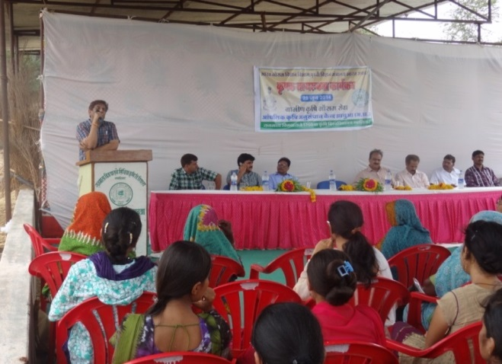
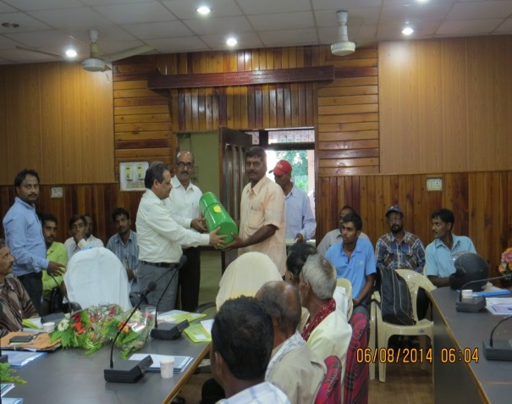
GKMS: Farmers Awareness Programme
AMFU Jhabua, Raipur, Portblair, Anathapuram, Chennai, Hyderabad, Aduthurai and Akola conducted Farmer Awareness Programmes.
Target is to conduct Farmer Awareness Programmes at remaining 63 AMFUs upto March 2015

Slide 42
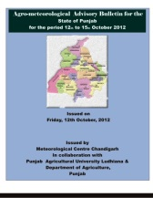
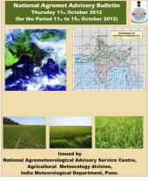
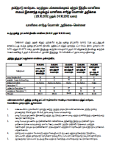
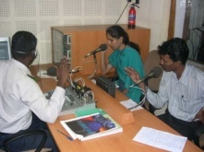
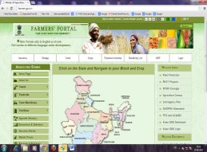
Operational Agromet Advisory Services in India
Preparation of value added medium range forecast at district level
Parameters
Rainfall, Wind speed and direction, Maximum temperature, Relative humidity, Minimum temperature, Cloud cover
Friday
Tuesday
NWP products
From Composite State Level Bulletin, Agrimet Division, IMD preparing National AAS bulletin
State Met Centre (SAMC)
Issuing State Level Composite Bulletin
Conducting State Level Meeting
Also Brochures for Awareness were completed for 14 languages
Issuing District Level Bulletin
In all total 622 bulletins in 13 languages & uploading in the website of Agrimet Division (http://imdagrimet.gov.in)
Value addition
Agromet Field Units
(AMFUs)
Conducting Farmer Awareness Programme, Completed at 106 stations, will be conducting more in 71 locations
Dissemination of Agromet Advisory, alerts in extreme weather through Multi-Channel
Central Silk Board
NOKIA
Farmer Portal
Organised different training programmes.
Established feedback mechanism
8.01 million farmers
Receiving SMS
Outcome : Large Economic Impact
Agromet
Advisory

Slide 43
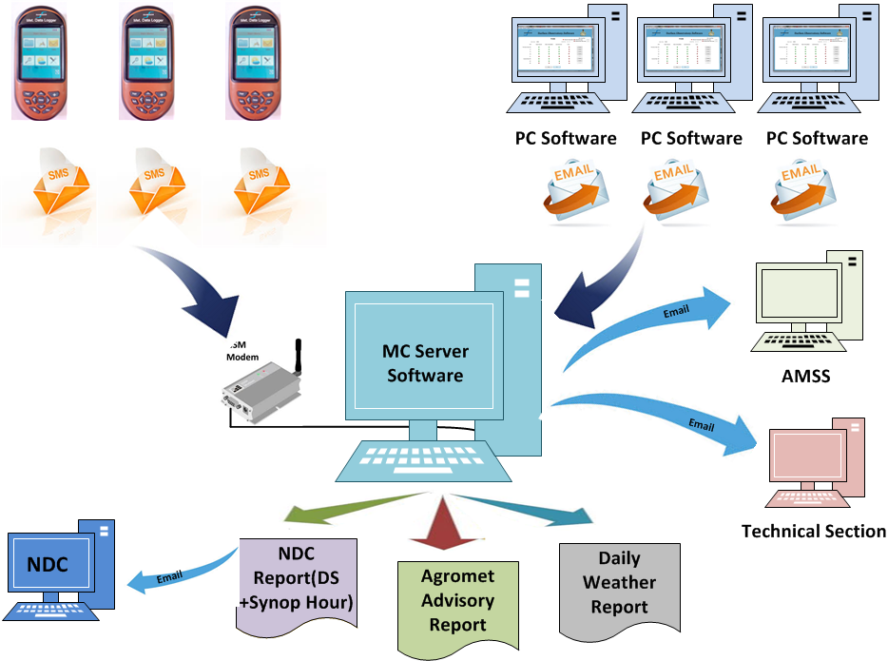
Future Plan : Automation in observational system
Hand Held Data Logger (HHDL) with GSM Modem
Used for data entry, automatic processing, and message transmission in all conditions
Embedded HHDL Software
Software with built- in Quality checks to enable user to do all tasks related to synoptic Observations
Synoptic Observatory Software (SOS)
PC-based application with similar functionality as present in HHDL, and serves as alternative to HHDL
Data Flow System
HHDL
HHDL
HHDL
4.Synoptic Server Software (SSS)
Server software to collect synoptic data from various places (HHDL/PC) and also offers various other functions

Slide 44
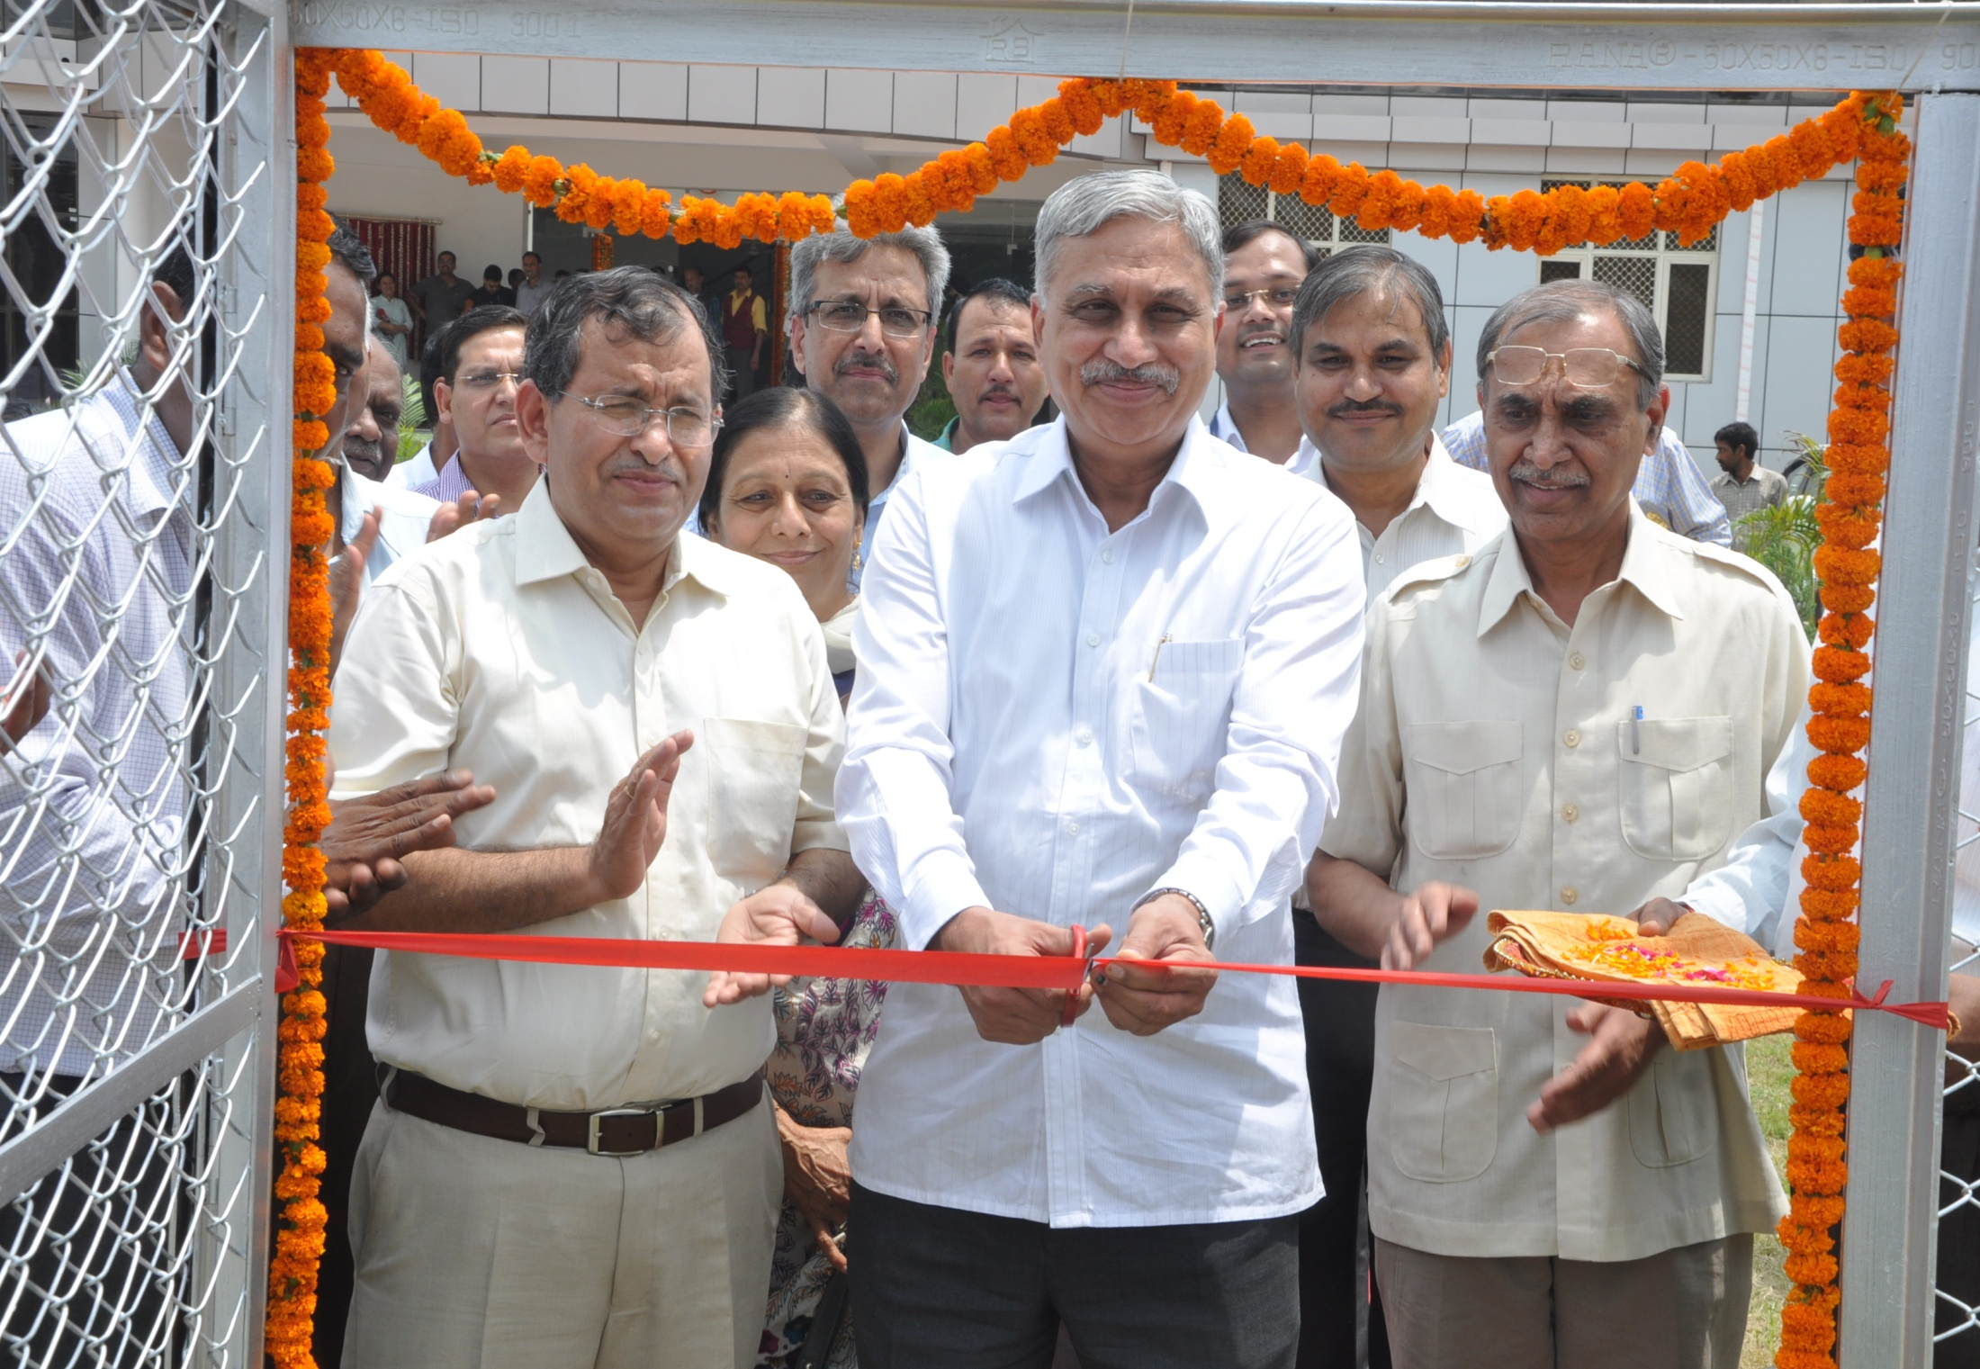
Special Forecasting Services
Special forecasting services for Chardham & Hemkund sahib .
Special forecast for Shri Amarnathji yatra issued and disseminated to users.
Issued mesoscale weather forecast for 15 High altitude of Uttarakhand to all concerned state Government authorities by SMS & emails.
New Infrastructure created in Dehradun

Slide 45
Information Systems & Services
Upgradation of Internet bandwidths from 45 Mbps to 60 Mbps for smooth operation of IMD website and internet services at HQ
Exchange of RARS data between JMA and NCMRWF / NWP through GTS (RTH New Delhi).
M.C. Bhubaneswar equipped with NKN connectivity and Synergie systems installed at M.C. Jaipur and M.C. Dehradun.
Creation & uploading of Special Yatra Web Page on IMD's Website for enroute Satellite Images and NWP products relevant to Yatra.
Header for Drifting buoy, XBT and XCTD created for INCOIS enabling GTS transmission of data through RTH New Delhi .
AMC of MFI system was awarded for one more year w.e.f. 14 July, 2014.
National and international data /products (like NWP, SADIS, Synop, METAR & TAF, Upper Air, SIGMET, Satellite bulletins, IWB, Regional inferences etc.) routed to INMAC (Indian Navy) Kochi

Slide 46
Update plans for NWP system
Year | 2014 (Existing) | 2015 | 2016 | 2017
Global Deterministic | GFS- T574/L64 (25km) GSI 3D var | GFS-T574/64L Hybrid EnKF (80 mem ensemble) | GFS-T1534/L64 (13km) Hybrid EnKF
Regional Deterministic | WRF - 27/9 km 38L 3D-Var(12 hr) | WRF-9/3km 51L Hybrid 3D Var (6hr) | WRF-9/3/1km 70L Hybrid 4dVar(3hr)
Cyclone Deterministic | HWRF - 27/9/3 km 42L GSI 3D-Var(12 hr) | HWRF - 27/9/3km 42L (Ocean coupling) Hybrid EnKF (6hr) | HWRF Atmospheric-Ocean coupled - 9/3/1km 70L Hybrid EnKF (3hr)
Local Deterministic | WRF - 3km 38L ARPS-9 km,WDSS-II Nowcast Products | WRF- 3/1km 70L (Semi operation) ARPS-3km,WDSS-II Nowcast Products | WRF - 3/1 km 70L (operational) ARPS-1km,WDSS-II Nowcast Products | WRF - 1km 70L ARPS-1km,WDSS-II Nowcast Products

