Slide 1
Decadal Climate Change and the Human System: The Need for Bidirectional Coupling of
the Climate and Human Systems
Jorge Rivas, Safa Motesharrei
Eugenia Kalnay
IITM, March 5, 2020
Presented at AGU 2019
Session: Decadal to Multidecadal Climate Variability: Mechanisms, Predictability, and Impacts II
2019 December 10, San Francisco, CA

Slide 2
It is clear that the Human System is dominating the Earth System, and that climate models must include bidirectional coupling of the Human and Earth Systems
We have published several papers on the Earth and the Human Systems, and I will present some important results.
Safa Motesharrei, Jorge Rivas and Eugenia Kalnay

Slide 3
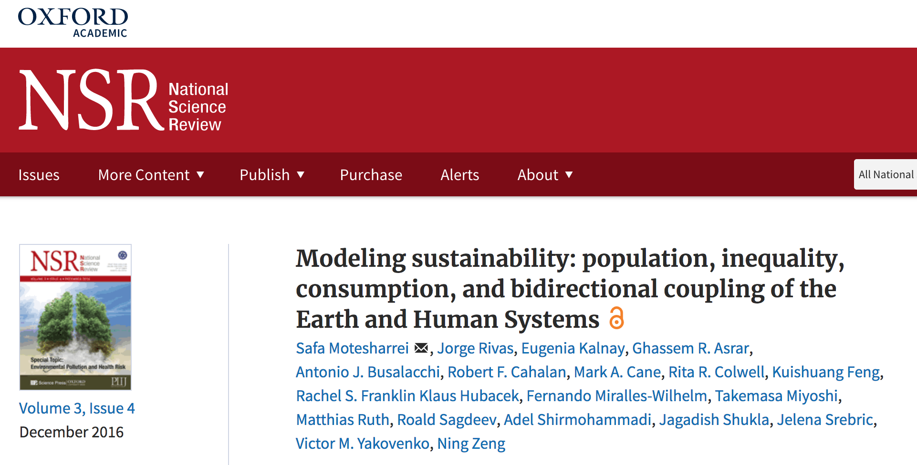
In this paper, we argue that the Human System has grown so large that it drives the Climate System, which then has to be modeled bidirectionally coupled to the Human System.

Slide 4
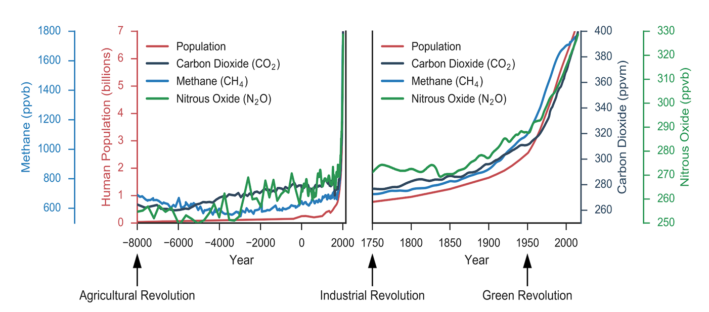
This chart shows that the 3 primary greenhouse gases follow population growth, which has grown rapidly since 1750, and explosively after 1950.
Population has become the dominant driver of changes in the climate.
Notes:
The abrupt and simultaneous upward trajectories of human population and greenhouse gases after the Industrial Revolution (~1750), and the distinct acceleration after the Green Revolution (~1950), show that the Human System
has become the primary driver of these gases and the changes in the Earth System. Adapted from Fu & Li (2016).

Slide 5
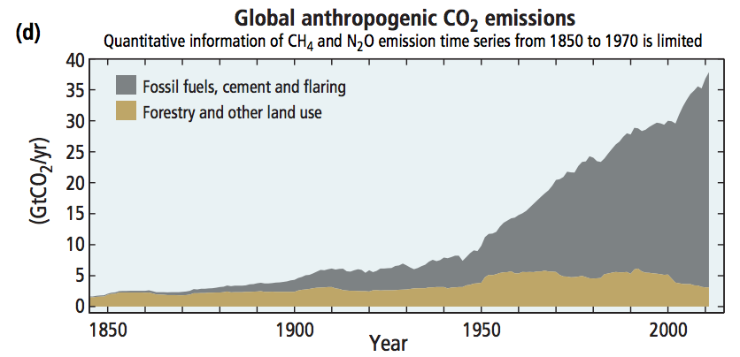
This IPCC chart shows how CO2 emissions exploded after the Green Revolution around 1950
Haber-Bosch nitrogen fertilization
leads to Green Revolution
Industrial Revolution
Green Revolution

Slide 6
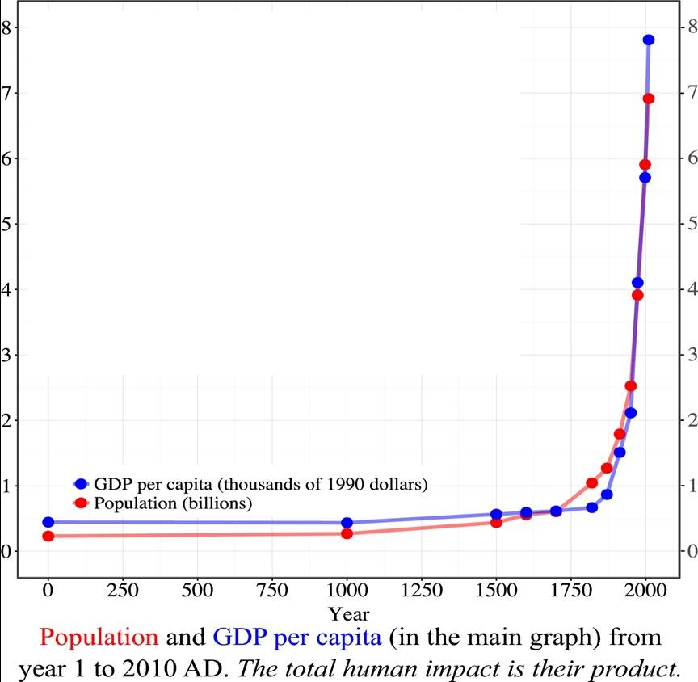
In this chart of Population
and GDP/Capita
over the last 2000 years, we see that each has exploded in the last 200 years.
It is important to emphasize:
The Total Human Impact is the
product
of these two exploding curves!
6
Notes:
Population Growth and GDP/Capita have each increased by about 2% per year since 1950. The total human impact is their product and doubles every ~18 years!

Slide 7
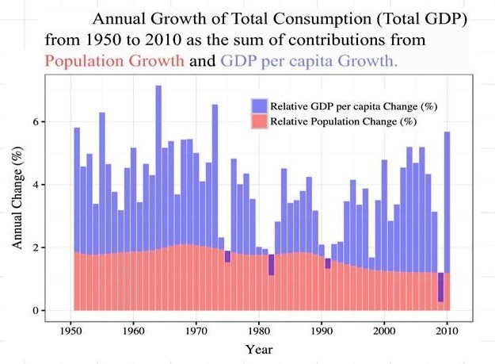
Since Population and GDP/Capita have each increased by ~2%/year since 1950, the Total Human Impact doubles approximately every 18 years!
It is clear that this is a driver of change in the climate on a decadal scale.
Notes:
Population Growth and GDP/Capita have each increased by about 2% per year since 1950. The total human impact is their product and doubles every ~17 years!

Slide 8
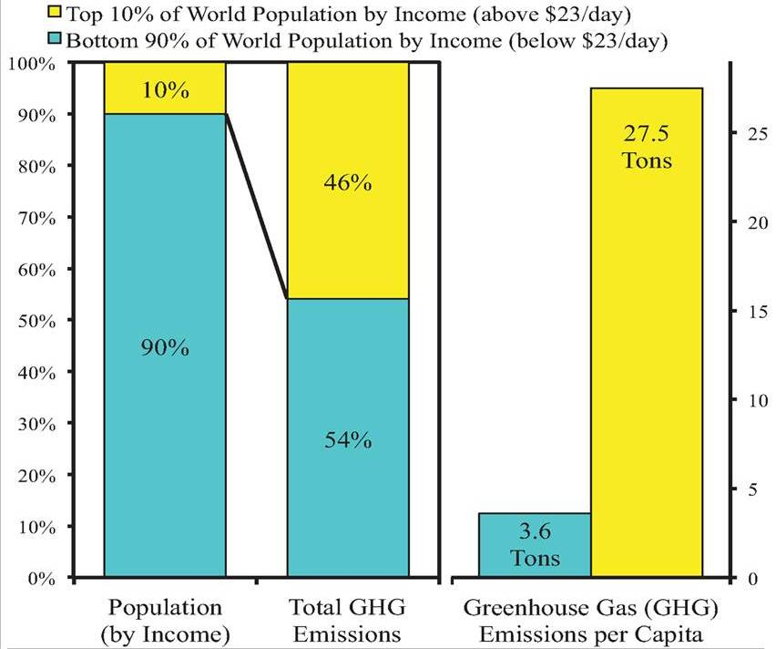
The wealthiest 10% of people produce about the same emissions as the poorest 90% of people.
Thus, raising the bottom 90% to match the top 10% would require increasing total emissions by ~5 times.
But there is Inequality in Green House Gas Emissions:
Notes:
Erase the text at the bottom

Slide 9
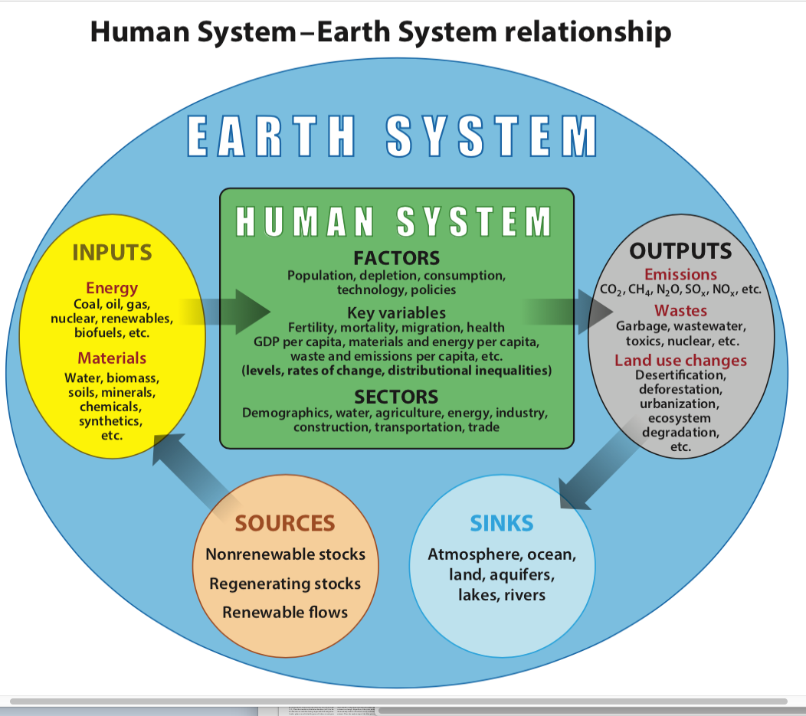
What is the real
Human System-Earth System
relationship?
The Human System is within the Earth System:
The Earth System Sources provide the Inputs to the Human System.
The Human System Outputs must be absorbed by the Earth System Sinks
(such as the Atmosphere, Oceans and Land).

Slide 10
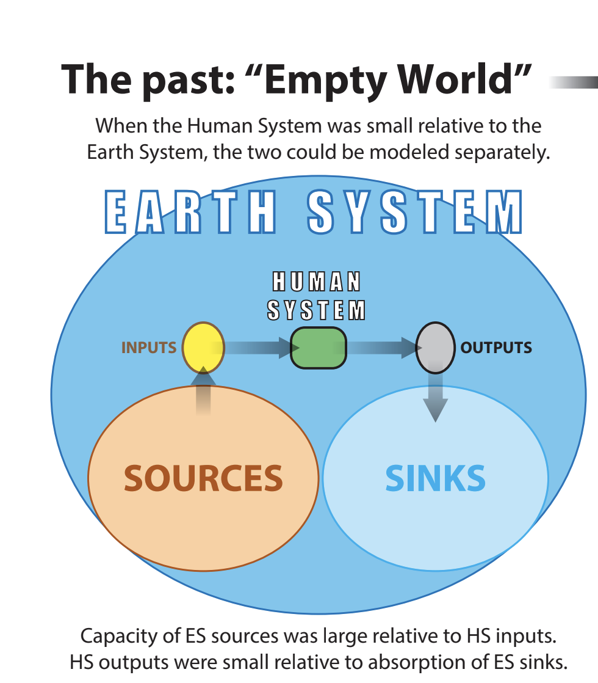
Notes:
Cut text at the bottom

Slide 11
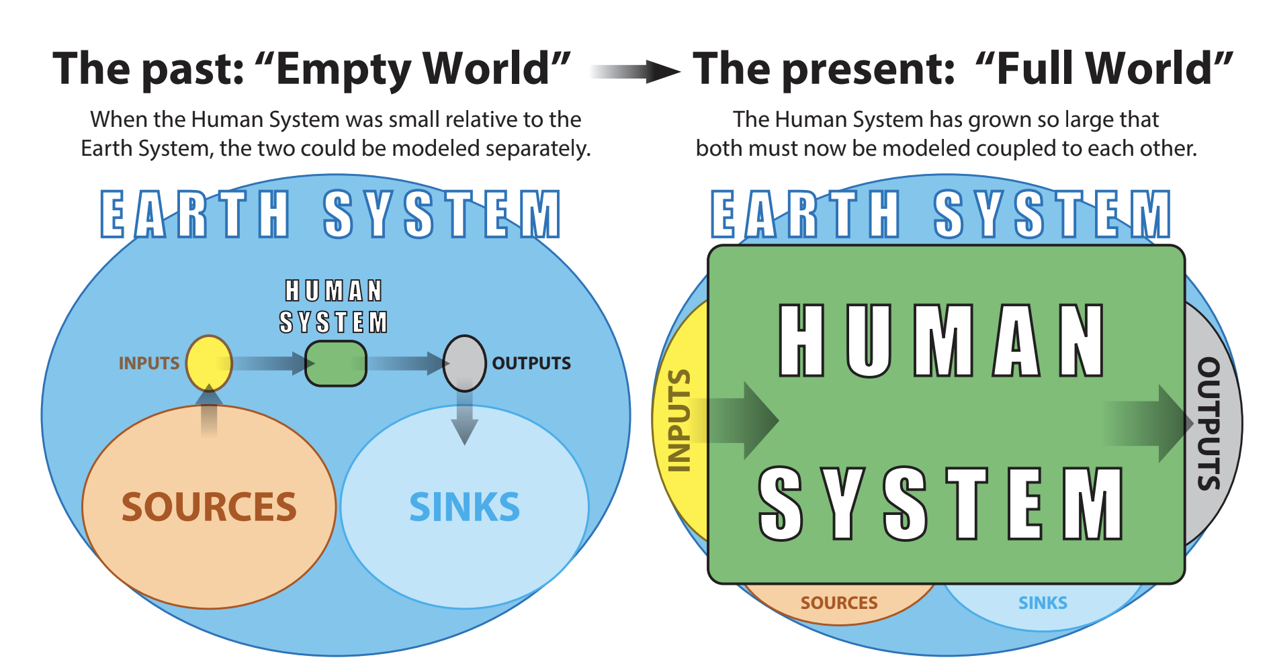
Now, HS inputs and outputs are so large relative to the ES, they threaten to deplete its sources and overwhelm it sinks!

Slide 12
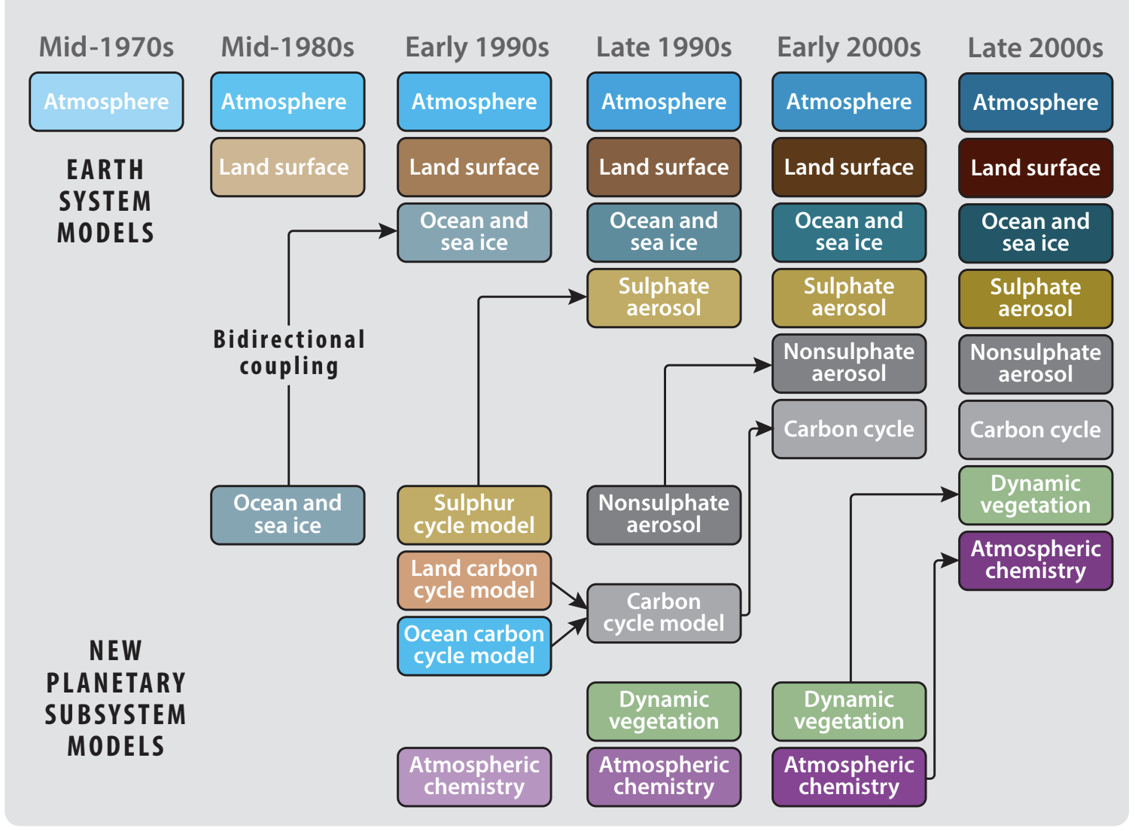
This is a adapted from a
well known
IPCC
graphic
showing
how Earth
System
components
have been
developed
and then by-
directionally
coupled
over time.

Slide 13
The example of ENSO shows the need for bidirectional coupling:
Until Cane and Zebiak (1986) developed an atmosphere-ocean model that was bidirectionally coupled, it was impossible to predict El Niño!

Slide 14
The example of ENSO shows the need for bidirectional coupling:
But the most important subsystem, the HUMAN system, is still missing and uncoupled!

Slide 15
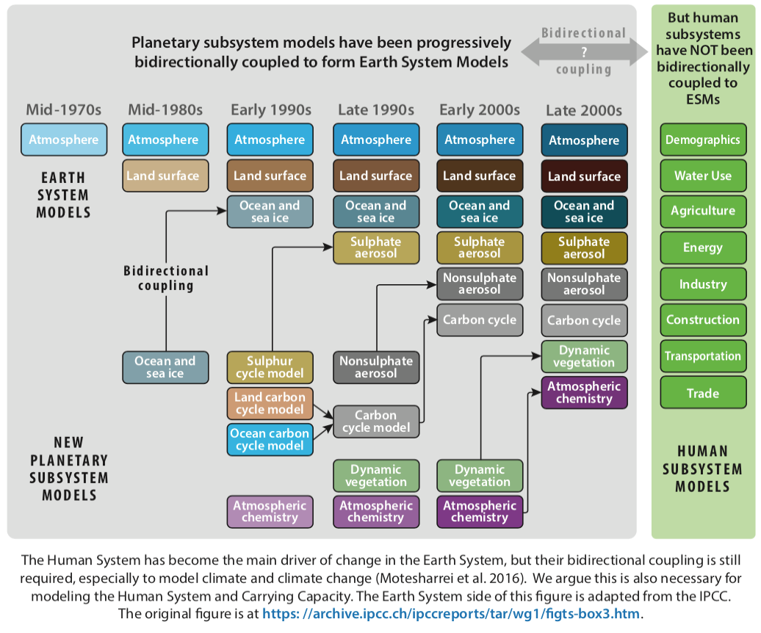
The Human System has become the main driver of change in the Earth System, but their bidirectional coupling is still required, in particular, to model climate and climate change (Motesharrei et al. 2016). We argue this is also necessary for modeling the Human System and Carrying Capacity.
The Earth System side of this figure is adapted from the IPCC.

Slide 16
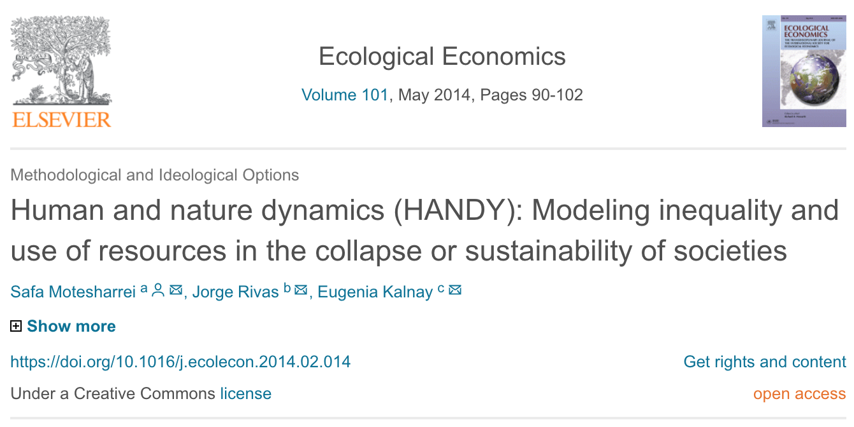
Bidirectional coupling does not have to be complex. In this paper, we developed a minimal model of bidirectionally coupled Human and Natural Systems:
Citations > 300 (Google Scholar)
Blog about HANDY in the Guardian went viral:
40 million hits! Even the Onion wrote about HANDY

Slide 17
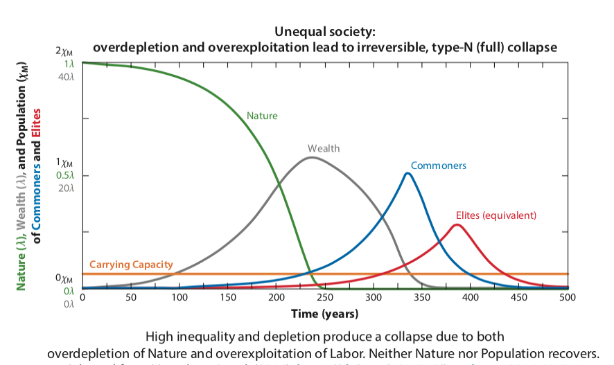
Unequal society: overdepletion and overexploitation lead to irreversible, type-N (full) collapse

Slide 18
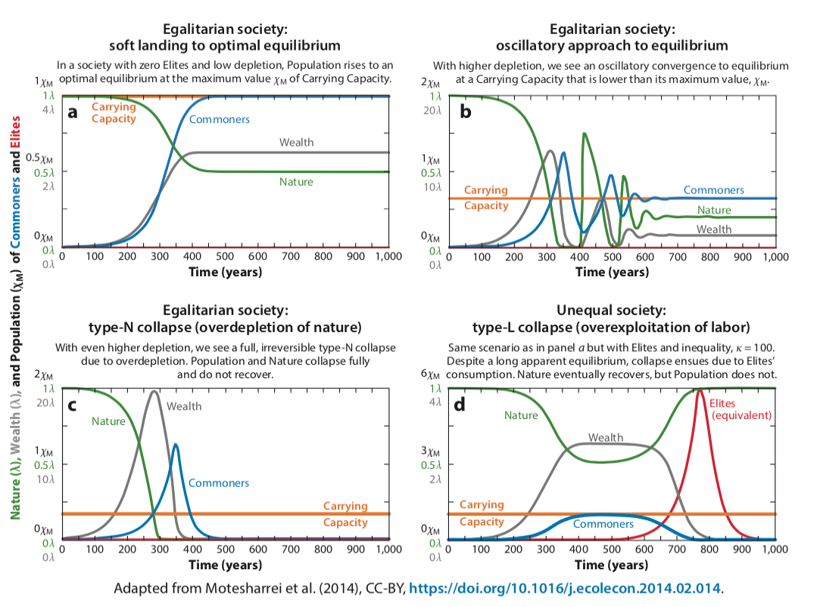

Slide 19
Among the other important results, the HANDY model shows that adding fossil fuels, the collapse is postponed by ~200 years and Population increases by a factor >10!
Both Regenerating and Nonrenewable Resources (fossil fuels)
Regenerating Nature Only
This is what happened after the Industrial Revolution!

Slide 20
Humans also Impact Climate through Land-Use change!
Examples:
Impact of urbanization and land-use change on climate. Kalnay and Cai, Nature, 2003. ~1900 citations.
Impacts of land use/land cover on temperature trends over the continental US: assessment using the North American Regional Reanalysis. S Fall et al, Intern. J. of Climatology, 2010. 173 citations.
And many other studies
Another example of how land-use change can impact climate is given in our 2018 Sahara paper published in Science.

Slide 21
Climate model shows large-scale wind and solar farms in the Sahara increase rain and vegetation
Yan Li*, Eugenia Kalnay*, Safa Motesharrei*, Jorge Rivas,
Fred Kucharski, Daniel Kirk-Davidoff, Eviatar Bach, Ning Zeng
*Corresponding authors: yanli.geo@gmail.com (Y.L.); ekalnay@umd.edu (E.K.); ssm@umd.edu (S.M.)
Published in Science 2018 September 07
Within 3 weeks, it was downloaded >100K times,
Reached #30 out of 50,000 papers (Science)

Slide 22
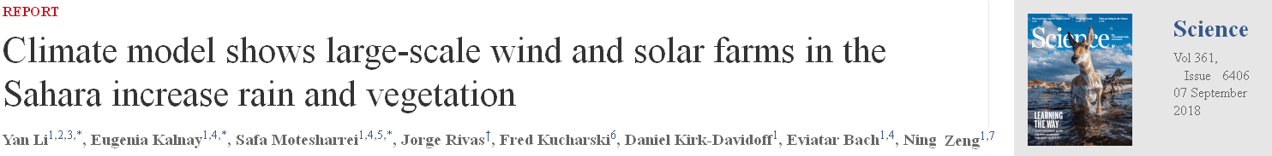
In this paper, we modeled how Solar and Wind energy infrastructure can affect climate conditions in the Sahara and the Sahel, in particular precipitation,
Yan Li*, Eugenia Kalnay*, Safa Motesharrei*, Jorge Rivas,
Fred Kucharski, Daniel Kirk-Davidoff, Eviatar Bach, Ning Zeng
Rating by Altmetric:
a) in the top 10 climate papers of 2018 and
b) in the top 100 of all science papers of 2018 (including medical papers)

Slide 23
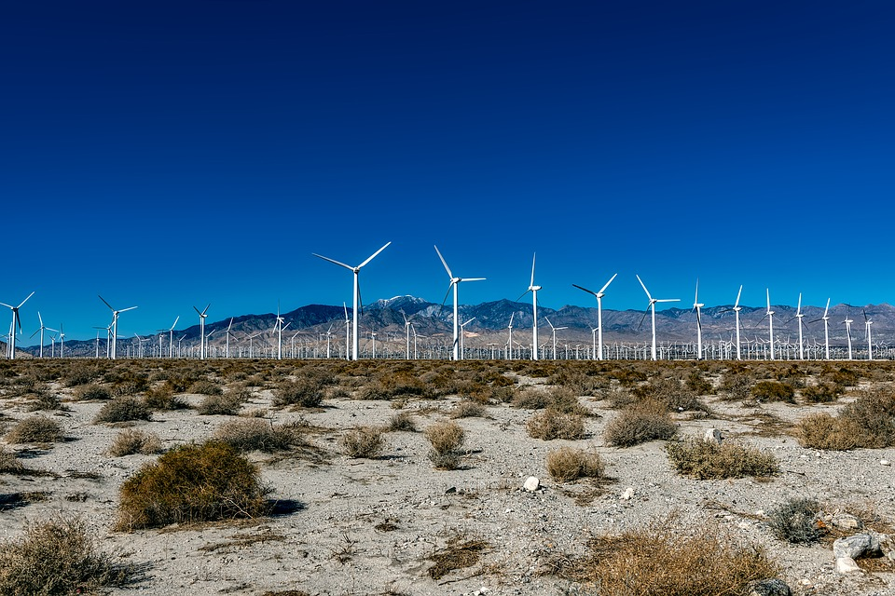
Wind farms change the land surface friction

Slide 24
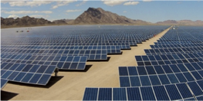
Solar farms change the surface albedo (reflectivity)

Slide 25
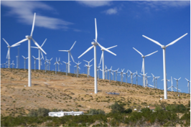
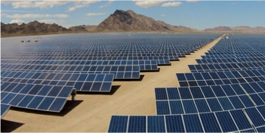
But: Large-scale wind and solar farms could also affect climate!
(Like an unintended geo-engineering experiment?)

Slide 26
What are the impacts of wind and solar farms on the climate?
Global climate impact (good!):
By substituting fossil fuels, renewable energy farms would reduce the emission of greenhouse gases, and thus could reduce or slow anthropogenic climate change.
Local climate impact (good?, bad? geo-engineering?):
Changes to surface roughness and albedo could affect climate.
To test whether this is beneficial or detrimental, we conducted simulation experiments with the UMD-ICTP Earth System Model (SPEEDY+VEGAS models).

Slide 27
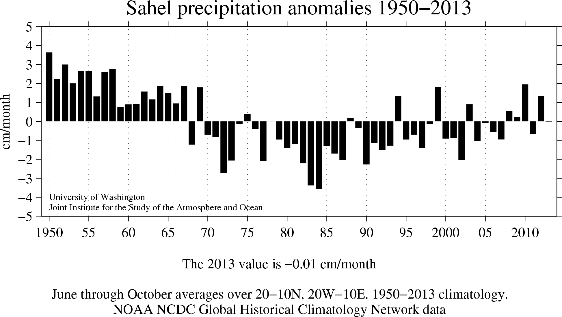
From the mid 1960s to ~2010, Sahel precipitation decreased substantially
Drought Δpp ~
-1 to -3 cm/month
-0.3 to -1.0 mm/day
Δpp from wind and solar farms:
+1.34 mm/day
1 - 4 times larger!

Slide 28
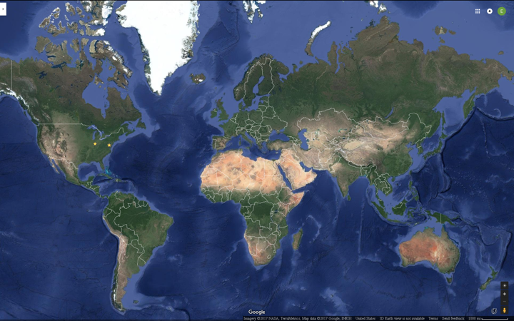
Sahara is not only the largest desert, but also has the highest albedo.
So in the model, we covered the Sahara with wind and solar farms.
Notes:
We could cut this slide

Slide 29

Charney and Sud Feedback Mechanisms
to explain the Sahel Drought
Charney (1975):
Overgrazing=>
Increased albedo=>
Less heating=>
Downward motion=>
Less rain=>
Less vegetation
Sud and Smith (1985):
Overgrazing=>
Reduced friction=>
Less convergence=>
Less rain=>
Less vegetation
J. G. Charney, Dynamics of deserts and drought in the Sahel. Q. J. R. Meteorol. Soc. 101, 193–202 (1975).
Y. C. Sud, W. E. Smith, The influence of surface roughness of deserts on the July circulation - A numerical study. Boundary-Layer Meteorol. 33, 15–49 (1985).

Slide 30
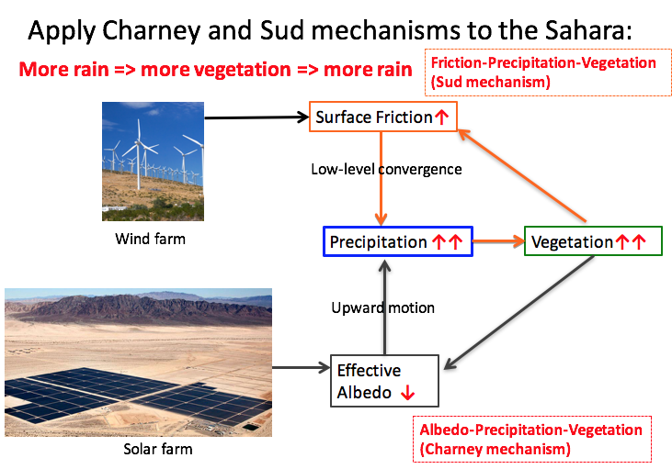
Wind farm

Slide 31
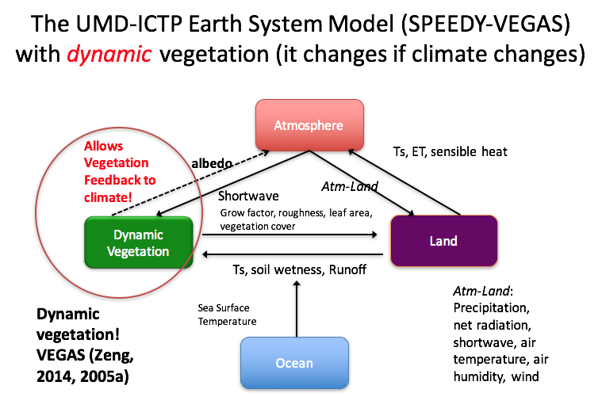

Slide 32
Climate model shows large-scale wind and solar farms in the Sahara increase rain and vegetation
Yan Li*, Eugenia Kalnay*, Safa Motesharrei*, Jorge Rivas,
Fred Kucharski, Daniel Kirk-Davidoff, Eviatar Bach, Ning Zeng
*Corresponding authors: yanli.geo@gmail.com (Y.L.); ekalnay@umd.edu (E.K.); ssm@umd.edu (S.M.)
Published in Science 2018 September 07
Within 3 weeks, it was downloaded >100K times,
Reached #30 out of 50,000 papers (Science)

Slide 33
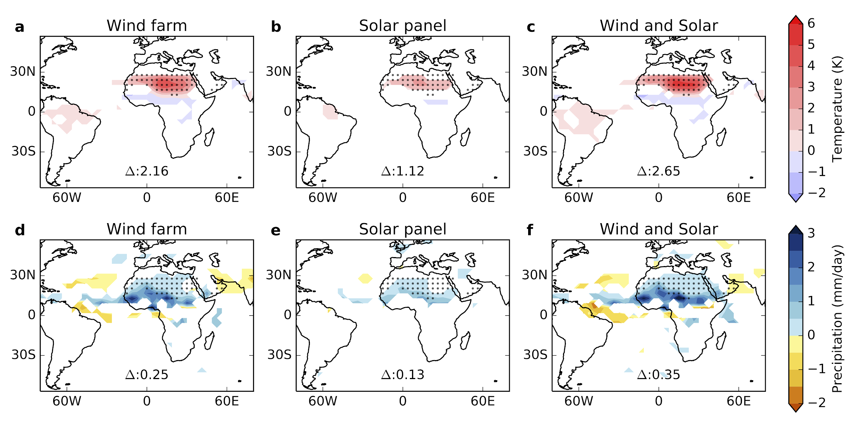
The Model Results: increased local temperature and
More than doubled precipitation in the Sahara
Surface
Temperature (K)
Precipitation
(mm/day)

Slide 34
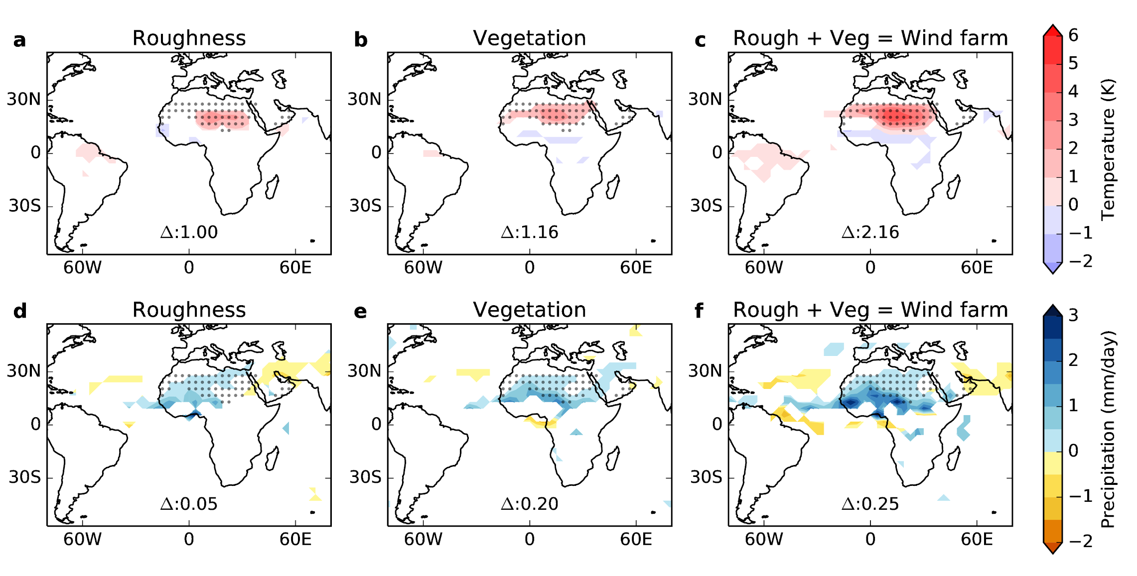
80% of the precipitation impact is due to the dynamic vegetation feedback. This shows the importance of bidirectional coupling.

Slide 35
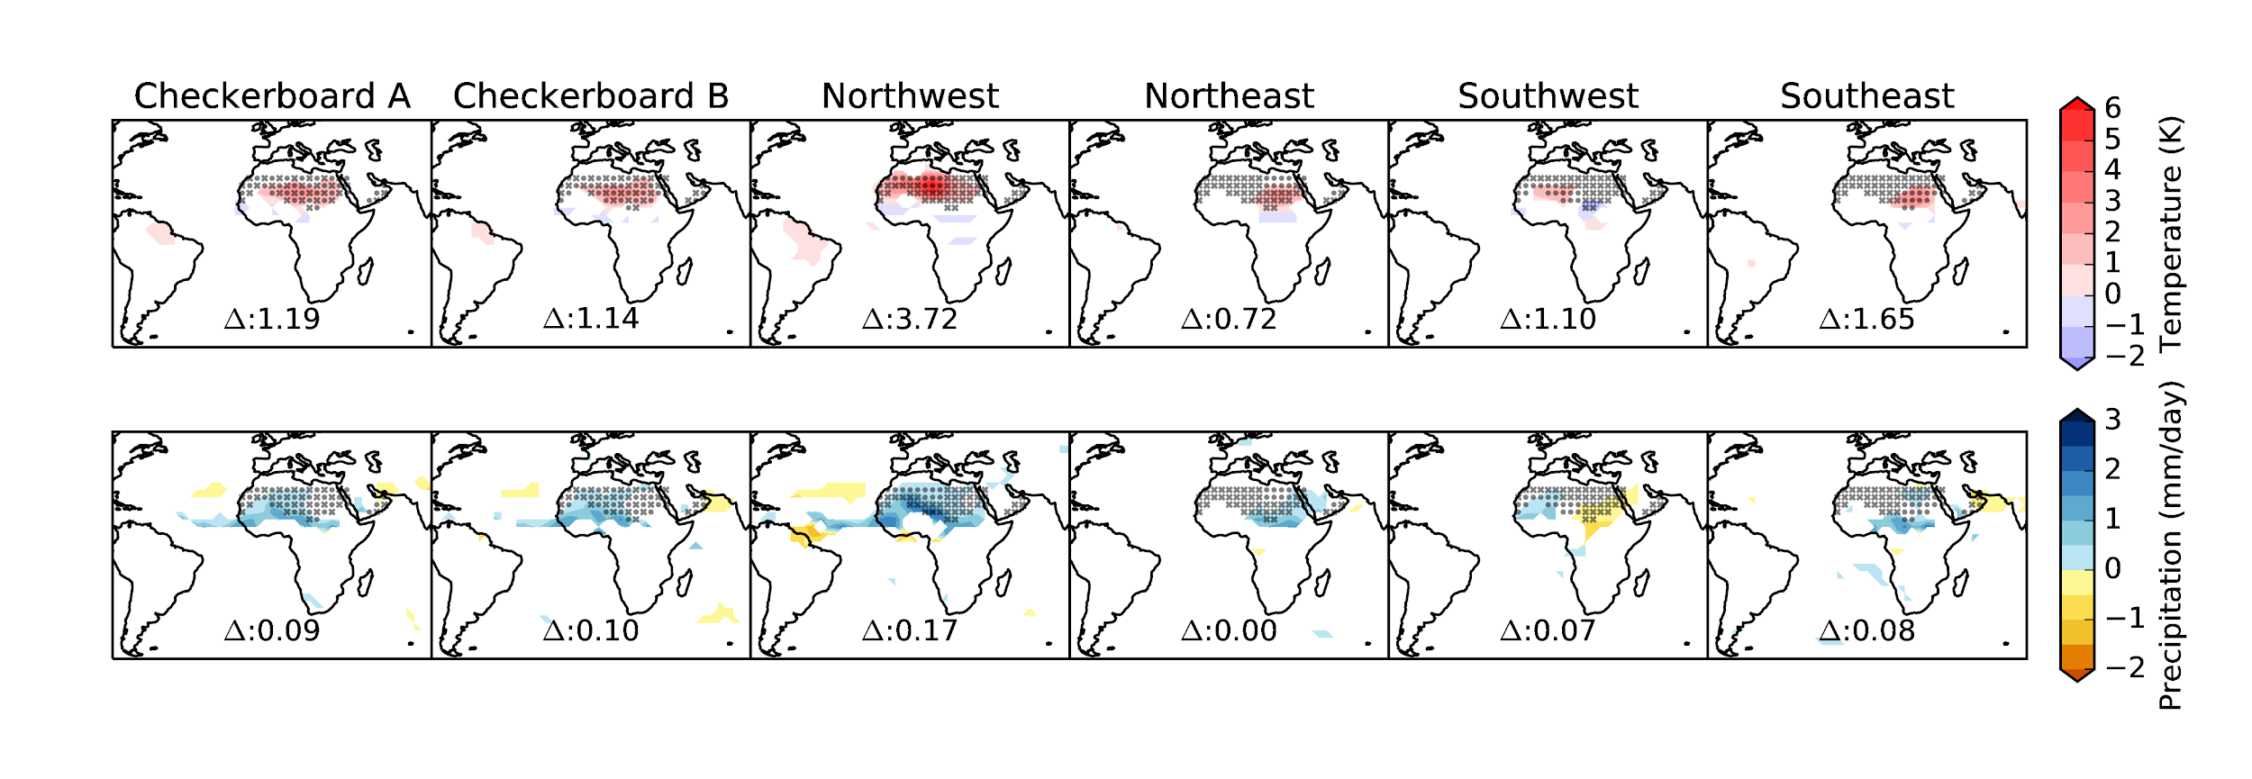
Covering only the Northwest quadrant of the Sahara had a similar total impact
Would there be impacts from a smaller area?
Notes:
We could cut this slide

Slide 36
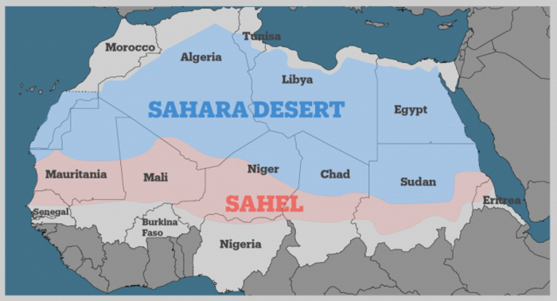
The Sahara desert is ~ 9.2 million km² and the Sahel is ~ 3.1 million km².

Slide 37
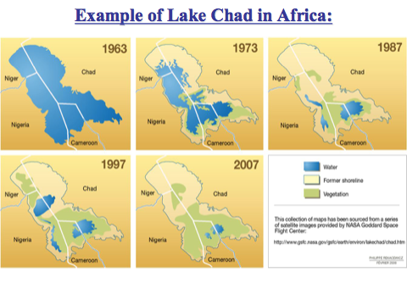

Slide 38
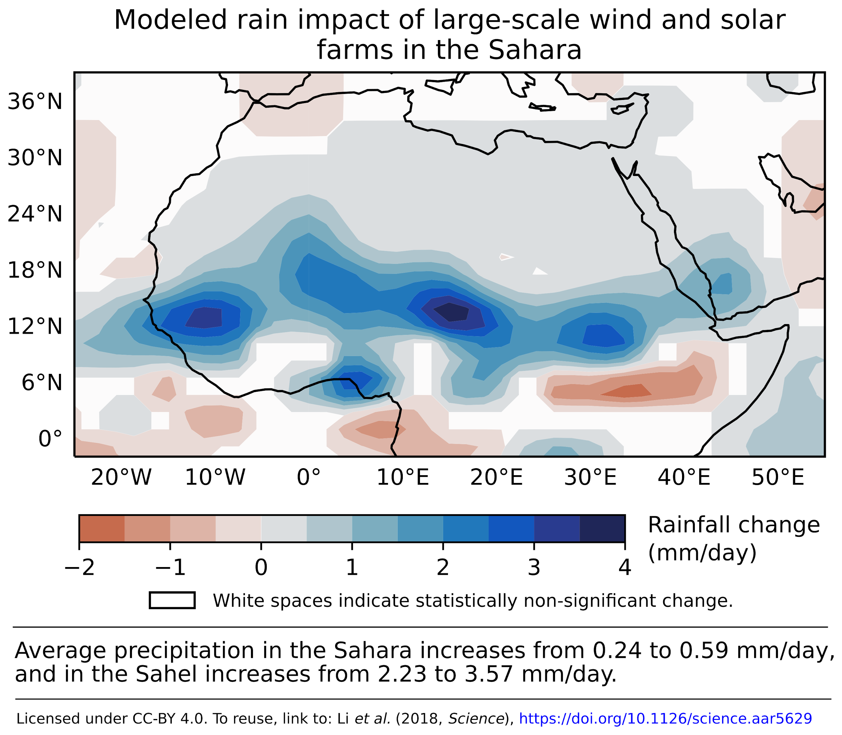
Precipitation in the Sahel increases up to 500 mm/year, with a maximum in the area of Lake Chad, which is currently disappearing because it is drying up.
The increase in precipitation is larger than the decrease during the 1960-1990s drought.
Lake Chad

Slide 39
These solar panels and windmills would produce more than 4 times the TOTAL energy used by humanity.
So, no need for fossil fuels!
Lake Chad
39

Slide 40
The Sahel is the poorest region in the world, with the fastest population growth (>7 children/family). It has the largest emigration (with deaths) in the world. The UN population projections estimate emigration will go to zero, because they could not estimate how it will evolve!!!!!!
Lake Chad
40

Slide 41
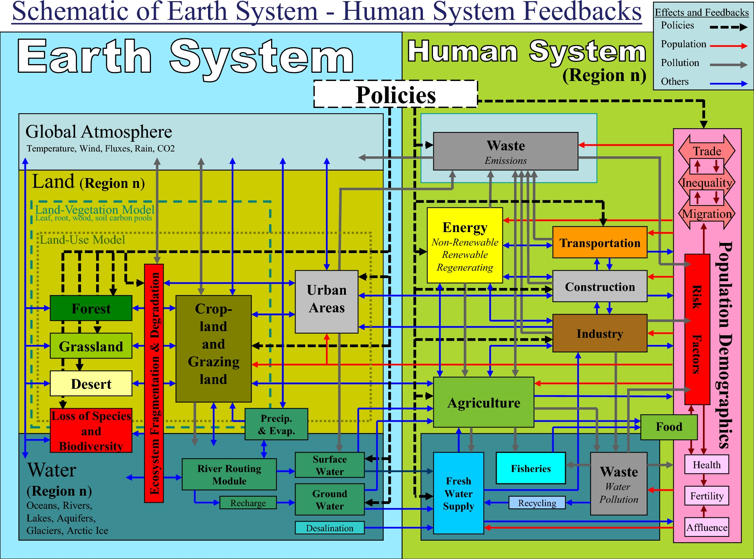
This is a schematic of the bidirectional coupling of the Earth and Human System that could be used in a coupled climate model.
Notes:
This is a schematic of the bidirectional coupling of the Earth and Human System that could be used in a coupled climate model. Thanks!

Slide 42
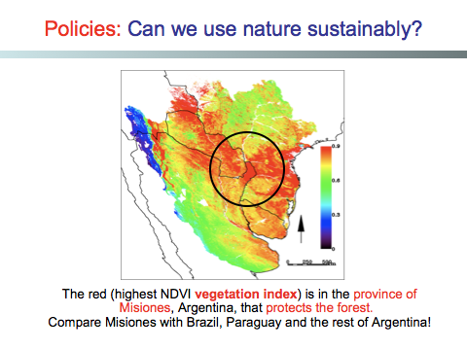

Slide 43
This is a schematic of the bidirectional coupling of the Earth and Human System that could be used in a coupled climate model.
Thanks!
Notes:
This is a schematic of the bidirectional coupling of the Earth and Human System that could be used in a coupled climate model. Thanks!

