Slide 1
Extended Range Prediction of Monsoon 2021- onset and Initial advancement
AVIJIT DEY
Extended Range Prediction Group
Indian Institute of Tropical Meteorology, Pune – 411 008, INDIA
Contributors: ERP Group Members
Monsoon Discussion Forum, 25 June 2021

Slide 2
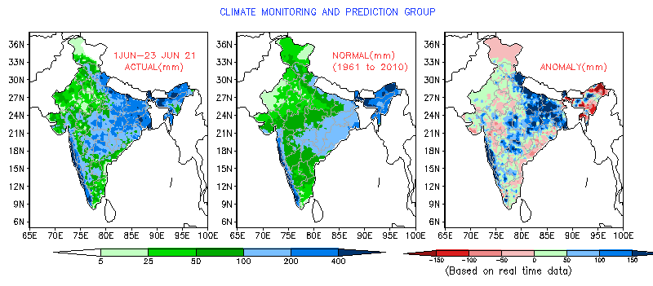
Actual
Normal
Anomaly
Cumulative Actual (Till June 23)=145.8mm
Cumulative Normal (Till June 23)=114.2mm
Cumulative % departure (Till June 23)=28%
Source:http://imdpune.gov.in/

Slide 3
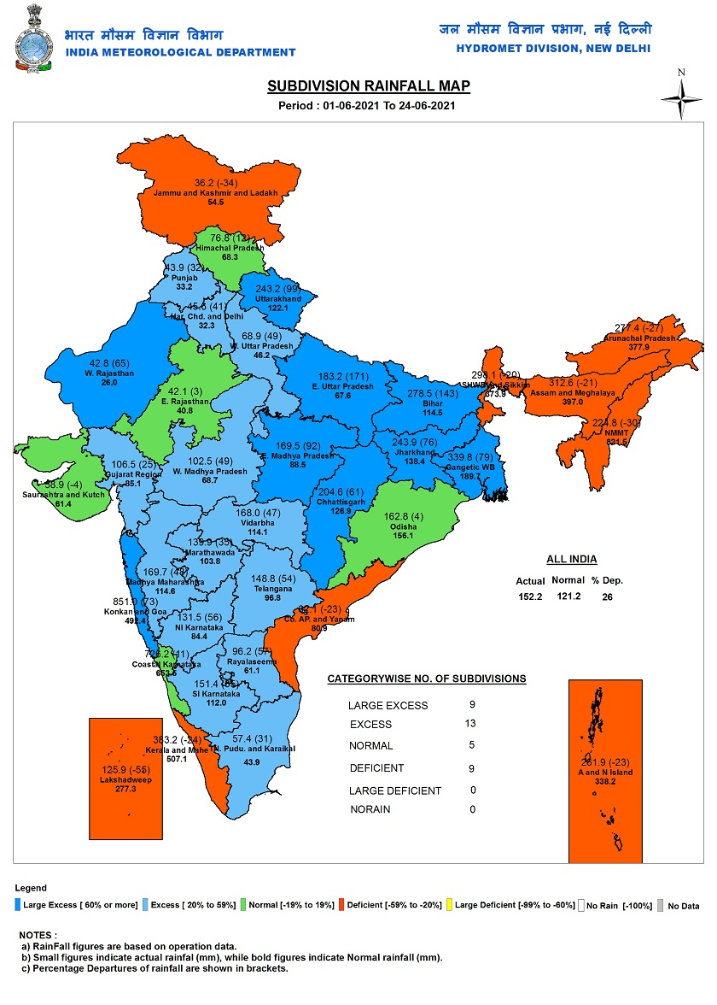
Source:http://imdpune.gov.in/

Slide 4
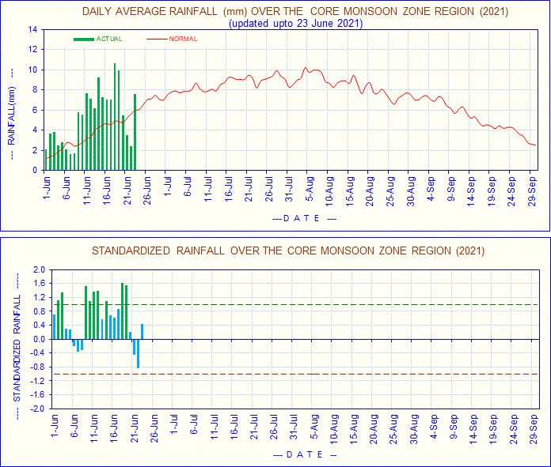
Source:http://imdpune.gov.in/

Slide 5
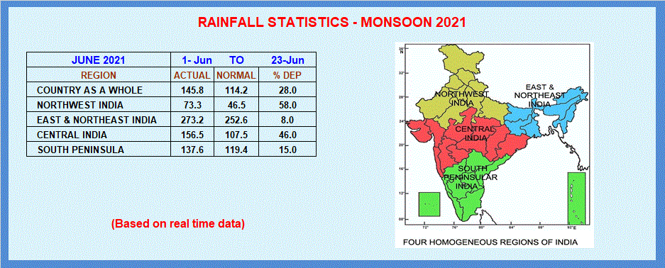
Source:http://imdpune.gov.in/

Slide 6
Monsoon Onset

Slide 7
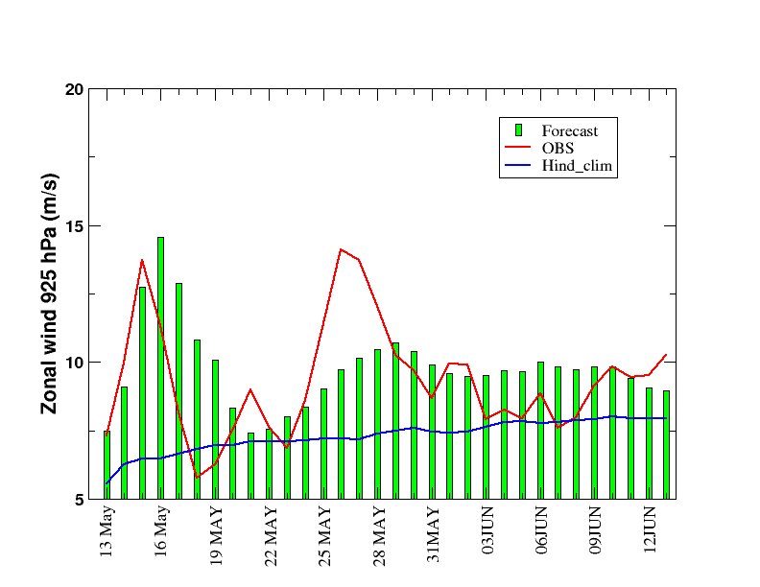
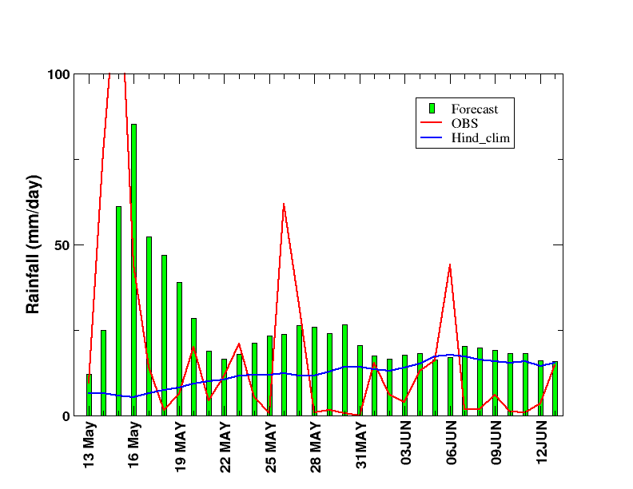
925 hPa Zonal wind over (70-80 E; 05-10 N) & Rainfall over Kerala coast (75-77.5; & 8-10.5N)
12th May IC

Slide 8
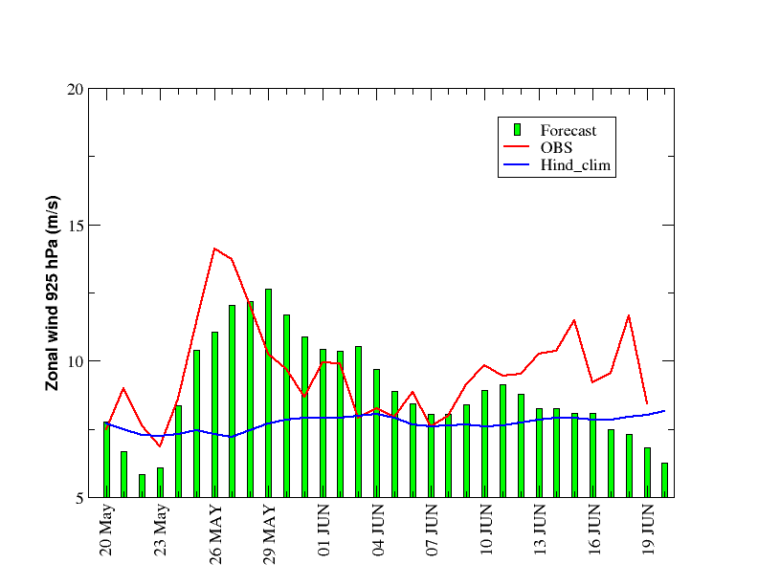
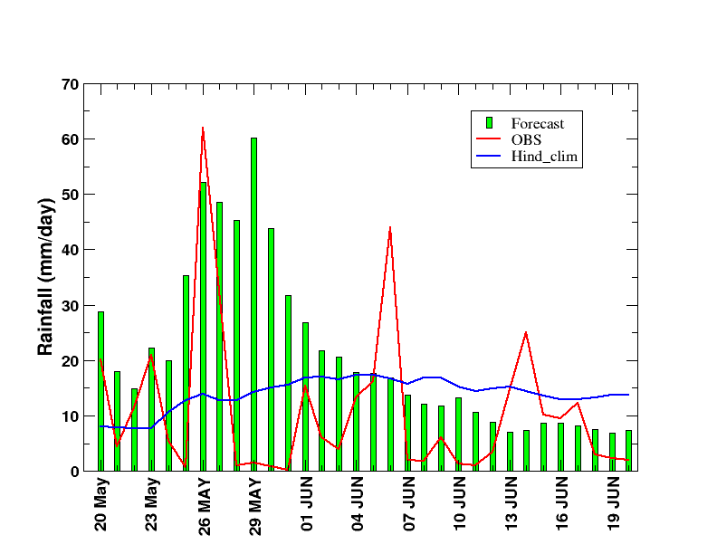
925 hPa Zonal wind over (70-80 E; 05-10 N) & Rainfall over Kerala coast (75-77.5; & 8-10.5N)
19th May IC

Slide 9
Time-Height evolution of zonal wind over 55-80E 0-10N

Slide 10
Rainfall verification

Slide 11
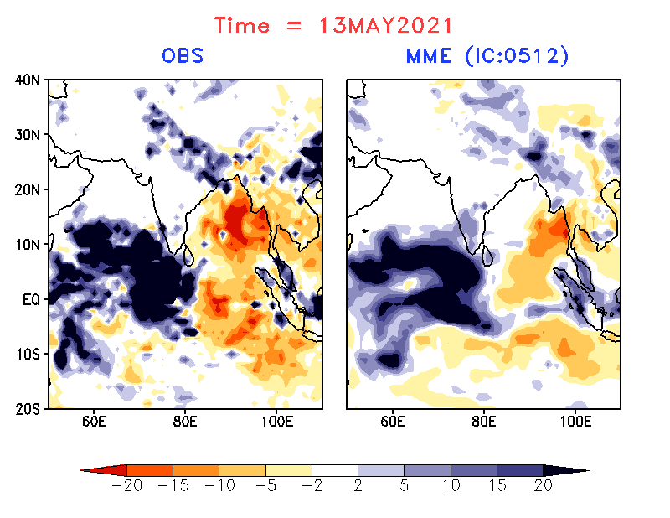
Cyclone TAUKTAE

Slide 12
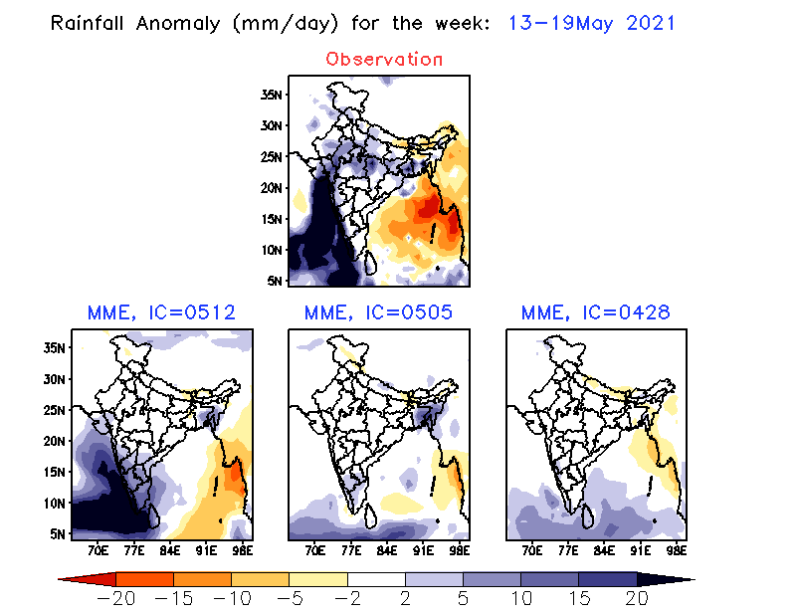
Rainfall verification for target week 13-19 May
Cyclone TAUKTAE

Slide 13
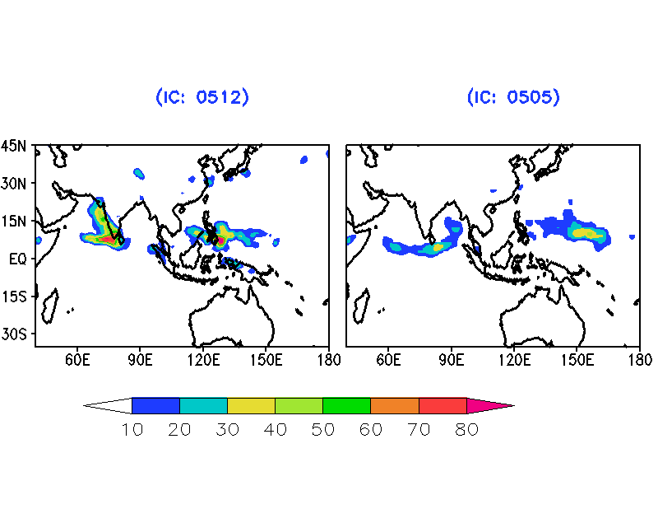
Cyclogenesis probability for Cyclone TAUKTAE based on 05th May & 12th May IC
Averaged over Target week 13-19 May

Slide 14
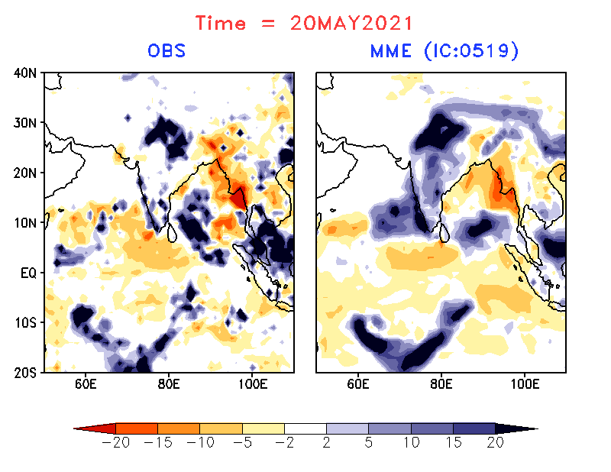
Cyclone YAAS

Slide 15
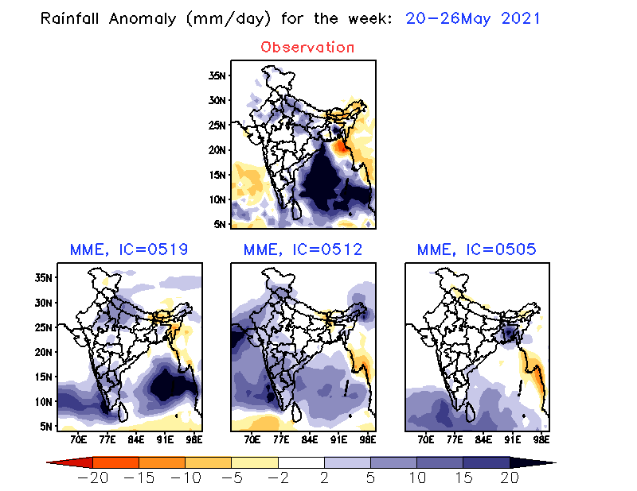
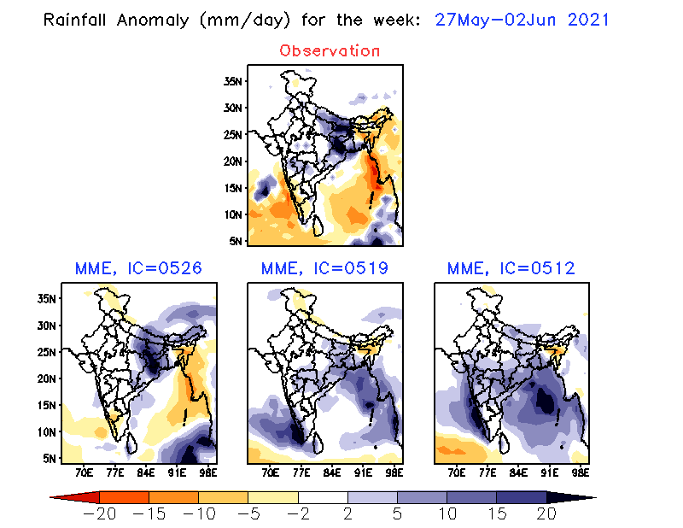
Rainfall verification for target week 20-26May & 27May - 02June
Cyclone YAAS

Slide 16
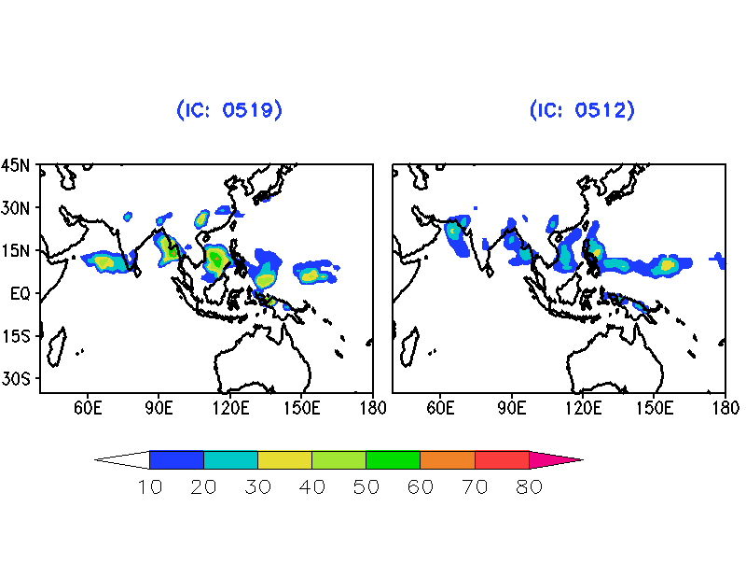
Cyclogenesis probability for Cyclone YAAS based on 12th May & 19th May IC
Averaged over Target week 20-26May

Slide 17
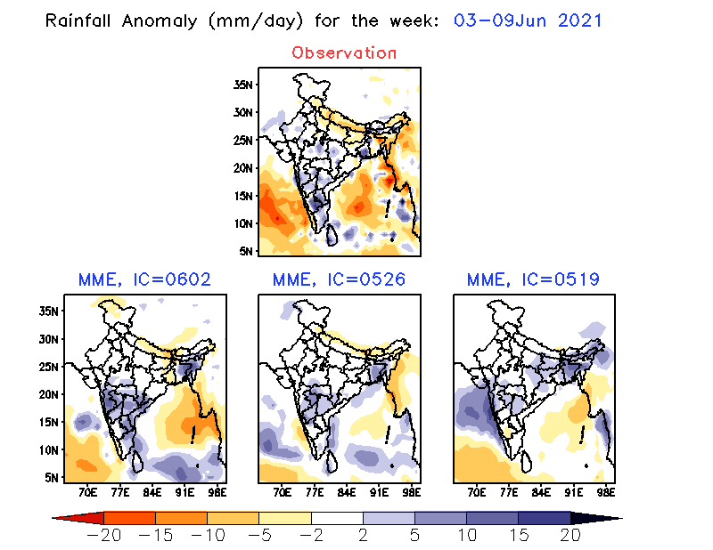
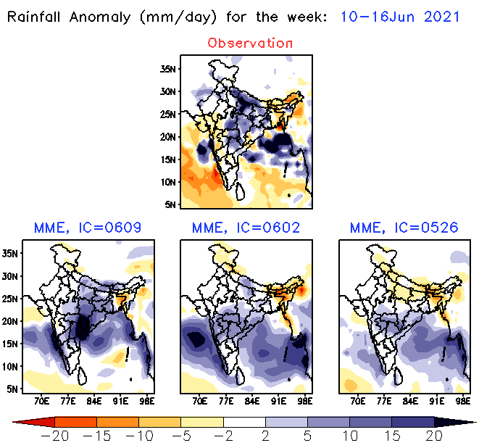
Rainfall verification for target week 03-09June and 10-16June

Slide 18
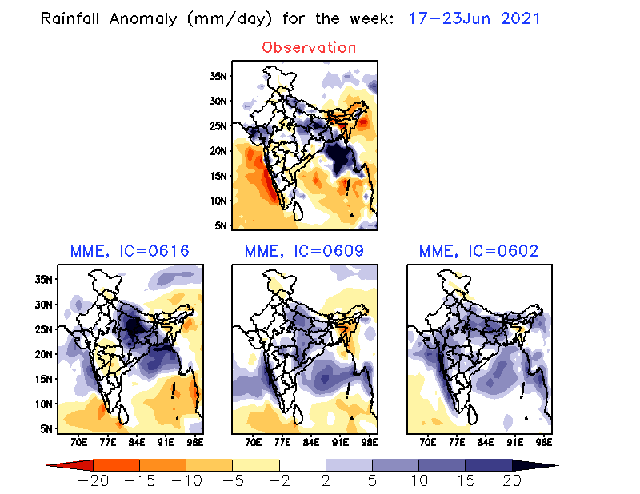
Rainfall verification for target week 17-23 June

Slide 19
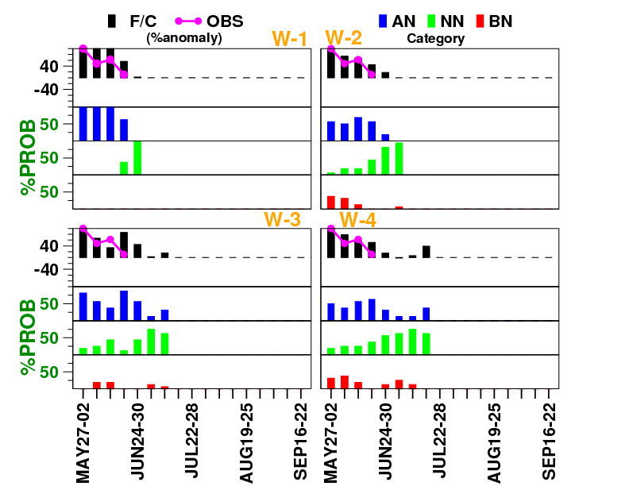
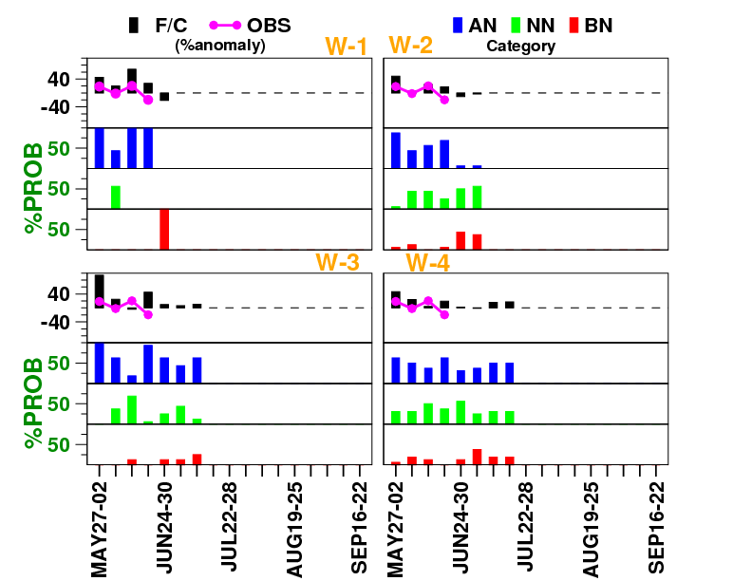
Verification of Area Averaged rainfall
Monsoon Zone
All India

Slide 20
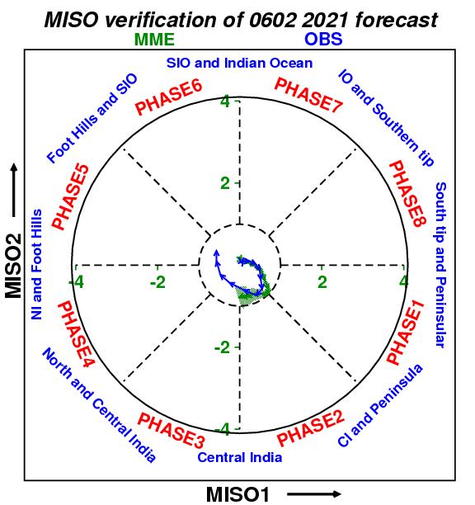
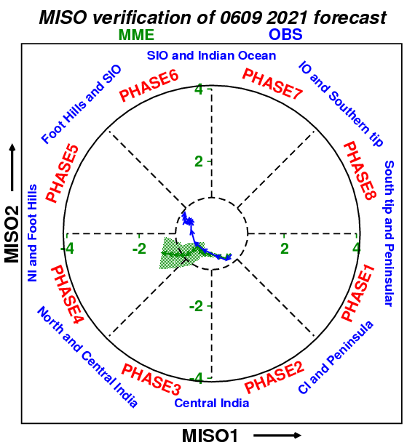
MISO verification
OBSERVED MISO during 1-23 JUN
IC: 09 JUN
IC: 02 JUN

Slide 21
Latest Forecast based on 23rd June IC

Slide 22
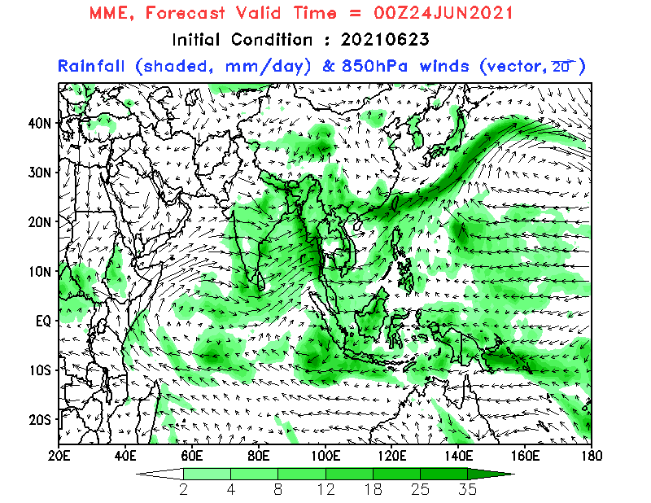
Daily evolution of rainfall and wind at 850hPa (by MME)

Slide 23
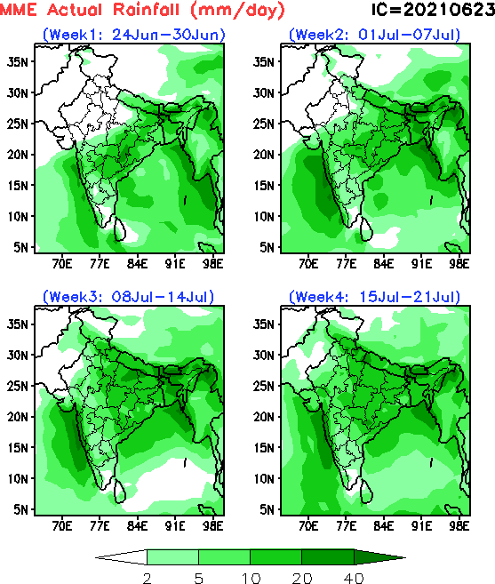
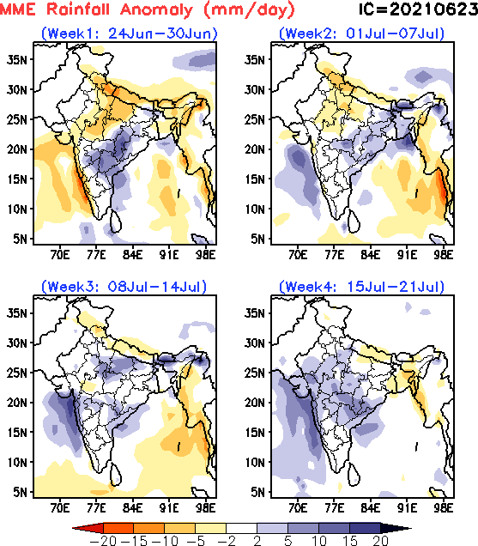
Predicted week wise rainfall (by MME)

Slide 24
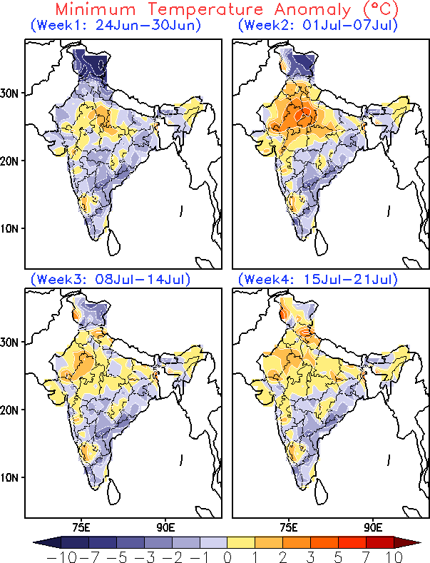
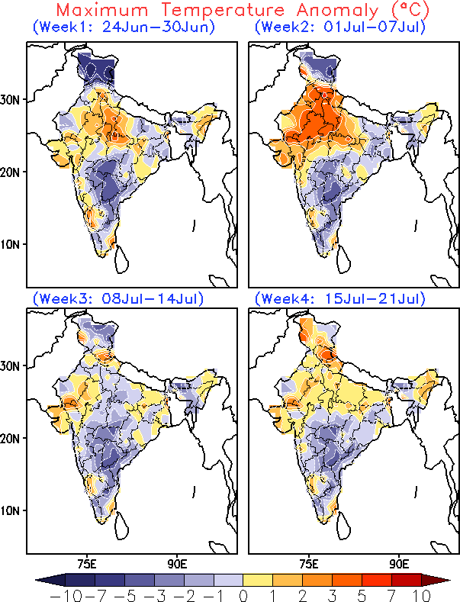
Predicted week wise temperature anomaly (by MME)

Slide 25
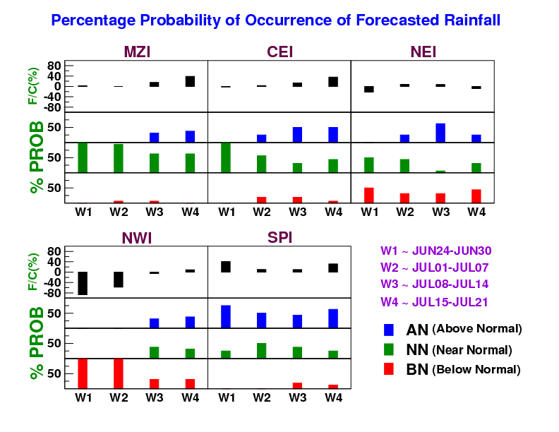
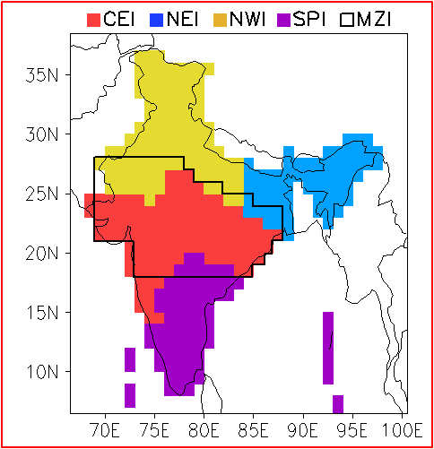
Area averaged rainfall over homogeneous regions predicted by MME

Slide 26
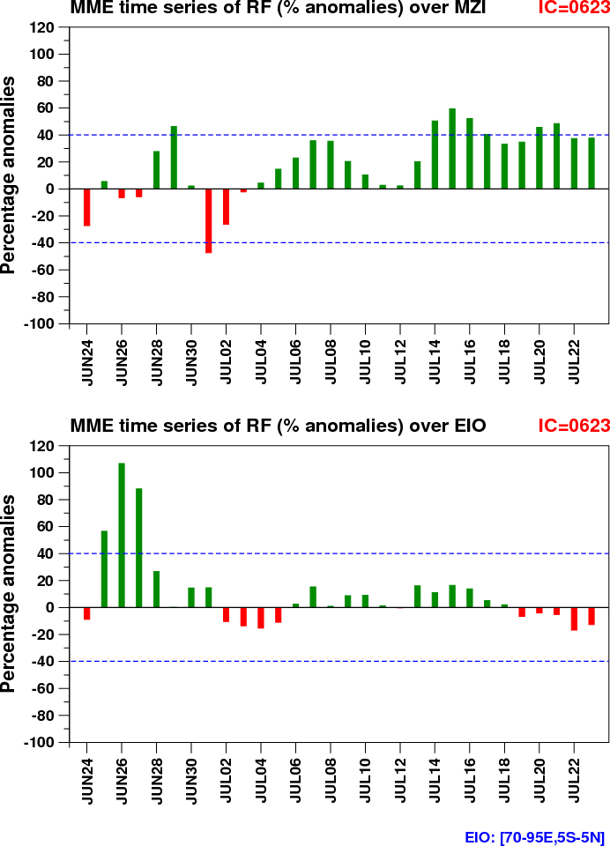
Time series of Area averaged rainfall predicted by MME
OVER MZI
OVER EIO

Slide 27
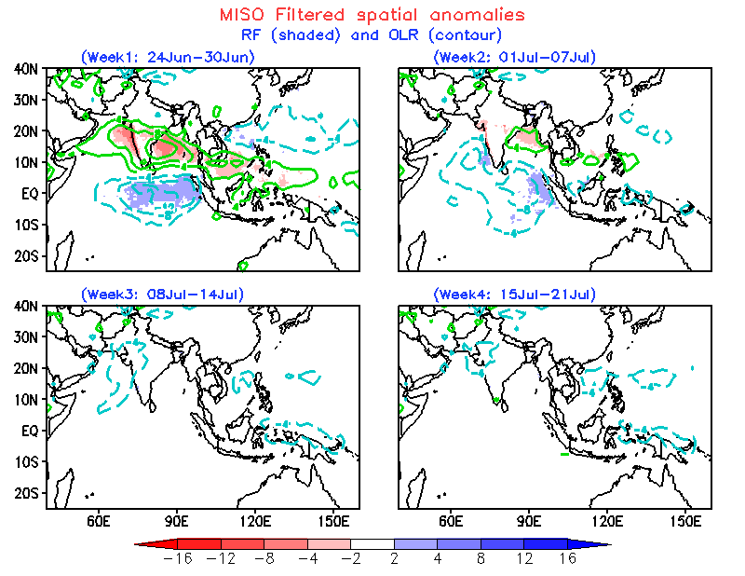
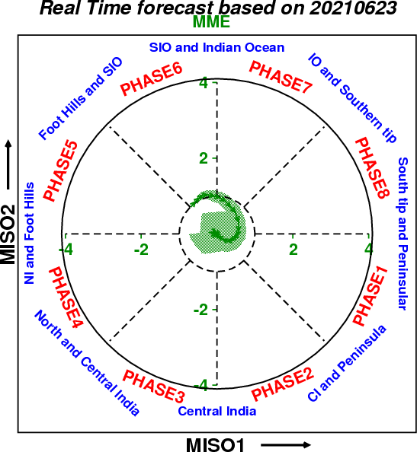
MISO Forecast
Notes:
Circle regions with some skill on both forecast and ACC map – these are areas where it is worth looking at
Problem calculating these – don’t match with colder temperature forecasts

Slide 28
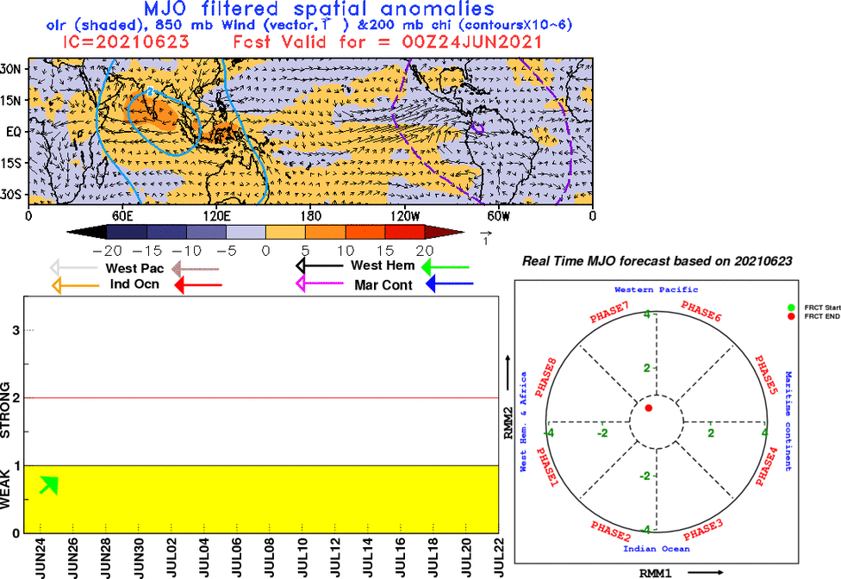
MJO Forecast
Notes:
Circle regions with some skill on both forecast and ACC map – these are areas where it is worth looking at
Problem calculating these – don’t match with colder temperature forecasts

Slide 29
Summary
1. Cyclone “Tauktae” and “YAAS” was predicted from the nearest ICs.
Model indicated early onset from 12th May & 19th May ICs.
Conclusions from latest forecast:
A. Rainfall:
1. Rainfall is likely to be below normal over NWI , normal over MZI region, normal to below normal over NEI and normal to above normal over SPI in the first two weeks.
2. Afterwards normal conditions are expected over most parts of the country.
B. MISO:
MISO associated signal is weak for next 4 weeks.
C. MJO:
MJO associated signal is currently located over Western hemisphere and Africa region, which is not favorable for active monsoon conditions over India.

Slide 30
THANK YOU

Slide 31
NCEP forecast based on 23 JUN IC

Slide 32
