Slide 1
Advancement of monsoon 2021 and extended range prediction
Presented by
Raju Mandal
Contributors: IITM-ERPAS group and Dr. D.R. Pattanaik, IMD
IITM Seminar (Monsoon Discussion) on 16th July 2021

Slide 2
Outline
Recapitulation
Forecast Verifications
Observed Monsoon
Latest Extended Range Forecast
Part-1
Part-2
Part-3
Part-4

Slide 3
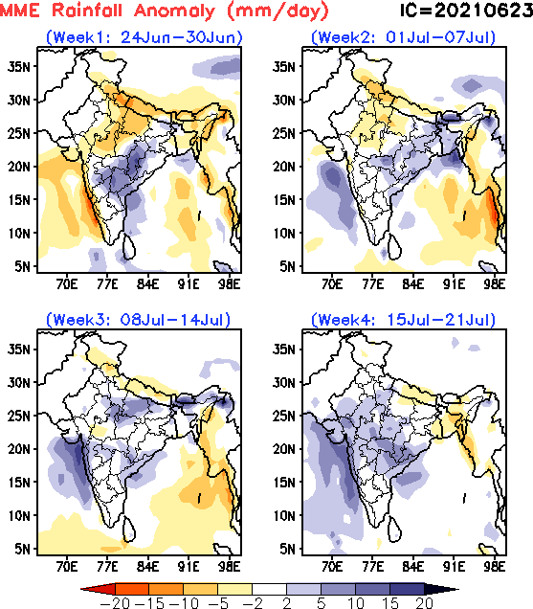
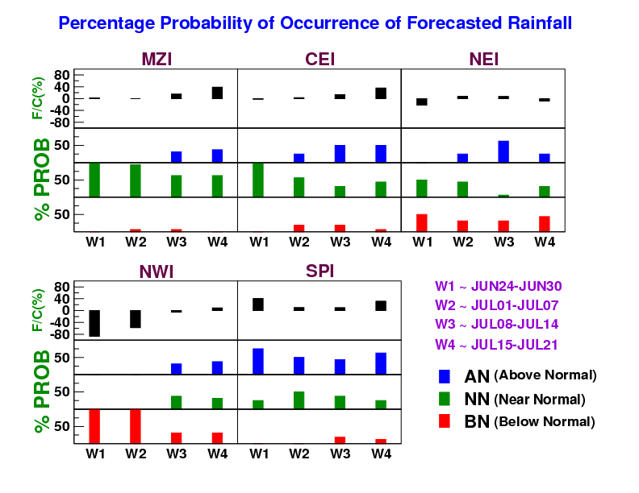
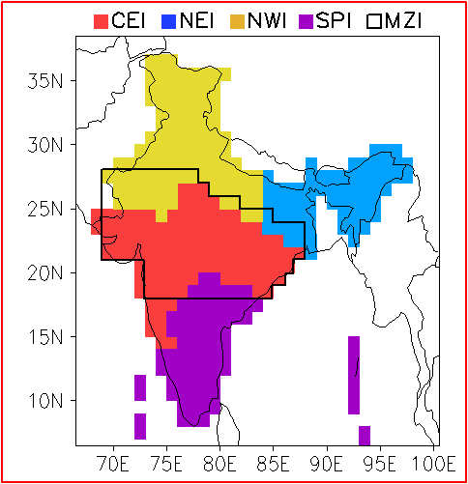
Forecast based on 23rd June, 2021 IC
Rainfall is likely to be below normal over NWI , normal over MZI region, normal to below normal over NEI and normal to above normal over SPI in the first two weeks. Afterwards normal conditions are expected over most parts of the country.
MISO associated signal is weak for next 4 weeks.

Slide 4
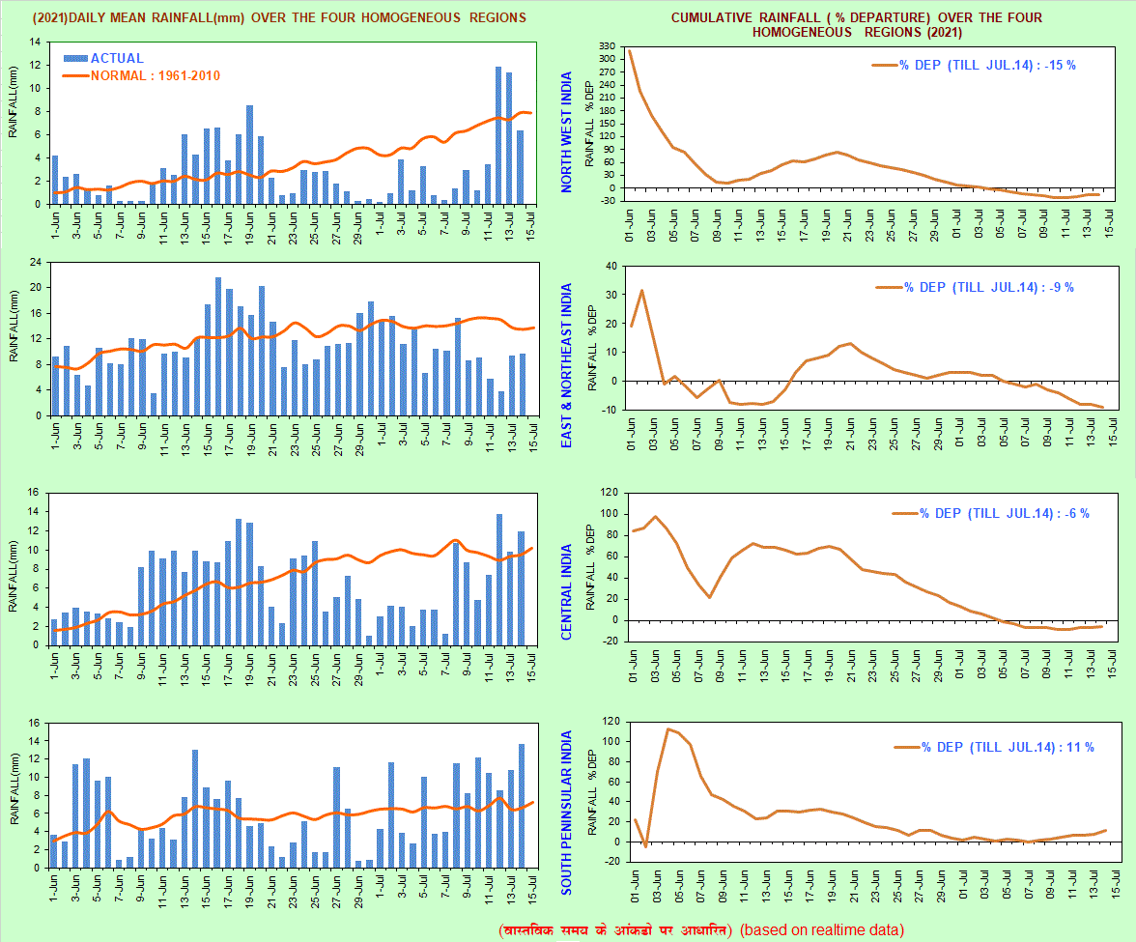
IMD Observation: Daily Rainfall Series
Source: IMD

Slide 5
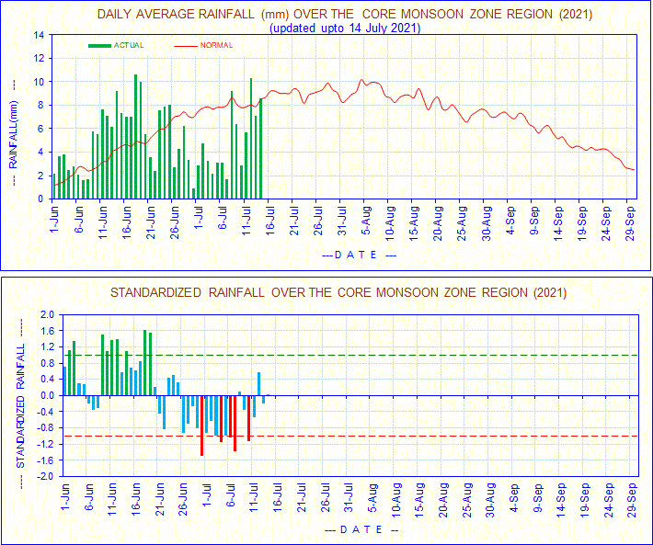
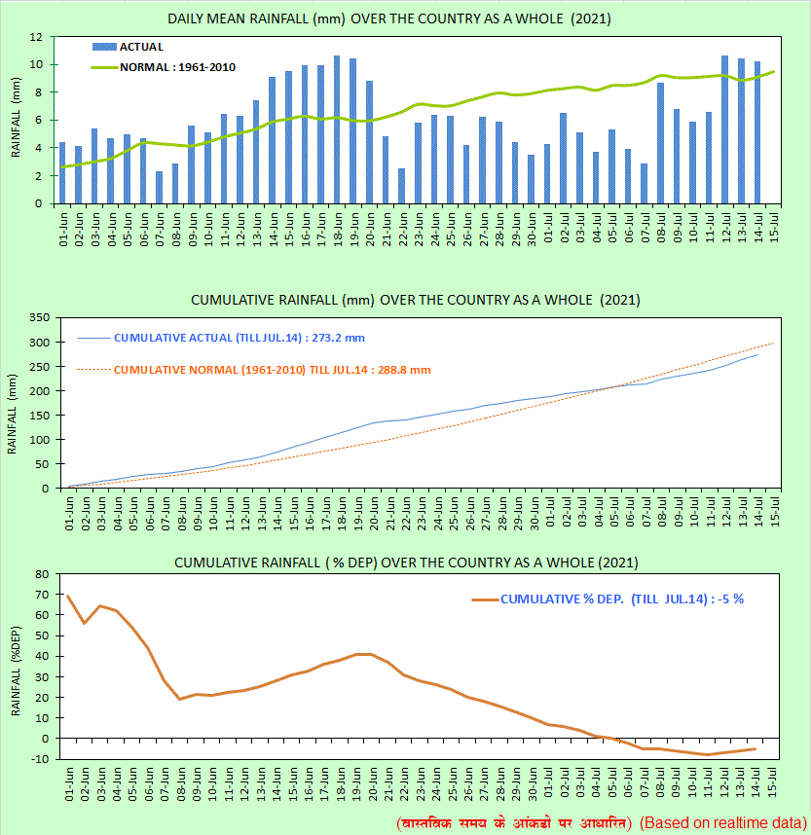
IMD Observation: Daily Rainfall Series for year 2021
Active to Break: After 3rd week of June
Break to Active: After 11th July
Source: IMD

Slide 6
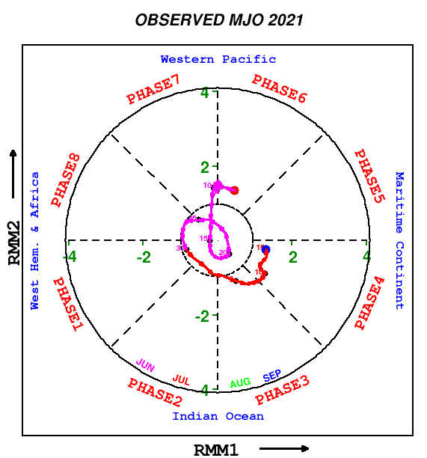
Observed MISO & MJO
MISO
MJO
Clockwise rotation
North-south movement of convection
Anti-clockwise rotation
East-west movement of convection
Suhas et al. 2012, Sahai et al. 2013
RMM Index: Wheeler and Hendon, 2004

Slide 7
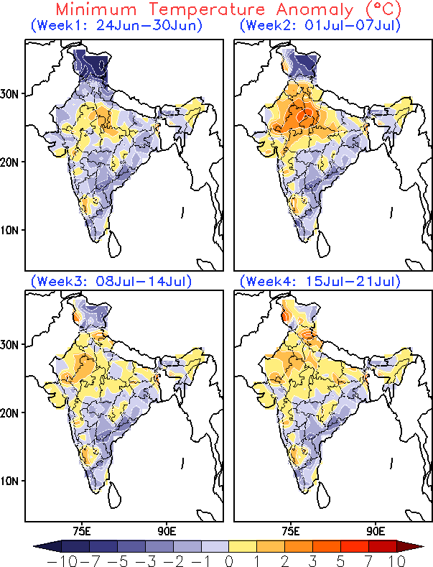
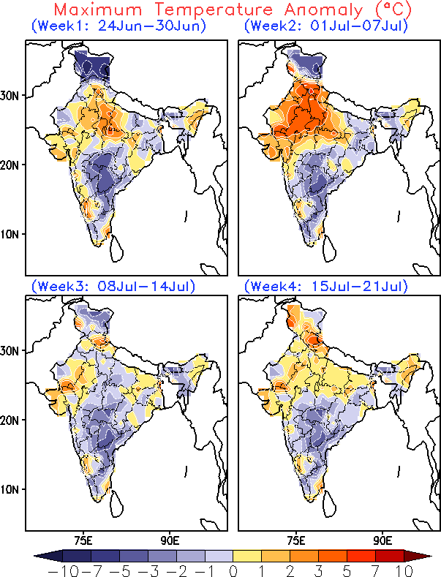
Predicted week wise temperature anomaly (by MME)
Forecast based on 23rd June, 2021 IC

Slide 8
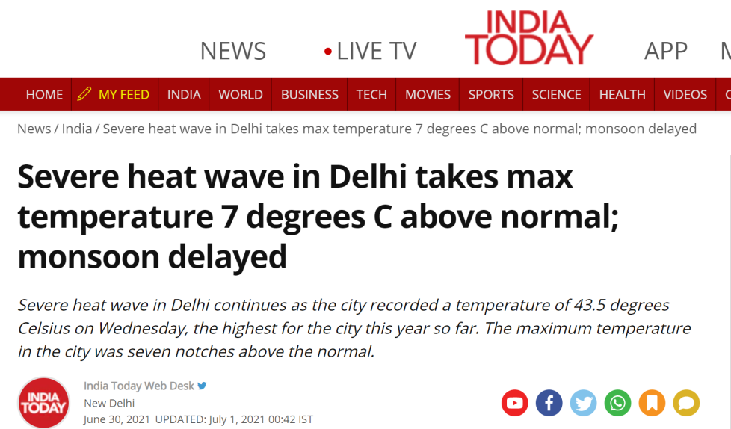
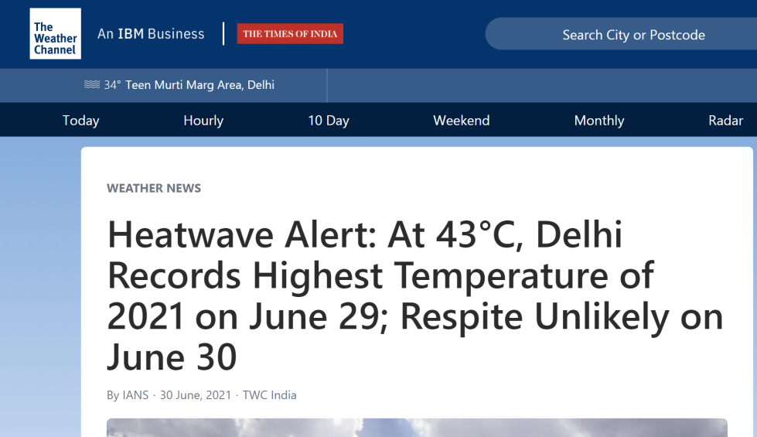
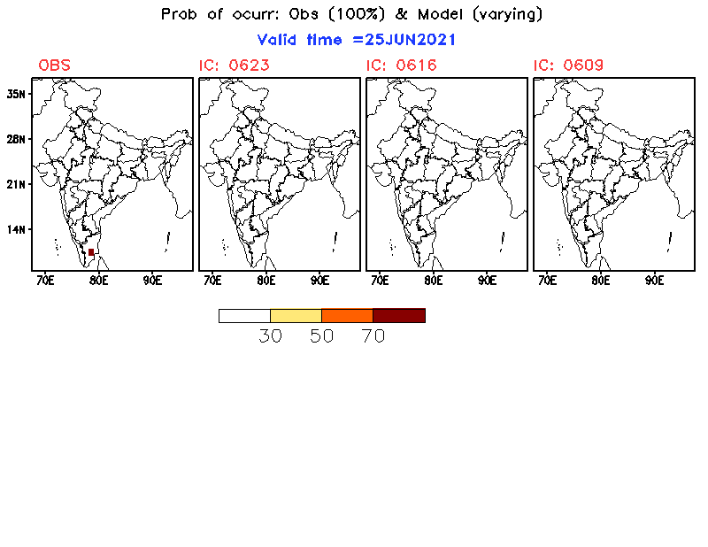
Heat wave over north-western parts (surrounding Delhi)
Mandal R. and Joseph S. et al. 2019

Slide 9
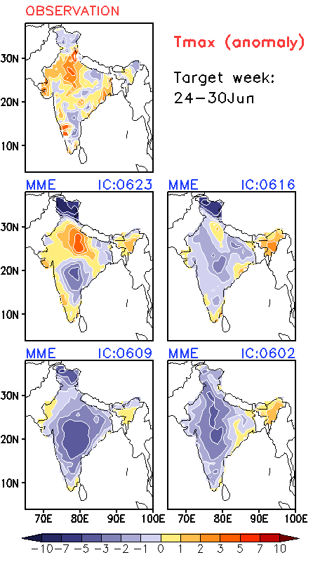
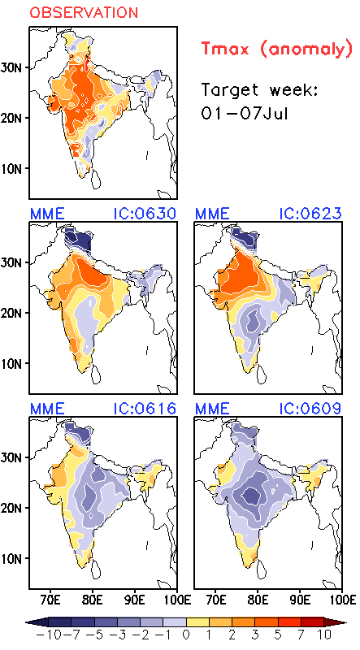
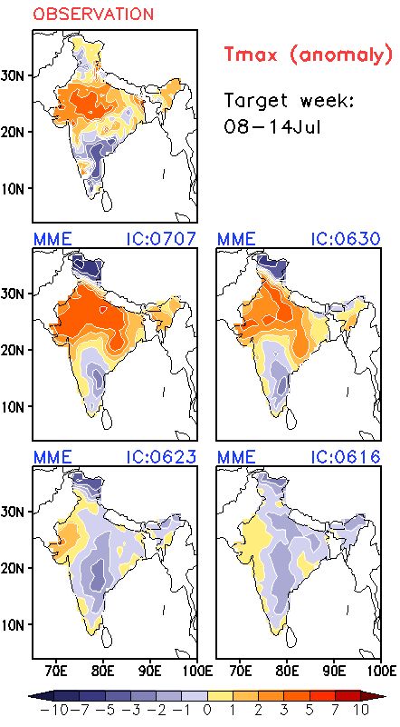
Weekly Maximum temperature anomalies: Verification

Slide 10
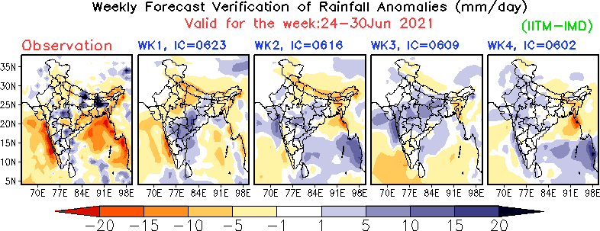
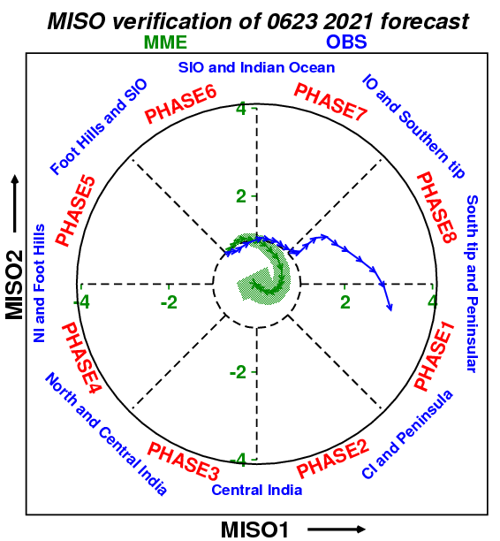
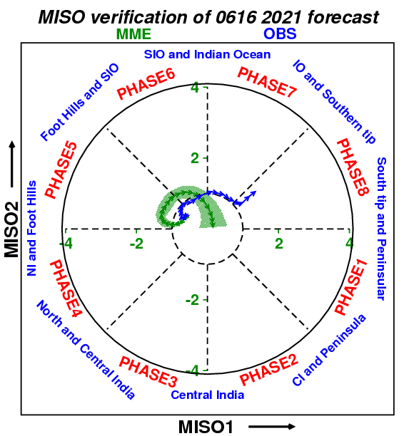
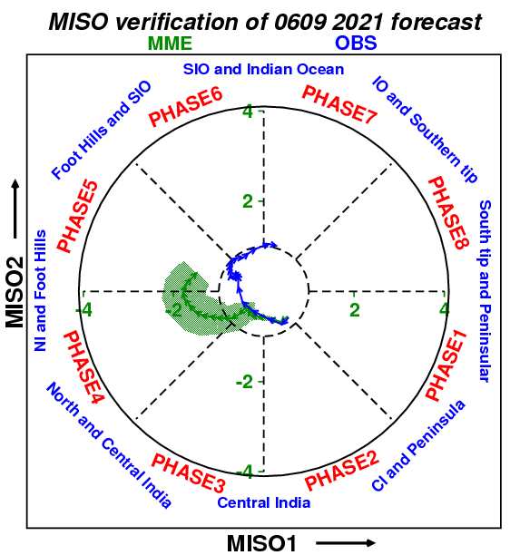
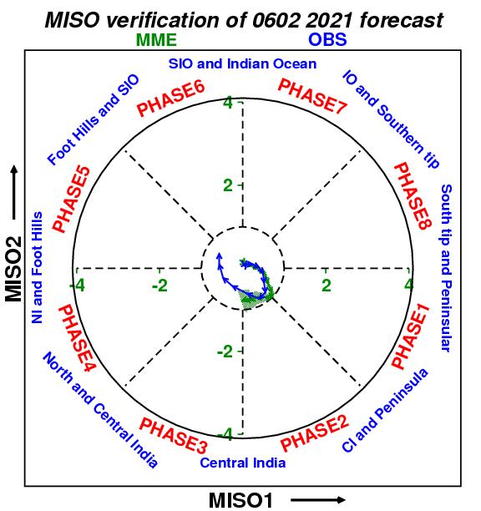
Suhas et al. 2012, Sahai et al. 2013

Slide 11
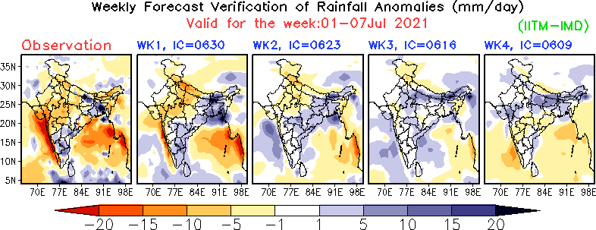
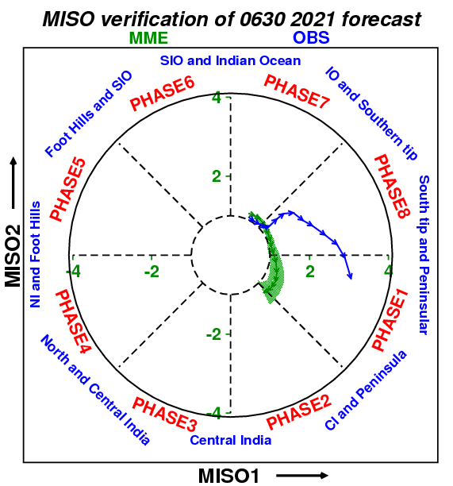
Suhas et al. 2012, Sahai et al. 2013

Slide 12
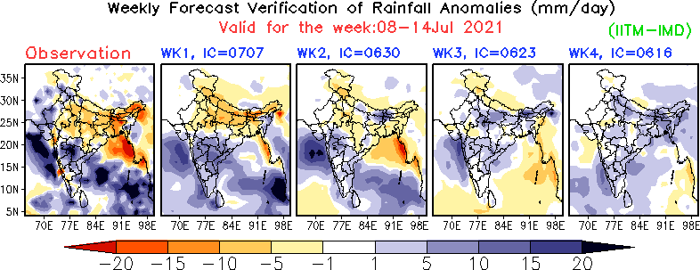
Suhas et al. 2012, Sahai et al. 2013

Slide 13
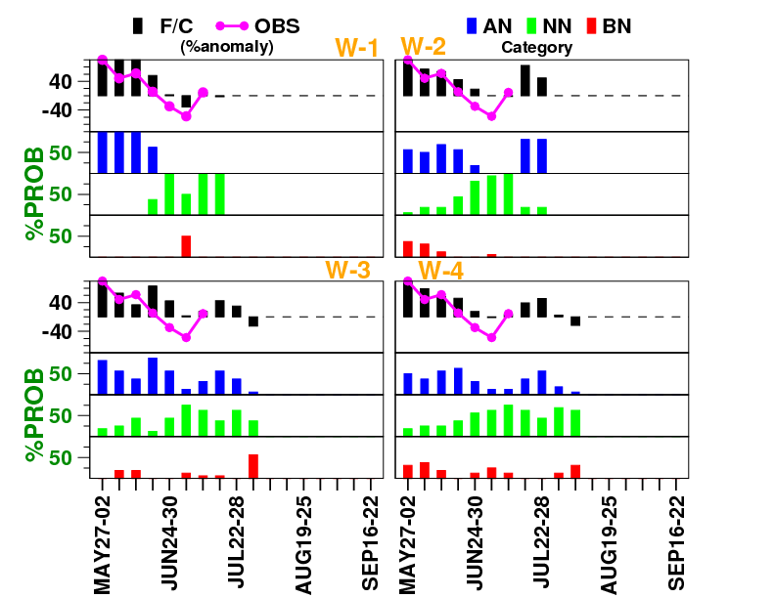
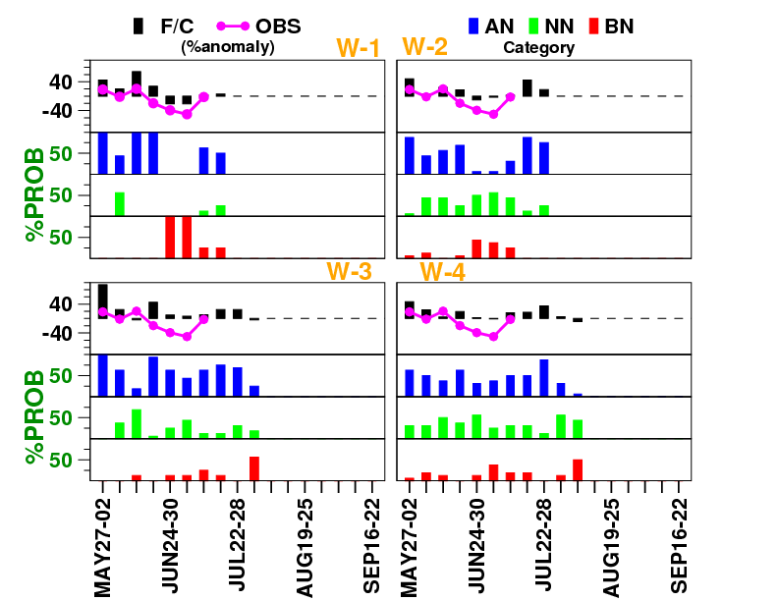
Verification of Area Averaged rainfall
Monsoon Zone
All India

Slide 14
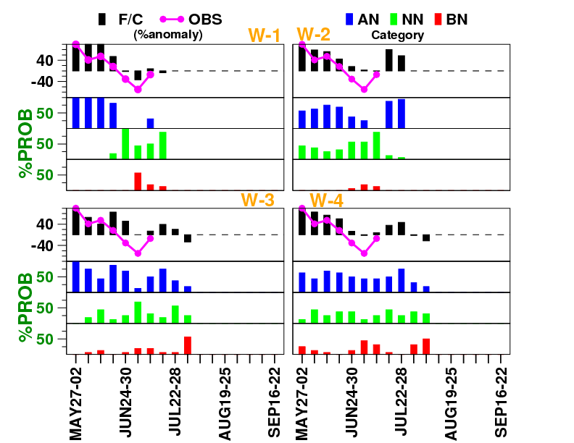
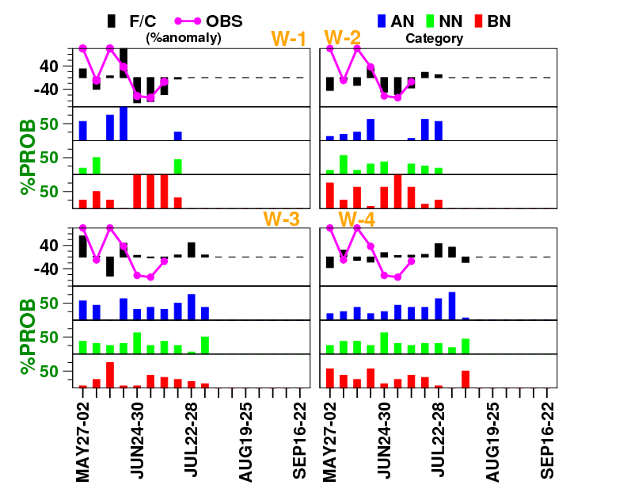
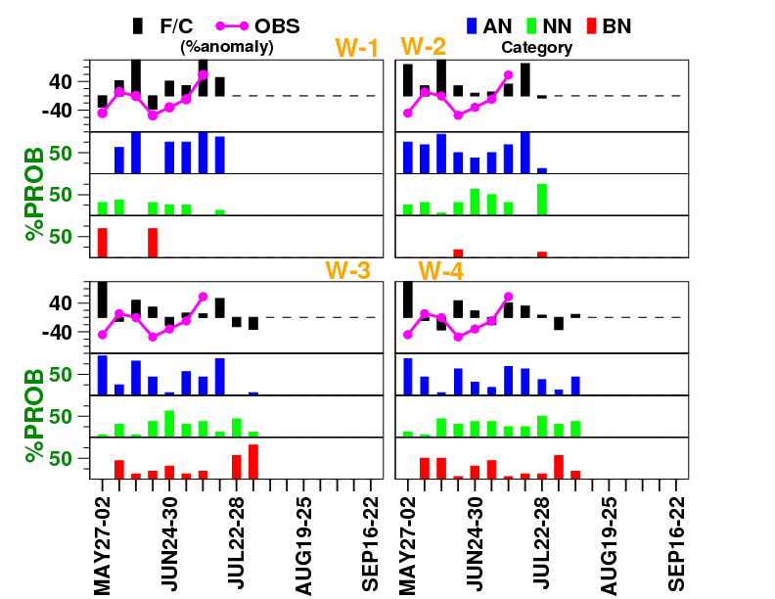
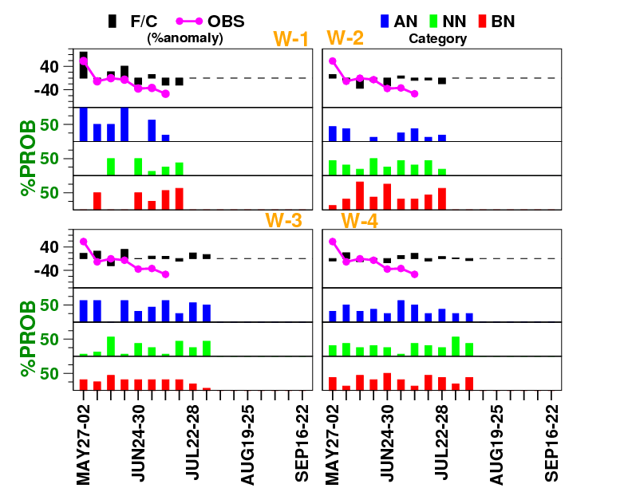
CEI
NWI
SPI
NEI

Slide 15
Source: IMD

Slide 16
Latest extended range forecast
based on
14th July, 2021 initial condition

Slide 17
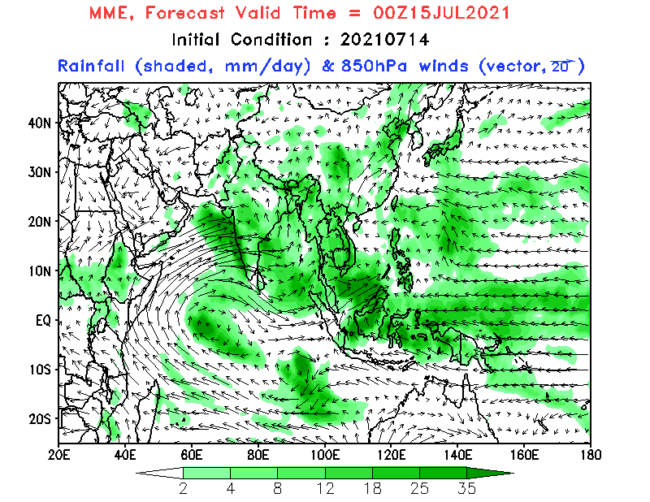
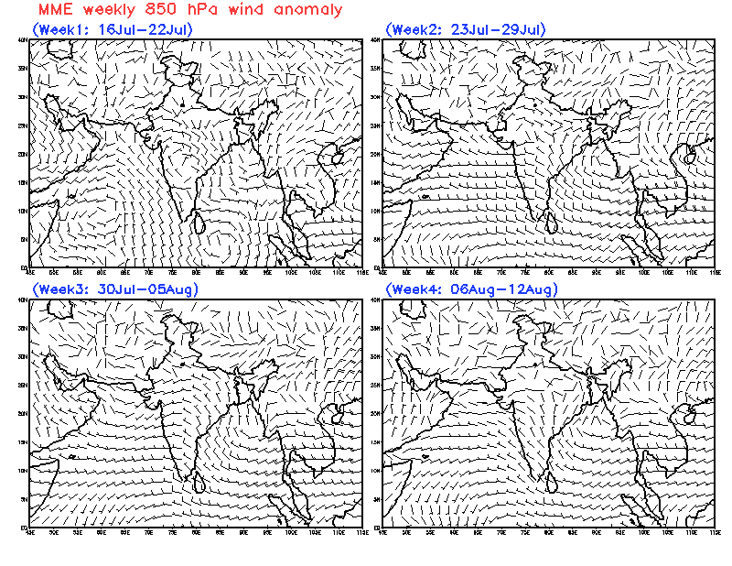
Daily evolution of rainfall and
wind at 850hPa (MME)
Weekly 850hPa wind anomalies
(MME)
Improved monsoon circulation in week-1 over southern part and in week-2 over central and western parts.
Weak monsoon circulation in week-3 and week-4 mainly over central India.

Slide 18
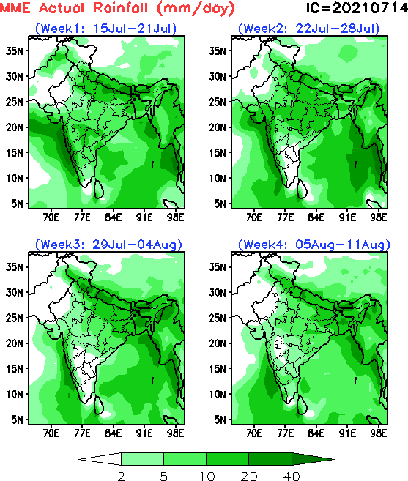
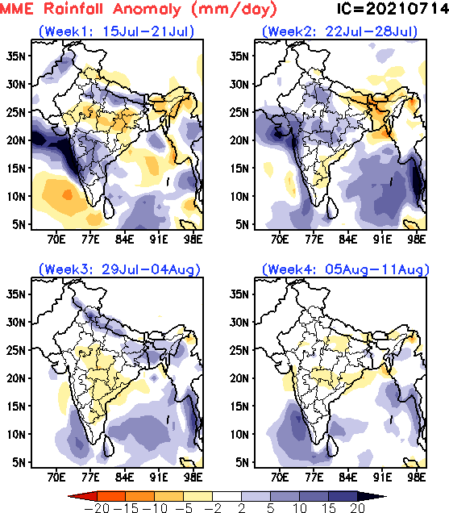
Predicted week wise rainfall (MME)
Week-1 : Improvement in rainfall over Indo-Gangetic plains, western coastal parts and parts of northern India and below normal over northeast India.
Week-2 : Below normal over northeast and south-east coastal regions. The remaining parts will have above normal rainfall.
Week-3&4 : Below normal rainfall in week-3 and week-4 mainly over central India. Monsoon rainfall over Indo-Gangetic plain and north-east likely to be normal to above normal in week-3.

Slide 19
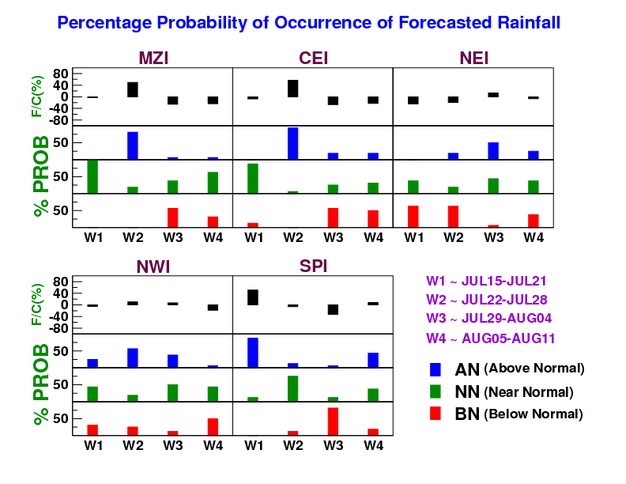
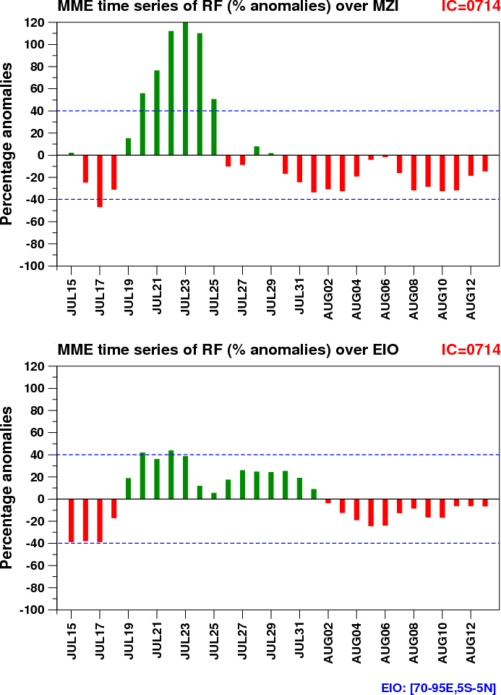
Area averaged rainfall over homogeneous
regions predicted by MME
Time series of Area averaged
rainfall predicted by MME

Slide 20
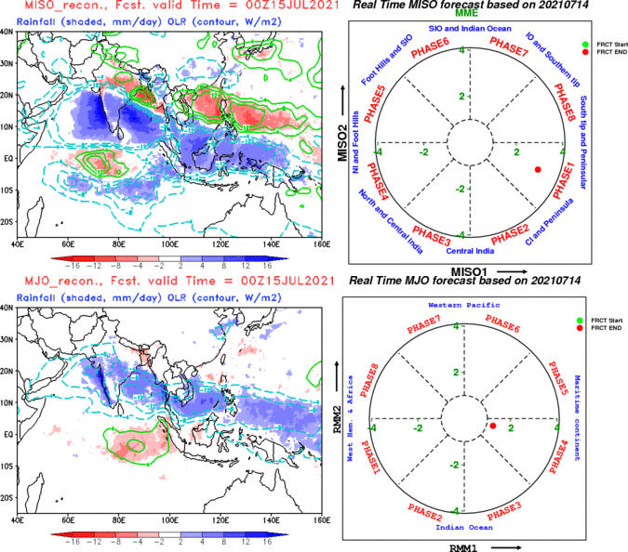
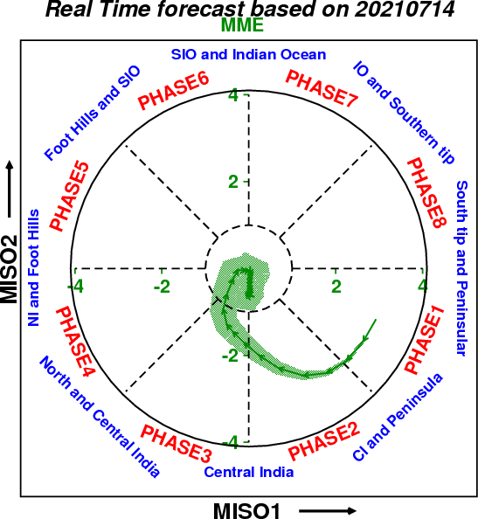
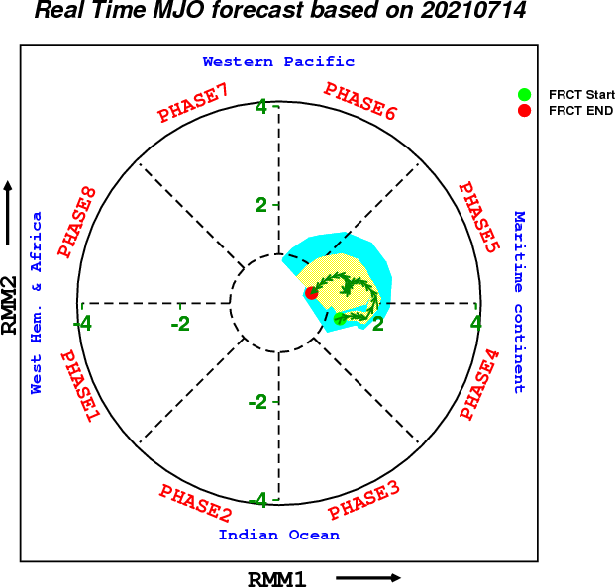
MISO & MJO forecast for next 28 days

Slide 21
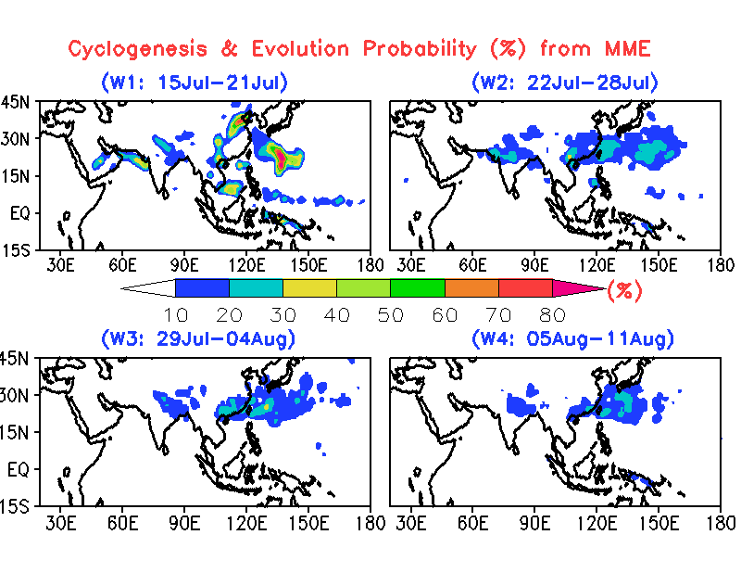
Saranya G. and Sahai A.K. et al. 2020

Slide 22
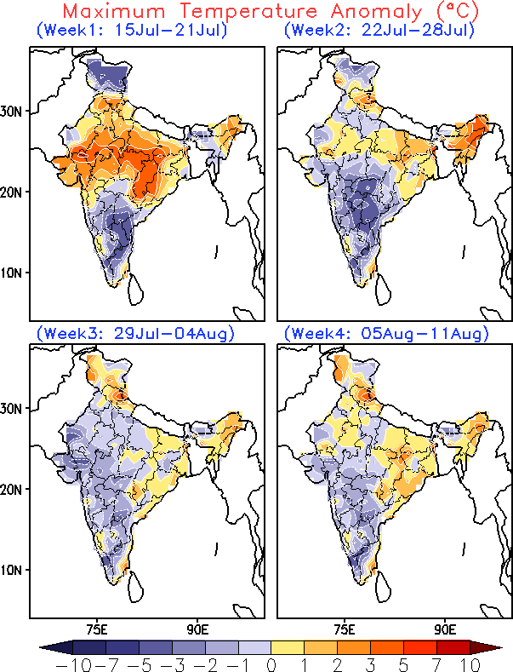
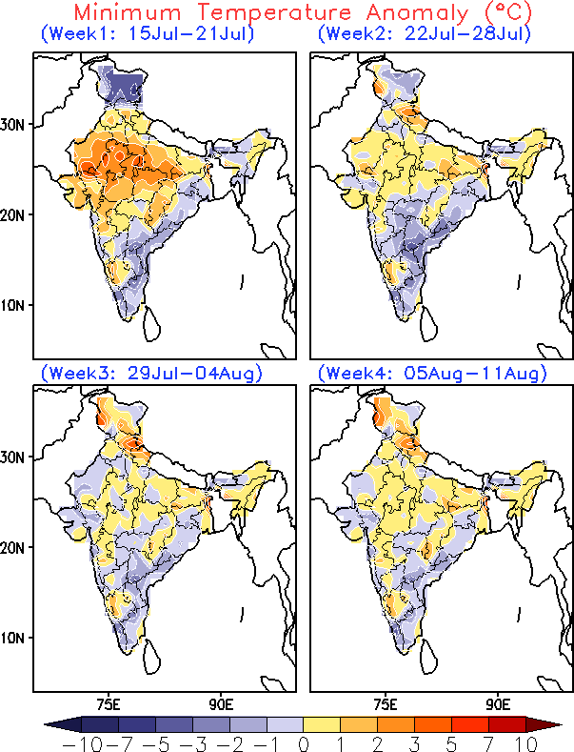
Predicted week wise temperature anomalies (MME)
Tmax: Mainly below normal in week-1 over southern parts and above normal over north, northwest and central India. In subsequent weeks, the Tmax is likely to be normal to below normal.
Tmin: It is mostly close to normal to below normal over south-eastern coastal regions and above normal over most parts of northern and north-western parts of India in week-1&2.

Slide 23
Circulation:
Week-1&2: Improved monsoon circulation in week-1 over southern part and in week-2 over central and western parts.
Week-3&4: Weak monsoon circulation in week-3 and week-4 mainly over central India.
Rainfall:
Week-1: Improvement in rainfall over Indo-Gangetic plains, western coastal parts and parts of northern India and below normal over northeast India.
Week-2: Below normal over northeast and south-east coastal regions. The remaining parts will have above normal rainfall.
Week-3&4: Below normal rainfall in week-3 and week-4 mainly over central India. However, over the Indo-Gangetic plain and parts of north-east India monsoon rainfall will be normal to above normal in week-3.
Temperature:
Tmax: Mainly below normal in week-1 over southern parts and above normal over north, northwest and central India. In subsequent weeks, the Tmax is likely to be normal to below normal.
Tmin: It is mostly close to normal to below normal over south-eastern coastal regions and above normal over most parts of northern and north-western parts of India in week-1 and week-2.

Slide 24
THANK YOU !!!

Slide 25
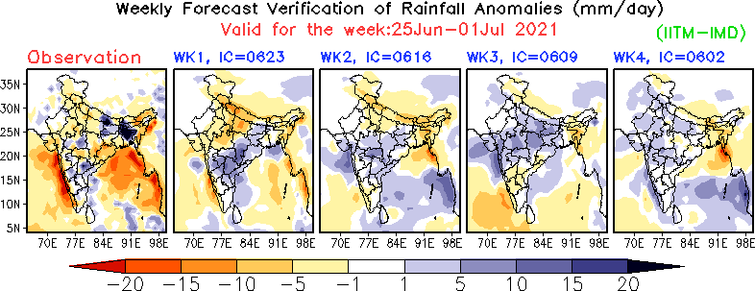
OBS and Model
Climatologies
are different
IITM/IMD
NCMRWF
Figure
Courtesy:
Dr. AK Mitra,
NCMRWF
NCEP

Slide 26
OBS and Model
Climatologies
are different
IITM/IMD
NCMRWF
Figure
Courtesy:
Dr. AK Mitra,
NCMRWF
NCEP

Slide 27
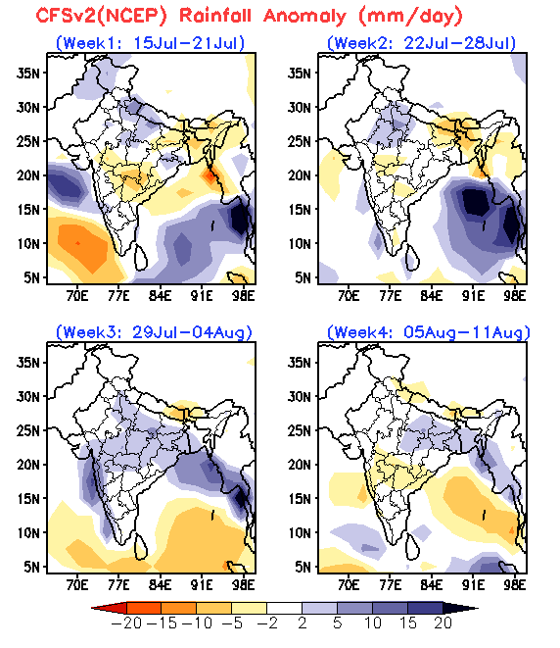
Forecasts from different centres
IITM-IMD MME
NCEP CFSv2

Slide 28
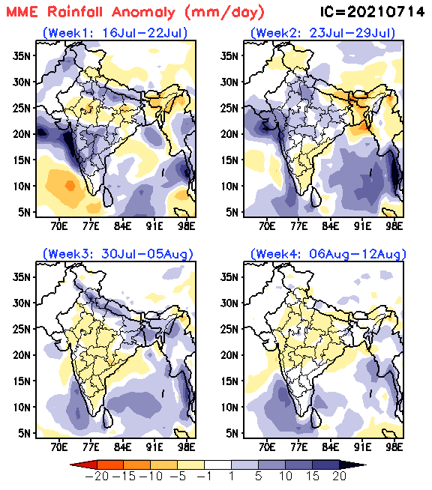
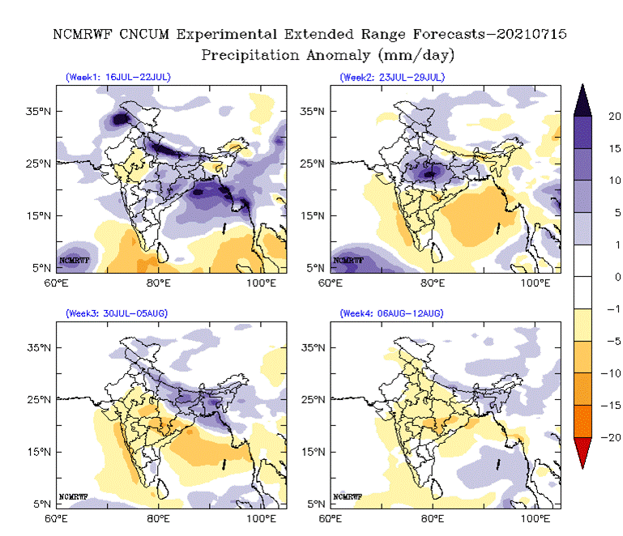
Forecasts from different centres
IITM-IMD MME
NCMRWF CNCUM

