Slide 1
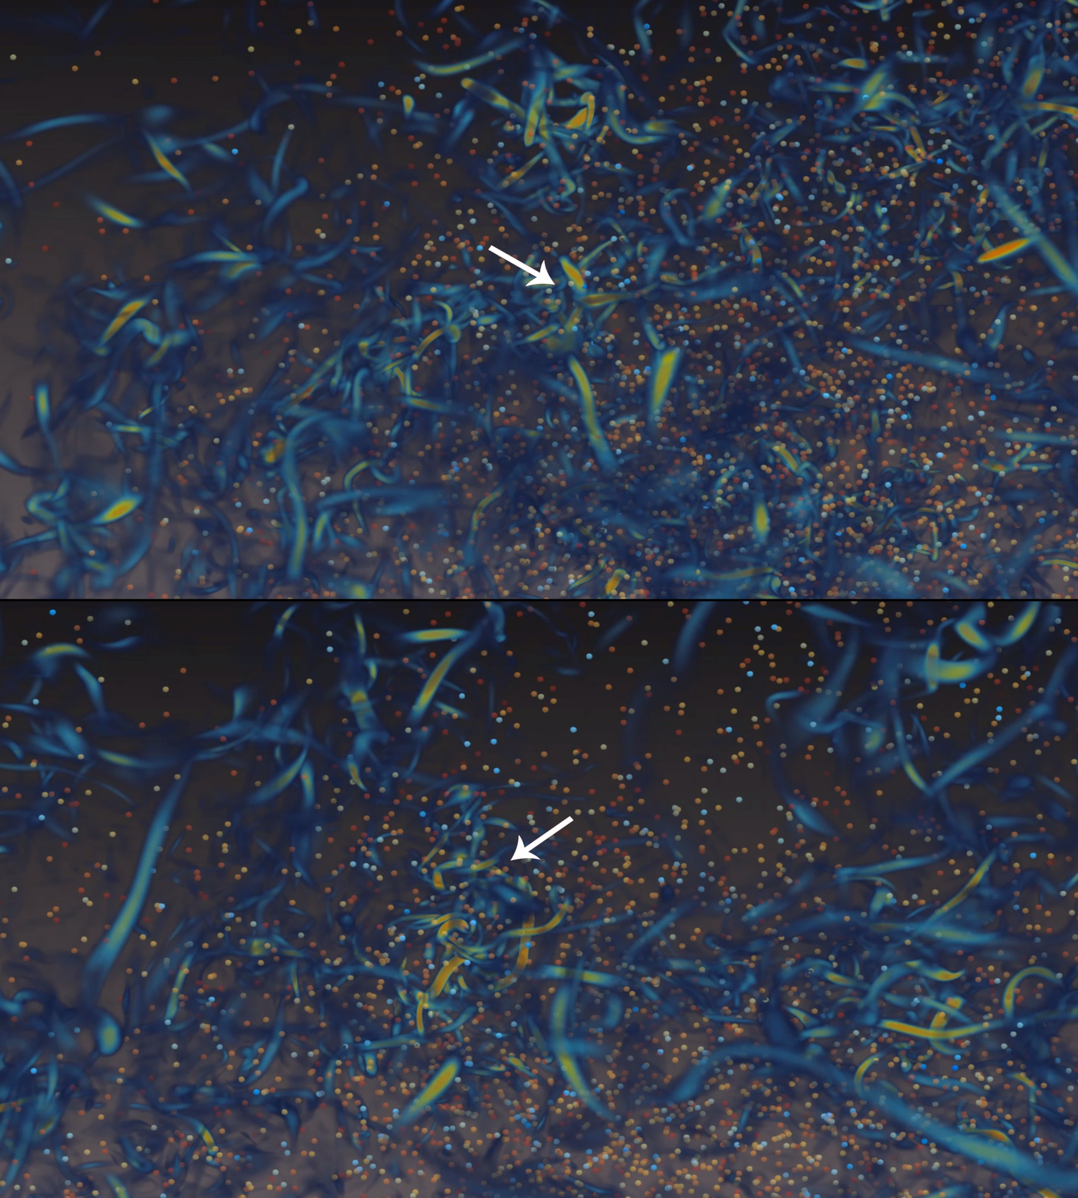
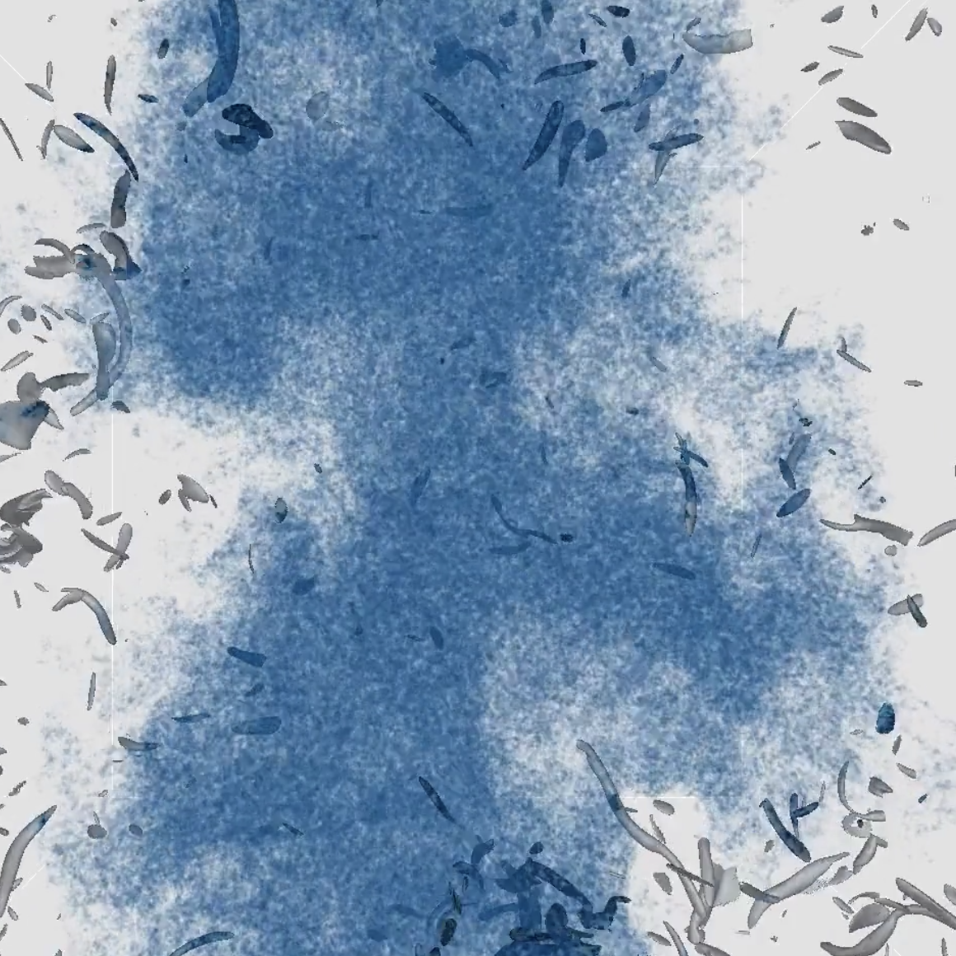
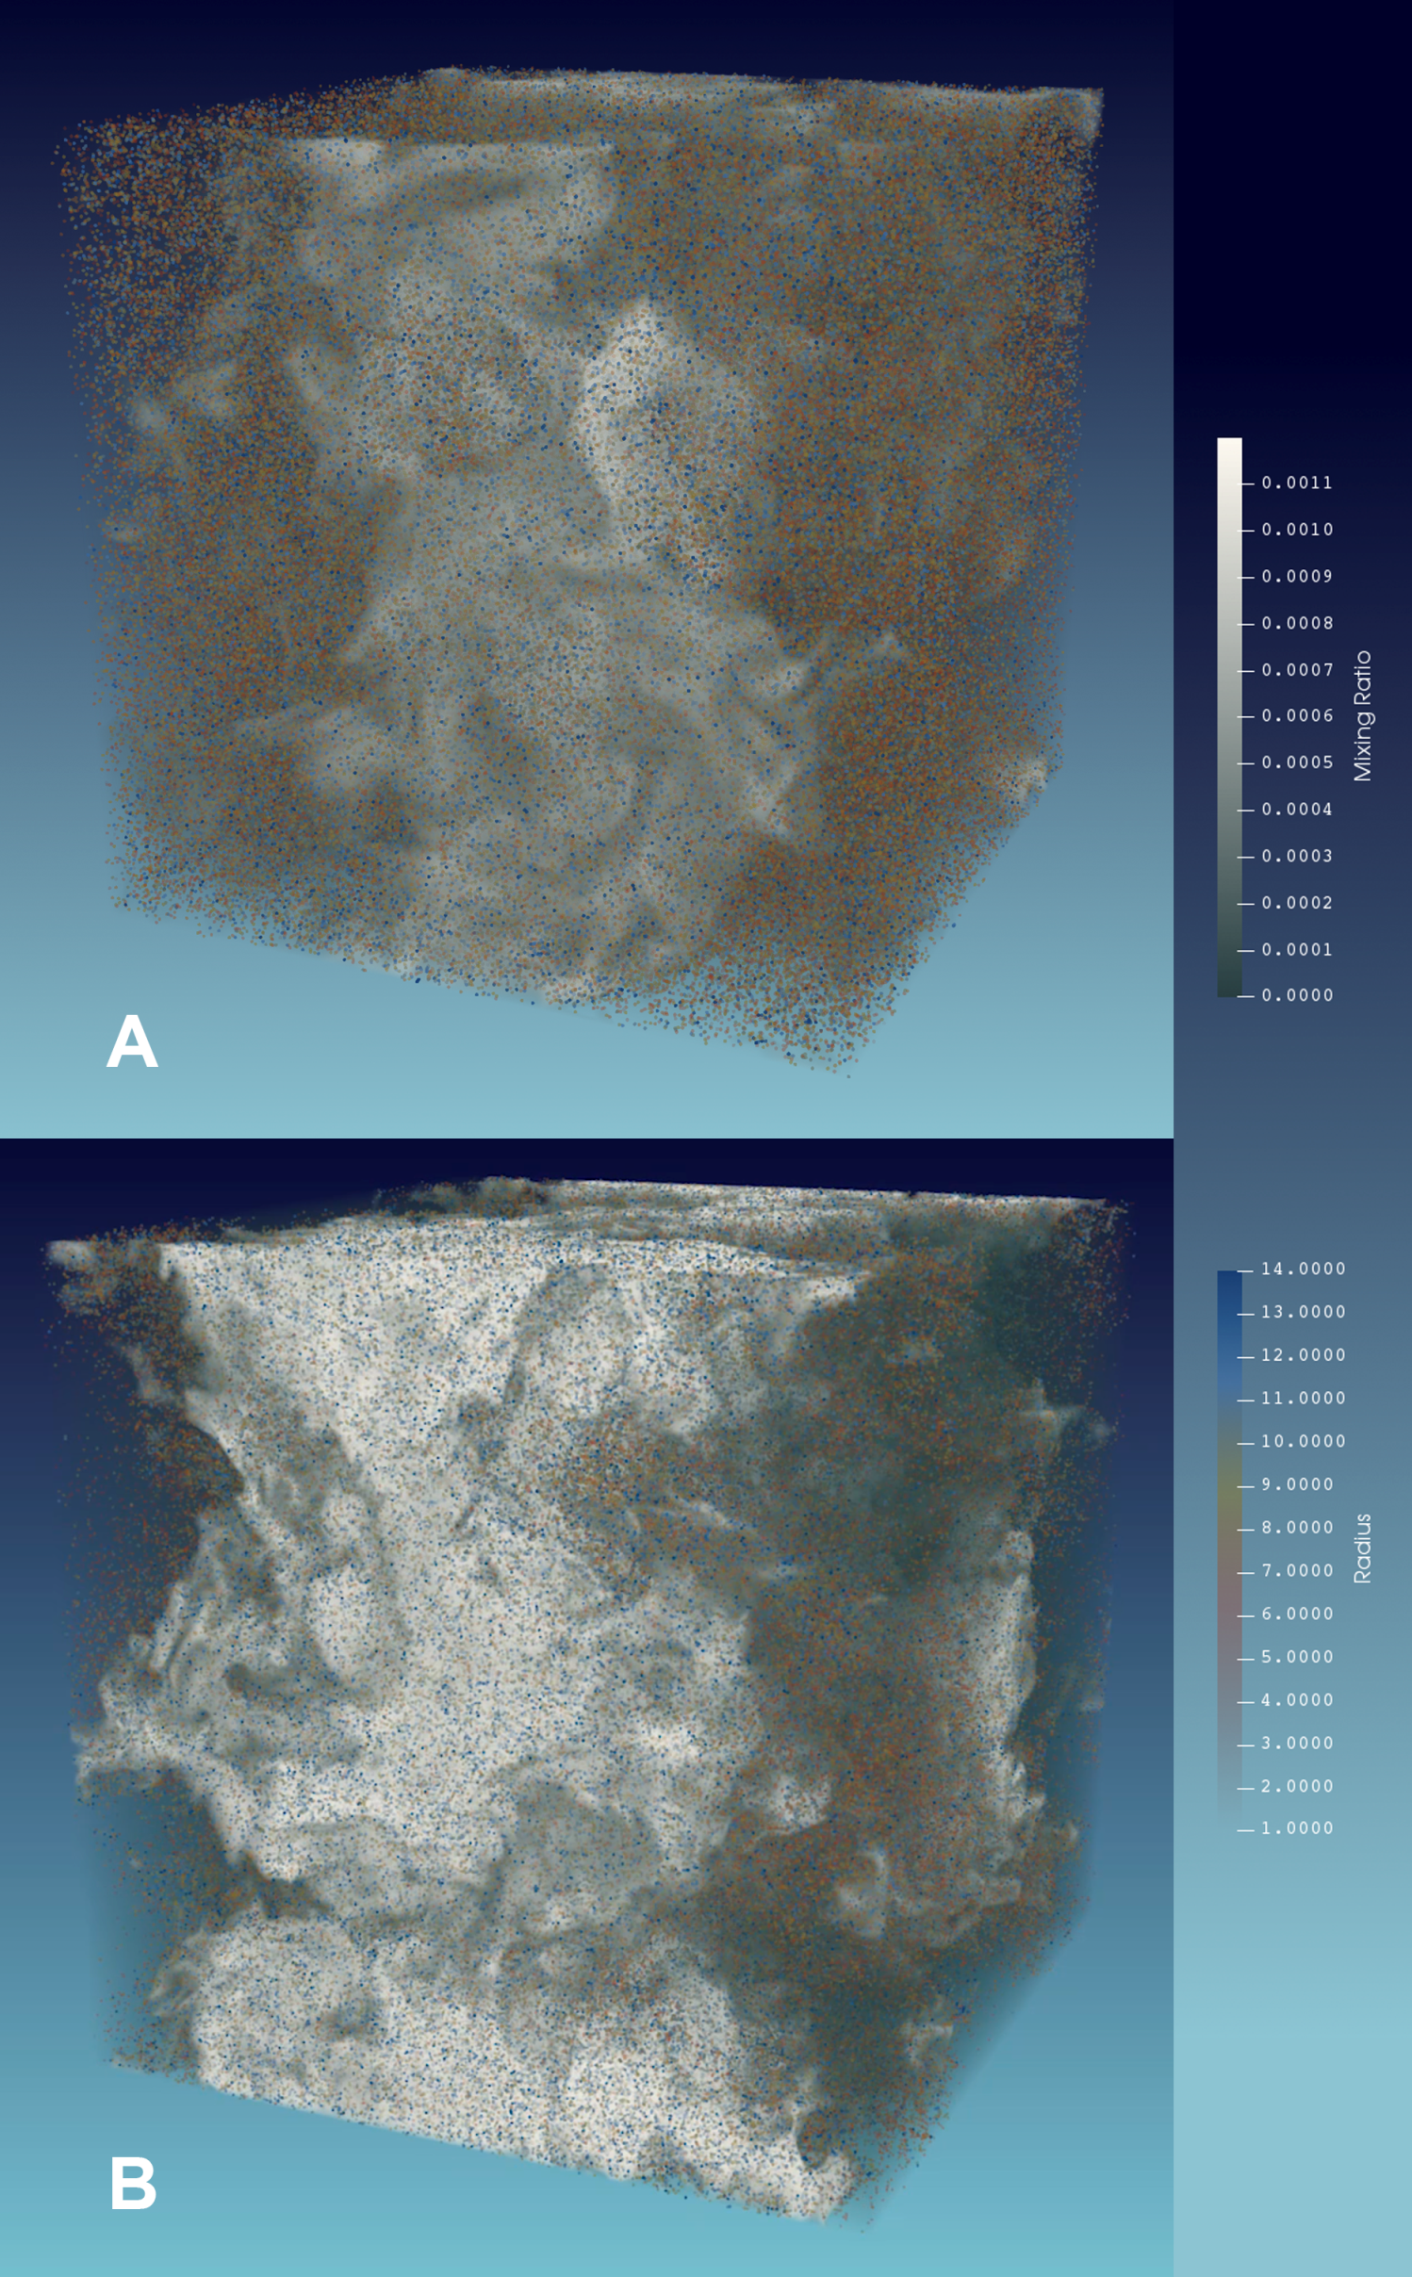
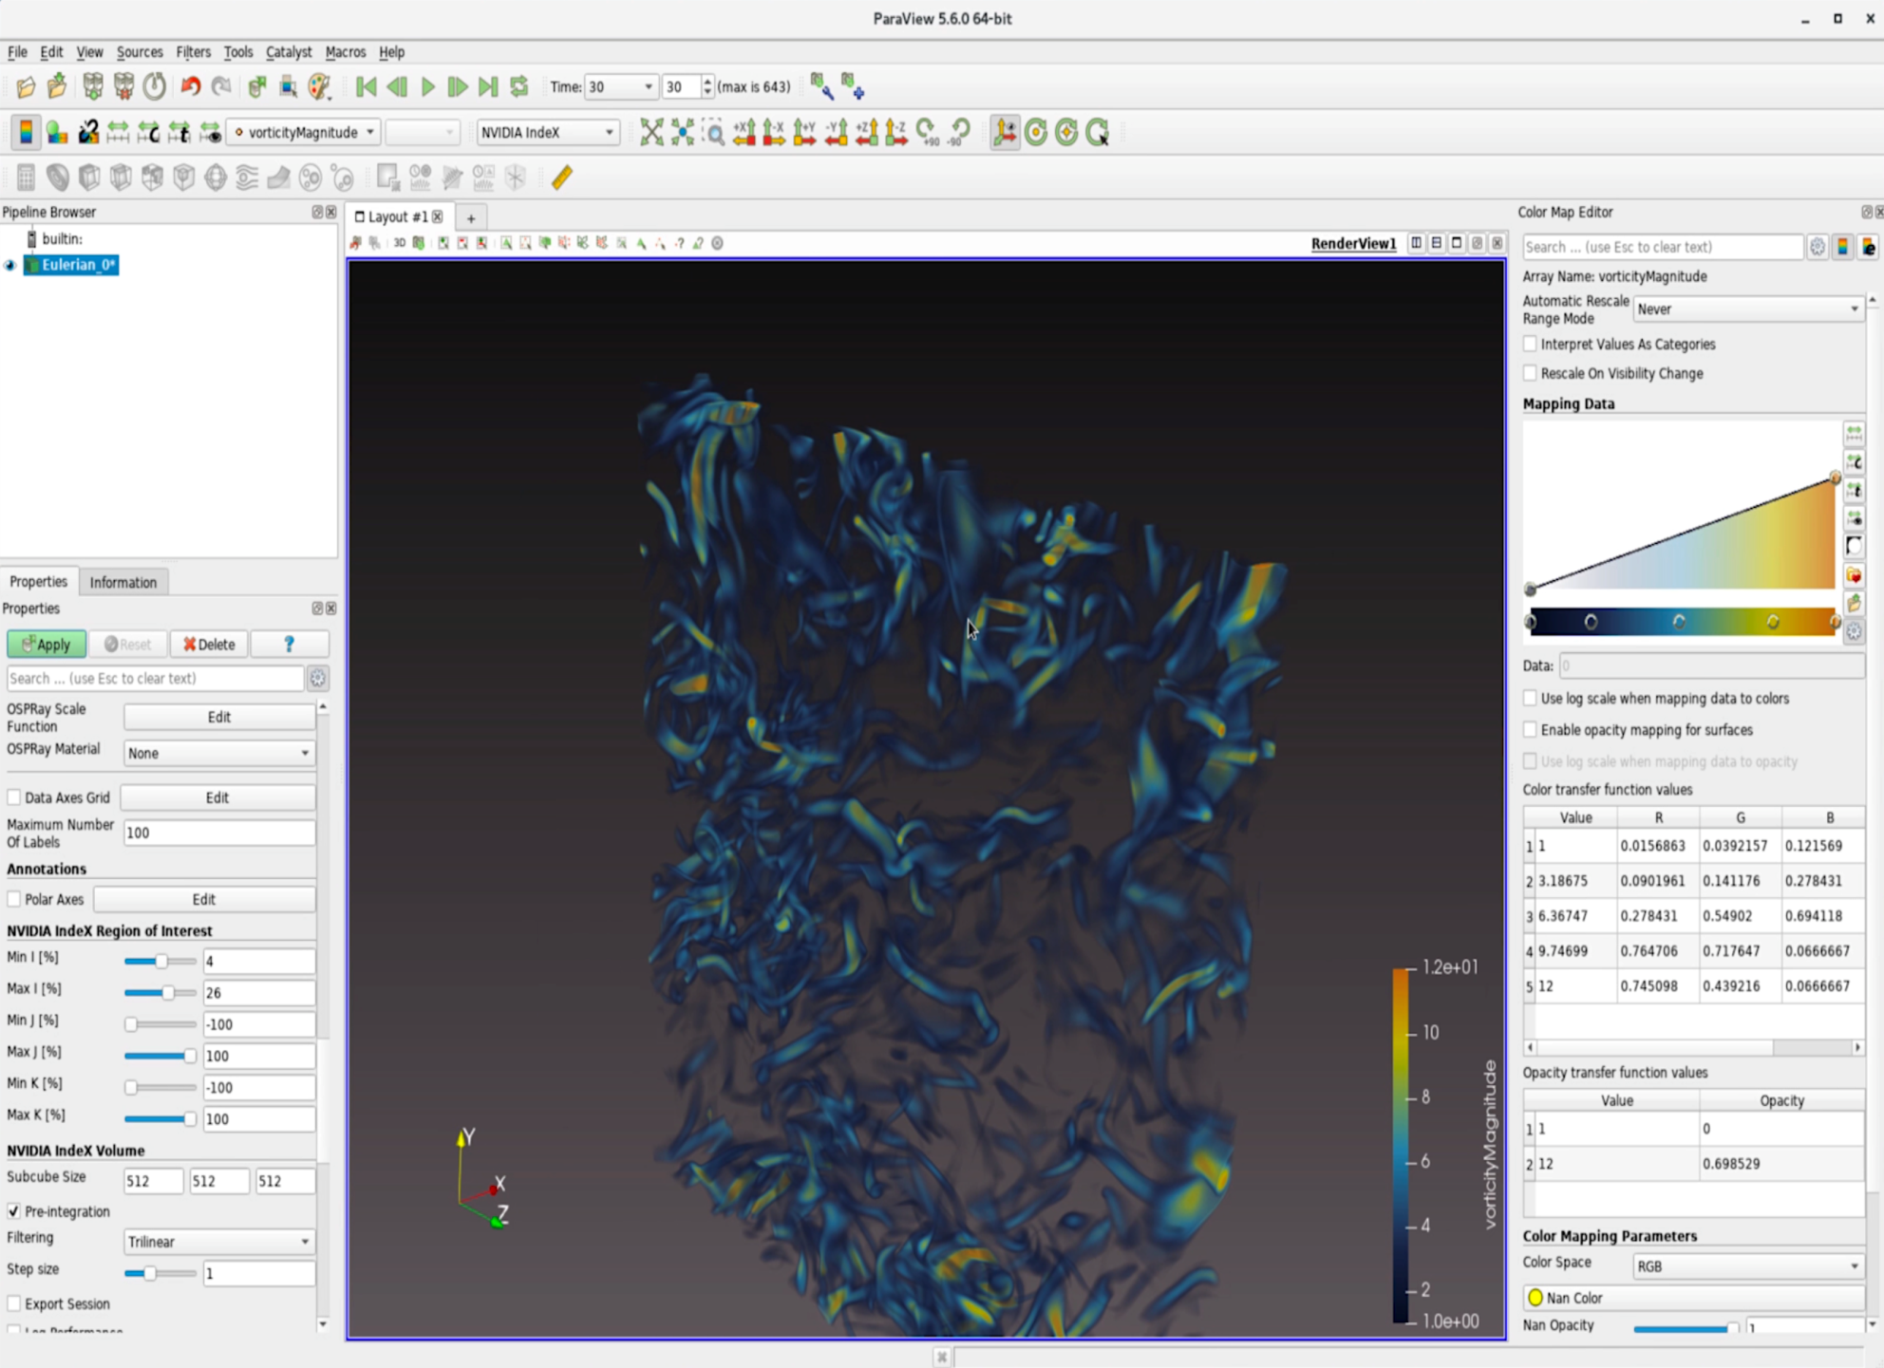
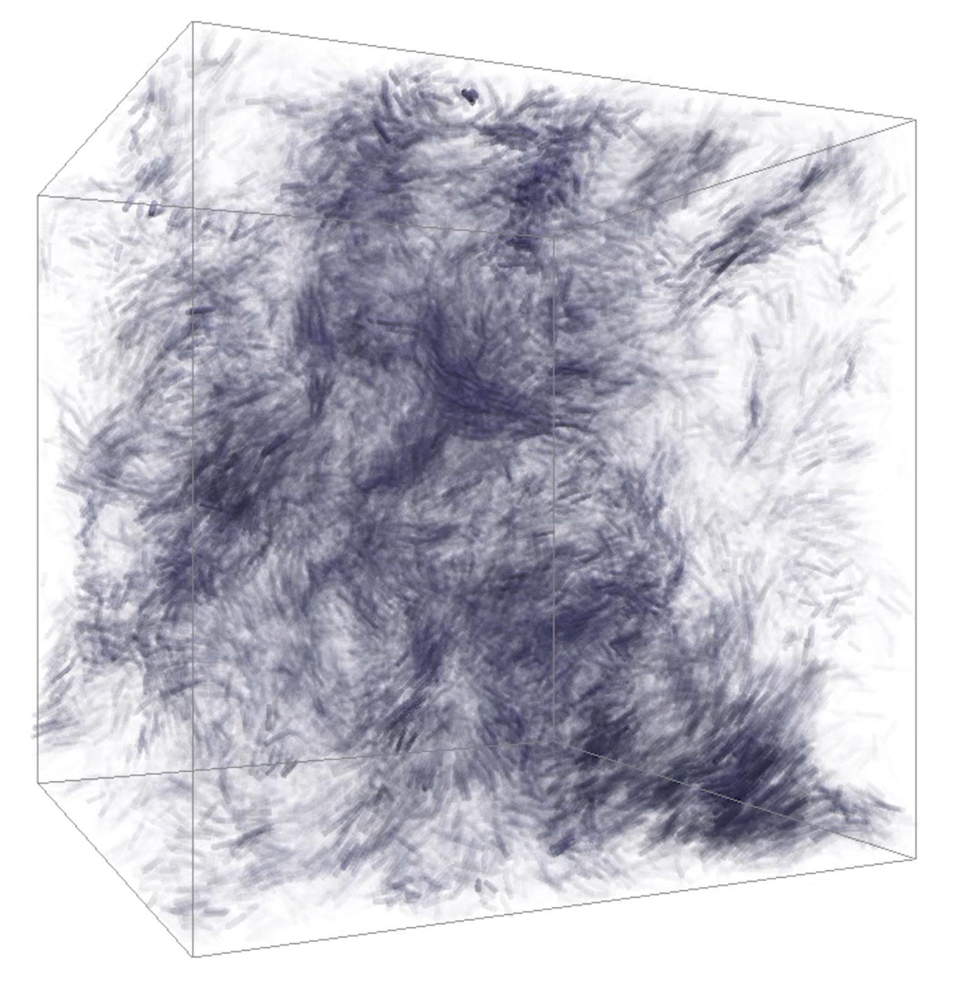
3DVisualization of Entrainment and Mixing Phenomena at Cloud Interface
Bipin Kumar¹, Matt Rehme², Neethi Suresh¹, Nihanth Cherukuru², Stanislaw Jaroszynski², Shaomeng Li²,
Scott Pearse² and Tim Scheitlin²
¹HPCS, Indian Institute of Tropical Meteorology, Pune, Dr. Homi Bhabha Road, Pashan, Pune, India 411008
²Computaional and Information System Lab, National Center for Atmospheric Research, Boulder, CO, USA, 80305
Introduction
Entrainment and mixing processes occur during the entire life of a cloud. These processes change the droplet size distribution, which determines rain formation and radiative properties. Being a microphysical process, it requires small scale simulations such as Direct Numerical Simulations (DNS) for better resolution. Visualization of these processes is challenging. So, some techniques which uses tools like ParaView, Vapor and other tools developed at NCAR are presented.
Data Set
Binary data from DNS of entrainment and mixing in NetCDF/SION format.
Data are converted to various formats depending on visualization tools used.
Lagrangian scattered particles are converted to VTK unstructured objects.
VAPOR Data Collection (VDC) format generated for VAPOR software.
Visualization Techniques and tools
Droplets are treated as Lagrangian particles.
Radius, ID, and X,Y, Z spatial positions of particles stored form simulation.
Eulerian data consists of mixing ratio, temperature, and U, V, W velocity vector components.
Two additional fields vorticity and its dot product with vorticity magnitude were are also calculated.
Figure : 3 Illustration of interaction of droplets with vortices.
(0.5 m)³ domain.
(1.0 m)³ domain
Figure 1 : 3D Visualization of Eulerian mixing ratio (gray color) and Lagrangian droplet radii (red to blue mapped to small to large radius, respectively). Panel A has domain of (512)³ grid points while there are (1024)³ grid points in domain at panel B.
Mixing ratio fields are shown using volumetric rendering.
Lagrangian particles are shown as points rendered as spheres (fig. 1).
Figure 4: Particle density field & vorticity isosurface rendered in VAPOR.
Isosurface of vorticity magnitude rendered in VAPOR (fig. 4).
NCAR application used to analyze the particle data (fig. 5).
A representative subset of the particles was selected.
The particles are represented by shapes (cylinders in this case).
Particles elongate in the direction of their motion.
Figure 2 : Utilization of the IndeX plug-in in ParaView.
Figure 5: Direct particle visualization using a newly developed NCAR application.
Index plug-in (fig. 2) expedites the process of finding areas where large amount of vorticity occurs.
Water droplets heavier than surrounding air are ejected from vortices due to centrifugal forces.
This results in a lower concentration of droplets inside vortical regions as observed near the arrows as shown in fig. 3.
Future Work
The tools discussed can be applied in future visualization of :
Particle collision process and subsequent coalescence.
Aerosol activation and formation of CCN from aerosols.
Concept of super-droplet evolution.
Acknowledgment
HPC facilities provided by Ministry of Earth Science at IITM Pune for conducting DNS. The computational time and data storage was provided by HPCS project of MoES.
Computational and storage resources provided by CISL, NCAR USA. Collaborative effort to create the visualizations was supported by the CISL Visitor Program at NCAR.
Reference
Kumar. B., Rehme, M, Suresh, N., Cherukuru, N., Jaroszynski, S., Li, S., Pearse, S., Scheitlin, T., (2019), Visualization of Entrainment & Mixing Phenomena at Cloud Edges, The International Conference for High Performance Computing, Networking, Storage and Analysis during November 17-22, 2019 at Colorado Convention Center, Denver, CO, USA.

